Slide 1
Predicting MSYE Fails
Dale Ohmart

Slide 2
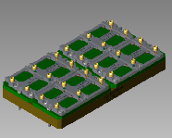
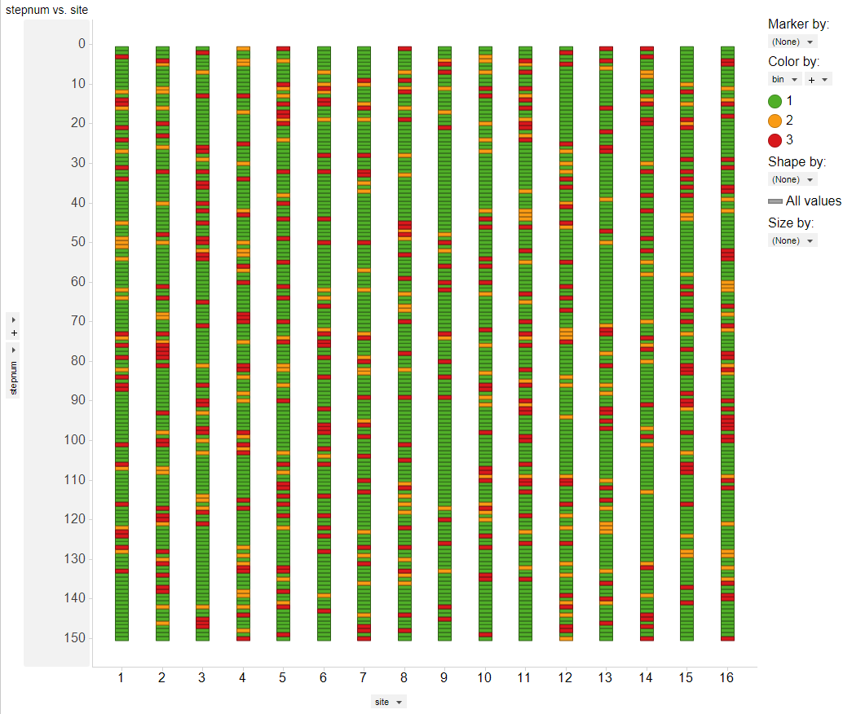
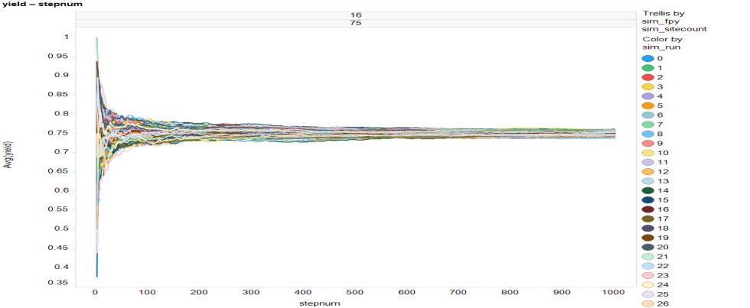
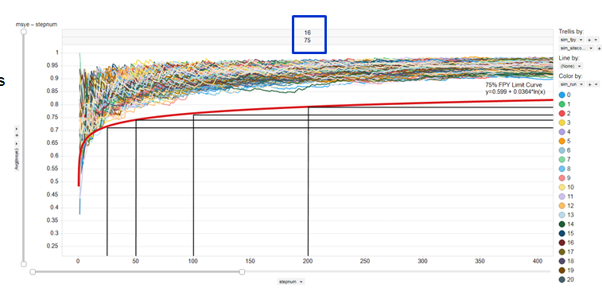
Semiconductor Final Test
Typical 16-site tester board with sockets
Simulation lot run
16 sites
75% yield
150 touchdowns (150*16 = 2400 units)
Simulated Yield at each TD out to 1000TD
Simulated MSYE at each TD out to 1000TD
MSYE = Total Lot Yield / Yield of Highest Yielding Site. Can be measured at any TD on cumulative results.

Slide 3
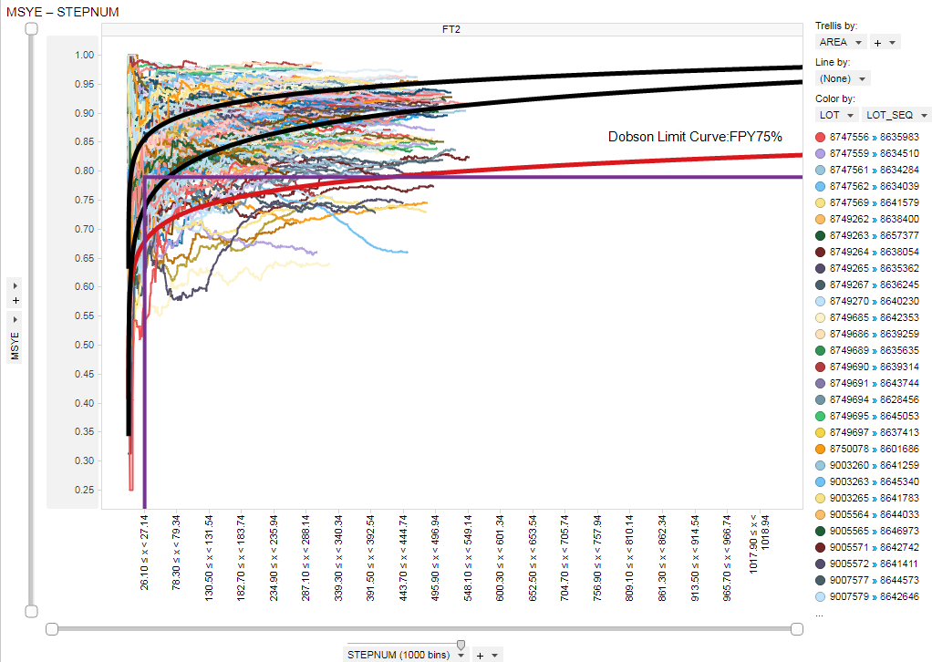
MSYE Example Product
Simulation envelope
Detection limit
Actual 1Q19 graph of MSYE for one product
Detection limit calculated based on simulation results
Limit = 0.6 + 0.4 * ln(x)
Objective is to prevent excursions below the detection limit by predicting when a setup is drifting into that region

Slide 4
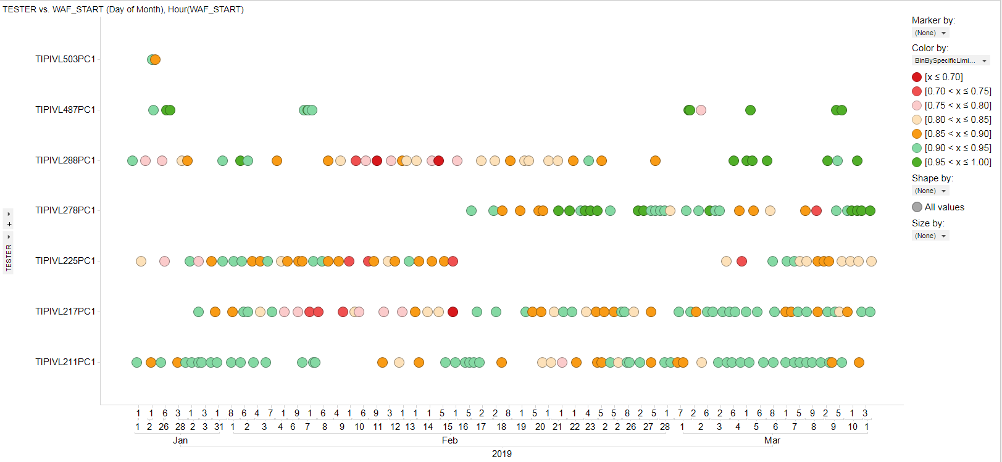
Predicting MSYE
We are using variation in MSYE to detect equipment failures
Sometimes, there appears to be degrading performance, followed by fail
In these cases, product and productivity are both lost until fail is detected and corrective action taken
Sometimes, fails seem to come out of nowhere
In both cases, there can be long periods of undetected “marginal” performance
Machine Learning Questions:
Can we learn to predict the failures?
Can we learn to be more sensitive to marginal performance?
Marginal - Undetected
Degrade to fail

Slide 5
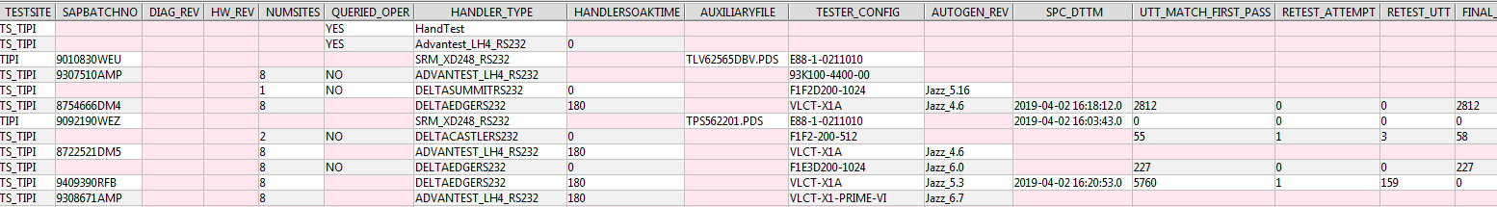
Data Sources
Setup Success DB
MSYE – ML outut value
More Attributes
TestWare – vwafer table
More Attributes
TestWare – tw_wafer_attributes table
More Attributes

Slide 6
Predicting MSYE as Final Project
Potentially 3 Oracle DBs
SetupSuccess
Primary manufacturing data source
Shows key metrics by tested lot of material
TestWare
Has all of the lot-level engineering data
More metadata than SetupSuccess
There may be features here that can improve sensitivity
ATE Analytics (?)
Shows actual tester downtime
May be able to use to help refine results
Might not be possible to align data – still a new data source
Use Python and Pandas to mine and merge data
Put the data into a local (MySQL?) db on my machine for now using Pandas, so I can add to it incrementally
Could use Tableau for final analysis (rather use Spotfire!)

