Slide 1
1
1
2
MODEL
2
1
1
…
…
3
4
4
INPUT: x days
OUTPUT:
y days

Slide 2
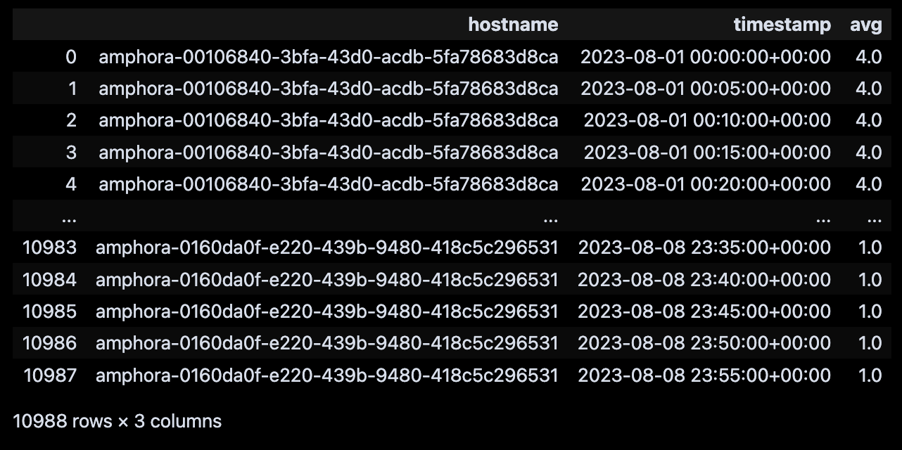
Data format

Slide 3
Data format
VM1
00:00
1
00:05
1
00:10
1
14 days
…
…
23:50
2
23:55
1
VM2
00:00
10
00:05
11
00:10
11
…
…
23:50
21
23:55
12
VM3
00:00
13
00:05
13
00:10
14
…
…
23:50
22
23:55
14

Slide 4
Reformat data
VM1
VM2
VM3
00:00
1
10
13
00:05
1
11
13
00:10
1
11
14
…
…
…
…
23:50
2
21
22
23:55
1
12
14

Slide 5
Preparing data
TRAIN
TEST

Slide 6
Preparing data
TRAIN
TEST
VM1
VM2
VM3
00:00
1
10
13
00:05
1
11
13
80%
00:10
1
11
14
…
…
…
…
23:50
2
21
22
23:55
1
12
14

Slide 7
Preparing data
Day 1
00:00
1
00:05
1
Processed Train
x days for input
00:10
1
…
…
23:50
2
23:55
1
y days for output
Day 2
00:00
1
00:05
1
00:10
1
…
…
23:50
2
23:55
1
Day 14
00:00
1
00:05
1
00:10
1
…
…
23:50
2
23:55
1

Slide 8
Preparing data
Day 1
00:00
1
00:05
1
00:10
1
Processed Train
…
…
x days for input
23:50
2
23:55
1
Day 2
00:00
1
y days for output
00:05
1
00:10
1
…
…
23:50
2
23:55
1
Day 14
00:00
1
00:05
1
00:10
1
…
…
23:50
2
23:55
1

Slide 9
Preparing data
Day 1
00:00
1
00:05
1
00:10
1
…
…
23:50
2
Processed Train
x days for input
23:55
1
Day 2
00:00
1
00:05
1
y days for output
00:10
1
…
…
23:50
2
23:55
1
Day 14
00:00
1
00:05
1
00:10
1
…
…
23:50
2
23:55
1

Slide 10
Preparing data
Day 1
00:00
1
00:05
1
00:10
1
…
…
23:50
2
23:55
1
Day 2
00:00
1
00:05
1
00:10
1
…
…
23:50
2
23:55
1
Processed Train
Day 14
00:00
1
x days for input
00:05
1
00:10
1
…
…
23:50
2
y days for output
23:55
1

Slide 11
Preparing data
Processed Train
Processed test

Slide 12
Train model
Processed Train
MODEL

Slide 13
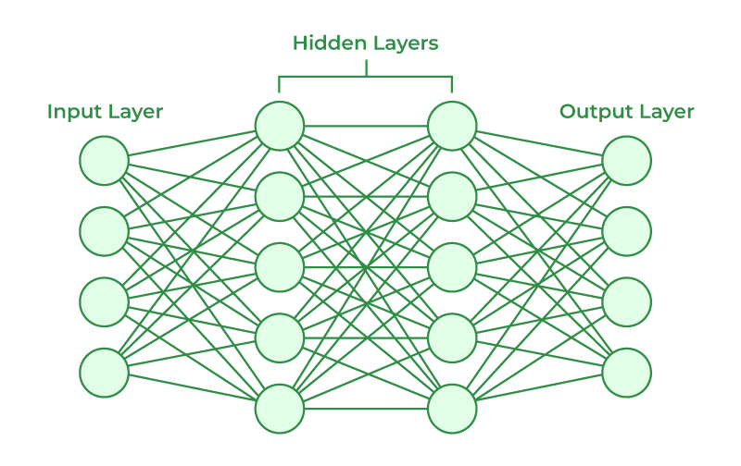
Train model
MODEL

Slide 14
Evaluating model
MODEL

Slide 15
Evaluating model
x = 144 ~ 12 hours
y = 12 ~ 1 hour
x = 144 ~ 12 hours
y = 1 ~ 5 mins

Slide 16
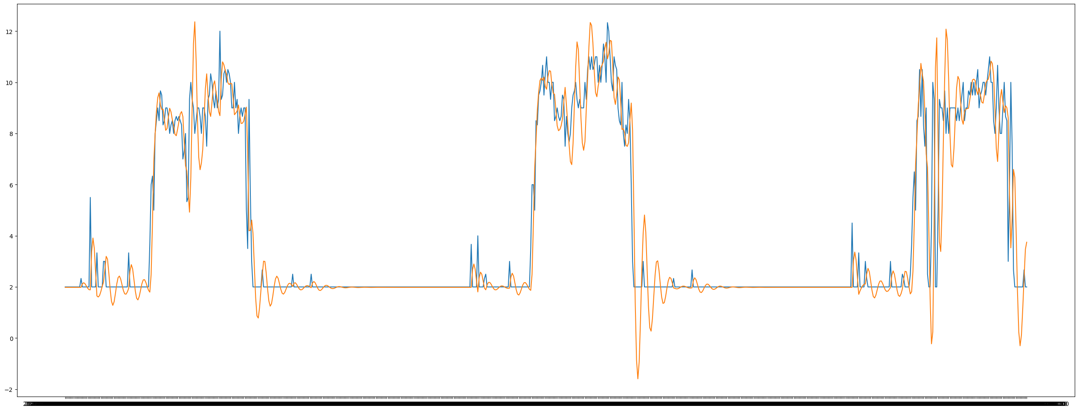
Evaluating model
x = 144 ~ 12 hours
y = 12 ~ 1 hour

Slide 17
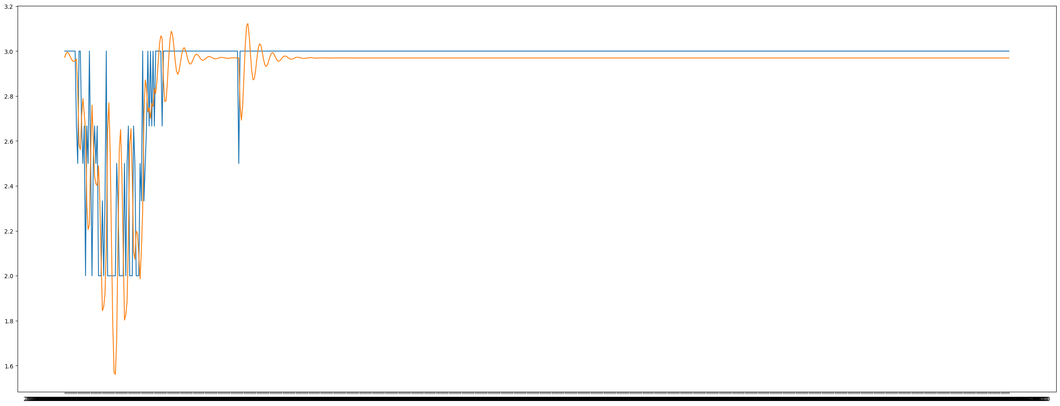
Evaluating model
x = 144 ~ 12 hours
y = 12 ~ 1 hour

Slide 18
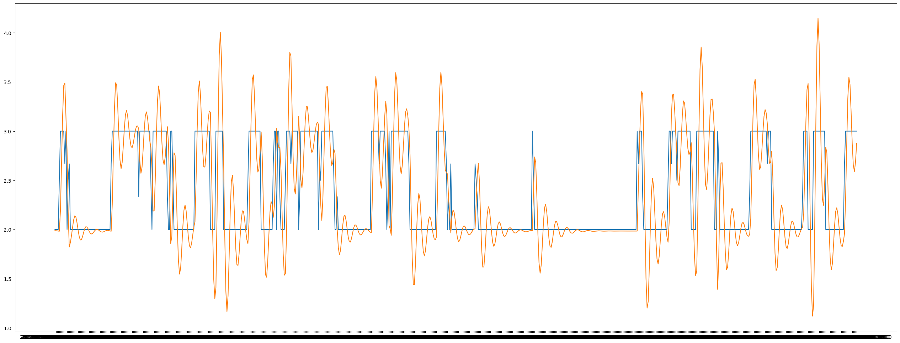
Evaluating model
x = 144 ~ 12 hours
y = 12 ~ 1 hour

Slide 19
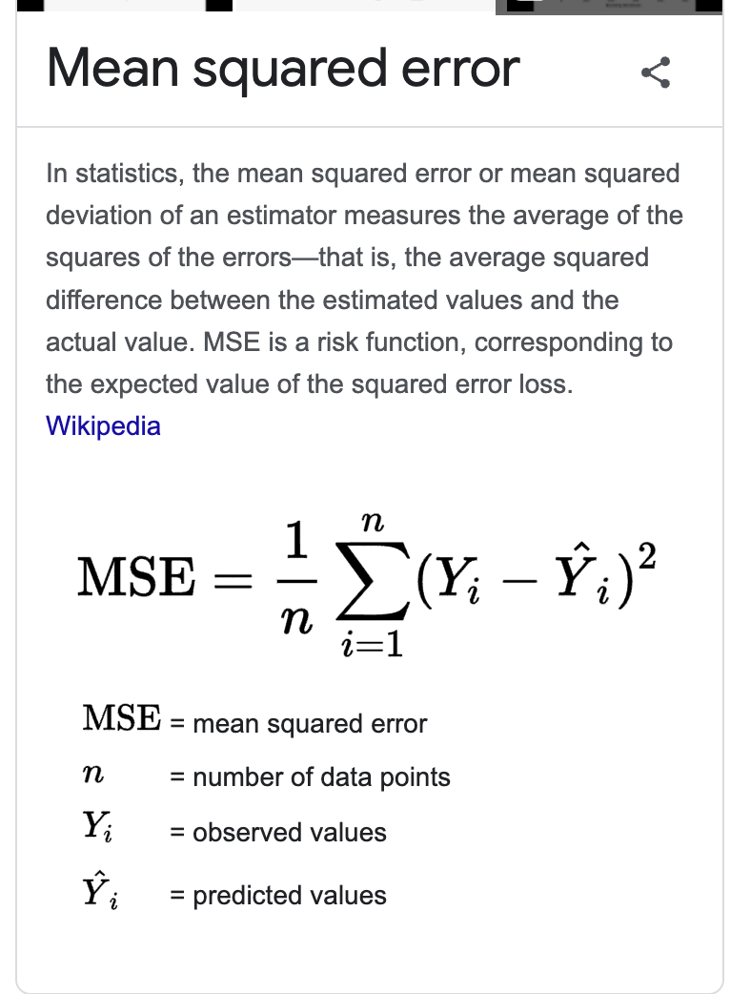
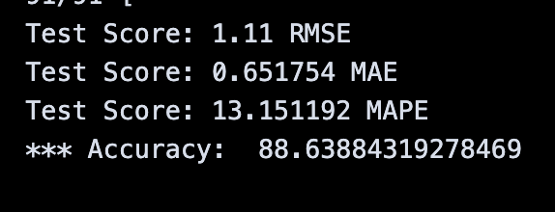
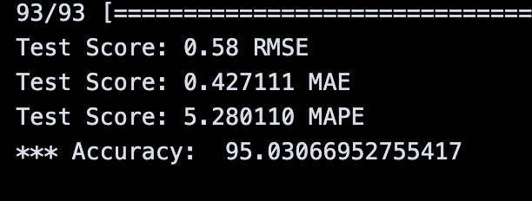
Evaluating model
x = 144 ~ 12 hours
y = 12 ~ 1 hour
x = 144 ~ 12 hours
y = 1 ~ 5 mins

Slide 20
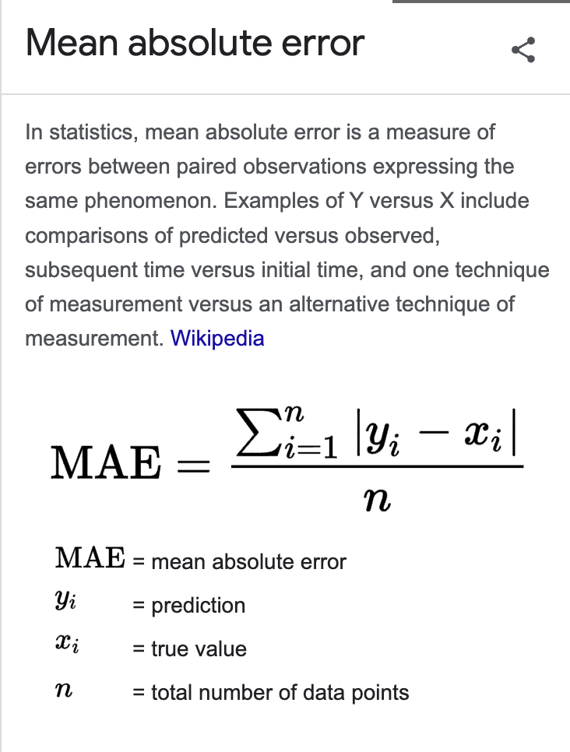
Evaluating model
x = 144 ~ 12 hours
y = 12 ~ 1 hour
x = 144 ~ 12 hours
y = 1 ~ 5 mins

Slide 21
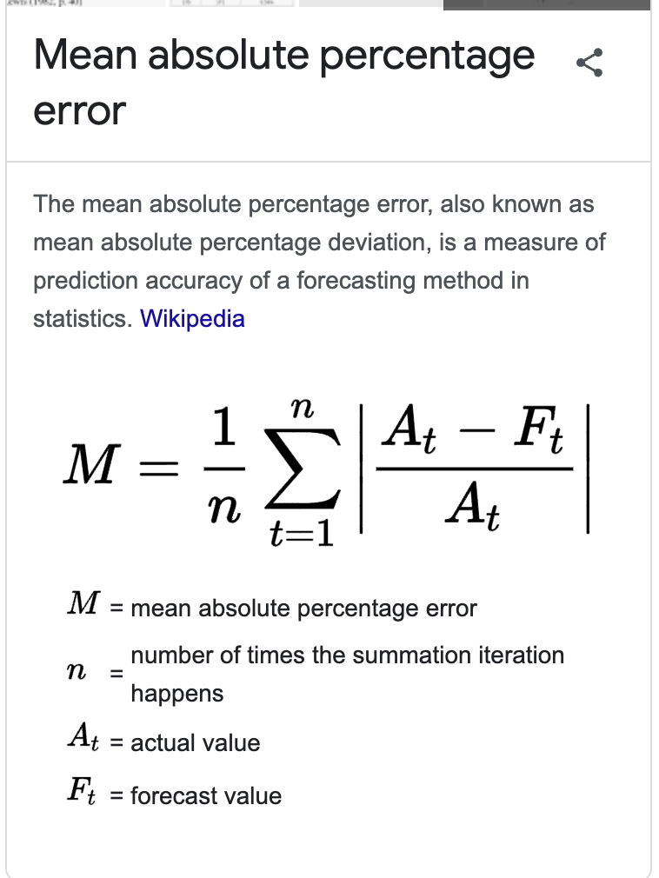
Evaluating model
x = 144 ~ 12 hours
y = 12 ~ 1 hour
x = 144 ~ 12 hours
y = 1 ~ 5 mins

Slide 22
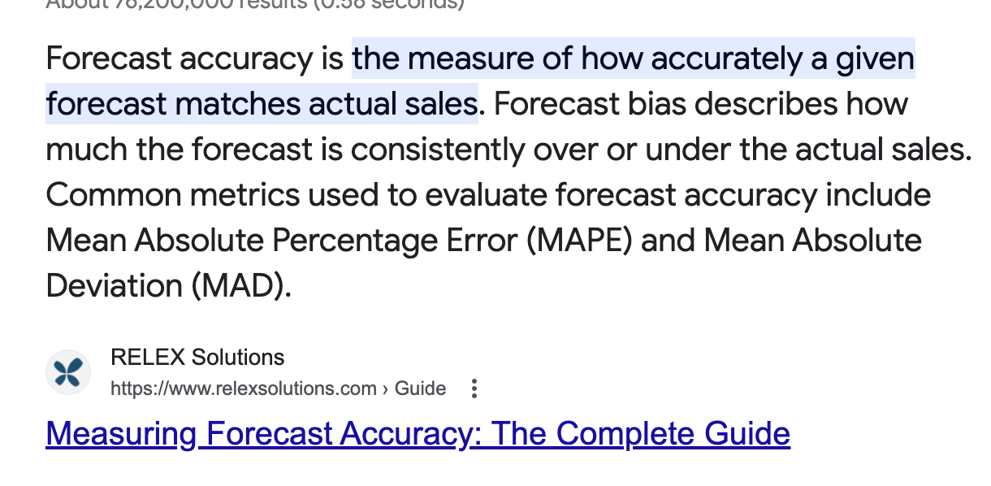
Evaluating model
x = 144 ~ 12 hours
y = 12 ~ 1 hour
x = 144 ~ 12 hours
y = 1 ~ 5 mins

