Slide 1
Model Checking and verification of Web Student Grading System (WSGS)
Submitted To:
Dr. Jamal Benthar
Submitted By:
Mayank Kumar (26885624)
Dhruv Ohri (27149220)

Slide 2
INTRODUCTION
Model checking is a formal method to verify, if a software system or model meets the properties asserted by users or not.
A formal system model describes the behavior of the system based on user requirements.
Model checking discovers the properties of the system stated by the user and checks that those are valid or not on the model. Generally the properties, which the system has to satisfy, are defined in a formal way using temporal logic formulas and the model is defined as finite state transition systems.
Model checkers build a finite state system and exhaustively explore the reachable state where the properties being checked are being violated.
Both the model of the system and the specification can be modeled by the formal description language which acts as input to model checker and formulated as a task in logic, namely to check whether a given structure satisfies a given logical formula

Slide 3
Pros and Cons of model checking
PROS:
It supports partial verification
It is a systematic approach and not vulnerable to the likelihood with which an error is exposed
It provides counterexamples in case a property is not satisfied
It does not require a high degree of expertise
CONS:
It is not suitable for infinite-state systems
It needs a model, and modeling can not be automated
It verifies a system model, and not the system itself
It checks only stated properties
It suffers from the state space explosion problem

Slide 4
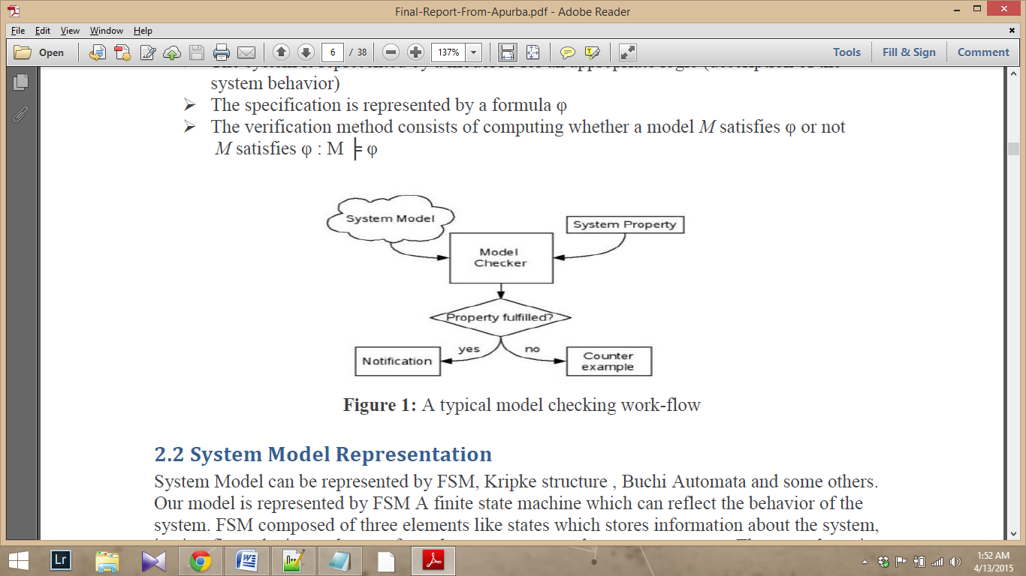
Steps of Model Checking
Model specification language- a formal notation for encoding the system to be verified as a finite-state transition system, i.e., the model M
Property specification language φ based on temporal logic
Verification procedure - an intelligent exhaustive search of the model state space that determines whether the specification is satisfied or not (If M ╞ φ). In the latter case, the procedure provides a counterexample exhibiting the violation of the specification.

Slide 5
System Model Representation
System Model can be represented by FSM, Kripke structure, Buchi Automata and some others. Our model is represented by FSM which reflects the behavior of the system. FSM composed of three elements like states which stores information about the system, i.e. it reflects the input changes from the system start to the present moment. The second one is transitions which indicates a state change and is described by a condition that would need to be fulfilled to enable the transition. The third one is Actions which is a description of an activity that is to be performed at a given moment.
Kripke Structure:
- A kripke structure K is a tuple
- K = (S, I, R, Label)
- S: a countable set of states
- I S: a set of initial states
- R s × s: a transition relation satisfying
- s S. (s’ S. (s, s’) R)
- Label: S 2AP: an interpretation function

Slide 6
Specification Representation
The properties of our model are written using temporal logic which provides a formal system for describing and reasoning about how the truth values change over time. It is appropriate for describing the time varying behavior of systems. The properties to be checked can be written in propositional LTL and CTL format. Now we introduce the syntax of these two languages.
LTL (Linear Temporal Logic):
- Linear temporal logic is an infinite sequence of states where each point in time has a unique successor, based on a linear-time perspective. Linear temporal property is a temporal logic formula that describes a set of infinite sequences for which it is true.
CTL (Computation Tree Logic):
- CTL (Computation Tree Logic) is branching-time logic, meaning that its model of time is a tree-like structure in which the future is not determined. It is based on propositional logic with a discrete notion of time and only future modalities. In CTL temporal operators quantify over the paths that are possible from a given state (branching time). In CTL, each basic temporal operator must be immediately preceded by a path quantifier (i.e., either A or E). The verified properties on model can be formulized by CTL.

Slide 7
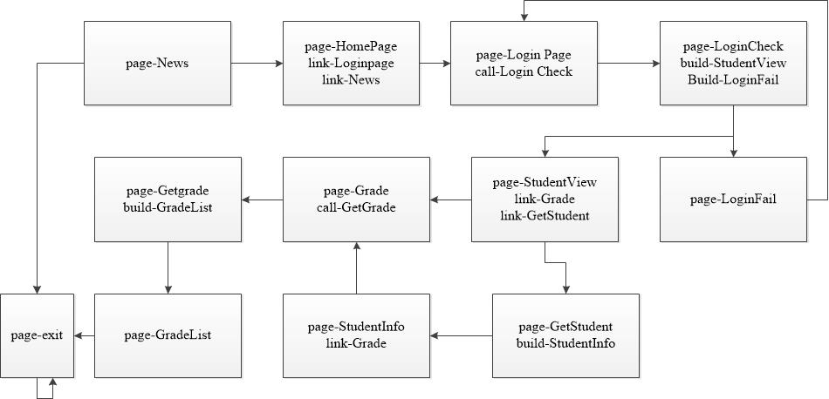
Model Description (Kripke Structure)

Slide 8
Requirement Specifications or Properties
Properties can be classified into three major categories:
- Reachability Property (State Coverage): All states of the Web application model must be covered at least once by the generation of system properties. Reachability property for a web page page-s is defined in CTL formula with EF operator: EF page-s.
- Liveness property (Transition Coverage): All transitions of the Web application model must be covered at least once by the generation of system properties. These properties denotes the liveness of the model, i.e., the Web application implements all the legal navigations. According to the implement model K of Web applications, the transitions of state s and s’ are (s, link, s’), (s, call, s’), (s, build, s’)
- Safety Property (Transition Composition Coverage): all emitting transitions of a state must be covered at least once by the generation of system properties. This can be regarded as a safety property. Safety property represents a behavior which may not occur on any path, i.e., check if there are some illegal transitions in the model

Slide 9
Model Checking with NuSMV
NuSMV is a model checker based on the SMV (Symbolic Model Verifier) software.
This class of model checkers verifies temporal logic properties in finite state systems with “implicit” techniques.
NuSMV uses a symbolic representation of the specification in order to check a model against a property. Originally, SMV was a tool for checking CTL properties on a symbolic model. But NuSMV is also able to deal with LTL (+Past) formulae and SAT-based Bounded Model Checking..
NuSMV uses the SMV description language to specify finite state machines.
NuSMV modules can declare state variables and input variables, an SMV specification can be both state and event oriented.

Slide 10
WSGS Specifications
Reachability:
No | State | Property
P1 | HomePage | AG (page-HomePage -> AX page-LoginPage)
P2 | News | EF page-News
P3 | LoginPage | EF page-LoginPage
P4 | LoginFail | EF page-LoginPage;
P5 | LoginCheck | AG (page-LoginCheck -> AX page-StudentView)
P6 | StudentView | AG (page-StudentView -> AX page-Grade)
P7 | Grade | EF page-Grade
P8 | GetGrade | EF page-GetGrade
P9 | GradeList | EF page-GradeList
P10 | GetStudent | EF page-GetStudent
P11 | StudentInfo | EF page-StudentInfo

Slide 11
WSGS Specifications
Liveness:
P12 | (HomePage, link,News) | AG EF(page-HomePage -> (link-News & EX page-News))
P13 | (HomePage, link,LoginPage) | AG EF(page-HomePage -> (link-LoginPage & EX page-LoginPage))
P14 | (LoginPage,call,LoginCheck) | AG EF(page-LoginPage ->(call-LoginCheck & EX page-LoginCheck))
P15 | (LoginCheck,build, Student-View) | AG EF(build-StudentView -> EX page-StudentView)
P16 | (LoginCheck,build, LoginFail) | AG EF(build-LoginFail -> EX page-LoginFail)
P17 | (StudentView,call, GetStudent) | AG EF(page-StudentView ->(call-GetStudent & EX page-GetStudent))
P18 | (Grade, call, Get-Grade) | AG EF(page-Grade ->(call-GetGrade & EX page-GetGrade))
P19 | (GetStudent,build, StudentInfo) | AG EF(build-StudentInfo -> EX page-StudentInfo)
P20 | (GetGrade, build,GradeList) | AG EF(build-GradeList -> EX page-GradeList)
P21 | (StudentInfo,link,Gradelist) | AG(page-StudentInfo -> (link-Grade & EX page-GradeList))
P22 | (StudentView,link,Gradelist) | AG(page-StudentView -> (link-Grade & EX page-GradeList))

Slide 12
WSGS Specifications
Safety:
P25 | HomePage | AG EF(page-HomePage -> !EX(link-News | link-LoginPage))
P26 | LoginPage | AG EF(page-LoginPage -> !EX(call-LoginCheck))
P27 | LoginCheck | AG EF(page-LoginCheck -> !EX(build-StudentView | build-LoginFail))
P28 | StudentView | AG EF(page-StudentView -> !EX(link-Grade | call-GetStudent))
P29 | GetStudent | AG EF(page-GetStudent -> !EX(build-StudentInfo))
P30 | StudentInfo | AG EF(page-StudentInfo -> !EX(link-Grade))
P31 | Grade | AG EF(page-Grade -> !EX(call-GetGrade))
P32 | GetGrade | AG EF(page-GetGrade -> !EX(build-GradeList))
P33 | LoginFail | SPEC AG(page-LoginFail -> EX page-Exit)

Slide 13
Counter Example
The model checker takes a model and the properties to be verified as input, a counterexample will be generated when the property is discovered to be false. A counterexample is a sequence of states which start from initial page to the state that violates the property. In SMV, 1 and 0 denote true and false, “!, &, |” denotes “￢,^,∨”. We present in the Appendix section, the snapshots of the NuSMV execution results and tried to explain some of the FALSE properties i.e. counter ex.

Slide 14
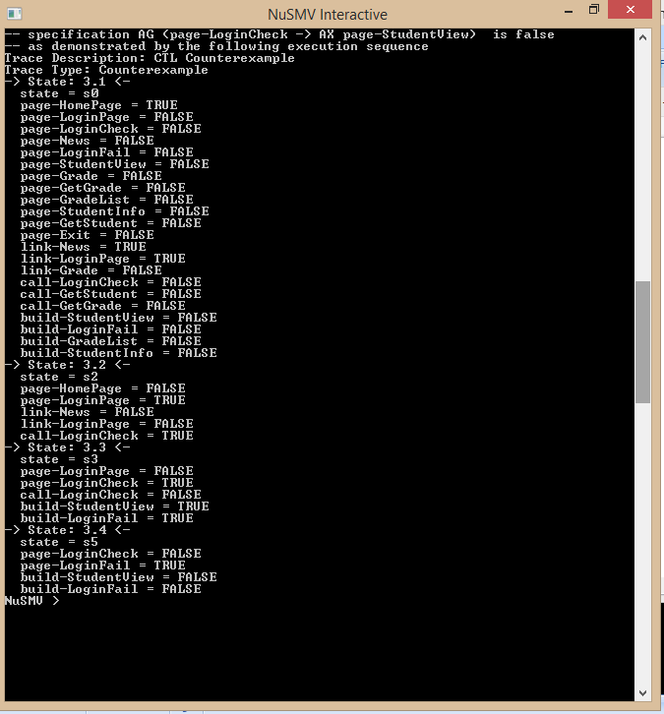
False property in WSGS
(Reachability): SPEC AG (page-LoginCheck -> AX page-StudentView): All the paths leading from page-LoginCheck do not always end up in next page as Student view

Slide 15
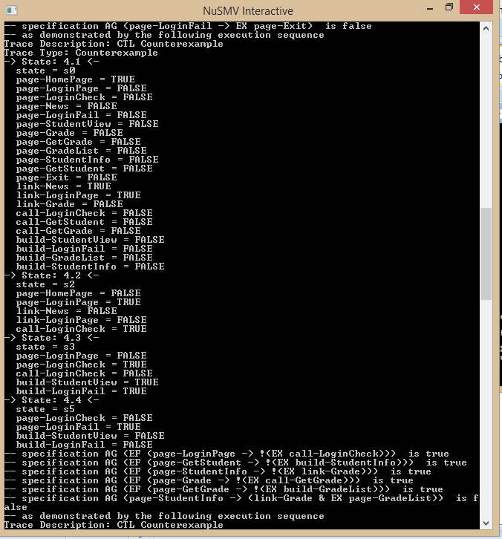
False property in WSGS
(Safety): SPEC AG(page-LoginFail -> EX page-Exit): If user ends up in login failed page then next page should not be exit page rather is should go back to login page thus we get a counter example thus a safety feature of our model for the specification.

Slide 16
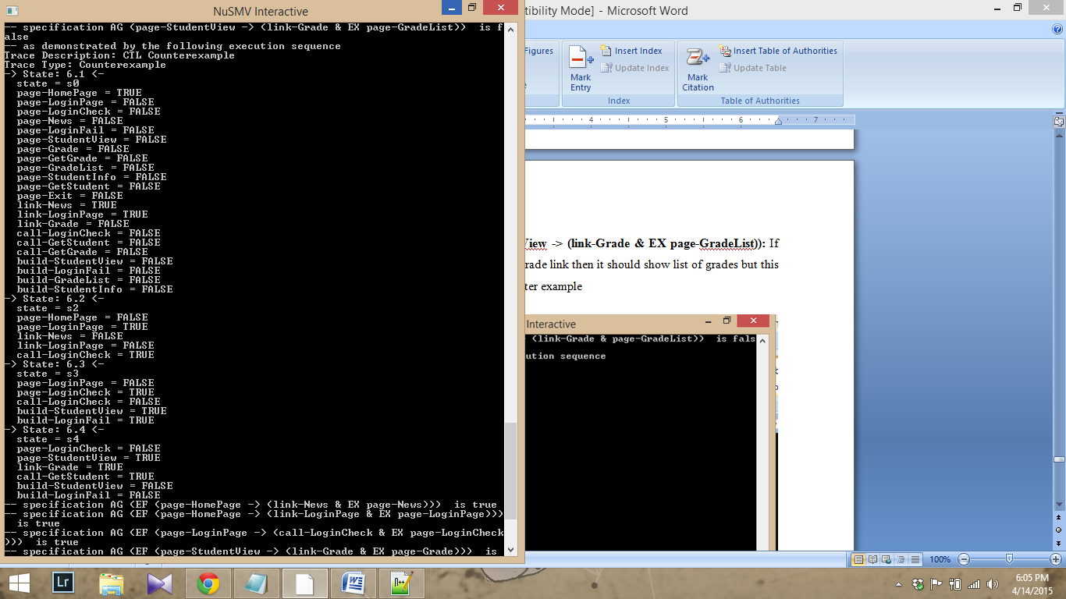
False property in WSGS
(Liveness): SPEC AG(page-StudentView -> (link-Grade & EX page-GradeList)): If user is on student view and clicks on grade link then it should show list of grades but this is not true as per our model hence counter example

Slide 17
Some of the true properties in WSGS
SPEC AG EF(page-LoginPage -> !EX(call-LoginCheck))
SPEC AG EF(page-GetStudent -> !EX(build-StudentInfo))
SPEC AG EF(page-StudentInfo -> !EX(link-Grade))
SPEC AG EF(page-Grade -> !EX(call-GetGrade))
SPEC AG EF(page-GetGrade -> !EX(build-GradeList))

Slide 18
Questions…?

Slide 19
THANK YOU

