Slide 1
WebSocket

Slide 2
Agenda
What is websocket?
Pros and Cons
How it works

Slide 3
What is Websockets

Slide 4
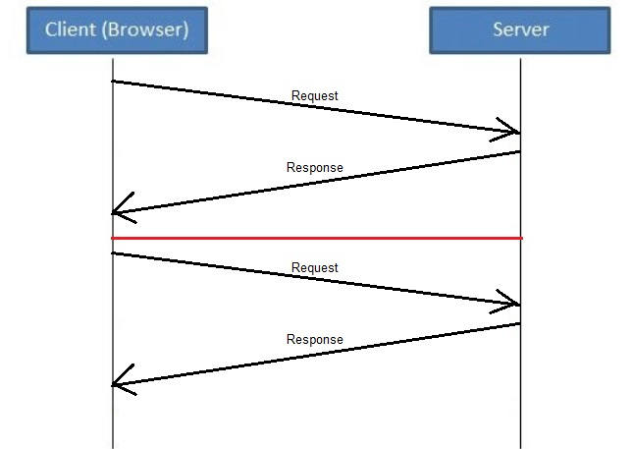
HTTP

Slide 5
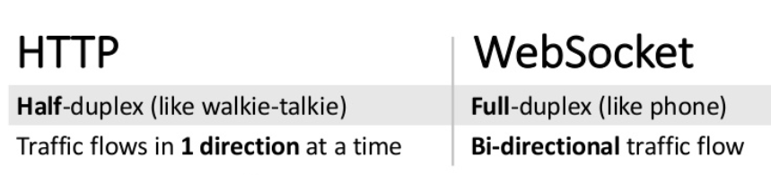
WebSocket is a computer communications protocol, providing full-duplex communication channels over a single TCP connection
WebSocket "is designed to work over HTTP ports 80 and 443 as well as to support HTTP proxies and intermediaries," thus making it compatible with the HTTP protocol

Slide 6
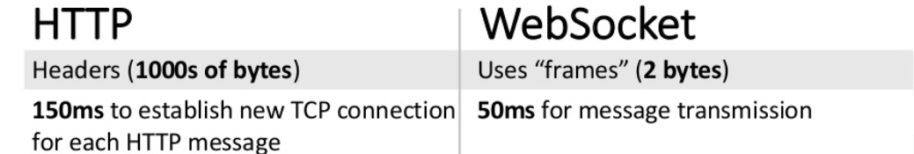
The WebSocket protocol enables interaction between a web browser (or other client application) and a web server with lower overhead than half-duplex alternatives such as HTTP polling, facilitating real-time data transfer from and to the server.
The websocket protocol communicates with frames. Frames are a header + application data. The frame header contains information about the frame and the application data. The application data is any and all stuff you send in the frame “body”

Slide 7
Use cases
Social feeds
Notification
Multiplayer games
Collaborative editing
Streaming
Multimedia chat
Online education

Slide 8
Pros and Cons

Slide 9
Pros
Providing full-duplex communication, good for building real-time application
WebSockets pass through most firewalls without any reconfiguration.
Good security model

Slide 10
Cons
Not all the browser support websocket
Different browser treat websockets differently

Slide 11
How it work?

Slide 12
All phase
Handshake phase
Communication phase
Closing phase

Slide 13

1. Handshake phase
Hi, Bob
Who are you?

Slide 14
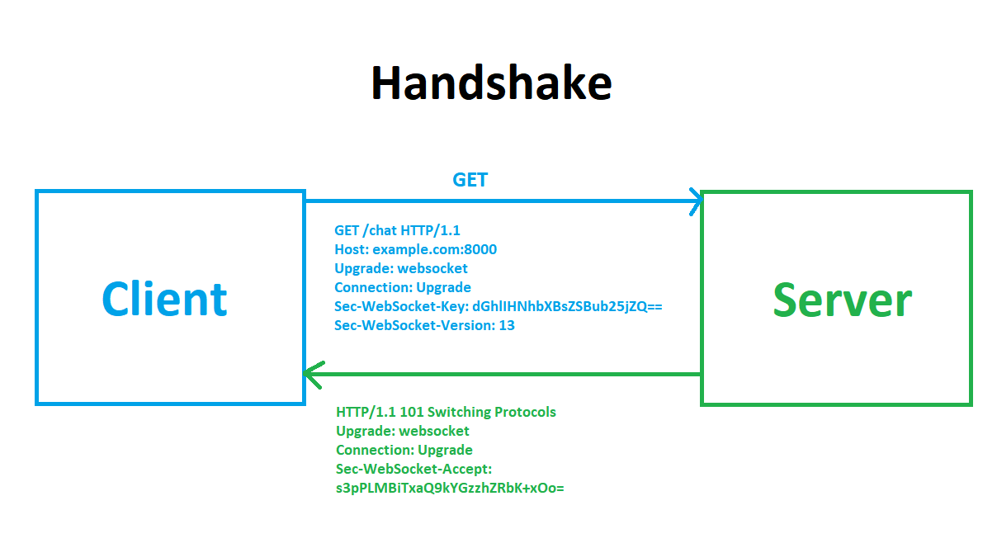
1.1 Handshake request
Purpose connection
Baseded64
Plus Fixed String
SHA-1
Base64
Connected
Accept Key

Slide 15
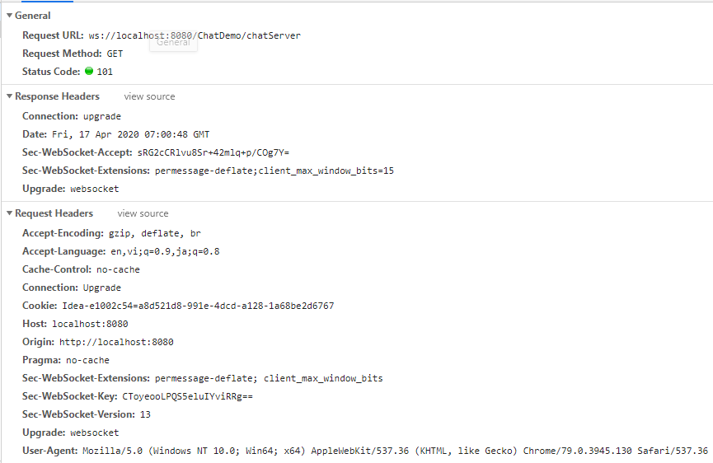
1.1 Handshake inspect

Slide 16
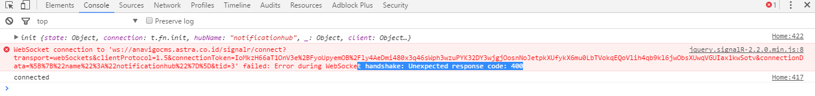
1.2 Handshake error

Slide 17
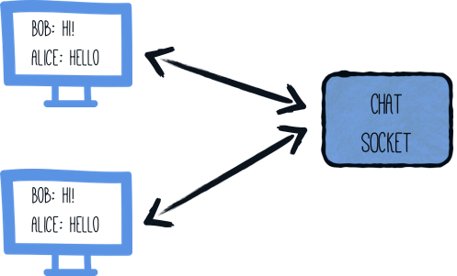
2. Communication phase

Slide 18

2.1 OnOpen
Open()
Cuong
Open()
Phuc
Cuong
Thai
Thai
Open()
Hung
Open()
Phuc
Hung

Slide 19
2.2 OnMessage
Cuong: Hello everyone
Cuong: Hello everyone
send()
Thai
Cuong
onMessage(Hello everyone)
Phuc
send()
Cuong: Hello everyone
Thai
send()
Hung
Cuong
Hung
send()
Cuong: Hello everyone
Phuc

Slide 20
3. Closing phase
Bye Bob
Bye Alice

Slide 21
3.1 OnClose
Phuc is disconnected!
Phuc is disconnected!
send()
Thai
Cuong
Thai
send()
Phuc is disconnected!
Hung
send()
Cuong
Hung
onClose()
Phuc

Slide 22
Pure Java

Slide 23
Annotation
OnOpen
OnClose
OnClose
PathParam
Websocket
ServerEndpoint
OnMessage
ClientEnd point

Slide 24
Annotation | Meaning
OnOpen | This method level annotation can be used to decorate a Java method that wishes to be called when a new web socket session is open.
OnClose | This method level annotation can be used to decorate a Java method that wishes to be called when a web socket session is closing.
OnMessage | This method level annotation can be used to make a Java method receive incoming web socket messages. Each websocket endpoint may only have one message handling method for each of the native websocket message formats: text, binary and pong. Methods using this annotation are allowed to have parameters of types described below, otherwise the container will generate an error at deployment time.
OnError | This method level annotation can be used to decorate a Java method that wishes to be called in order to handle errors.
PathParam | This annotation may be used to annotate method parameters on server endpoints where a URI-template has been used in the path-mapping of the ServerEndpoint annotation. The method parameter may be of type String, any Java primitive type or any boxed version thereof. If a client URI matches the URI-template, but the requested path parameter cannot be decoded, then the websocket's error handler will be called.
ServerEndpoint | This class level annotation declares that the class it decorates is a web socket endpoint that will be deployed and made available in the URI-space of a web socket server. The annotation allows the developer to define the URL (or URI template) which this endpoint will be published, and other important properties of the endpoint to the websocket runtime, such as the encoders it uses to send messages.

Slide 25
ClientEndpoint | The ClientEndpoint annotation a class level annotation is used to denote that a POJO is a web socket client and can be deployed as such. Similar to ServerEndpoint, POJOs that are annotated with this annotation can have methods that, using the web socket method level annotations, are web socket lifecycle methods.

Slide 27
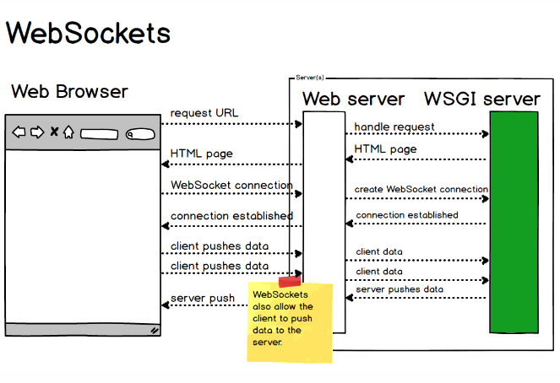
Websocket Flow

Slide 28
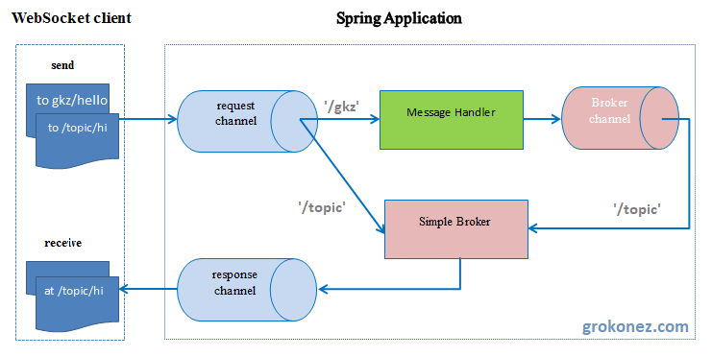
Spring Websocket Architecture

Slide 29
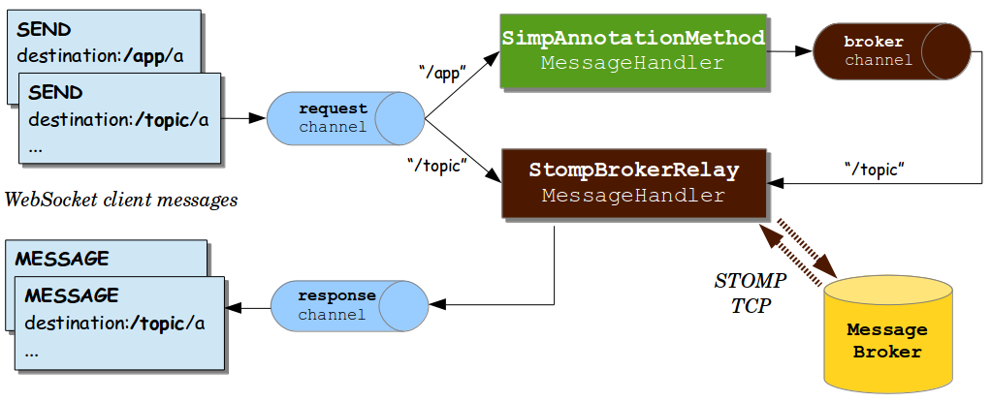
Spring Websocket Architecture

Slide 30
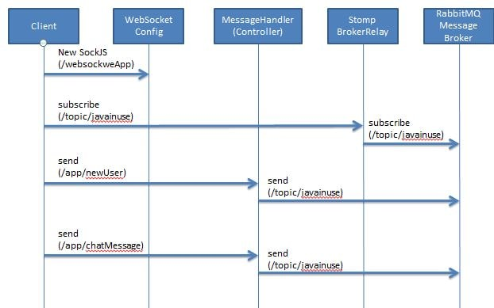
Flow logic

