Slide 1

HOTEL BOOKING AND RESERVATION SYSTEM USING MICROSERVICES TECHNOLOGY WITH MEAN STACK AND SPRING MVC HIBERNATE
By
Do Hung Cuong
Notes:
Hello everyone, my name is Do Hung Cuong, and today I am very happy to be here to present about my thesis
My topic is HOTEL BOOKING AND RESERVATION SYSTEM USING MICROSERVICES TECHNOLOGY WITH MEAN STACK AND SPRING MVC HIBERNATE
I will talk about 15-20 minutes, if you have any questions, you can ask me at the end of my presentation

Slide 2
Table of content
1. Technology
2. Hotel Business Industry
3. Goal and Scope
4. Features
5. System Architecture
6. Demo
Notes:
Now, I wanna show you what I am going to talk today.
Firstly, the technology which I use to implement my system
Secondly, I will introduce about Hotel Business industry
Next, The goal and scope of my thesis
Then I will show you the features that my system support
Finally I will show the architecture for the whole of my hotel booking and reservation system and Demo

Slide 3
I. Technology
Notes:
Let move on the first session: Technology
As I mentioned, my thesis’s hotel booking and reservation system using mircoservers techonology with MEAN stack and Spring MVC Hibernate
So in this session these techonologies

Slide 4
Mircoservices
Microservices is an architectural style where its application is structured as a collection of loosely coupled services and each service implements its own business capabilities
It is simply known as a combination of many small services called module, that is most popular used in many companies to implement large-scale projects
The Microservices architecture allows us to continuously deliver and deploy the large and complex applications. Based on its architecture, the organizations can evolve its technology stack for their own products.

Slide 5
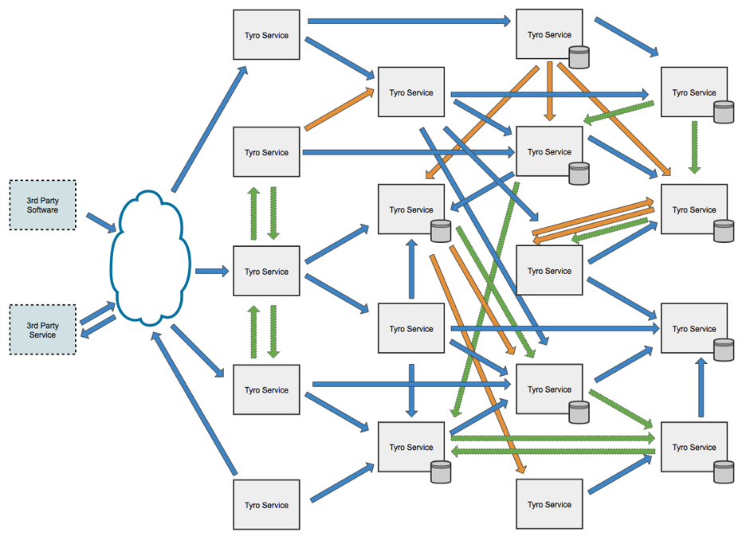
Mircoservices
Notes:
In Microservices, a service provides API or uses API from other services to execute its own business logic. A service can also be a client with variety of difference from other services including desktop browsers, mobile browsers and native mobile applications
The architecture of Microservices is the interaction of many independent services. Each service has the own architecture which can be implemented in different programming language or use different database system

Slide 6



Spring MVC Hibernate
Spring MVC is a very common framework for java that support building a J2EE web application follow MVC architecture on the server side.
Java is one of the most popular programming langue which powerfully supports Object Oriented Programming
Hibernate is an object-relational mapping tool for the Java programming language. It provides a framework for mapping an object-oriented domain model to a relational database
Notes:
As I know, Spring is a very common framework for java that support building a J2EE web application follow MVC architecture on the server side.
I think Java seem not very strange for everyone here. According to stackoverflow and github, Java is one of the most popular programming langue which is powerful in Object Oriented Programming

Slide 7




MEAN stack
The term MEAN stack refers to a collection of JavaScript based technologies used to develop web applications.
From client to server to database, MEAN is full stack JavaScript.
MEAN is an stand for:
MongoDB is a free and open-source cross-platform document-oriented database program. Classified as a NoSQL database program, MongoDB uses JSON-like documents with schemas
M =
E =
Express is a light-weight web application framework; the most popular framework for Node.js to help organize your web application into an MVC architecture on the server side
A =
Angular is open source JavaScript framework, one of the most popular Single Page Application framework support building a complex application on client side
Node.js is a JavaScript runtime using JavaScript on server side support building real-time application effectively.
N =
Notes:
The term MEAN stack refers to a collection of JavaScript based technologies used to develop web applications.
From client to server to database, MEAN is full stack JavaScript.

Slide 8
Technology used
- Architecture style: Microservices, Single Page Application, RESTful webservice, MVC
- Back end: Java web J2EE + Spring MVC framework + Hibernate
Node.js + Express framework
- Front end: HTML5, CSS3, Javascript, Jquery, Bootstrap
Angular JS and Angular 2 framework
- Database: MongoDB, SQL (MySQL & MS SQL Server)
- Build and Deploy: maven with Glassfish, Tomcat, package.json with npm
- Online server: heroku.com, mlab.com, freesqldatabase.com
- Version control: Git
- Project management tool: Trello
- Other tool: Dreamweaver CS6 , UMLET, Edraw, Netbeans, Vscode, RoboMongo, PHPmyadmin, Sonar Lint, SQL Server Management Tool, Erdaw,
Notes:
Besides these technology I have mentioned. I also use a lot of other technology. Here is a list of summary technology I used

Slide 9
II. Hotel Business Industry

Slide 10
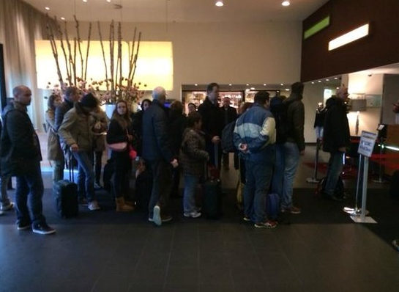
Problem
in many enormous hotels, management is very difficult
Booking only based on pen and paper is not convenient for both the customers and the receptionists
Customer have to come directly to hotel for booking => waste time, not comfortable
=> need a hotel booking and reservation system
.
Notes:
As you can see in the picture, it is an image of Hilton Hampton Hotel in America, you can see that many customers are making a queue waiting for own turn to book room or fill a reservation form. In fact, in many enormous hotels, management is very difficult where booking based on pen and paper is not convenient for both the customers and the receptionists.
This is because Customer have to come directly to hotel for booking
And it wastes time, not convenient
Therefore, if you are earning money from hotel bussiness industry, you need a hotel booking and reservation system

Slide 11
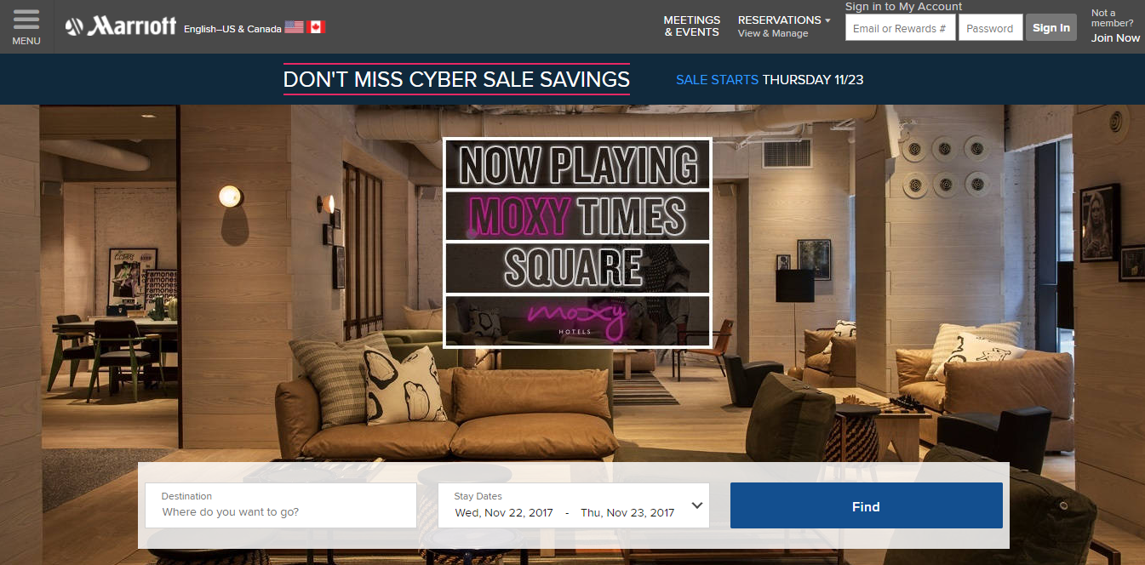
Modern Hotel System
Many deluxe hotels or five stars hotels in the world already have their own hotel booking systems
In developing technology industry, their systems have friendly user interface, high performance and especially the ability to track the behavior of customers
Notes:
To solve these problems above, many deluxe hotels or five stars hotels in the world such as Marriott International, Hilton Worldwide or InterContinental Hotels Group lready have their own hotel booking systems. You can see the modern Hotel booking website of Marriott International Hotel here
In developing technology industry, their systems were improved so much with friendly user interface, high performance and especially the ability to track the behavior of customers. So thatThey would know which pages customers clicked on, how long customers stayed at each page, which rooms, which services that customers had searched, booked, ordered or send the feedbacks.

Slide 12
III. GOAL AND SCOPE

Slide 13
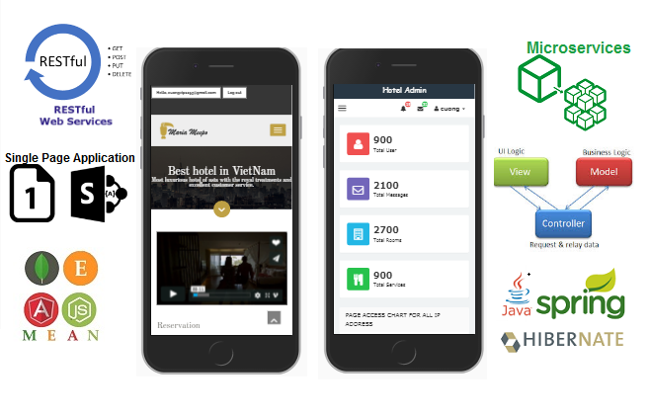
Goal and Scope
The goal of my thesis is experiment Mircoservices technology with MEAN stack and Spring MVC Hibernate to build a Hotel Booking and Reservations system with more than 60 primary features similar to some other modern five-star hotel system.
Two responsive websites with apply Mircoservices, Single Page Application, RESTful webserivce and MVC architecture style.
Notes:
Apply all technology to expreiment Hotel

Slide 14
Goal and Scope
My system is an online single page web application with high performance and dynamically loading.
A lot of advanced, modern and popular web application technologies are used to implement my system includes Microservices, RESTful web service; Java, Spring framework, AngularJS, SQL and Hibernate; Mean stack with MongoDB, Express framework, Angular 2 and Node.js.
My hotel booking websites also have friendly user interface which supports running on many browsers, devices include smart phone, iPad, laptop and desktop.
It owns almost features for hotel bookings & reservations management with more than 60 features available

Slide 15
Goal and Scope
It has ability to track user’s behavior so that I can know the pages, the images customers click, total times they visited my websites, the duration they stayed in each page with their username, IP address and location. Even the keyword that customers search or the buttons they click for filter rooms or restaurant services are under controlled.
With all the data collection from customers, my system can automatically recommend rooms for them according to the rooms they had interacted.
=> Can apply AI machine learning in the future
The hotel owners can improve their hotel based on customers wish if they apply my system for their hotel business.

Slide 16
IV. FEATURES

Slide 17
Features
Support more than 60 features
3 roles guest, customers, admin
Hotel business features for each role
Tracking features
Notes:
Where ever you are, what ever you do, you are followed if using my system

Slide 18
Use case

Slide 19
V. SYSTEM ARCHITECTURE

Slide 20
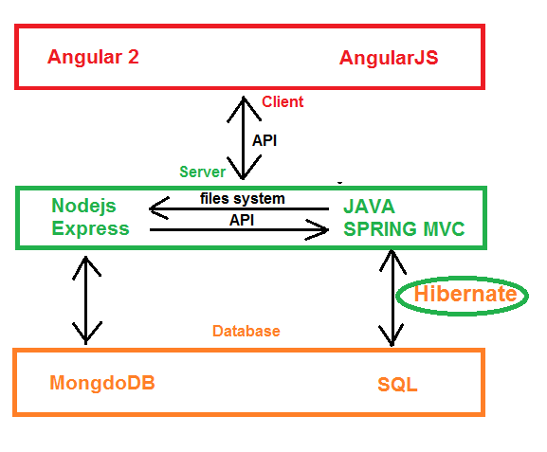
System architecture

Slide 21
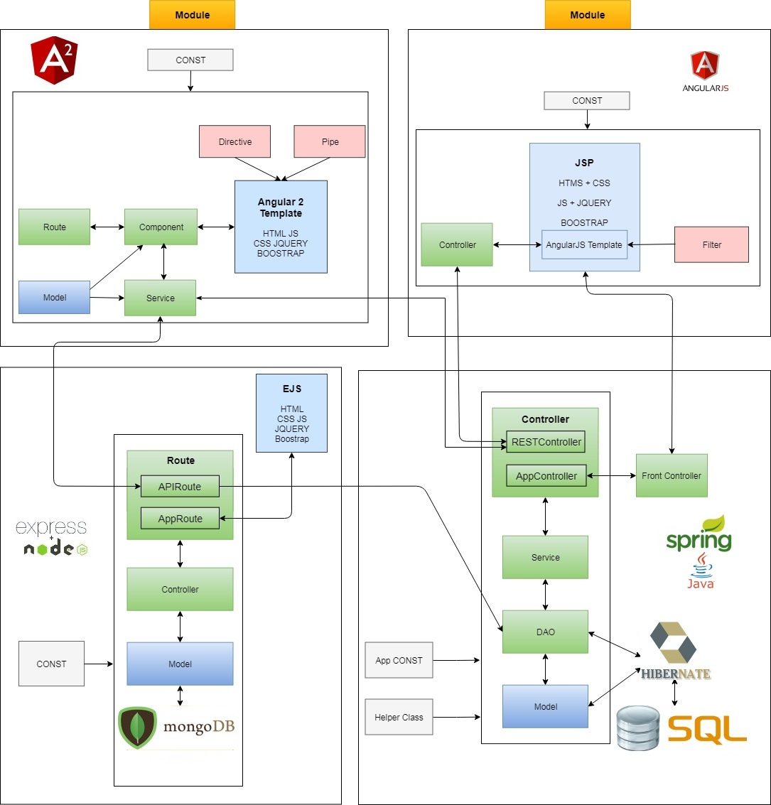
V. System Architecture
Notes:
`

Slide 22
VI. Demo

