Slide 1

HOTEL BOOKING AND RESERVATION SYSTEM USING MICROSERVICES TECHNOLOGY WITH MEAN STACK AND SPRING MVC HIBERNATE
By
Do Hung Cuong
Notes:
Hello everyone, my name is Do Hung Cuong, and today I am very happy to be here to present about my thesis
My topic is HOTEL BOOKING AND RESERVATION SYSTEM USING MICROSERVICES TECHNOLOGY WITH MEAN STACK AND SPRING MVC HIBERNATE
I will talk about 20-25 minutes, if you have any questions, you can ask me at the end of my presentation

Slide 2
Table of content
1. Technology
2. Hotel Business Industry
3. Goal and Scope
4. Features
5. System Architecture
6. Demo
7. Conclusion
Notes:
Now, I wanna show you what I am going to talk today.
Firstly, the technology which I use to implement my system
Secondly, I will introduce about Hotel Business industry
Next, The goal and scope of my thesis
Then I will show you the features that my system support
Finally I will show the architecture for the whole of my hotel booking and reservation system and Demo

Slide 3
I. Technology
Notes:
Let move on the first session: Technology
As I mentioned, my thesis’s hotel booking and reservation system using mircoservices technology with MEAN stack and Spring MVC Hibernate
So in this session I will introduce these technologies

Slide 4
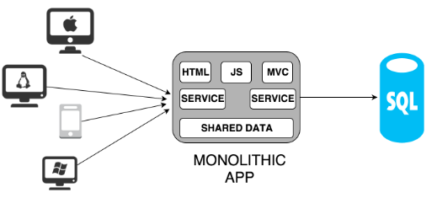
Mircoservices
Monolithic Architecture
- Effort to optimize, agile working method is ineffective.
- Not easy to maintain.
- Difficult to extend in the future
Notes:
Before talking about mircoservices, I will introduce a tradition one call Monolithic Architecture
This picture show the Architecture of Monolithic app. As you can see, all the components are stick together in only one Monolithic block
That will help you build an web application, a small project easily.
However, with a big project, when the users of your system increase, the data increase as well, developers add new features or complex functions to your system. It leads to the fact that Only a few years or even a few month later, your system become big monster and every effort to optimize or agile working methods is no long effective
Just imaging how terrible is when billions lines of code were put in one single Monolithic block. What can we do to organize or maintain our source code?
Moreover, in the future, it is very difficult to extend this application. In Monolithic block, we can only focus on one programming language, framework or database. It is very difficult or even impossible to add another one to your system
And for example, in the feature there is a new programming language call ABC so how you can write ABC in your system

Slide 5
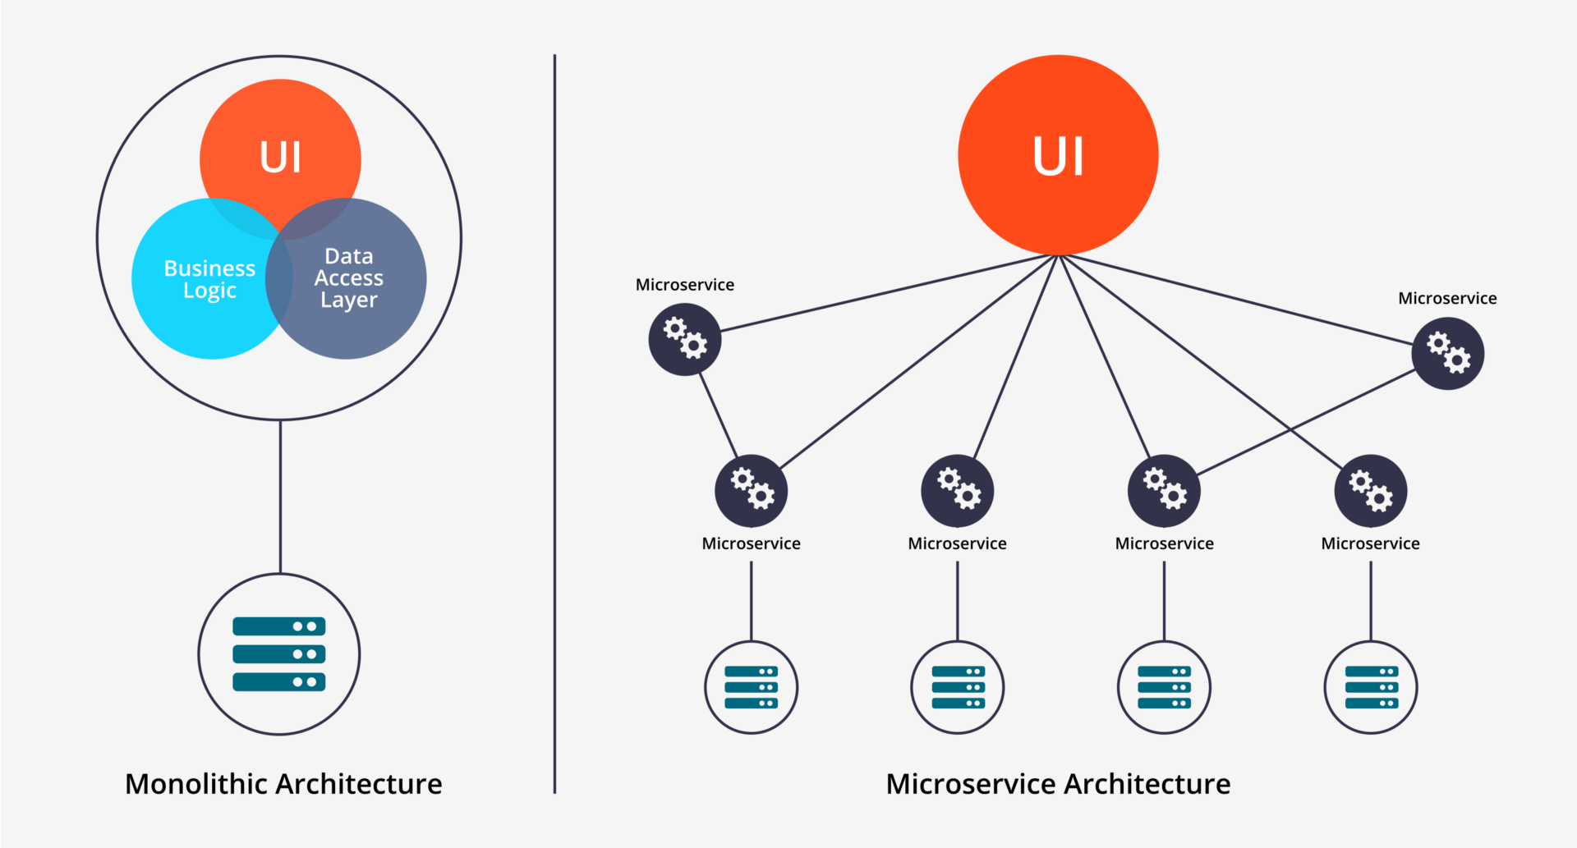
Mircoservices
Separated into a lot of smaller services
Each Service provides API or uses API from other services to execute its own business logic.
Independency of architecture, programming language or use different database system
Notes:
Thus, Mircoservices is released to improved the limited of Monolithic architecture
Opposite to Monolithic Architecture, In Microservices, this previous main building monolithic block is separated into a lot of smaller services
So it is very easy to maintain and manage a big project. Cause in fact, each developer team only focus on 1-2 services at the same time and
Each service execute its own business logic.
The services can have different architecture which can be implemented in different programming language or use different database system
And they can communicate easily through API to provides data and function. So in the feature if you have another services which is write in ABC programming language, XYZ framework or new database system, it can also interact with your system by this way.

Slide 6
Mircoservices
Microservices is an architectural style
Structured by collection of loosely coupled services .
Each service implements its own business capabilities
Most popular used in many companies to implement large-scale projects
Allow to continuously deliver and deploy the large and complex applications.
Notes:
So in summary
Microservices is an architectural style where structured by collection of loosely coupled services .
Each service in Microservices implements its own business capabilities
Microservices is Most popular used in many companies to implement large-scale projects
Microservices Allow to us continuously deliver and deploy the large and complex applications.

Slide 7

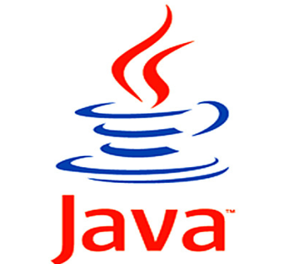
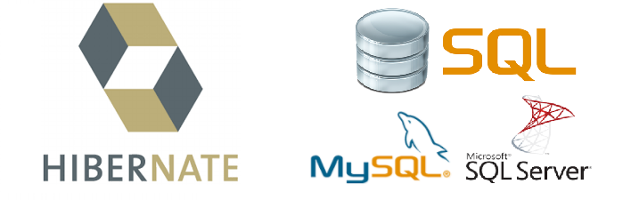
Spring MVC Hibernate
common framework for java
support building a J2EE web application follow MVC architecture on the server side.
object-relational mapping framework.
mapping model to a relational database
query language independency
Notes:
Another technology I use to develop my system is Spring MV hibernate
Spring MVC is a very common framework for java that support building a J2EE web application follow MVC architecture on the server side.
And Hibernate
For the guy who have used JBDC with SQL, you have to get set all the variables , the attributes from your object or model to the database system
It wasted a lot of time of developer and may cause the lacking of information
So Hibernate is an object relation mapping framework support mapping an object-oriented model to a relational database.
And hibernate also support query language independency that allow you to change database system dynamically no matter you use MYSQL, MSSQL server or Oracle

Slide 8




MEAN stack
The term MEAN stack refers to a collection of JavaScript based technologies used to develop web applications.
From client to server to database, MEAN is full stack JavaScript.
MEAN stands for:
M =
- NoSQL database program
- uses JSON-like documents with schemas
E =
- most popular framework for Node.js
- help organize web application into an MVC architecture
- Support RESTful webservice
A =
- open source JavaScript framework, one of the most popular Single Page Application framework
- support building a complex application on client side
N =
- using JavaScript on server side
- support building real-time application effectively.
Notes:
The term MEAN stack refers to a collection of JavaScript based technologies used to develop web applications.
From client to server to database, MEAN is full stack JavaScript.
MEAN stands for:
M = MongoDB, it is a free and open-source cross-platform document-oriented database program. Classified as a NoSQL database program, MongoDB uses JSON-like documents with schemas
Express is a light-weight web application framework; the most popular framework for Node.js to help organize your web application into an MVC architecture on the server side or RESTful webservice withNode.js
Angular is open source JavaScript framework, one of the most popular Single Page Application framework support building a complex application on client side. For SPA I will show you in the next slide
Node.js is a JavaScript runtime using JavaScript on server side support building real-time application effectively.

Slide 9
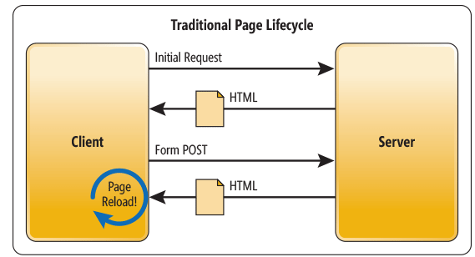
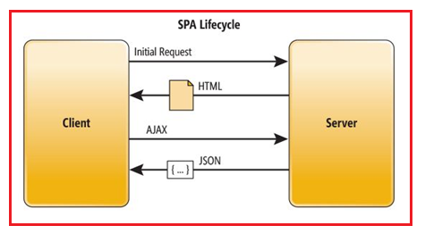
Single page application
- Every time the app calls the server, the server renders a new HTML page
- Load new page or reload page make customer feel uncomfortable
- Low performance
- Server and client interaction via AJAX
- Update the page dynamically
- High performance
Notes:
Here is the traditional website architecture
When the client initialize loading, the server have to handle the logic code and then render a new HTML page for client.
When the client want to send the form or request update the page, the server continue to handle the logic code and request client to reload the page
Loading or reload page make customer feel inconvinient. For example, if you just want to update a little content of the page or sending a form with just one fields you also have to wait for the whole page loading. It wastes a lot of time and the performance is low as well
With Single page application, after the first page loads, all interaction with the server happens through AJAX calls.
AJAX is a dream of developer, because It supports changing the content of a web page without reloading it. After the page has loaded, we can still send request or receive data from the server
These AJAX calls return data usually in JSON format. The app uses the JSON data to update the page dynamically, so the performance is higher

Slide 10
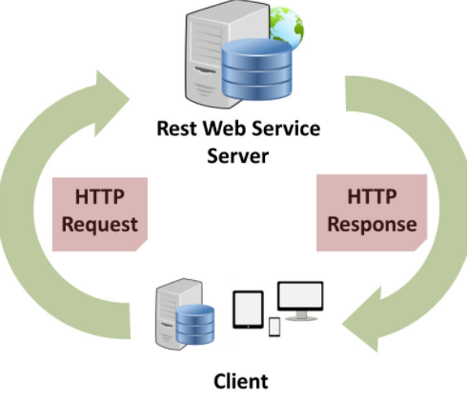
RESTful webservice
- Web service build on server side
- use HTTP methods : GET, POST, PUT , DELETE …
- provide API data as Text, JSON, xml format
Notes:
To apply Single page application, we need to provides data for client via AJAX as well as the request backward from client.
Nowadays, RESTful webservice is the most popular way that help your server connect provides API resources for client side.
RESTful webservice provides REST HTTP methods such as GET, PUT, POST, DELETE for data retriveing and storing and it and these methods are match
With the HTTP method on client side via AJAX
RESTful webservice can provide API data as Text, JSON, XML format, usually in JSON

Slide 11
Technology used
- Architecture style: Microservices, Single Page Application, RESTful webservice, MVC
- Back end: Java web J2EE + Spring MVC framework + Hibernate
Node.js + Express framework
- Front end: HTML5, CSS3, Javascript, Jquery, Bootstrap
Angular JS and Angular 2 framework
- Database: MongoDB, SQL (MySQL & MS SQL Server)
- Build and Deploy: maven with Glassfish, Tomcat, package.json with npm
- Online server: heroku.com, mlab.com, freesqldatabase.com
- Version control: Git
- Project management tool: Trello
- Other tool: Dreamweaver CS6 , UMLET, Edraw, Netbeans, Vscode, RoboMongo, PHPmyadmin, Sonar Lint, SQL Server Management Tool, Erdaw,
Notes:
Besides these technology I have mentioned. I also use a lot of other technology. Here is a list of summary technology I used such as Juery, boostrap, MySQL, SQL, Maven , tomcat Git hub, Trello and so much more

Slide 12
II. Hotel Business Industry

Slide 13
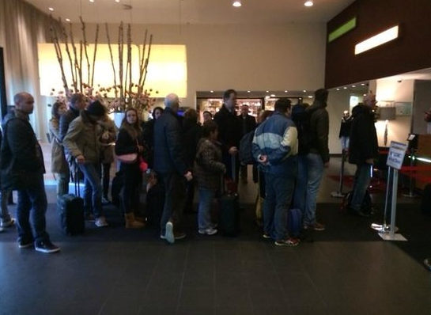
Problem
in many enormous hotels, management is very difficult
Booking only based on pen and paper is not convenient for both the customers and the receptionists
Customer have to come directly to hotel for booking => waste time, not comfortable
=> need a hotel booking and reservation system
.
Notes:
As you can see in the picture, it is an image of Hilton Hampton Hotel in America, you can see that many customers are making a queue waiting for own turn to book room or fill a reservation form. In fact, in many enormous hotels, management is very difficult where booking based on pen and paper is not convenient for both the customers and the receptionists.
This is because Customer have to come directly to hotel for booking
And it wastes time, not convenient
Therefore, if you are earning money from hotel business industry, you need a hotel booking and reservation system

Slide 14
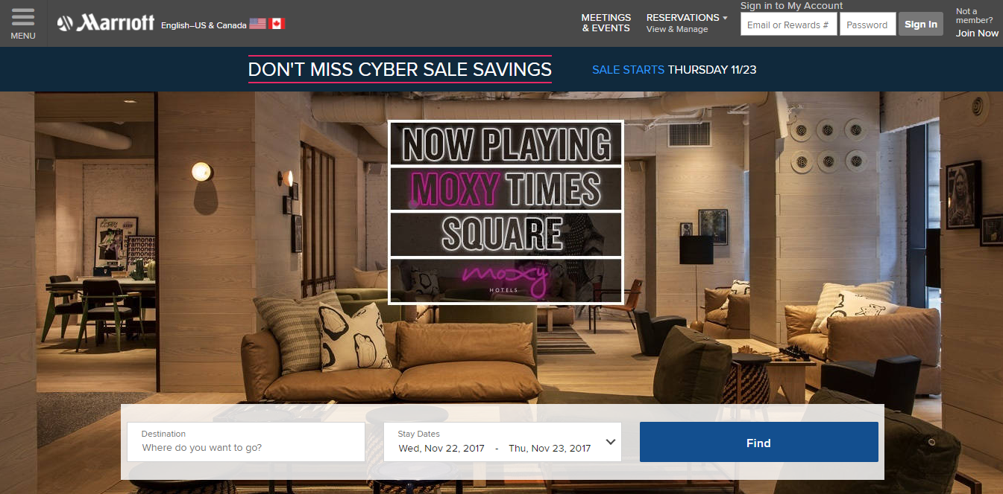
Modern Hotel System
Many deluxe hotels or five stars hotels in the world already have their own hotel booking systems
In developing technology industry, their systems have friendly user interface, high performance and especially the ability to track the behavior of customers
Notes:
To solve these problems above, many deluxe hotels or five stars hotels in the world such as Marriott International, Hilton Worldwide or InterContinental Hotels Group already have their own hotel booking systems. You can see the modern Hotel booking website of Marriott International Hotel here
In developing technology industry, their systems were improved so much with friendly user interface, high performance and especially the ability to track the behavior of customers. So that They would know which pages customers clicked on, how long customers stayed at each page, which rooms, which services that customers had searched, booked, ordered or send the feedbacks.

Slide 15
III. GOAL AND SCOPE

Slide 16
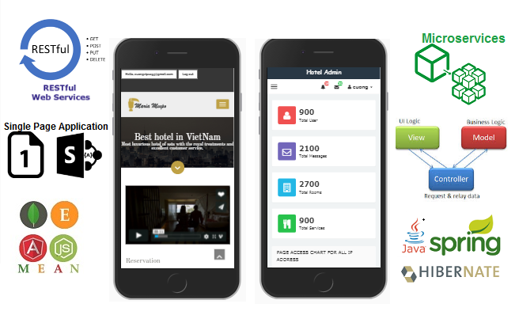
Goal and Scope
experiment Mircoservices technology with MEAN stack and Spring MVC Hibernate
features similar to some other modern five-star hotel system.
Two responsive websites with apply Mircoservices, Single Page Application, RESTful webserivce and MVC architecture style.
Notes:
The goal of my thesis is experiment Mircoservices with all technologies have mentioned to build a Hotel Booking and Reservations system similar to some other modern five-star hotel system.
Two responsive websites with apply Mircoservices, Single Page Application, RESTful webserivce and MVC architecture style.

Slide 17
Goal and Scope
online single page web application
high performance and dynamically loading.
A lot of modern technologies are used to implement my system
Support Hotel business
friendly user interface which supports running on many browsers
Notes:
My system is the online single page web application with high performance and dynamically loading by using Single Page application thank to Angular and RESTful webservice
A lot of advanced, modern and popular web application technologies are used to implement my system such as mircoservices, mean, spring mvc hibernate and so much more
My system support Hotel business with all the features related to booking and management
My system also friendly user interface which supports running on many browsers, devices include smart phone, iPad, laptop and desktop.

Slide 18
IV. FEATURES

Slide 19
Features
almost features for hotel bookings & reservations management with more than 60 features available
Ability to track user’s behavior
automatically recommend rooms for user according to the rooms they had interacted.
Statistic and chart features => hotel owners can improve their hotel based on customers wish

Slide 20
Use case
Notes:
This use case diagram clarify the features for each role.
The guest without the account can only view the website as guest, send a contact to admin or create a new account
The customer have an account so they can login, logout, book room, cancel room, feedback or view their activity
The admin can manage hotel items, manage users, view statistics tracking data and chart.

Slide 21
V. SYSTEM ARCHITECTURE

Slide 22
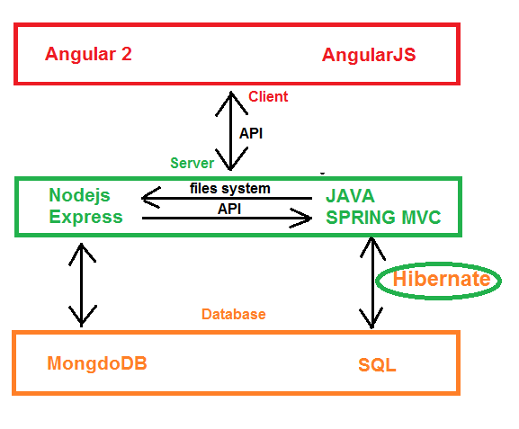
System architecture
Notes:
This is my general system architecture.
As you can see, on server side, Node.js and Express framework connect to MongoDB for data and similar to Spring MVC connect SQL DB using Hibernate
Both these 2 apps on server side built RESTful web service to provide data for client as JSON. The role of Angular is to interact with REST API and display the page dynamically.
The server sides can also interact with each other via API . All of these technology from client to server to database have created a picture of Mircoservices architectures which work independently and effectively.

Slide 23
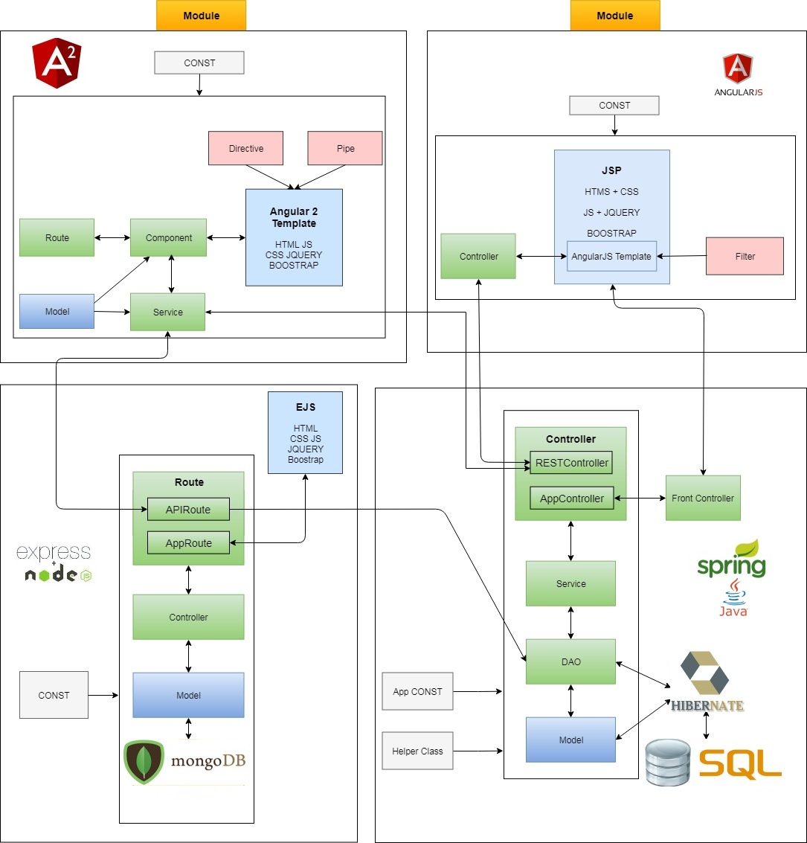
V. System Architecture
Notes:
This is my system architecture in details with all the important materials in Angular 2, AngularJS, Express, Spring MVC Hibernate
There are too much relationship so I just summary some important points:
There is 4 services available in my system with all the technologies I mentioned above
You can see that the Nodejs and Express connect mongodb and provides API for 3 other services
The Spring MVC Hibernate apply 3 layer architecture connect to SQL map with Hibernate also the provides API for 3 other service
And On the client side Angular have responsibility to retrive data from server and display or send request to server via AJAX by HTTP method

Slide 24
VI. Demo

Slide 25
Online Demo
http://admin-hotel-booking.herokuapp.com/
http://admin-hotel-booking-v1.herokuapp.com/
http://hotel-booking-system-v1.herokuapp.com/
http://hotel-booking-system-v2.herokuapp.com/
https://hotel-booking-and-reservations.herokuapp.com/
Notes:
I also have deployed successfully on Heroku server for testing online function
Here is the list of my server
In your free time, you can go to these links to visit my hotel booking and reservations system

Slide 26
VII. Conclusion

Slide 27
Conclusion
After thesis
Learn a lot of new technologies
Experience in building a complex application
In the future
Add more features
Apply machine learning when I have enough data collection.
Notes:
Hotel business is a highly profitable industry but requires huge investment as well as having to meet the customer's demand. However, managing the hotels is not easy, Therefore, hotel management system is really important. The key of hotel business is service which means pleasure the customers. The best management system will bring the highest profit but there are many factors and difficulty to build a good management system.
After applied MEAN stack and Spring MVC to implements Hotel Booking system, I recognize that my system has friendly user interface, high performance with dynamically loading. Moreover, with tracking customer’s behavior feature, you can easily know what customers like and what they don’t in order to improve system day by day to match the customer ‘s wish.
In the future, I will add more features as well as apply machine learning when I have enough data collection.
After thesis, I have learnt a lot of new things, I learnt a lot of technologies such as AngularJS, Angular 2, MongoDB, Spring MVC, Node.js, Express Framework. I can work with lots of frameworks and I have ability to learn new technology. I also had a lot of experience in building single page application. I will improve myself in the future for working in professional environment.

Slide 28

Thank you for your listening

