Slide 1
HOTEL BOOKING AND RESERVATION SYSTEM USING MICROSERVICES TECHNOLOGY WITH MEAN STACK AND SPRING MVC HIBERNATE
By
Do Hung Cuong

Slide 2
Table of content
1. Overview
2. Introduction
3. Goal and Scope
4. Features
5. System Architecture
6. Demo

Slide 3
I. OVERVIEW

Slide 4
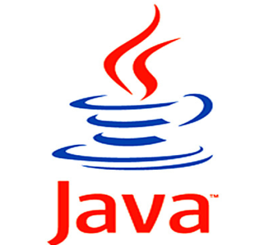

What is Spring MVC Hibernate?
Spring Framework is a Java platform that provides comprehensive infrastructure support for developing Java applications. Spring handles the infrastructure so you can focus on your application.
Notes:
Java một thuật nghữ quá quen thuộc với lập trình viên đã có từ rất lâu đời

Slide 5



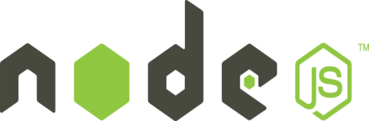
What is MEAN?
The term MEAN stack refers to a collection of JavaScript based technologies used to develop web applications.
From client to server to database, MEAN is full stack JavaScript.
MEAN is an acronym for:
M =
MongoDB is the leading NoSQL database, empowering businesses to be more agile and scalable.
E =
Express is a minimal and flexible node.js web application framework, providing a robust set of features for building single and multi-page, and hybrid web applications.
A =
Angular lets you extend HTML vocabulary for your application. The resulting environment is extraordinarily expressive, readable, and quick to develop
N =
Node.js is a platform built on Chrome’s JavaScript runtime for easily building fast, scalable network applications.
Notes:
Why full full stack JavaScript?

Slide 7
Features
Notes:
Almost feature for hotel booking system. Specially tracking feature – view more in demo

