Slide 1

DTIS · FEATURE UPDATES
What's New in DTIS
QR Code Receive · Routing Logbook · New & Updated Reports
DOH Western Visayas · Center for Health Development
[ Date ] | Presenter: [ Name ]
Notes:
Open with the theme: these updates take the two things that slow us down — receiving at the counter, and answering 'how are we doing?' — and make both a scan or a click away.

Slide 2
WHAT WE'RE ROLLING OUT
Four updates in this release
QR Code Receive
NEW
Scan the tracking form's QR code to receive a document — confirm once, done.
Routing Logbook
NEW
The paper logbook, online — what came in, when, and who received it.
External Requests report
UPDATED
Now tracks each request against its deadline, with status colors.
Per Unit & Turnaround Time reports
NEW
Workload by category, and how long each office holds documents.
Document Tracking Information System · DOH WV CHD
Notes:
Two brand-new capabilities (QR receive, logbook), one report upgraded (external requests), and two new reports.

Slide 3
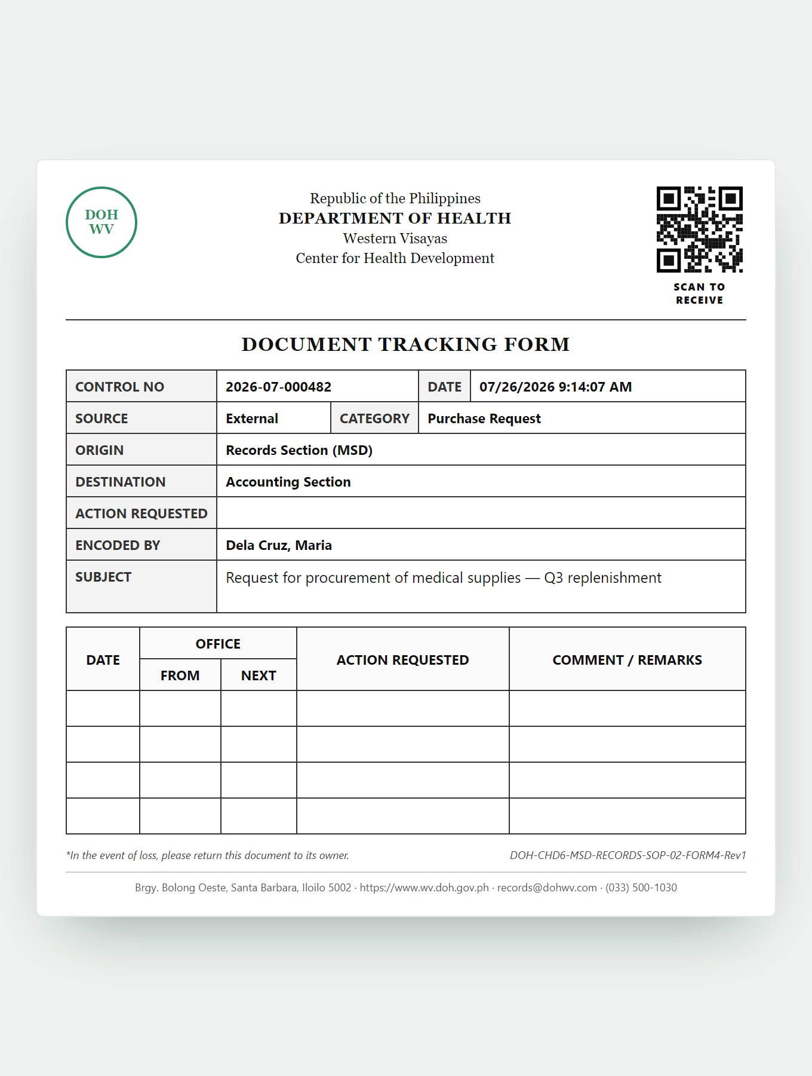
QR CODE RECEIVE
NEW
Receive a document by scanning its tracking form
Every printed tracking form now carries a QR code marked “SCAN TO RECEIVE.”
The receiving office scans it — no searching a list, no manual status change. One confirmation tap logs it as received and sets it to
On Process.
The paper form is unchanged for records — same layout and control number, plus the QR code.
Bundle-aware — one scan receives every attached document.
Printed tracking form (sample)
Notes:
Point at the QR code in the corner of the form. Fewer steps at the counter — the QR takes staff straight to the document. Sample data on the form.

Slide 4
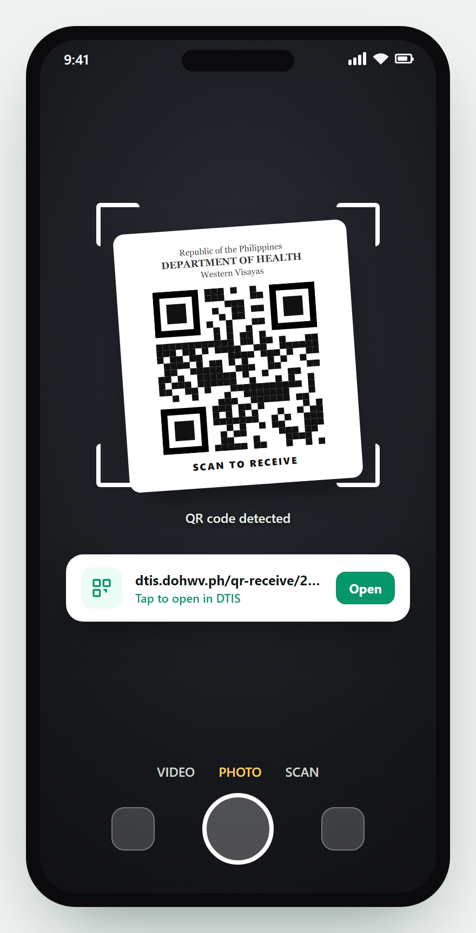
HOW TO SCAN THE QR CODE
Three ways to scan — most phones need no app
1
Phone Camera
Open the Camera app, point at the QR, and tap the link that appears. (iPhone & most Android)
2
Google Lens
Open the Google app, tap the Lens icon, point at the QR, then tap the result.
Any option opens DTIS in your browser — log in if prompted, then tap Receive.
Phone camera scanning (sample)
Notes:
Reassure non-technical staff: no app to install on most phones — the camera does it. Google Lens is the fallback for Android phones that don't auto-detect; a QR scanner app is the last resort. Tapping the link opens DTIS; they log in once, then Receive.

Slide 5
THE SAME CODE, THE RIGHT RESPONSE
DTIS checks who is scanning and the document's state
When it is scanned by… | What the scanner sees | Result
The correct office, document waiting | Full document + Receive → Received! | Received
A different office | “Not Assigned to Your Office” | Blocked
Already received | “Already Received” | No change
A completed document | “Document Closed” | No change
An invalid / unknown code | “Document Not Found” | Rejected
A QR code is a guardrail, not a blind button — the wrong office can't receive, and nothing gets received twice.
Notes:
Read one row aloud. Reassure that it's safe by design. The next two slides show the actual screens.

Slide 6
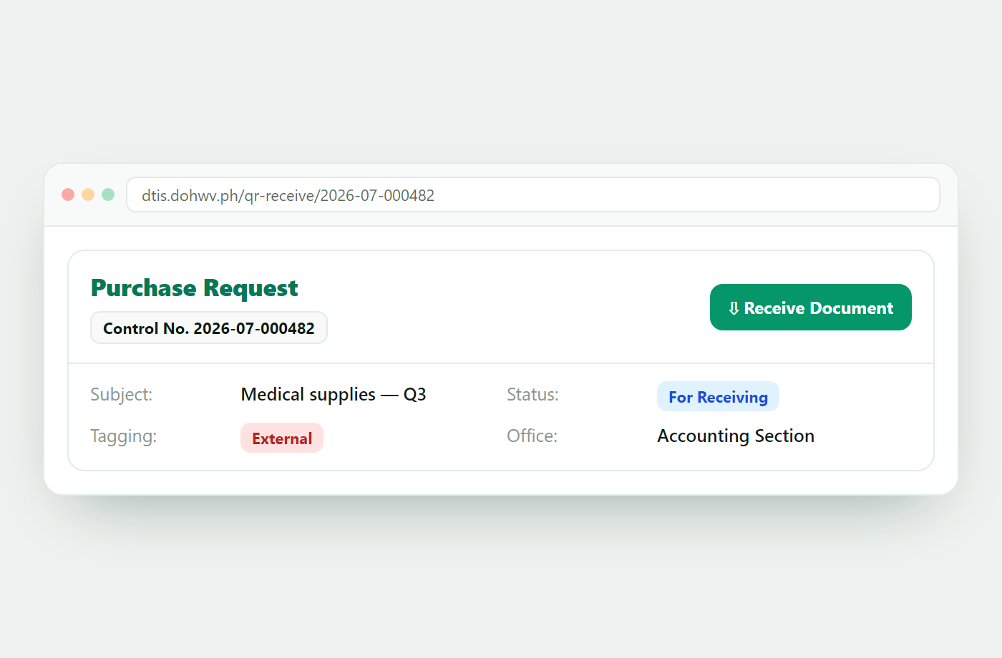
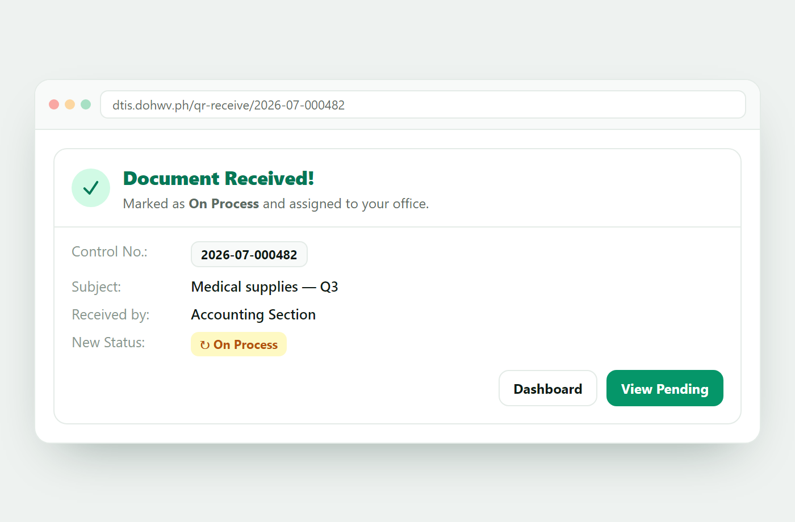
A SUCCESSFUL SCAN
What the receiving office sees — sample data
1 · Scan opens the document
2 · Confirm → Received
→
Status becomes On Process and the receipt is logged with the office, person, and time.
Notes:
Illustrative screens with sample data (control no. 2026-07-000482), not live records. Left to right: scan shows the document, one confirm receives it.

Slide 7
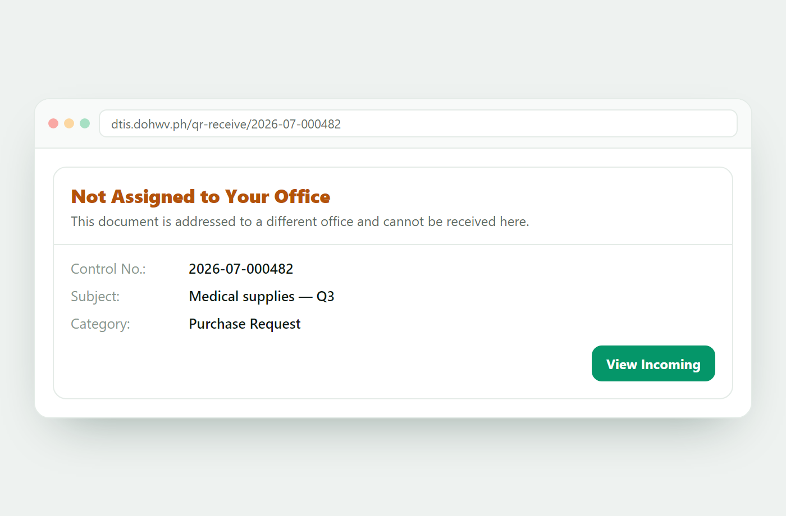
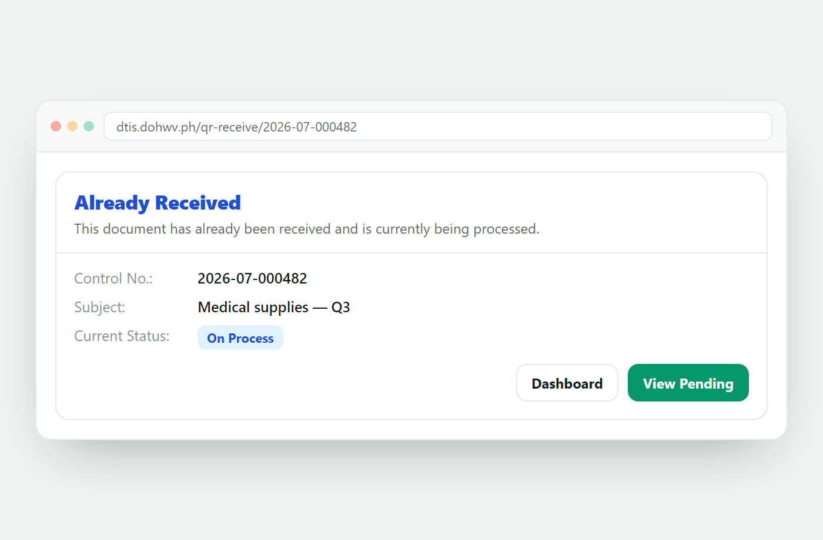
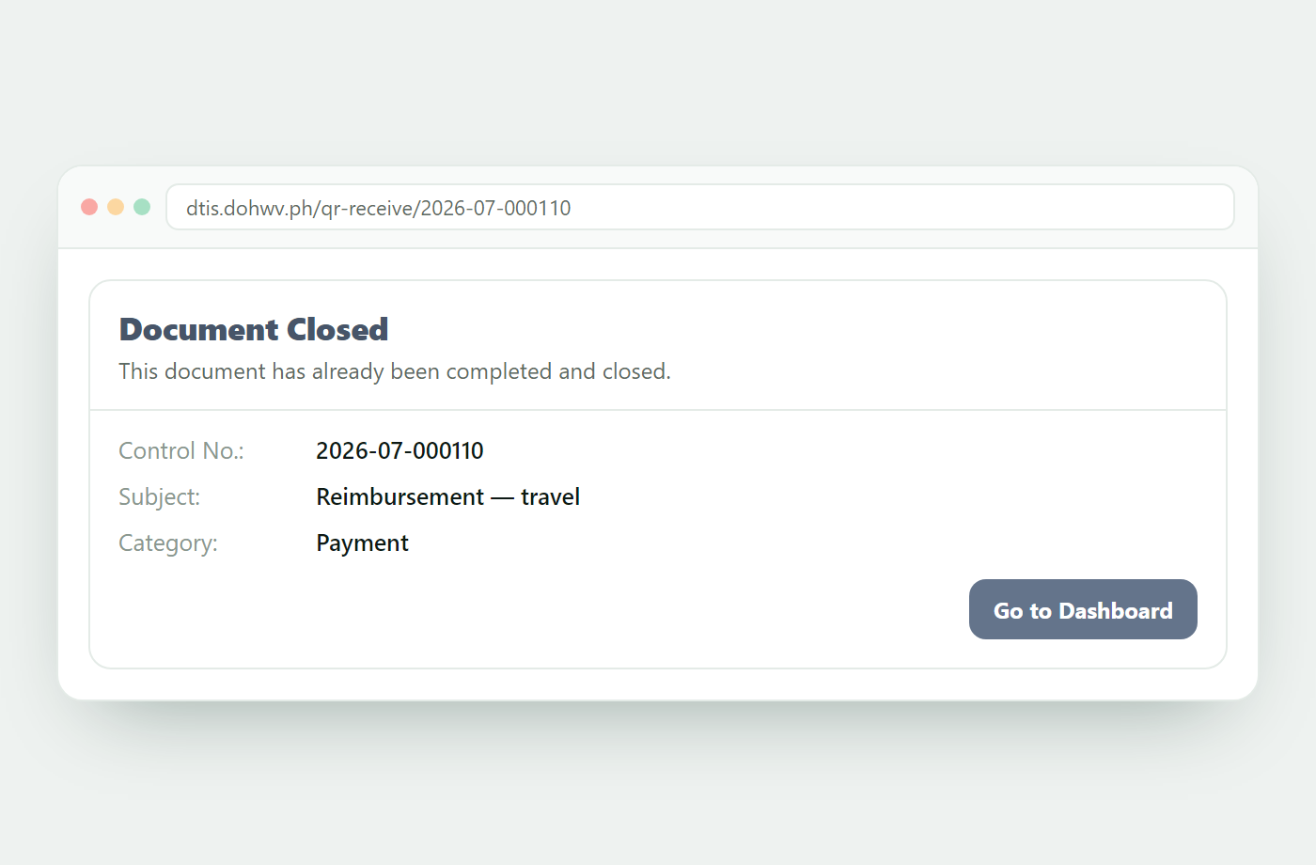
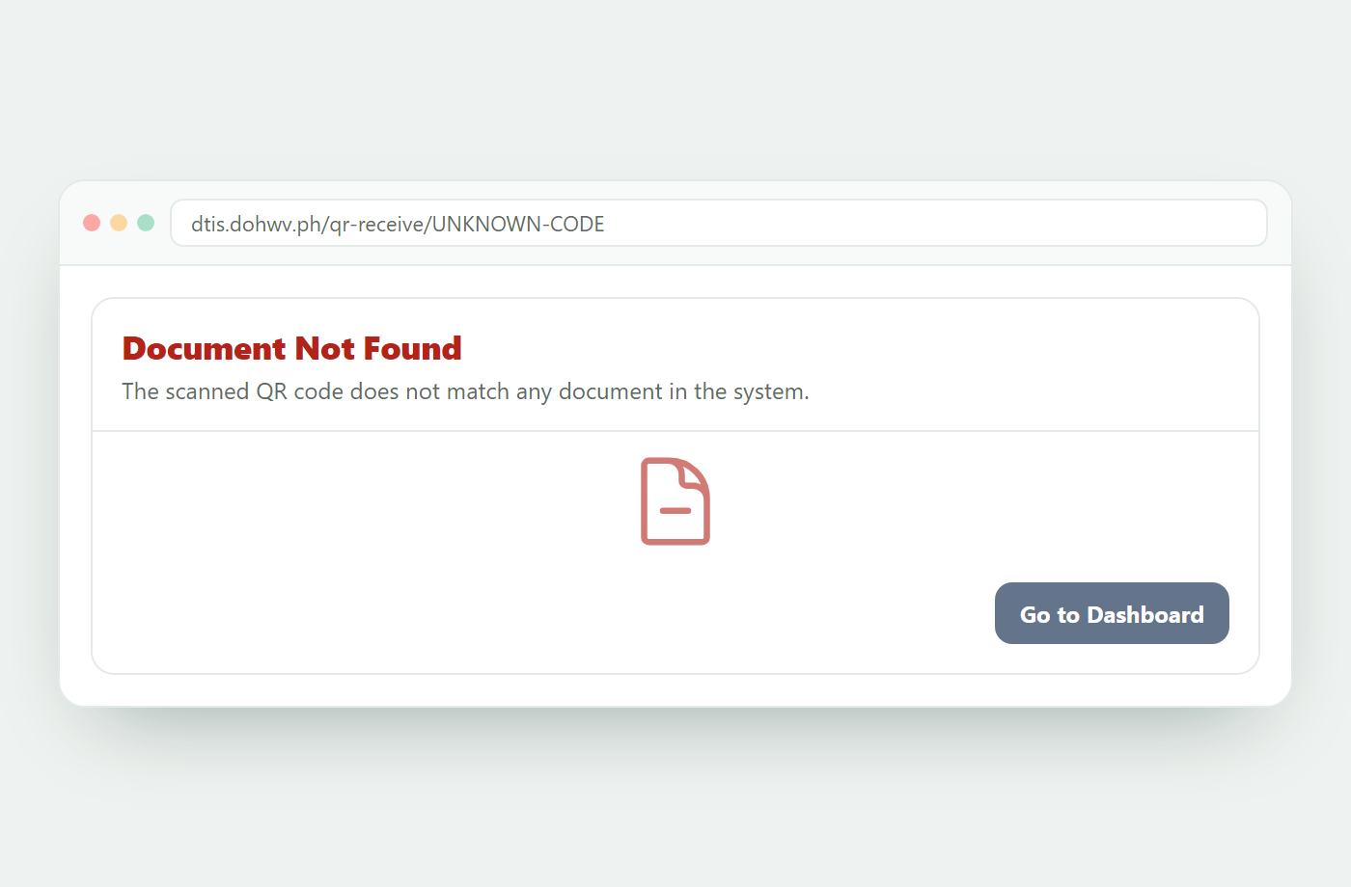
GUARDRAILS — WHEN DTIS SAYS “NOT YET”
The same code, a different response for each situation
Wrong office
Already received
Document closed
Invalid QR code
The wrong office can't receive a document, and nothing gets received twice — the scanner is always told exactly why.
Document Tracking Information System · DOH WV CHD
Notes:
Four protective outcomes from the same QR code. Reassure staff they can't 'break' anything by scanning.

Slide 8
ROUTING LOGBOOK
NEW
The paper logbook, online — per office
What it generates
Why it matters
A dated list of documents routed to your office.
For each: control number, category, date routed.
Who received it, and the exact time received.
Newest first; choose any date range.
Replaces the handwritten routing logbook.
Same accountability, captured automatically.
Ready for audits and reconciliation anytime.
One trusted answer to “did we receive it, and when?”
In the demo: the view defaults to yesterday–today — widen the date filter for older records.
Notes:
Frame it as a familiar thing made easier: their logbook, without the paper and handwriting.

Slide 9
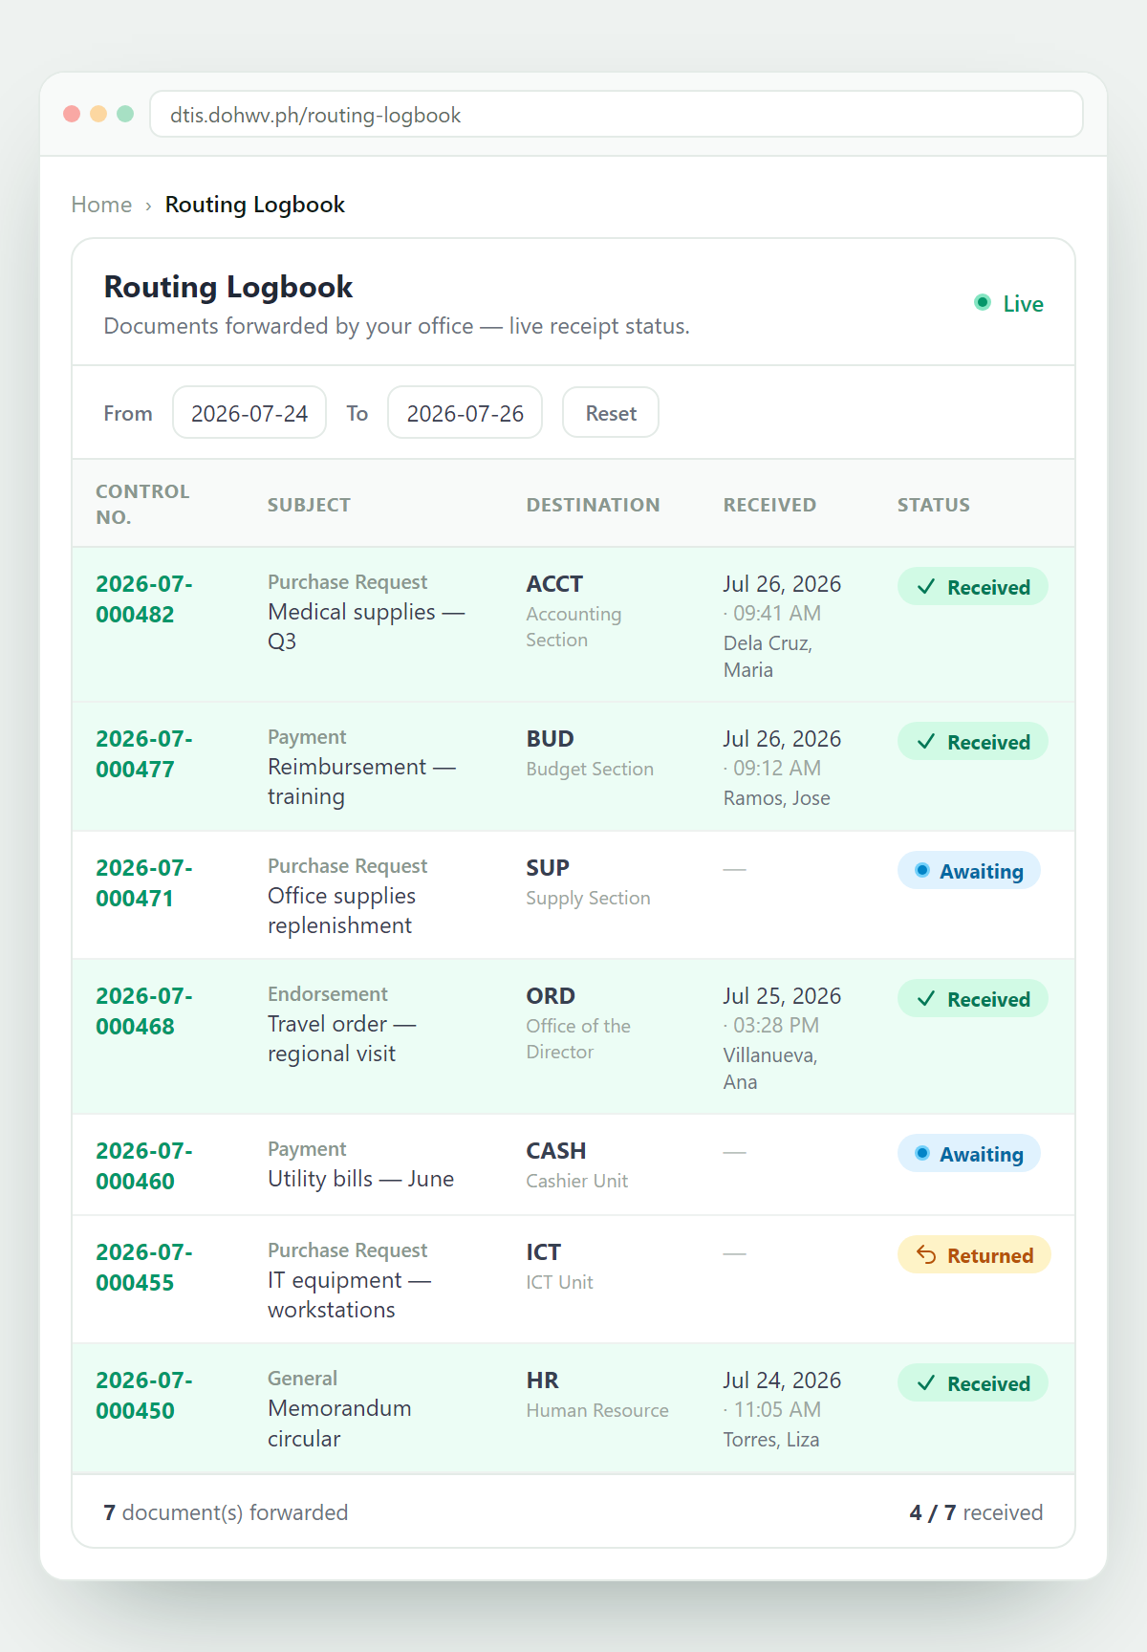
ROUTING LOGBOOK — IN THE APP
NEW
Live receipt tracking, at a glance — sample data
What you see
A Live list of every document your office has forwarded.
Control number, subject, and destination office.
Who received it and exactly when — the receiver's name and timestamp.
A per-row receipt status: Received, Awaiting, or Returned.
A running tally — “4 / 7 received” — updates as receipts come in.
Document Tracking Information System · DOH WV CHD
Routing Logbook (sample data)
Notes:
Portrait screenshot with sample data (not live records). Walk one row: forwarded to ACCT, received by Dela Cruz, Maria at 09:41 — that receipt row turns green. Awaiting rows are still out; Returned came back.

Slide 10
REPORTS
Three reports — each answers one plain question
“Are we meeting deadlines?” · “How much of what did we handle?” · “Where does the time go?”
Notes:
These updates improve output too — knowing how we're doing. Each report is simple and answers one question.

Slide 11
EXTERNAL REQUESTS REPORT
UPDATED
“Are we meeting our deadlines?”
What it generates
Why it matters
Every external request for your office in a date range.
Each tracked against its deadline (working days by category).
Color-coded: Completed, Due soon, Overdue, Pending.
Where it started, where it sits now, latest remark.
Printable for filing and records.
Turns a plain list into a deadline monitor.
Supports Citizen Charter / Anti-Red Tape Act timeliness.
Overdue items surface before they become complaints.
Note: weekdays only — holidays not deducted.
Completed
Due soon
Overdue
Pending
Notes:
Lead with the change: it now measures against deadlines, not just lists documents. Be honest about the holiday caveat.

Slide 12
PER UNIT REPORT
NEW
“How much of what did we handle?”
What it generates
Why it matters
Document counts broken down by category.
Grouped into Purchase Requests, Payments, General.
Per-group subtotals and a grand total.
Filterable by office, source, status, date range.
Shows the shape of a unit's workload.
Helps with staffing, planning, workload balancing.
A clean volume snapshot for period reporting.
Pair with Turnaround Time for speed.
128
94
57
279
Purchase Req.
Payments
General
Total
Notes:
Example numbers are illustrative — swap in a real period if you can. A counting report, not a timing one.

Slide 13
TURNAROUND TIME REPORT
NEW
“Where does the time go?”
What it generates
Why it matters
How long each office holds a document (receive → forward/close).
Average, fastest, slowest dwell per office, in working days.
Expand an office for a breakdown by category.
A live count of documents sitting at each office now.
Pinpoints where documents wait — the real bottlenecks.
Turns “it feels slow” into a measured number.
Supports performance review and process improvement.
Read fairly: weekends excluded; origin office not counted.
2.4 d
0 d
11 d
6
Avg dwell
Fastest
Slowest
Sitting now
Notes:
The most analytical report. Frame for supervisors: this is how you find the bottleneck. Walk the 'read fairly' line.

Slide 14
WHAT CHANGES FOR THE PEOPLE USING IT
Fewer steps to receive
The logbook, without paper
Numbers offices can act on
Scan, confirm, done — with checks that stop wrong-office and double receipts.
Every routed document and its receiver, searchable by date.
Deadlines, workload by type, and where time is spent.
One line to open with
“These updates take the two things that slow us down — receiving at the counter, and answering ‘how are we doing?’ — and make both a scan or a click away.”
Thank you!
Notes:
Close on value to the user, not the feature list. Offer to swap sample report numbers for real ones.

