Slide 1
Multi-Agent Path Finding
on a Real Fab OHT Network
Data Structure Project
김도현 · 202214223 · 전기전자공학과

Slide 2
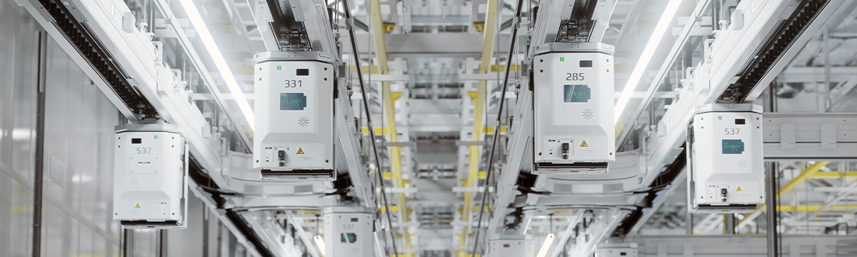
1 · INTRO
Hundreds of OHTs share one rail
A collision stalls the line — and a stalled line stalls production.

Slide 3
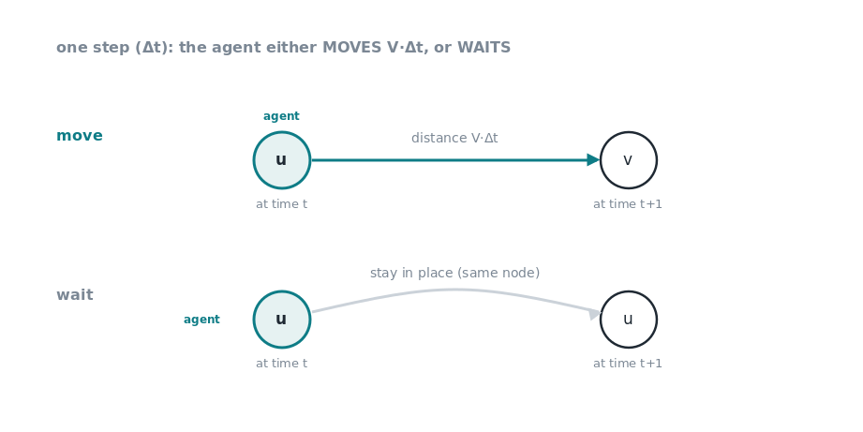
2 · PROBLEM SETUP
Discrete-time motion model
Directed graph · one step = move V·Δt or wait · min separation V·Δt

Slide 4
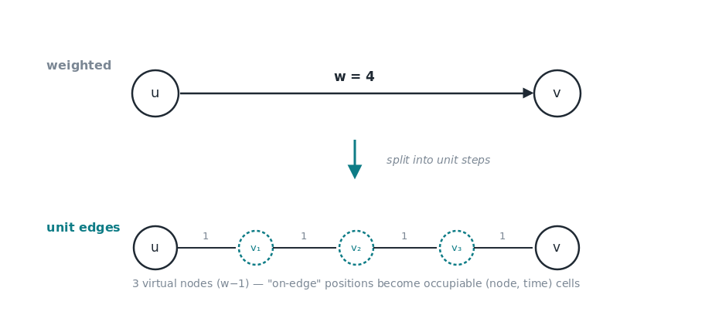
2 · PROBLEM SETUP
Edge → unit edges (virtual nodes)
Split each edge into unit steps → collision = same (node, time).

Slide 5
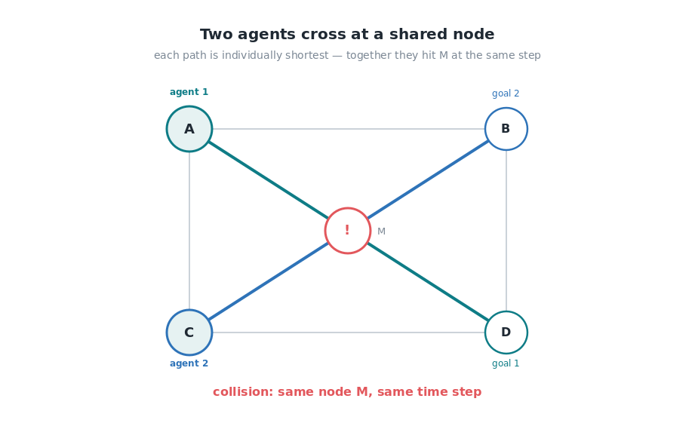
2 · PROBLEM SETUP
The conflict: why time is part of the problem

Slide 6
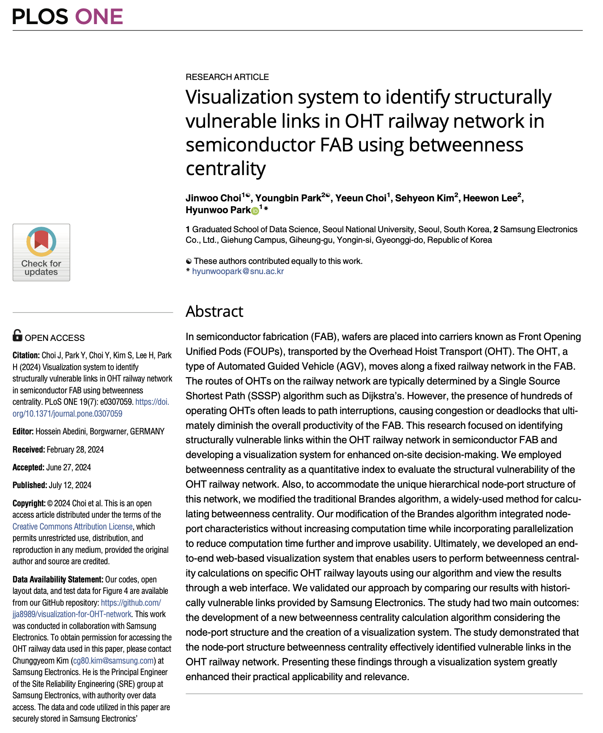
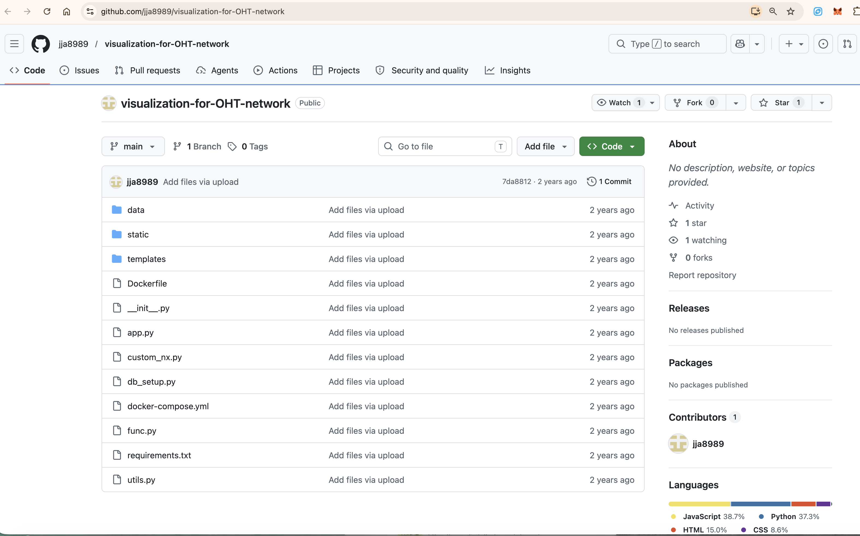
3 · DATA ACQUISITION
A Samsung semiconductor-fab network in Yongin
SMAT 2022 OHT network — Choi et al., PLOS ONE 2024 · 2,858 nodes / 3,424 edges

Slide 7
3 · DATA ACQUISITION
Directed weighted graph
→ quantize to integer steps

Slide 8
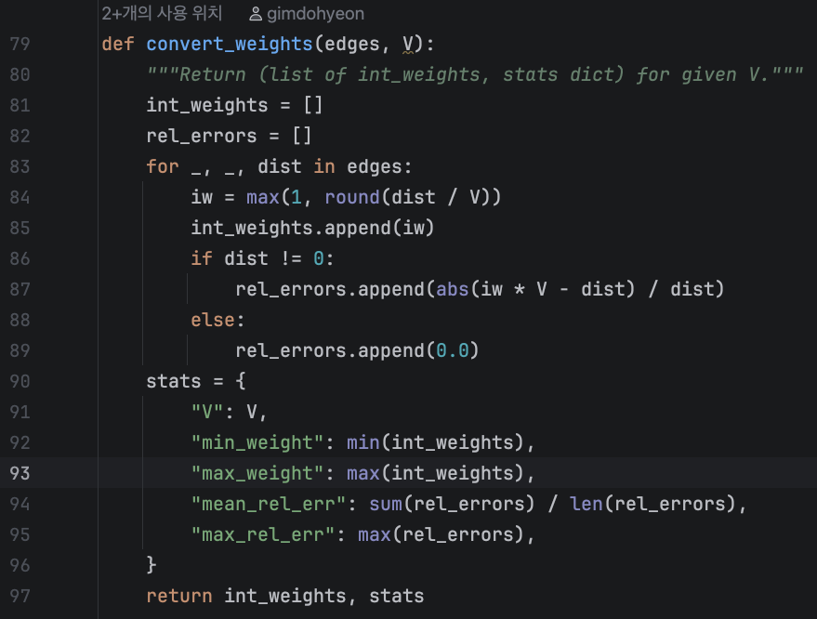
3 · DATA ACQUISITION · PREPROCESSING
Stage 1 — quantize (convert_weights)
distance → integer steps: round(d / V), clamp ≥ 1. Coding it is what lets us measure & tune the error.

Slide 9
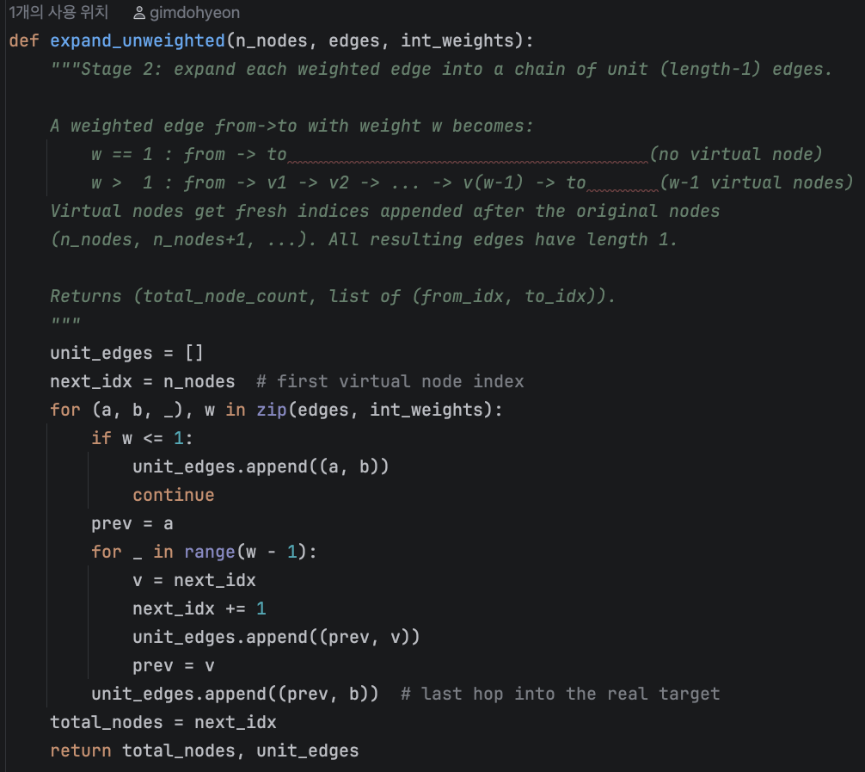
3 · DATA ACQUISITION · PREPROCESSING
Stage 2 — expand (expand_unweighted)
each weight-w edge → a w−1 virtual-node chain of unit edges.

Slide 10
3 · DATA ACQUISITION · TUNING RESULT
Quantization: smaller graph vs. more error
V·Δt | max w | edge avg err | edge max err | PATH avg err | expanded nodes
1000 | 14 | 11.8% | 33.3% | 1.6% | 10,312
1417 | 10 | 16.8% | 60.7% | 2.8% | 7,578
500 (chosen) | 28 | 7.1% | 20.0% | 3.6% | 21,178
1800 | 8 | 31.3% | 104% | 8.1% | 6,146
PATH error is the real metric — edges over/under-round, but a path sums many edges so errors cancel.
Smaller V·Δt → finer steps → a bigger graph, but more accurate. Chosen V·Δt=500: max w = 28, path error 3.6%.

Slide 11
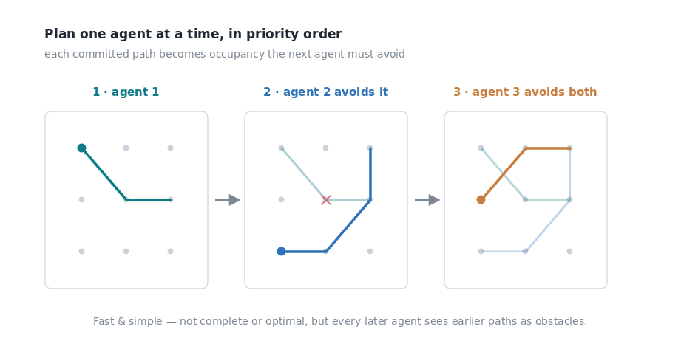
4 · THE BIG PICTURE
Prioritized Planning
Plan agents one at a time, in priority order. Each committed path becomes occupancy the next agent must avoid.

Slide 12
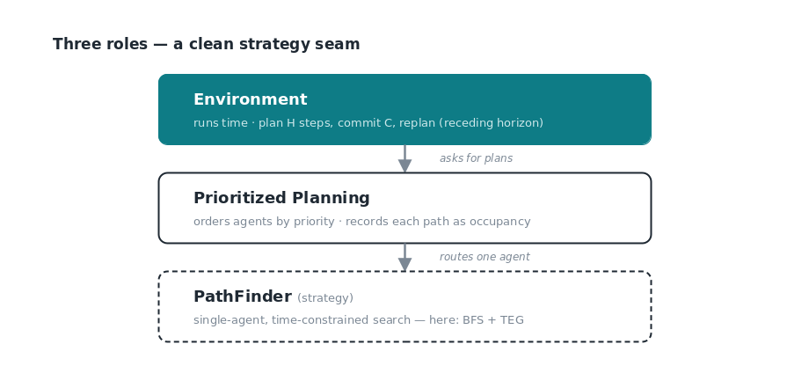
4 · THE BIG PICTURE
Three roles, receding horizon
Environment runs time (plan H, commit C, replan) · PP orders agents · PathFinder routes one agent.

Slide 13
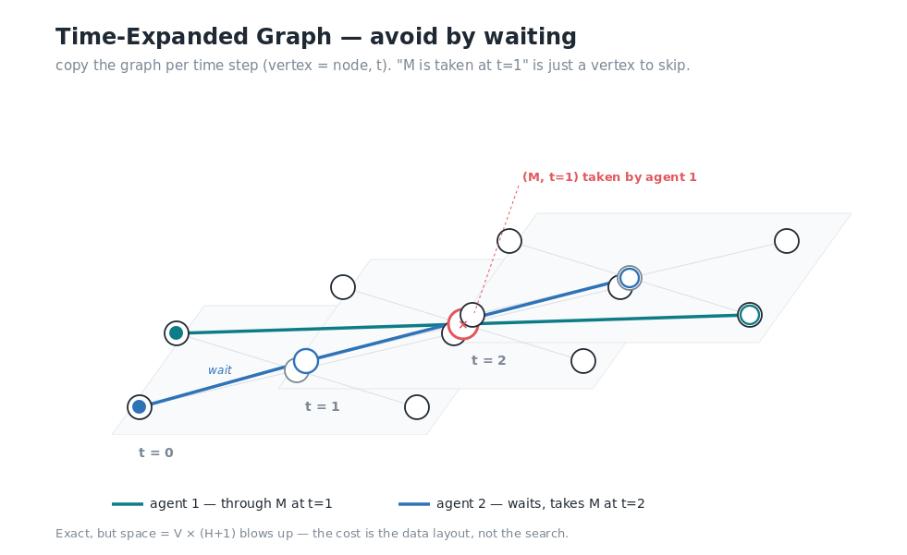
4 · THE BIG PICTURE · THE PATHFINDER
Pathfinding: BFS over a Time-Expanded Graph
Replicate the graph per step (TEG) · avoid occupancy via isFree · space = V × (H+1)

Slide 14
4 · THE BIG PICTURE · WHAT IT NEEDS
What this picture needs — and why
component | why it's needed
BFS | expand the frontier level by level
TEG & layout | represent the graph (copied per time step)
reservation | store every path's occupancy, queried constantly
priority pull | PP takes the next agent by priority
Why each is needed — here. The next section: what data structure realizes each, and why that one.

Slide 15
5 · DATA STRUCTURES
Each component → a data structure
need | data structure
BFS frontier | queue (FIFO)
TEG & layout | graph (adjacency list, on dynamic_array)
reservation | dynamic_array (per node) + AVL tree (intervals)
priority pull | min-heap
Emphasis three — graph · AVL · min-heap. (queue · linked_list · dynamic_array: one breath in the next map.)

Slide 16
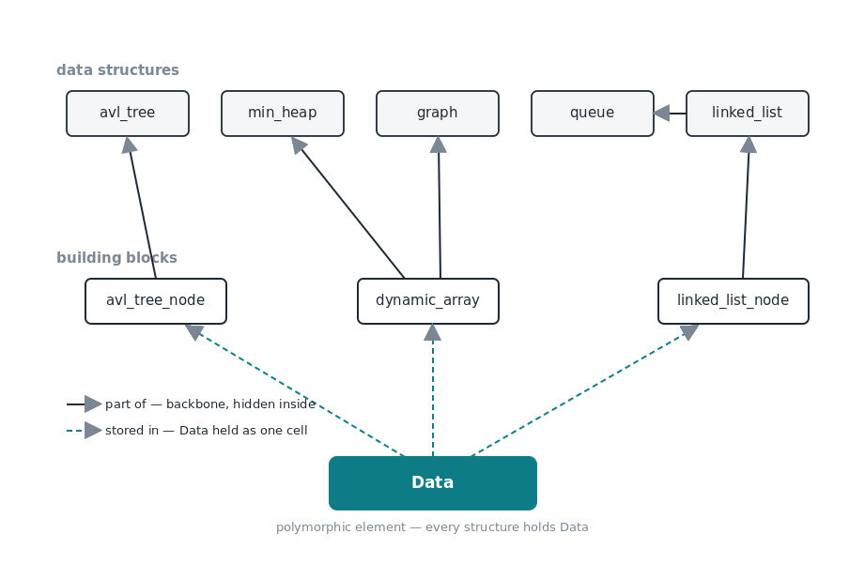
5 · DATA STRUCTURES
Built from class data structures
Two tiers: building blocks → structures. Every compare delegates to Data::operator<.

Slide 17
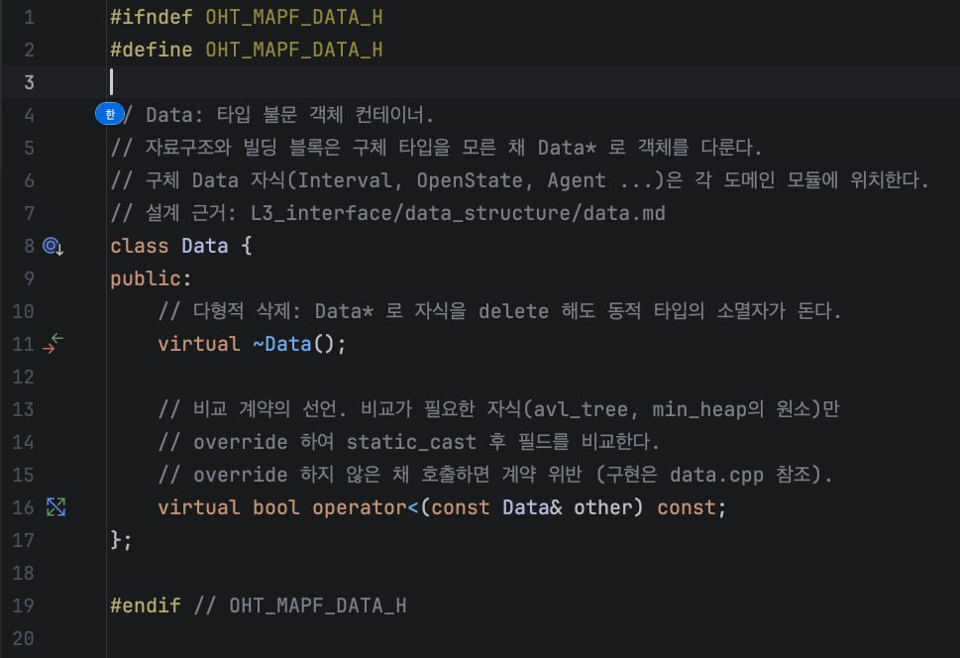
5 · DATA STRUCTURES · THE DATA CONTRACT
Every structure holds Data*
virtual ~Data → polymorphic delete (owner deletes, child cleans up). virtual operator< → comparison delegated.

Slide 18
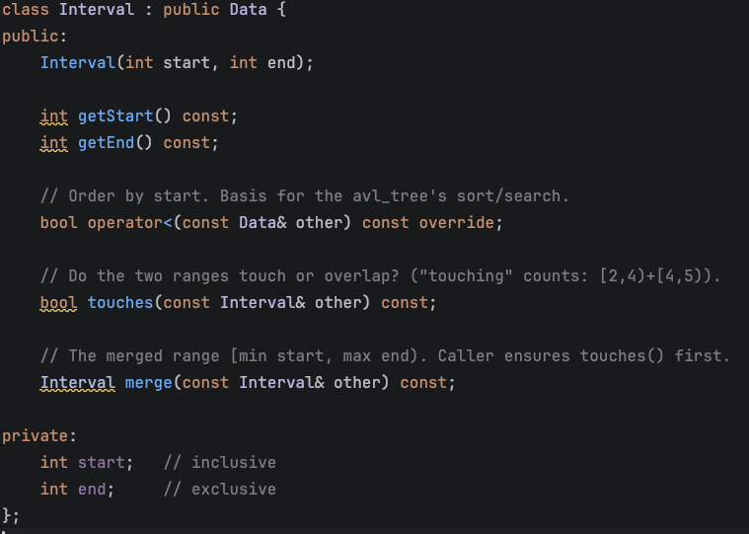
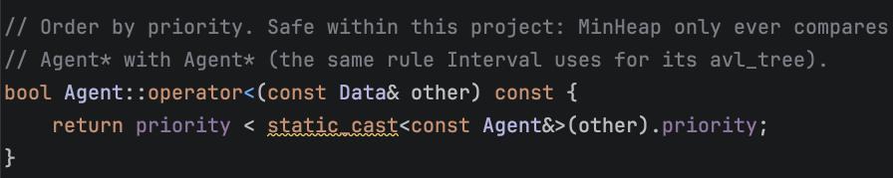
5 · DATA STRUCTURES · OPERATOR< OVERLOADING
The children override operator<
Interval (by start) makes a generic AVL an interval tree · Agent (by priority) makes a generic heap a priority queue.
Agent : public Data — operator< by priority

Slide 19
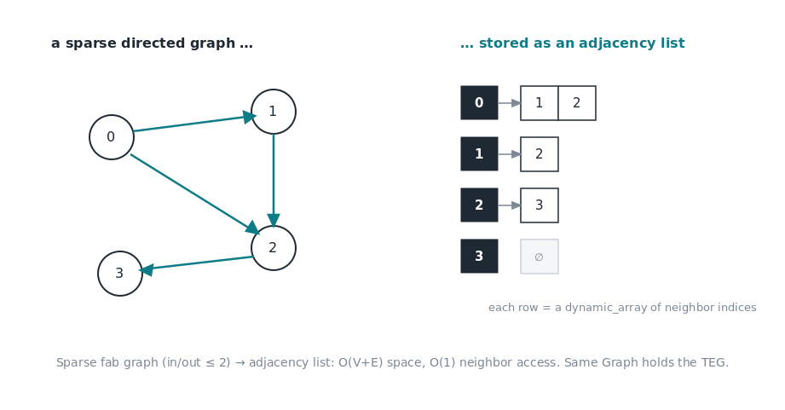
5 · DATA STRUCTURES · GRAPH ★
Graph — adjacency list
layout & TEG as adjacency lists — sparse, O(V+E), fast neighbor scan.

Slide 20
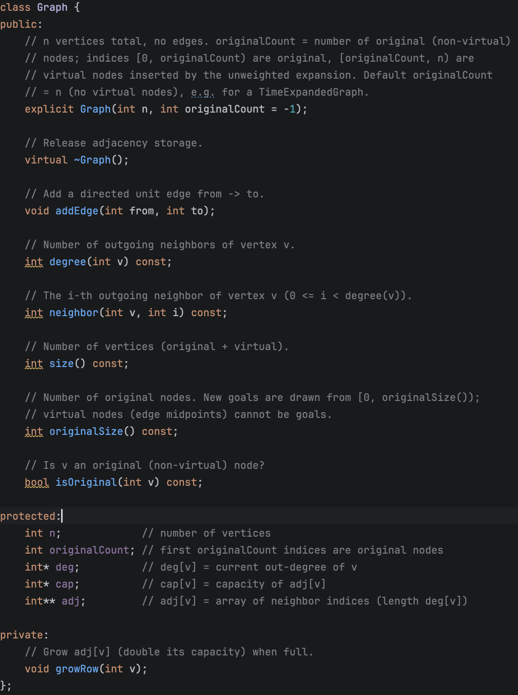
5 · DATA STRUCTURES · GRAPH ★ CODE
Graph — adjacency on dynamic_array
What the interface gives
addEdge(from, to)
appends a neighbor to a per-node dynamic_array
neighbor(u, i)
i-th out-neighbor of u — O(1) indexed access
one Graph type, two uses
the layout, and the TEG over (node, t)

Slide 21
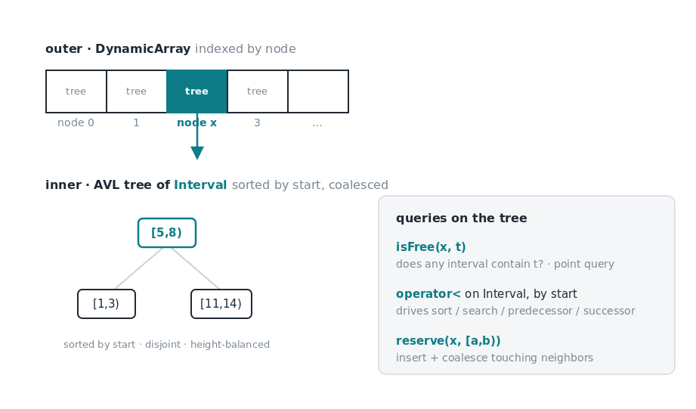
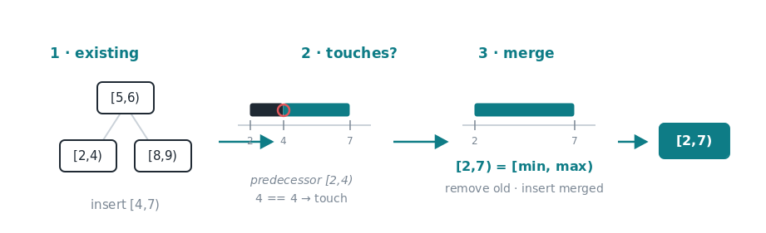
5 · DATA STRUCTURES · AVL ★
Reservation table = AVL tree of intervals
Per-node occupancy as sorted, merged intervals. Recorded by PP, read by BFS via isFree.

Slide 22
5 · DATA STRUCTURES · AVL ★ WHY
Why a balanced tree — not array / hash
candidate | insert | ordered / range query | verdict
sorted array | O(n) shift | O(log n) | insert too slow
hash table | O(1) | none — no order | can't do "next ≥ t"
unbalanced BST | O(log n) avg | O(log n) avg | O(n) worst case
AVL tree | O(log n) | O(log n) + pred/succ | balanced — chosen
Workload: insert occupancy + find first interval ≥ t, constantly. AVL gives both fast insert AND sorted neighbor queries.

Slide 23
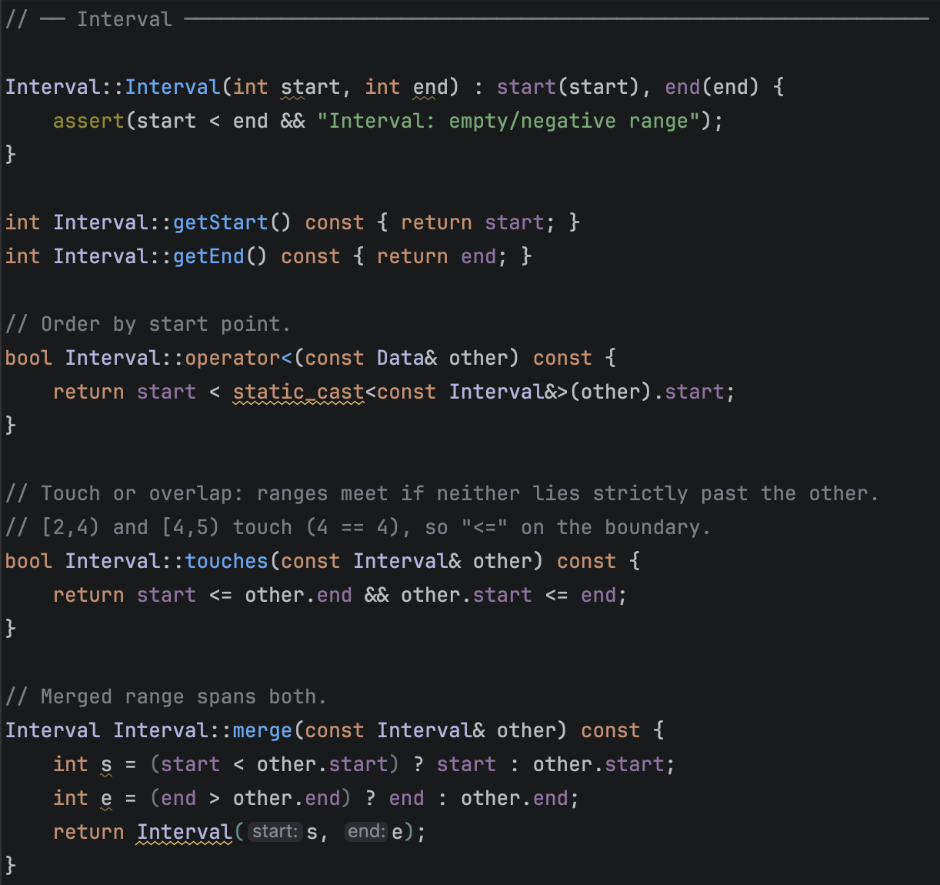
5 · DATA STRUCTURES · AVL ★ MERGING (1/2)
Merging — the geometry lives in Interval
operator< (by start) · touches (ranges meet?) · merge (their union). Interval owns the geometry; the AVL never knows it.

Slide 24
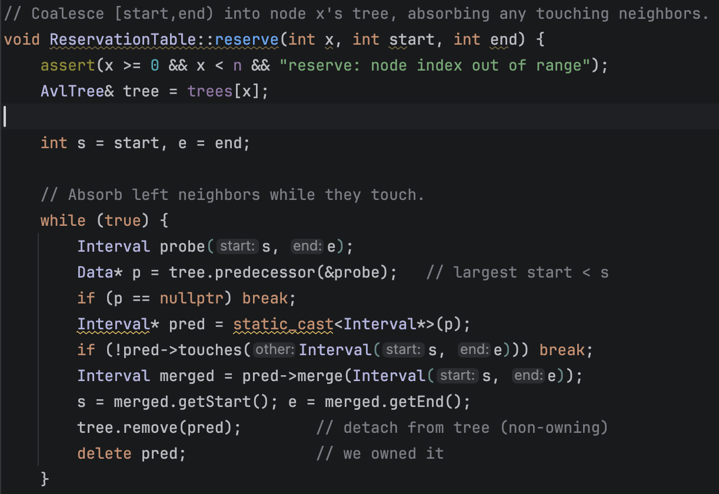
5 · DATA STRUCTURES · AVL ★ MERGING (2/2)
Merging — reserve() absorbs neighbors
How reserve() folds
predecessor / successor
find the touching neighbor in the AVL
touches? → merge
absorb it, then remove the old node (we own it)
repeat both sides → insert
one disjoint interval where several touched

Slide 25
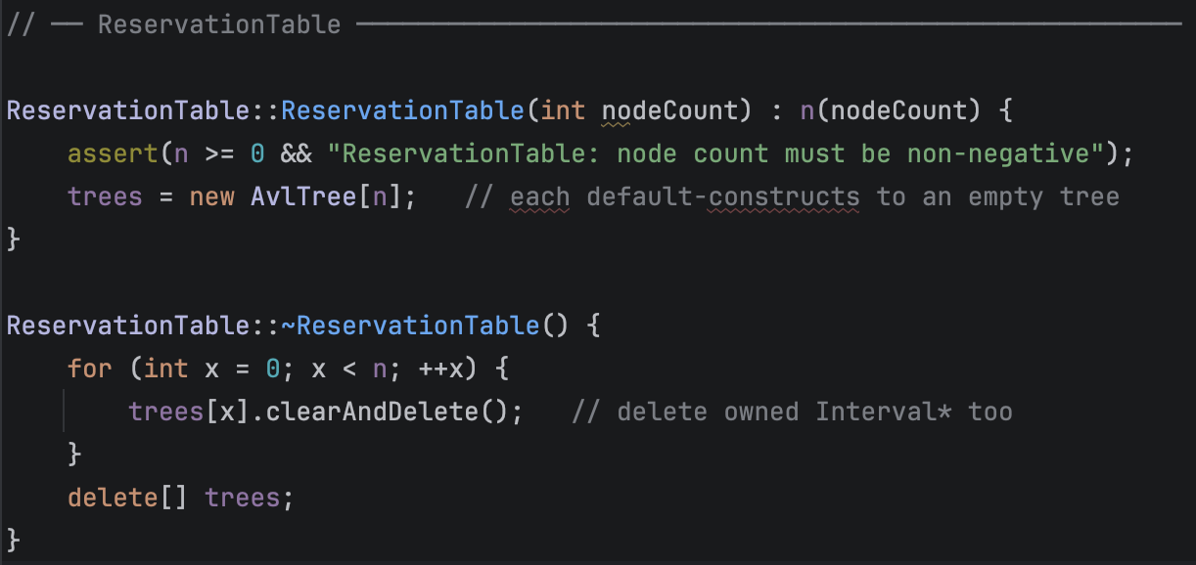
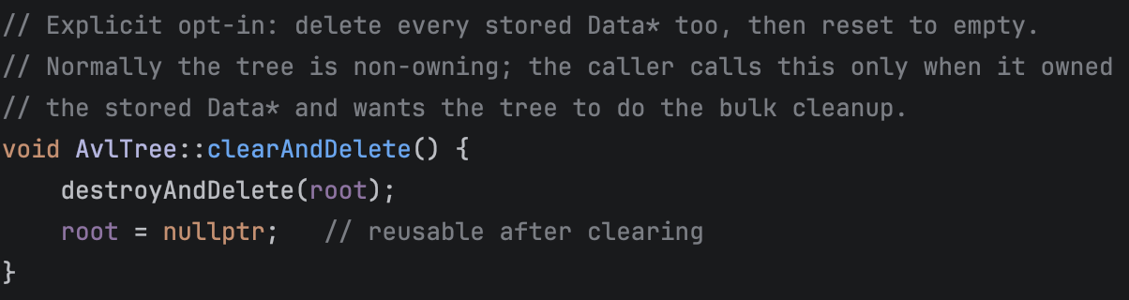
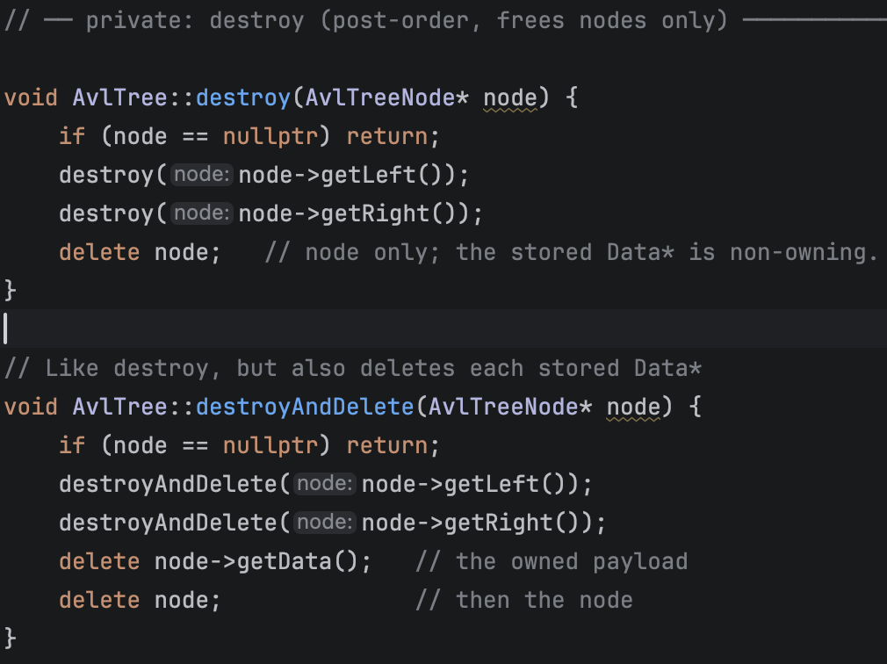
5 · DATA STRUCTURES · AVL ★ MEMORY
No leaks: dynamic_array → AVL → Node → Data*
Ownership is explicit; destruction walks the whole chain. (ASan/UBSan: leak-free.)
② clearAndDelete → destroyAndDelete(root)
① table dtor → per-node clearAndDelete → delete[] trees
③ post-order: delete each Data* (owned payload), then the node

Slide 26
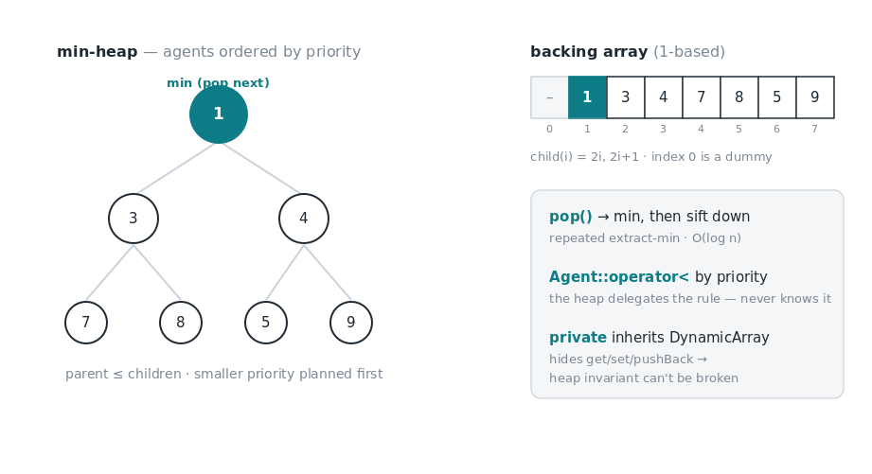
5 · DATA STRUCTURES · MIN-HEAP ★
Agent priority heap = min-heap
PP pulls the next agent by priority — repeated extract-min, O(log n). Why heap: array insert/extract is O(n).

Slide 27
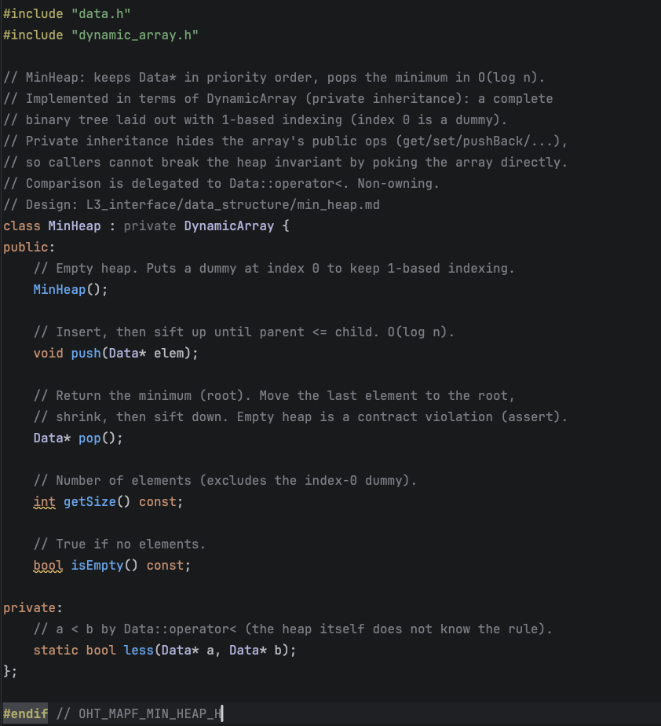
5 · DATA STRUCTURES · MIN-HEAP ★ CODE
Encapsulation by private inheritance
MinHeap privately inherits DynamicArray — hides get/set/pushBack, so the heap invariant can't be broken.

Slide 28
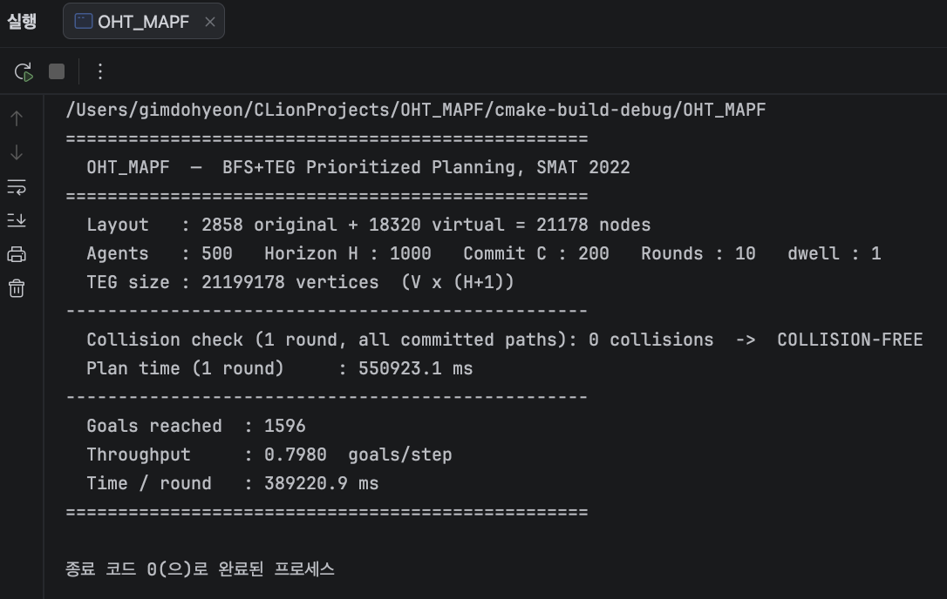
6 · RESULTS
Collision-free at fab scale
21,178 nodes · 500 agents · H=1000 · 1,596 goals · throughput 0.798 · collision-free, leak-free

Slide 29
CONCLUSION
Choosing the data structures is what
decides whether it works — and how far it scales.
Correctness rests on the reservation table's merge invariant; scale is bounded by data layout, not the search.

