Slide 1
foreach and drake, packages in R
Do Hyun Kim Biostatistics Branch
May 20, 2018

Slide 2
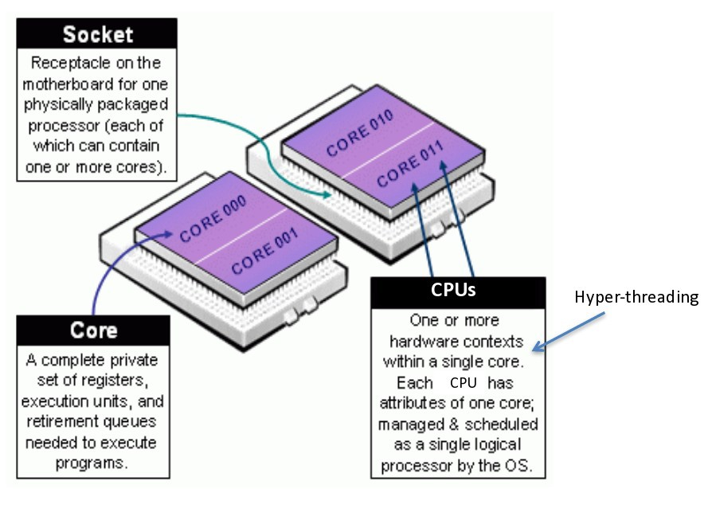
Basics
Example: 8-CPU Specification (My mac has quad-core, which means I can do spin 8-thread parallelism)
Source: NIH Biowulf HPC ,"Introduction to Biowulf.”
“Logical cores are the number of Physical cores times the number of threads that can run on each cores. This is known as HyperThreading”
Source: https://superuser.com/questions/1105654/logical-vs-physical-cpu-performance

Slide 3
Connect to Binder
https://mybinder.org/v2/gh/dophos/may_2019_forum.git/master

Slide 4
What can drake can do for you?
Similar to philosophy behind Make and Makefile in C++
Easy to track and map R object dependencies
Reduce unnecessary R script runs by caching the results of previous runs
Other researchers can easily and confidently reproduce your results

Slide 5
Resources
foreach: https://cran.r-project.org/web/packages/foreach/vignettes/foreach.pdf
drake: https://ropenscilabs.github.io/drake-manual/

