Slide 1
foreach and drake, packages in R
Do Hyun Kim Biostatistics Branch
May 20, 2018

Slide 2
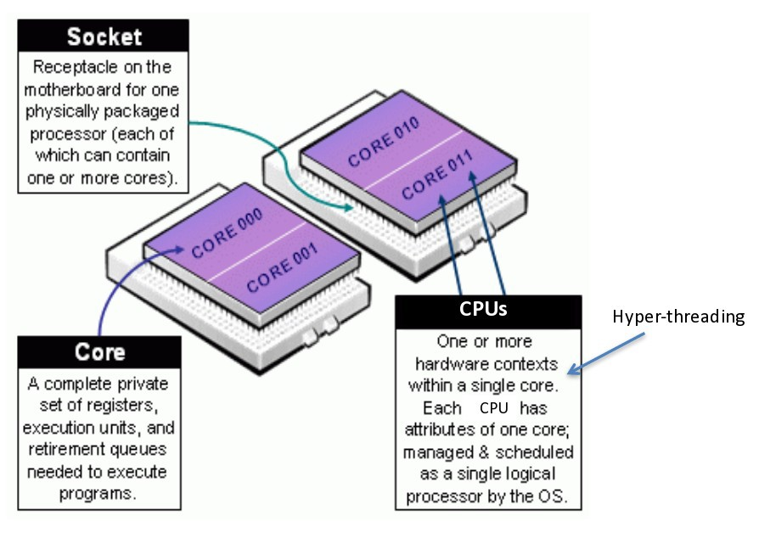
Basics before diving in …
Example: 8-CPU Specification (My mac has quad-core, which means I can do spin 8-thread parallelism)
Source: NIH Biowulf HPC ,"Introduction to Biowulf”

Slide 3
Connect to Binder

