Slide 1

Phage therapy: From biological mechanisms to future directions
Steffanie A. Strathdee, Graham F. Hatfull, Vivek K. Mutalik, Robert T. Schooley
Cell
Volume 186 Issue 1 Pages 17-31 (January 2023)
DOI: 10.1016/j.cell.2022.11.017
Copyright © 2022 The Authors Terms and Conditions

Slide 2
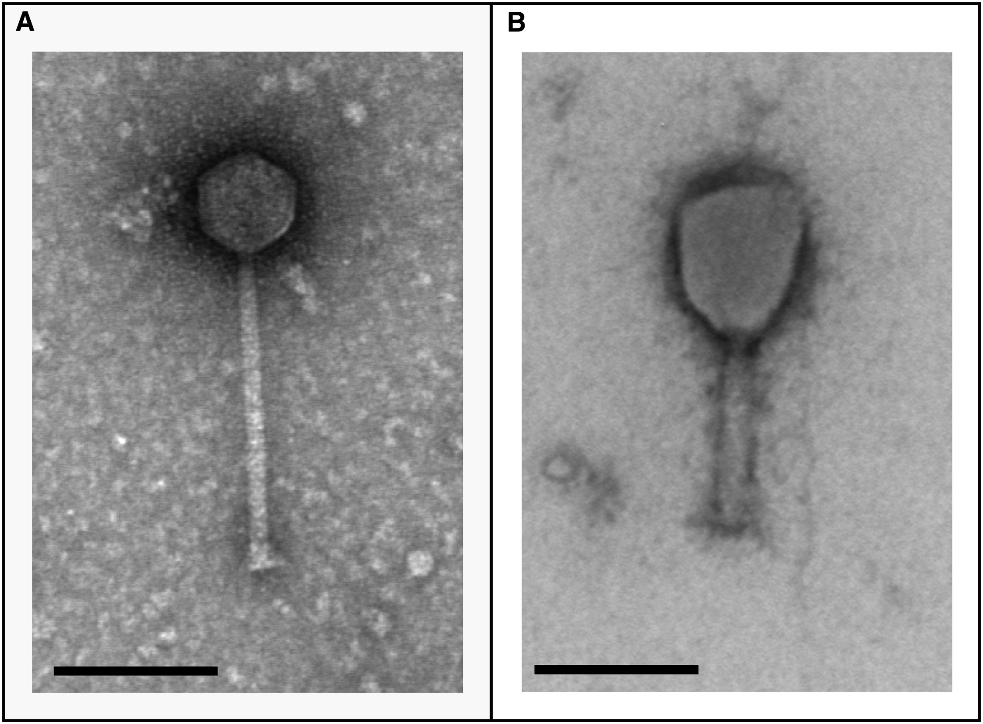
Figure 1
Cell 2023 18617-31DOI: (10.1016/j.cell.2022.11.017)
Copyright © 2022 The Authors Terms and Conditions
Notes:
Examples of therapeutically useful phages
(A and B) Bacteriophages Muddy (A) and Maestro (B) have been used to treat M. abscessus and A. baumannii infections, respectively. Muddy has a siphoviral morphotype with an icsohedral capsid containing the dsDNA genome and a flexible non-contractile tail; Maestro has a myoviral morphology with a contractile tail. Structures at the tail tips of these phages recognize specific receptors on the bacterial cell surface. Scale bars, 100 nm. Images courtesy of Graham Hatfull and Adriana Carolina Hernandez.

Slide 3
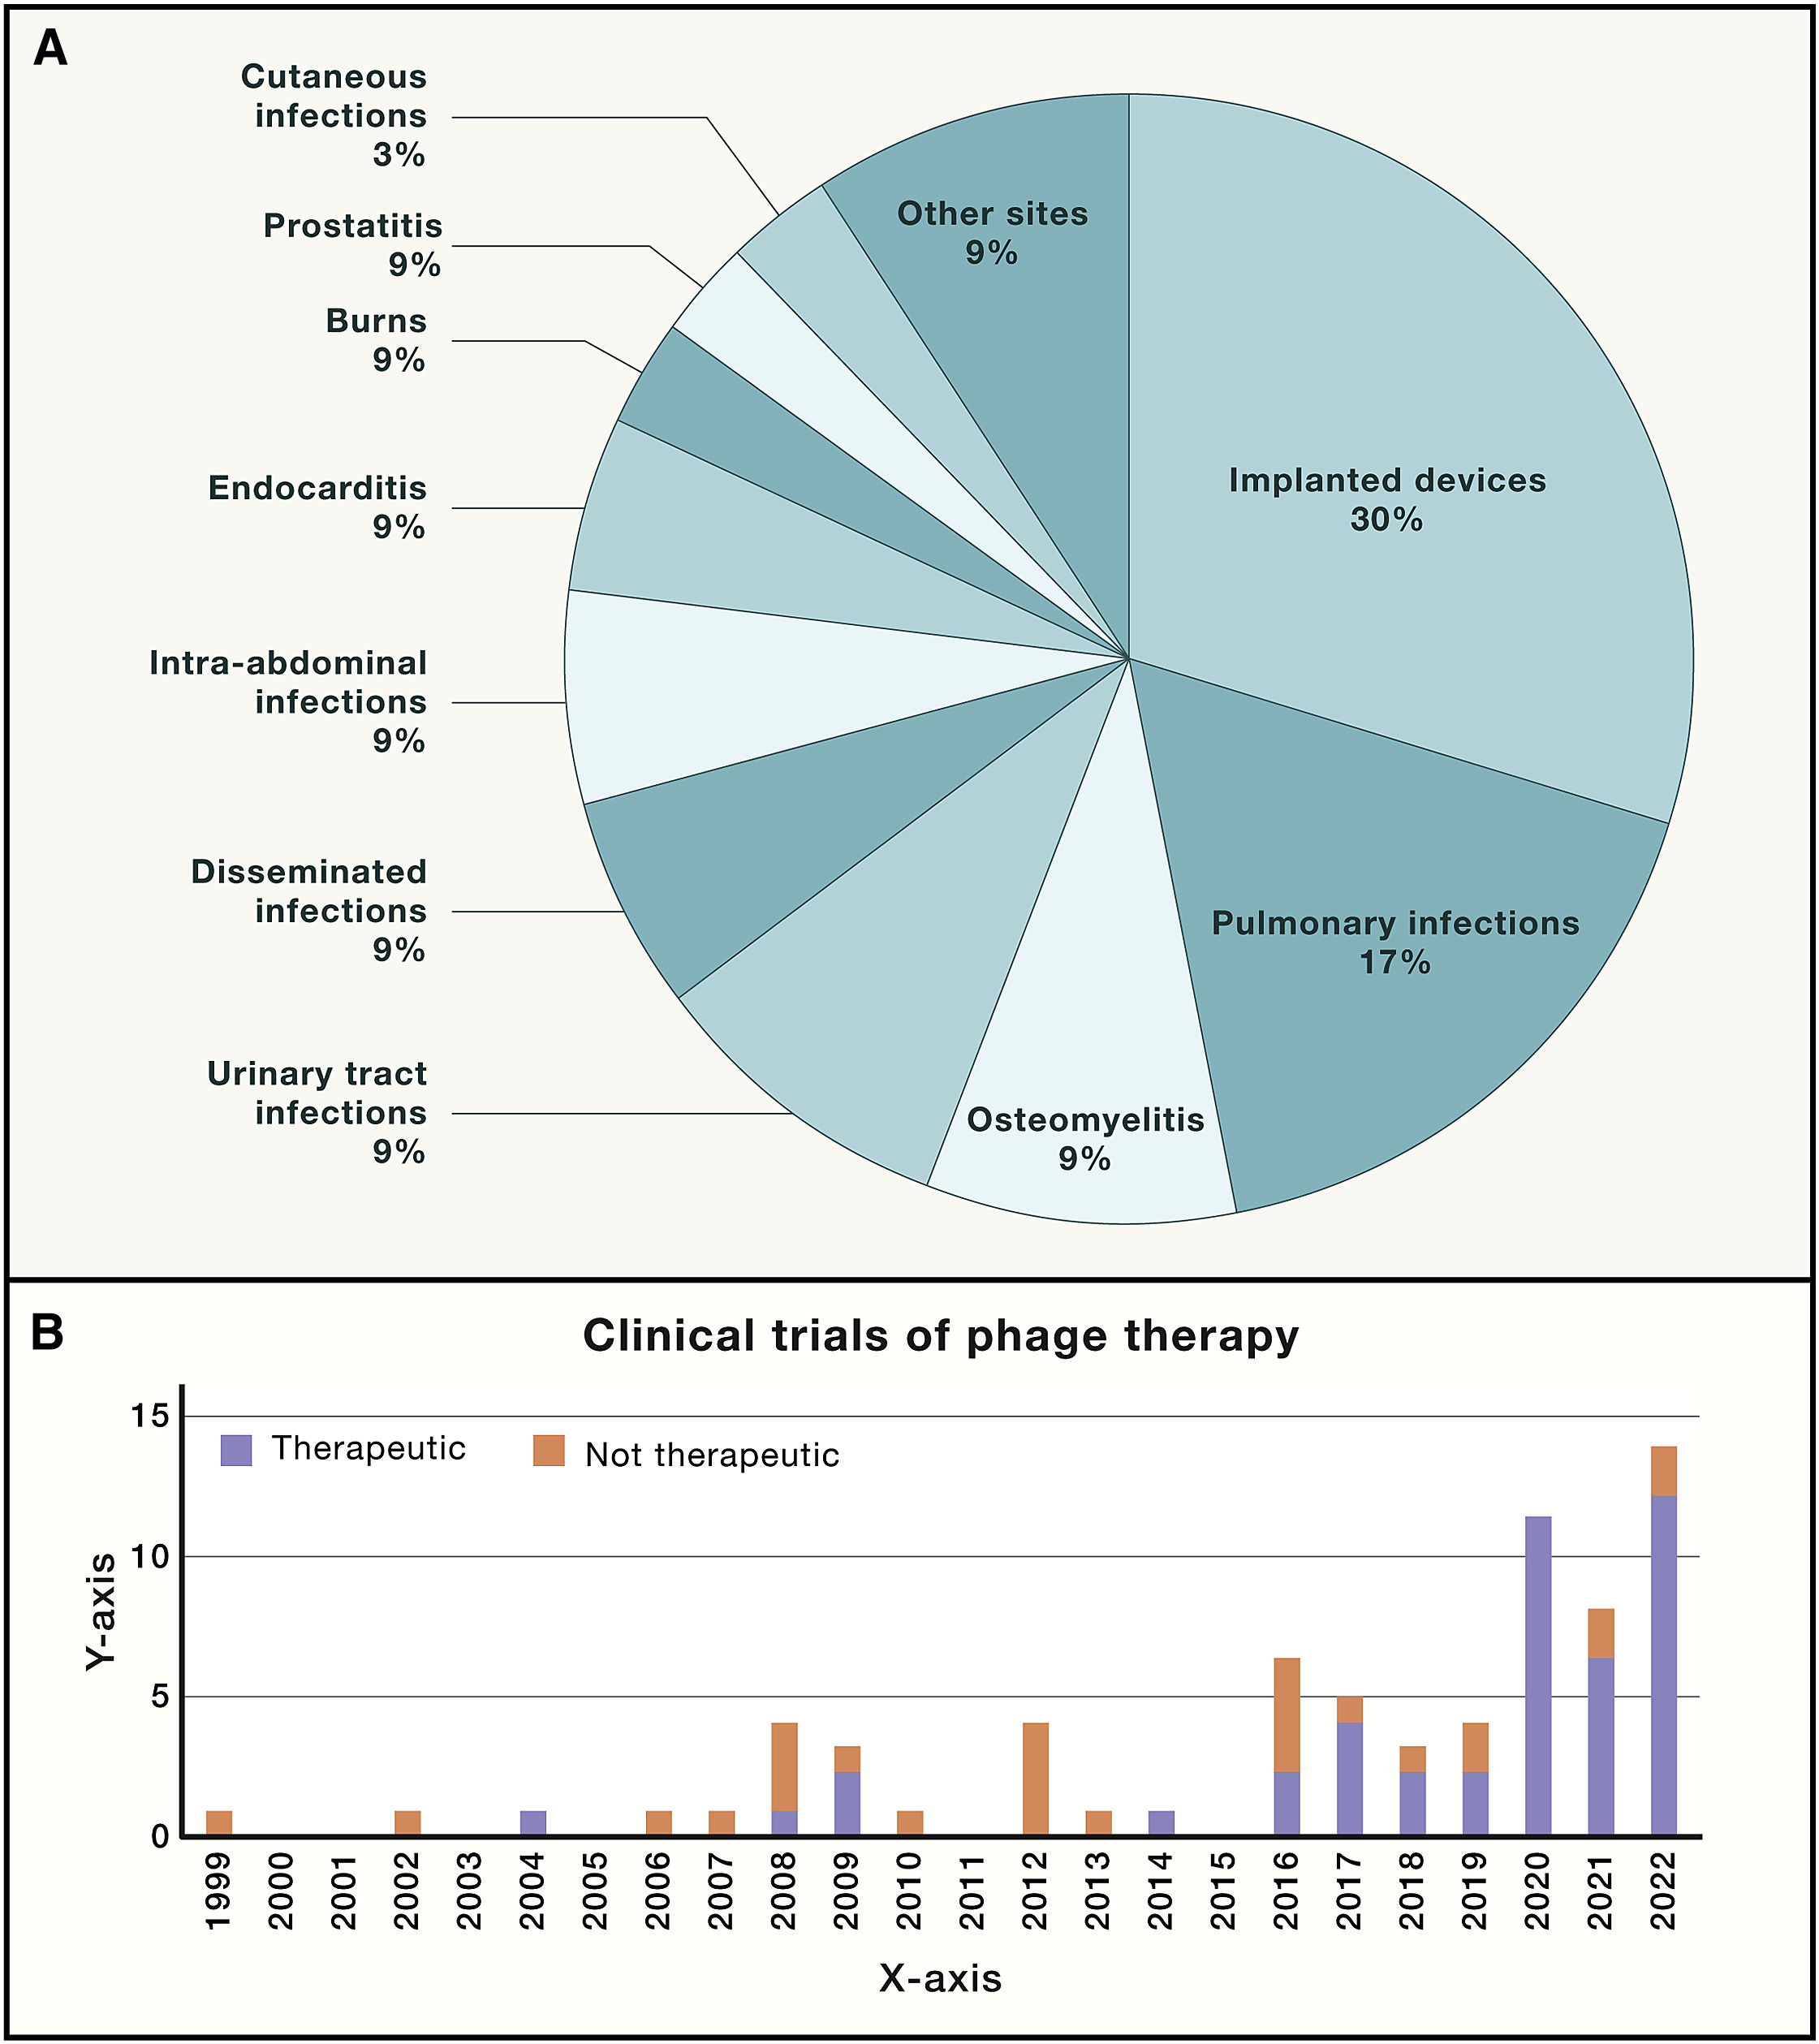
Figure 2
Cell 2023 18617-31DOI: (10.1016/j.cell.2022.11.017)
Copyright © 2022 The Authors Terms and Conditions
Notes:
Phage therapy reports and phage studies by year listed
(A) Case reports of phage therapy since 2000. A PubMed search was performed on September 22, 2022, using the search terms “(bacteriophage) AND (therapy) AND (case report).” Sites of infection in each of the 70 cases reported in 53 manuscripts are depicted.
(B) Clinical trials of phage therapy reported to ClinicalTrials.gov since 1999. The registry was queried using the key word “phage” on September 9, 2022.

Slide 4
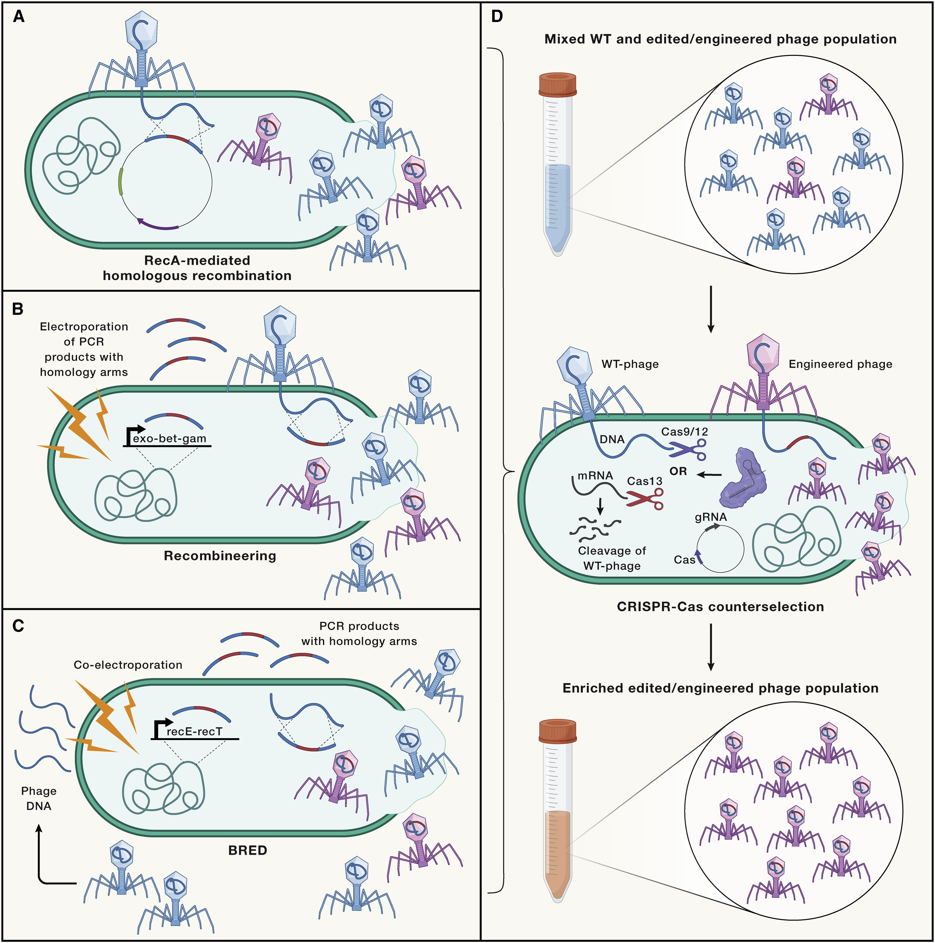
Figure 3
Cell 2023 18617-31DOI: (10.1016/j.cell.2022.11.017)
Copyright © 2022 The Authors Terms and Conditions
Notes:
Methods used in phage engineering
Commonly used in vivo homologous recombination methods in combination with CRISPR-Cas system-based counterselection strategy.
(A) Rec-A-mediated homologous recombination method involves phage DNA recombination with the homology region (shown in blue-red loci) present on plasmid DNA to yield recombinant phages.
(B) In vivo recombineering method involves recombination between phage genome and electroporated PCR products with homology arms (shown in blue-red fragments).
(C and D) (C) BRED method involves recombination between co-electroporated phage DNA (blue fragments) and PCR products with homology arms (shown in blue-red fragments). Because of different recombination efficiencies, each of these methods produces phage progenies made up of recombinant and wild-type phages (D). RNA-guided DNA nucleases such as Cas9 and Cas12 or RNA-guided RNA nuclease such as Cas13 counterselection is then applied to selectively remove unedited phages to enrich edited/engineered phages.

Slide 5
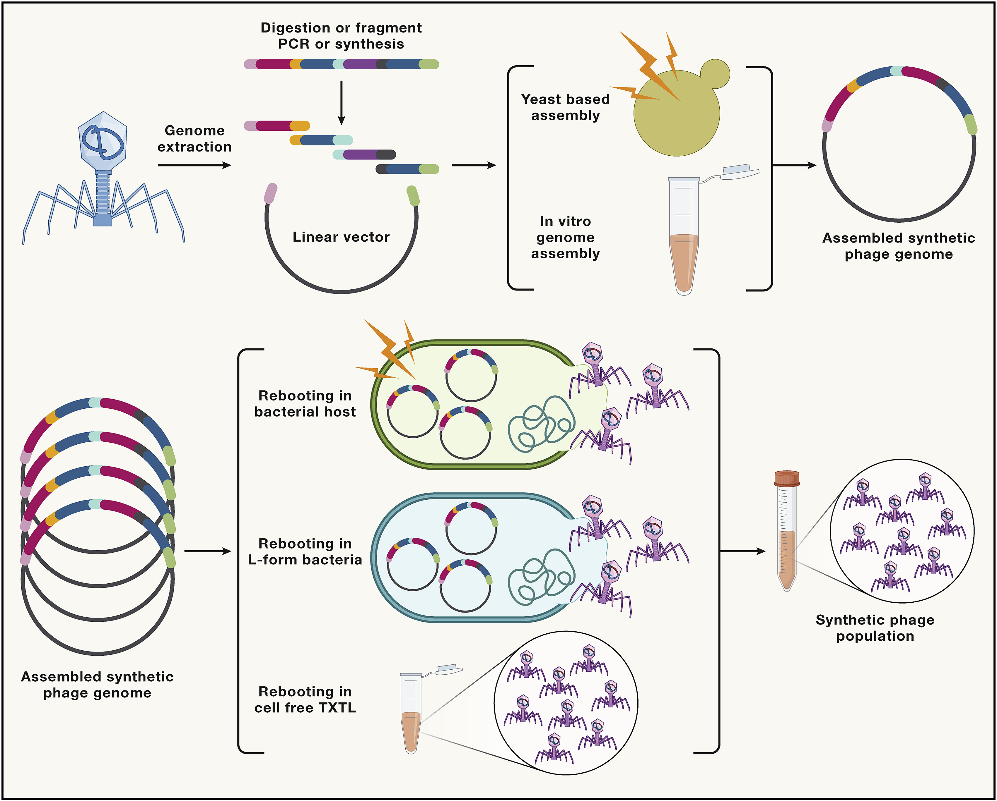
Figure 4
Cell 2023 18617-31DOI: (10.1016/j.cell.2022.11.017)
Copyright © 2022 The Authors Terms and Conditions
Notes:
Building synthetic phage genomes
Using combination of phage genome fragments amplified via PCR and/or built using synthetic oligonucleotides; synthetic phage genomes are assembled into a vector using yeast-based assembly or in vitro assembly methods. Thus assembled genomes are then “rebooted” using suitable permissive bacterial host, cell-wall-deprived (L-form) bacterial hosts, or by using cell-free transcription-translation (TXTL) systems.

Slide 6
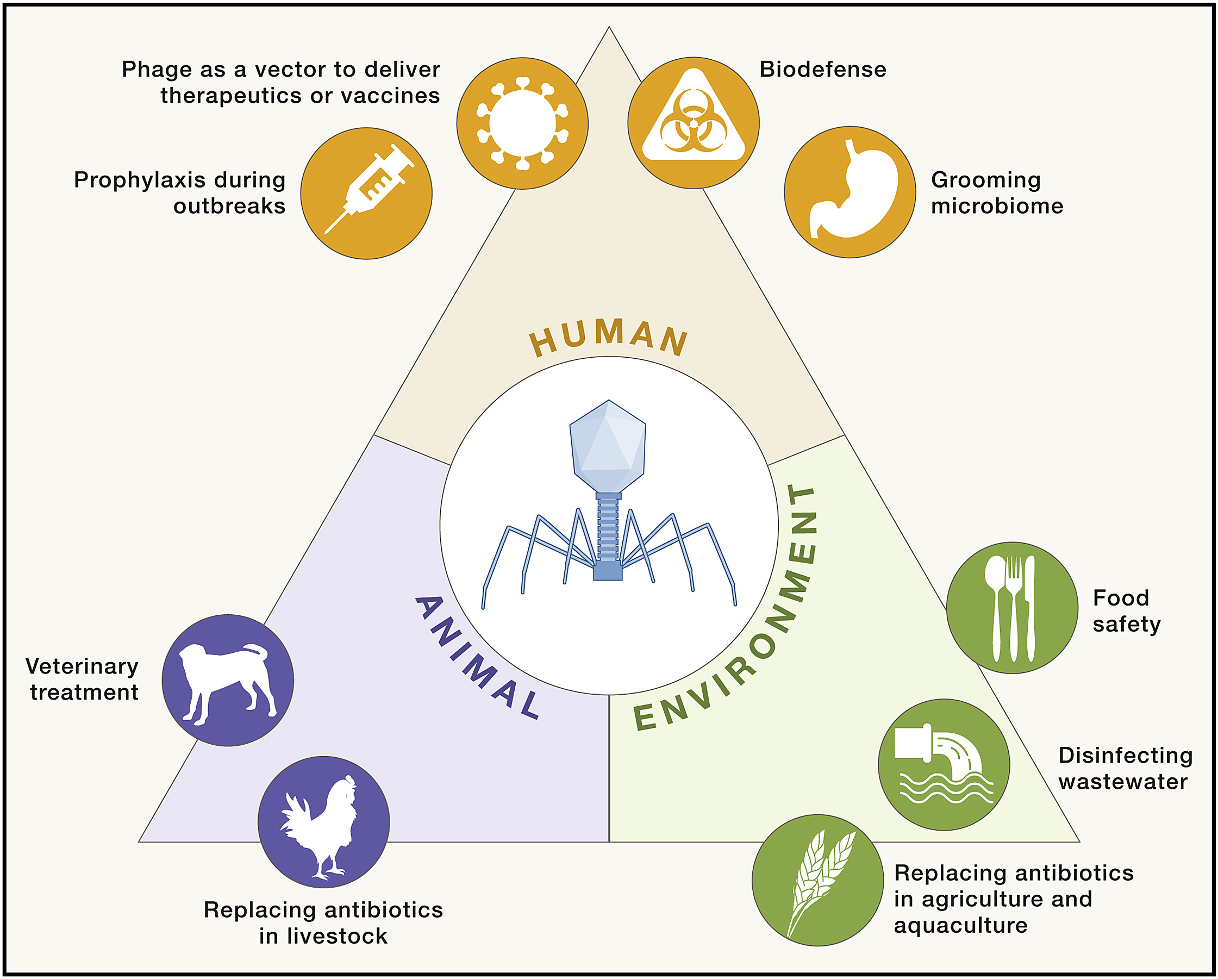
Figure 5
Cell 2023 18617-31DOI: (10.1016/j.cell.2022.11.017)
Copyright © 2022 The Authors Terms and Conditions
Notes:
Potential phage therapy applications from the One Health perspective
Depicted are phage applications that could be implemented to address AMR arising from interactions between humans, animals, and the environment.

