Slide 1


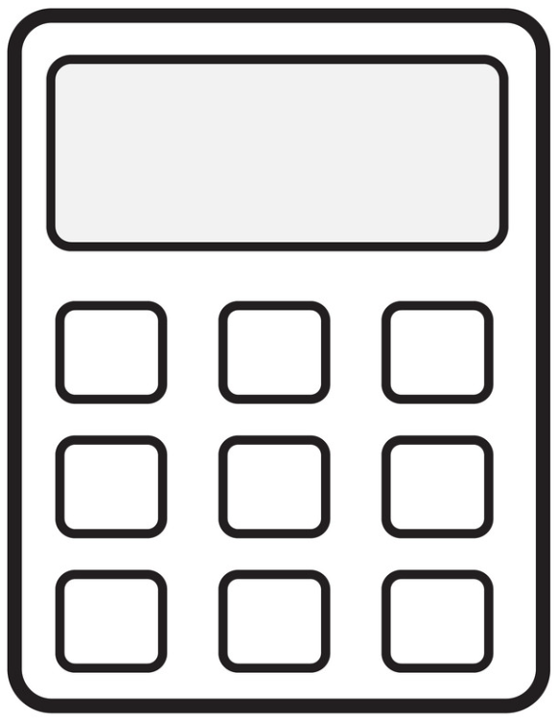
String Calculator Kata Lab (JavaScript)
Kevin Cunningham
TDD

Slide 2
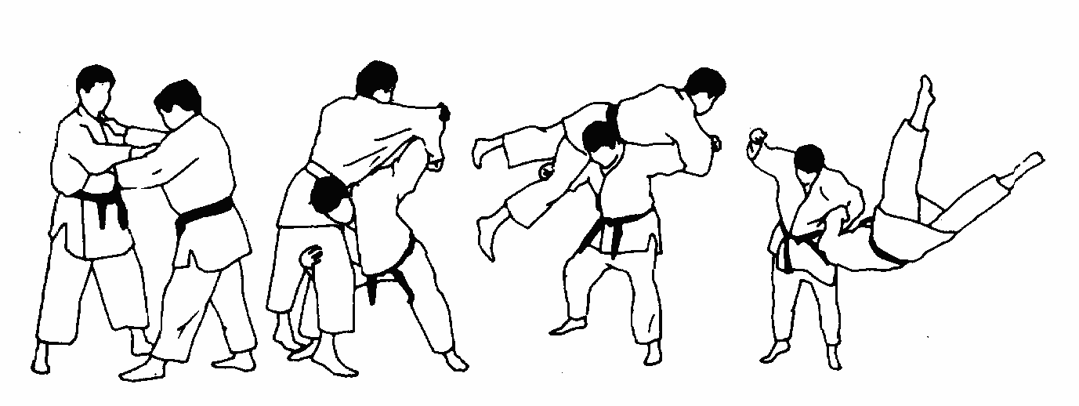
Plan for Session
Introduce the String Calculator problem
Additional Problem Features
Things to Note
Present Steps 1 to 12
Discussion

Slide 3
String Calculator Kata
Aim is to create a simple addition calculator
The add function takes a string
Each string contains zero or more integer values
Floating point numbers should be converted to integers
Separators are used between values
Separators can be , or ; or : or \n
For example, “1,2” or “3\n4” or “3;4”
These can be added together
An empty string will return zero
A string with a single integer will return that value

Slide 4
Additional Problem Features
Numbers bigger than 1,000 should be ignored,
for example: 2 + 1001 == 2
A Delimiter must be followed by a number
1\n2 and 1,2 as is 1;2 are all valid
1\n or 2; are not valid
Delimiters can be mixed e.g., 1,2;3
Only allow positive numbers,
negative numbers generate an error
Extension points
add a list of valid delimiters before the values in brackets
[,;]1,2;3

Slide 5

Things to Note
Start with the simplest test case
e.g., of an empty string, move to 1 then two then many etc
Solve things as simply as possible
so that you build up the solution a test at a time
Consider refactoring after each passing test
Build things up incrementally
Do this using your technology
E.g. Java and JUnit, Scala and ScalaTest, Python and PyTest,
JavaScript and Jasmine, Jest, Mocha/Sinon etc.
Go and testify

Slide 6
How to Proceed
Work on one test at a time
slides suggest a set of tests (it’s a Kata)
but can go it alone if you wish
Use your favourite IDE
WebStorm or Visual Studio Code etc.
IntelliJ or PyCharm etc.
Will work in pairs / triples
In separate breakout rooms
Aim to present back experiences / comments at end

Slide 7
Getting Started
Set up your environment
e.g. for JavaScript & Jasmine
For example,
Node.js
npm init
(tests to be run by “jasmine”)
Plus Jasmine
npm install --save-dev jasmine
Plus project directory structure
npx jasmine init
Check can run tests
npm test

Slide 8
Sample Kata Session Follows
Only Progress from here if you want to!

Slide 9

Sample Session for Reference
Step one : Create a simple add function/method
It should always return the same result e.g. 0
Write a test for this using an empty string
check the result – it should pass
class StringCalculator {
add(number) {
return 0;
}
}
describe('A string calculator', () => {
it('should return 0 for an empty string', () => {
calculator = new StringCalculator();
result = calculator.add("");
expect(result).toEqual(0); //check that the result = 0
})
}

Slide 10
Sample Session for Reference
Step Two
Write second test that takes a string with a single integer value
This test will now fail
Update add function
to convert string into an integer
And return as result of function
Test now passes, rerun all tests
Refactor code if necessary
it('should return 1 for an string with "1" in it', () => {
calculator = new StringCalculator();
result = calculator.add("1");
expect(result).toEqual(1);
})

Slide 11
Sample Session for Reference
Step Two
class StringCalculator {
add(number) {
if (number == '') {
return 0;
}
return parseInt(number);
}
}

Slide 12
Refactor
Is there anything you can refactor to improve the implementation of the class or the tests?
let calculator;
beforeEach(() => {
calculator = new StringCalculator();
});
describe('A string calculator', () => {
it('should return 0 for an empty string', () => {
const result = calculator.add(’’);
expect(result).toEqual(0);
});
it('should return 1 for a string containing "1"', () => {
const result = calculator.add('1’);
expect(result).toEqual(1);
});

Slide 13
Sample Session for Reference
Step Three
Write a third test to take a string containing two integers separated by a comma
Exercise the test – it should fail as it will try to convert “1,2” into an integer and return the result
it('should add together two comma separated values (1,2)', () => {
result = calculator.add("1,2");
expect(result).toEqual(3);
})

Slide 14
Sample Session for Reference
Step Three
Update the add function
Parse string for each individual value using separator
Add all the numbers together and return as result
Test now passes, now rerun all tests
Consider if code needs to be refactored
class StringCalculator {
add(numberString) {
if (numberString == '') {
return 0;
}
let numbers = numberString
.split(",")
.map(n => parseInt(n));
let finalSum = numbers.reduce((sum, n) =>{
return sum + n;
}, 0);
return finalSum;
}
}
Notes:
class StringCalculator {
add(numberString) {
if (numberString == '') {
return 0;
}
let numbers = numberString
.split(",")
.filter(n => n !== '')
.map(n => parseInt(n));
let finalSum = numbers.reduce((sum, n) =>{
return sum + n;
}, 0);
return finalSum;
}
}

Slide 15
Sample Session for Reference
Step Four
Write a fourth test to take three values separated by a comma
Exercise the test
Depending on how you implemented the add function this may pass
If not update add until it does pass
Test now passes, next rerun all tests
Now consider refactoring the code base
it('should add together three comma separated values (1,2,3)', () => {
result = calculator.add("1,2,3");
expect(result).toEqual(6);
})

Slide 16
Sample Session for Reference
Step Five
Write a fifth test to use a different separator
Exercise the test
The test will fail as add is using a comma as a separator
Update the test to support both commas and semi colons as separators
Test now passes, rerun all tests
Now considering refactoring code
it('should add together two semicolon separated values (1;2)', () => {
result = calculator.add("1;2");
expect(result).toEqual(3);
})

Slide 17
Sample Session for Reference
class StringCalculator {
add(numberString) {
if (numberString == '') {
return 0;
}
const delimiterRegExp = /[,;]/
let numbers = numberString
.split(delimiterRegExp)
.map(n => parseInt(n));
let finalSum = numbers.reduce((sum, n) =>{
return sum + n;
}, 0);
return finalSum;
}
}
Update the test to support both commas and semi colons as separators
Test now passes, rerun all tests
Now considering refactoring code

Slide 18
Sample Session for Reference
Step Six
Write a 6th test to use a newline separator
Exercise the test
The test will fail as add is not using the newline separator
it('should add together two newline separated values (1\n2)', () => {
result = calculator.add("1\n2");
expect(result).toEqual(3);
})

Slide 19
Sample Session for Reference
class StringCalculator {
add(numberString) {
if (numberString == '') {
return 0;
}
const delimiterRegExp = /[,;\n]/
let numbers = numberString
.split(delimiterRegExp)
.map(n => parseInt(n));
let finalSum = numbers.reduce((sum, n) =>{
return sum + n;
}, 0);
return finalSum;
}
}
Update the test to support commas, semi colons and newline as separators

Slide 20
Sample Session for Reference
Step Seven
Write a 7th test to use multiple separators
Exercise the test
Depending on how you implemented add this may or may not fail
If it does fail update to support mixed separators
it('should add together two mixed separated values (1\n2,3)', () => {
result = calculator.add("1\n2,3");
expect(result).toEqual(6);
})

Slide 21
Sample Session for Reference
Step Eight
Write an 8th test to use all separators
Exercise the test
Depending on how you implemented add this may or may not fail
If it does fail update to support mixed separators
Test passes, now rerun all tests
Consider refactoring codebase
it('should add together three mixed separated values (1\n2,3;4)', () => {
result = calculator.add("1\n2,3;4");
expect(result).toEqual(10);
})

Slide 22
Sample Session for Reference
Step Nine
Write a 9th test to check for incomplete expressions
The test will fail
it("should fail if the string is terminated by a separator (1,)", () => {
expect(function () {
calculator.add("1,");
}).toThrow(new Error("Invalid Terminator Expression"));
});

Slide 23
Sample Session for Reference
Update add to check for an incomplete expression with a comma
Once test Passes, re run all tests
Consider refactoring codebase
add(numberString) {
if (numberString == '') {
return 0;
}
if (numberString.endsWith(',')) {
throw new Error('Invalid Terminator Expression’);
}
const delimiterRegExp = /[,;\n]/
let numbers = numberString
.split(delimiterRegExp)
.map(n => parseInt(n));
let finalSum = numbers.reduce((sum, n) =>{
return sum + n;
}, 0);
return finalSum;
}

Slide 24
Sample Session for Reference
Step Ten
Write a test to check for a negative number
The test will fail
it("should fail if the string contains a negative number (1,-1)", () => {
expect(function () {
calculator.add("1,-1");
}).toThrow(new Error("Negative Number Error"));
});

Slide 25
Sample Session for Reference
Update add to handle a negative number
And generate an error
Test passes, now rerun all tests
add(numberString) {
if (numberString == '') {
return 0;
}
if (numberString.endsWith(',')) {
throw new Error('Invalid Terminator Expression’);
}
const delimiterRegExp = /[,;\n]/
let numbers = numberString
.split(delimiterRegExp)
.map(n => parseInt(n));
let negatives = numbers.filter(num => num < 0);
if(negatives.length > 0){
throw new Error('Negative Number Error’);
}
let finalSum =
numbers.reduce((sum, n) =>{ return sum + n; }, 0);
return finalSum;
}

Slide 26
Sample Session for Reference
Step Eleven
Write a test to ignore numbers over 1000
This test will fail
Update add to ignore numbers over 1000
Test passes, now rerun all tests
Consider refactoring codebase
it("should ignore numbers over one thousand (1001,2)", () => {
result = calculator.add("1001,2");
expect(result).toEqual(2);
});

Slide 27
Sample Session for Reference
Update add to ignore numbers over 1000
Test passes, now rerun all tests
Consider refactoring codebase
add(numberString) {
if (numberString == '') {
return 0;
}
if (numberString.endsWith(',')) {
throw new Error('Invalid Terminator Expression’);
}
const delimiterRegExp = /[,;\n]/
let numbers = numberString
.split(delimiterRegExp)
.map(n => parseInt(n))
.filter(num => num < 1001);
let negatives = numbers.filter(num => num < 0);
if(negatives.length > 0){
throw new Error('Negative Number Error’);
}
let finalSum =
numbers.reduce((sum, n) =>{ return sum + n; }, 0);
return finalSum;
}

Slide 28
Sample Session for Reference
Step Twelve
Write a test to check for more than 3 values
Exercise the Test
This may fail or not depending how you designed add
If the test fails update until it works
Rerun all tests
Refactor implementation for best code practices
it("should handle any number of values (1, 2, 3, 4, 5, 6)", () => {
result = calculator.add("1, 2, 3, 4, 5, 6");
expect(result).toEqual(21);
});

Slide 29
Don’t Go Past here!
Wait!

Slide 30

Question - What tests are Missing?
Easy to think that TDD will give you all the tests, but what about
Numbers with spaces
Two separators together
A string starting with a separator
Very long strings of numbers
Strings with other terminators
You still need to review and possibly design more tests
You may have missed a requirement
Missed variations on a requirement etc.

Slide 31
Question – how does this relate to a JIRA ticket?
The Kata’s tend to frame problem in a way that naturally maps to a set of tests
But what about a JIRA ticket?
Given-When-Then style can help
Break problem down into individual statements
Make each statement an individual scenario / requirement / function etc.
Progress from there

Slide 32

GitHub Repo
For an example in Java
With each branch representing each one of the steps
See
https://github.com/johnehunt/string-calculator-kata/branches/all
For JavaScript final solution version
https://github.com/johnehunt/string-calculator-kata-js

Slide 33
Questions?
?

