Slide 1

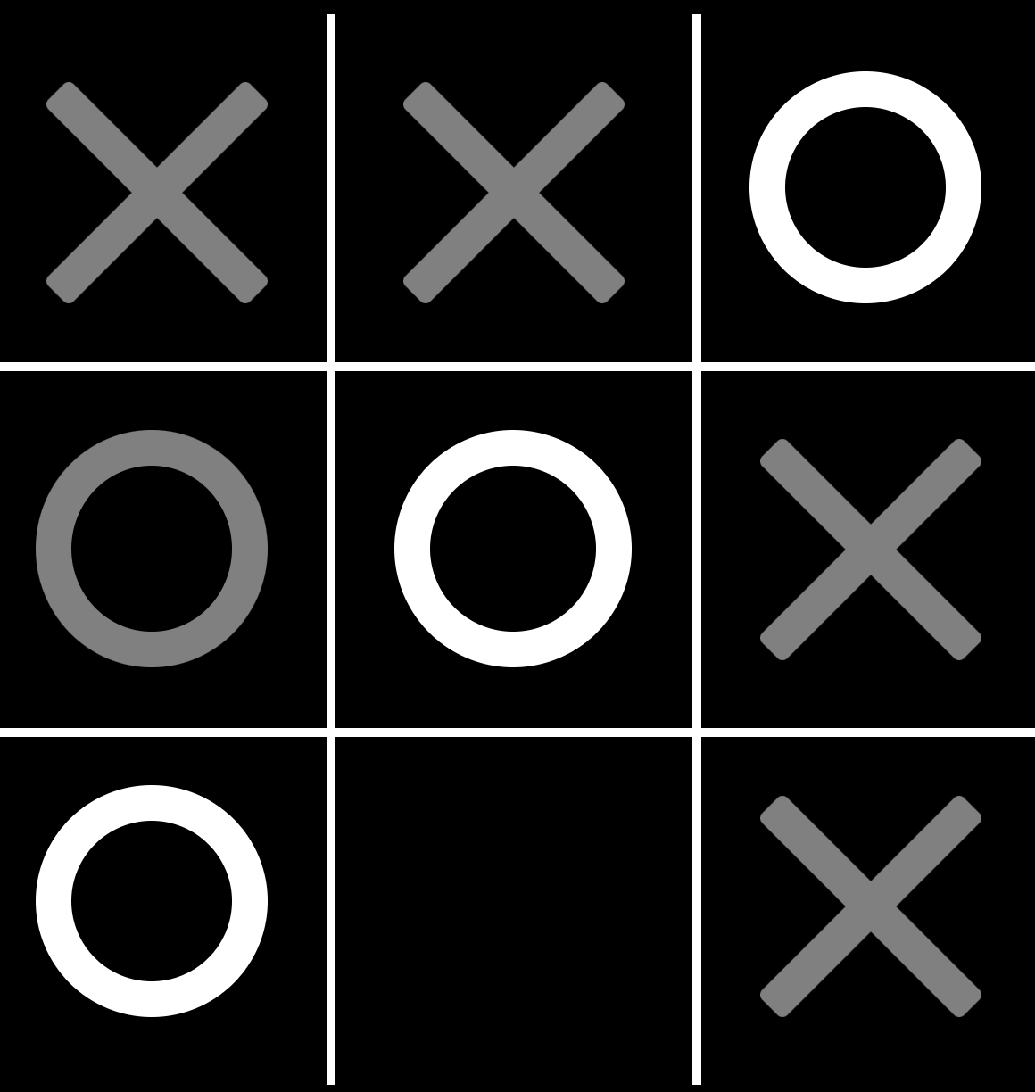
Tic-Tac-Toe TDD Lab (Optional)
Kevin Cunningham
TDD

Slide 2
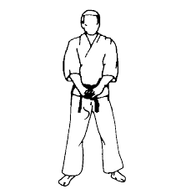
Plan for Session
Tic-Tac-Toe
Things to Note
https://playtictactoe.org/

Slide 3
Tic-Tac-Toe Kata
Another Kata used to help with learning TDD
Based around the Tic-Tac-Toe (or Noughts and Crosses) game
Game is played on a 3 by 3 grid
By two players X and O
Aim of the game is to get your counters in a line of three first

Slide 4

Tic-Tac-Toe Lab
Your aim is to
Write a series of functions / methods that will
Process the current state of the game board
Check for a win for either side
A player has a line of 3 tokens horizontally, vertically or diagonally in a straight line
Check for a draw
Occurs when all grid positions are filled
But neither player has a line of three counters
Allow a move to be made
In which a counter can be placed in an empty grid location
Ensure that the next move is made by the other player

Slide 5

Things to Note
Use your preferred development language / environment
Using your own technology platform
E.g. Java and JUnit, Scala and ScalaTest,
Python and PyTest,
JavaScript and Jasmine, Jest, Mocha/Sinon etc.
Go and testify
Work on your own solution
But use the room to discuss ideas / share thoughts / explore possibilities

Slide 6
Things to Note
Keep your workings
You may want to make notes as you go along
Will have a show and tell at the end of the session
Start with the simplest test case
Follow the patterns presented today
And build up a step at a time
Remember to refactor
Aim for a group discussion at the end of the day

Slide 7

Worked Example
See
https://github.com/johnehunt/TicTacToeKata/tree/main
Each branch is a different iteration
Main is the starting point
Steps 1 to 9 are the individual tests

Slide 8
Questions?
?

