Slide 1



Python Container Data Types
Framework Training

Slide 2
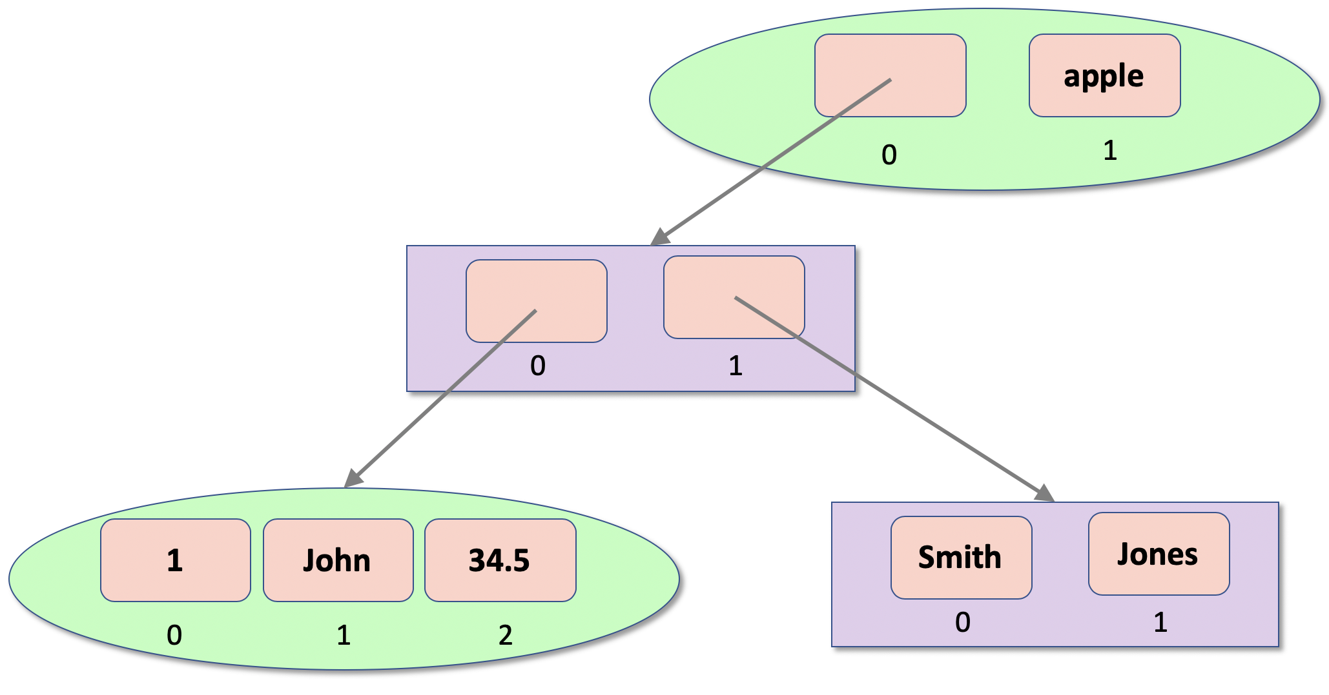
Plan for Session
Characteristics of Data Containers
Python Collection Types
Tuples
Lists
Collection constructor functions
Check for membership & iterations

Slide 3

Characteristics of Data Containers
Allow multiple values to be held together
Have a set of features
ordered or unordered
mutable or immutable
that is modifiable or not
allow duplicates or not
may associate a value with an index or key
may be growable or not
Choose appropriate container type based on your requirements
Often referred to as collections

Slide 4
Python Collection Types
Four core container types
Tuples represent a collection of values
ordered, fixed size
immutable (cannot be modified)
allow duplicate members
indexed
Lists are
ordered
mutable (changeable)
allow duplicate members
indexed
growable
Sets are
unordered, growable
mutable (changeable)
do not allow duplicate values
can only hold immutable objects
Dictionaries are
ordered 3.7 on (unordered prior to 3.7)
mutable (changeable)
indexed by a key which references a value
growable

Slide 5
Tuples
Immutable ordered collections
empty_tuple = ()
tup1 = (1, 3, 5, 7) print('tup1[0]:\t', tup1[0]) print('tup1[1]:\t', tup1[1])
print('tup1[1:3]:\t', tup1[1:3]) # return a slice print('tup1[:3]:\t', tup1[:3]) print('tup1[1:]:\t', tup1[1:])
print('len(tup1):\t', len(tup1))
tup2 = (1, 'John', True, -23.45) print(tup2) tup3 = ('apple', 'pear', 'orange', 'plum', 'apple') for fruit in tup3: print(fruit)
if 'orange' in tup3: print('orange is in the Tuple')
tup1[0]: 1
tup1[1]: 3
tup1[1:3]: (3, 5)
tup1[:3]: (1, 3, 5)
tup1[1:]: (3, 5, 7)
len(tup1): 4
(1, 'John', True, -23.45)
apple
pear
orange
plum
apple
orange is in the Tuple
tup[-1] – gets end of tuple

Slide 6
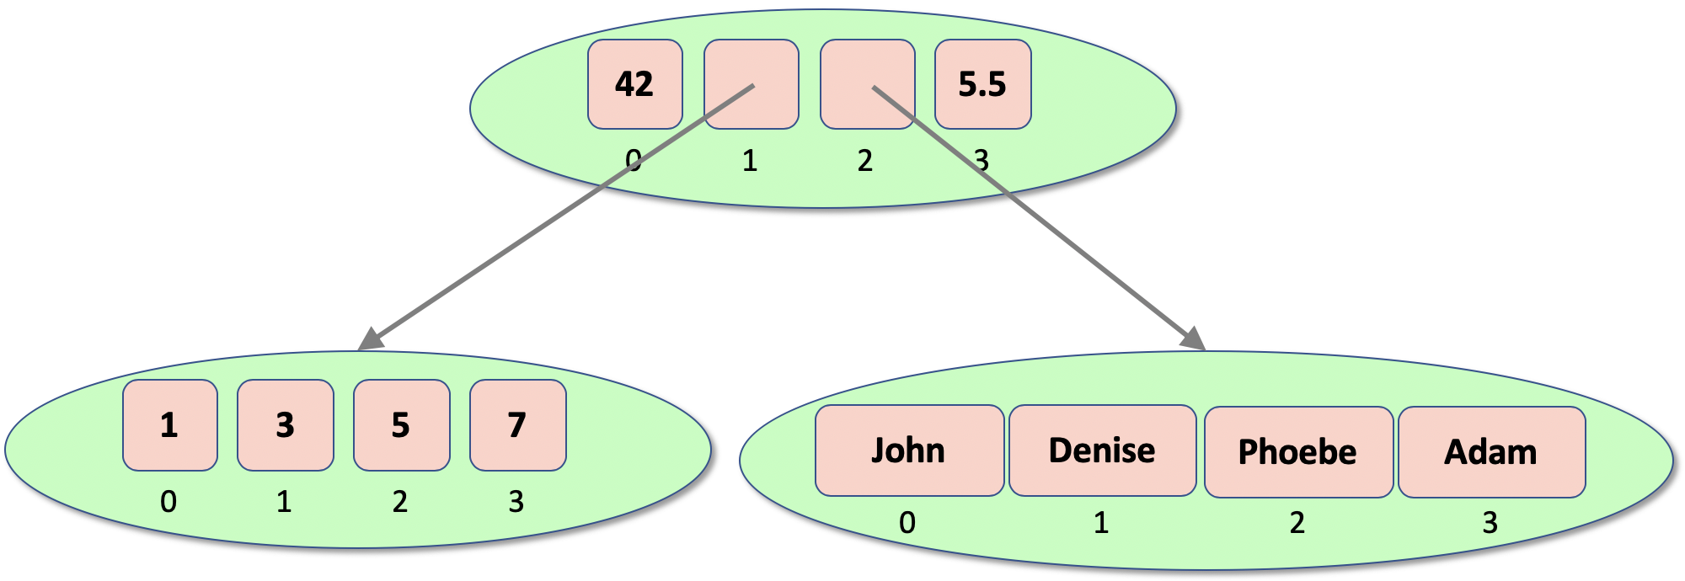
Nested Tuples
Can nest tuples
tuple1 = (1, 3, 5, 7) tuple2 = ('John', 'Denise', 'Phoebe', 'Adam') tuple3 = (42, tuple1, tuple2, 5.5) print(tuple3)
print(tuple3[1][1])
(42, (1, 3, 5, 7), ('John', 'Denise', 'Phoebe', 'Adam'), 5.5)
3

Slide 7
Lists
Mutable ordered container
empty_list = [] # empty_list = list()
list1 = ['John', 'Paul', 'George', 'Ringo’]
print(list1, ': ', len(list1))
print('list1[1]:', list1[1]) print('list1[1:3]:', list1[1:3]) # obtain a slice from 1 up to 3 print('list[:3]:', list1[:3]) # obtain a slice from start up to 3 print('list[1:]:', list1[1:]) # obtain a slice from start 1 to end
list1.append('Pete') print(list1) list1.extend(['Albert', 'Bob']) print(list1)
list1.insert(2, 7) print(list1)
list1.remove('Pete')
print(list1)
del list1[1:3]
print(list1)
['John', 'Paul', 'George', 'Ringo'] : 4
list1[1]: Paul
list1[1:3]: ['Paul', 'George’]
list[:3]: ['John', 'Paul', 'George’]
list[1:]: ['Paul', 'George', 'Ringo’]
['John', 'Paul', 'George', 'Ringo', 'Pete’]
['John', 'Paul', 'George', 'Ringo', 'Pete', 'Albert', 'Bob’]
['John', 'Paul', 7, 'George', 'Ringo', 'Pete', 'Albert', 'Bob]
['John', 'Paul', 7, 'George', 'Ringo', 'Albert', 'Bob]
['John', 'George', 'Ringo', 'Albert', 'Bob']

Slide 8
List methods
Method | Description
append() | Adds an element at the end of the list
clear() | Removes all the elements from the list
copy() | Returns a copy of the list
count() | Returns the number of elements with the specified value
extend() | Add the elements of a list (or any iterable), to the end of the current list
index() | Returns the index of the first element with the specified value
insert() | Adds an element at the specified position
pop() | Removes the element at the specified position
remove() | Removes the item with the specified value
reverse() | Reverses the order of the list
sort() | Sorts the current list

Slide 9
Nested Lists
Can nest lists
John
Denise
0
1
2
3
1
43.5
Phoebe
True
apple
orange
31
0
1
2
3
0
1
2
l1 = [1, 43.5, 'Phoebe', True] l2 = ['apple', 'orange', 31] root_list = ['John', l1, l2, 'Denise'] print(root_list)
print(root_list[1][1])
['John', [1, 43.5, Phoebe, True], ['apple', 'orange', 31], 'Denise']

Slide 10
Nesting Tuples and Lists
Can nest tuples and lists
t1 = (1, 'John', 34.5) l1 = ['Smith', 'Jones'] l2 = [t1, l1] t2 = (l2, 'apple') print(t2)
([(1, 'John', 34.5), ['Smith', 'Jones']], 'apple')

Slide 11
Collection constructor functions
Take an iterable
anything implementing the iterable protocol
e.g. lists, tuples, sets etc.
Return a type of collection
Create empty containers
tuple(iterable)
list(iterable)
tuple()
list()

Slide 12
Check for membership of Containers
Can check to see if a value is in a container
use the in and not in operators
can be used with tuples, lists, sets, dictionary keys etc.
# tuples
fruit = ('apple', 'pear', 'orange', 'plum', 'apple') if 'orange' in fruit: print('orange is in the Tuple') if 'orange' not in fruit: print('orange is NOT in the Tuple') # Lists list1 = ['John', 'Paul', 'George', 'Ringo'] if 'Pete' in list1: print('Pete in the list') else: print('Pete not in the list')
orange is in the Tuple
Pete not in the list

Slide 13
Iterating through Containers
Can iterate through all the values in a container
such as a list, a tuple or a set
Use a for loop
# Set up the list
list = [1, 3, 5, 7, 9]
# Using for loop
for i in list:
print(i)
1
3
5
7
9

Slide 14
Questions?
?

