Slide 1



Advanced Container Data Types
Framework Training

Slide 2
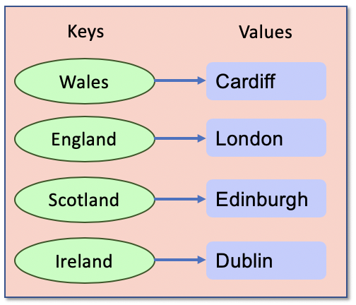
Plan for Session
Sets
FrozenSets
Dictionaries
List comprehensions

Slide 3
Sets
Unordered collection of immutable objects
Does not allow duplicates
empty_set = set() # Empty set
basket = {'apple', 'orange', 'apple', 'pear', 'orange', 'banana'} print(basket)
print(len(basket))
for item in basket:
print(basket)
print('apple' in basket)
basket.add('apricot') print(basket)
print(len(basket))
# Add more than one item at a time
basket.update(['apricot', 'mango', 'grapefruit'])
basket.remove('apricot’) # or discard
{'orange', 'banana', 'apple', 'pear’}
4
orange
banana
apple
pear
True
{'orange', 'banana', 'apple', 'apricot', 'pear'}
5
Notes:
Remove throws an error if the item is not in the set but discard does not

Slide 4
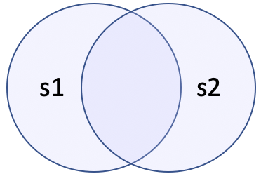
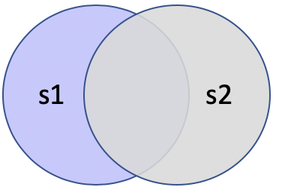
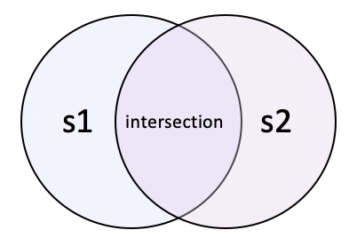
Set Like Operations
Provides set-like operations such as union (|), intersection (&), difference (-) etc.
For example, given
Union Intersection Difference
s1 = {'apple', 'orange', 'banana'} s2 = {'grapefruit', 'lime', 'banana'}
print('Union:', s1 | s2)
print('Difference:', s1 - s2)
Union: {'apple', 'lime', 'banana’,
'grapefruit', 'orange'}
print('Intersect:', s1 & s2)
Difference: {'apple', 'orange'}
Intersect: {'banana'}

Slide 5
Set Operations
Method | Description
add() | Adds an element to the set
clear() | Removes all the elements from the set
copy() | Returns a copy of the set
difference() | Returns a set containing the difference between two or more sets
discard() | Remove the specified item
intersection() | Returns a set, that is the intersection of two other sets
isdisjoint() | Returns whether two sets have a intersection or not
issubset() / issuperset() | Returns whether another set is a sub or super set
remove() | Removes the specified element
union() | Return a set containing the union of sets
update() | Update the set with the union of this set and others

Slide 6

Sets, Frozen Sets & Tuples
Sets can only hold immutable objects
tuples are immutable so OK
Lists and Sets are not immutable
so can’t nest lists and sets inside sets
Must convert a Set to a Frozenset
Convert a list to a tuple
s1 = { (1, 2, 3) }
print(s1)
{(1, 2, 3)}
# Need to convert sets to frozensets
s2 = { frozenset({1, 2, 3}) }
print(s2)
{frozenset({1, 2, 3})}
s3 = { tuple([1, 2, 3, 2, 1]) }
print(s3)
{(1, 2, 3, 2, 1)}
Notes:
Note no frozen dictionary!

Slide 7
Dictionaries
Mutable set of key:value pairs
empty_dictionary = {}
cities = {'Wales': 'Cardiff', 'England': 'London', 'Scotland': 'Edinburgh', 'Ireland': 'Dublin'}
print(cities)
{'Wales': 'Cardiff', 'England': 'London', 'Scotland': 'Edinburgh', 'Northern Ireland': 'Belfast', 'Ireland': 'Dublin'}

Slide 8
Dictionaries
Working with Dictionaries
print('cities[Wales]:', cities['Wales']) print('cities.get(Ireland):', cities.get('Ireland’))
print(cities.values()) print(cities.keys()) print(cities.items()) print('Wales' in cities) print('France' not in cities) for country in cities: print(country, end=', ') print(cities[country])
del cities['Scotland’] # Delete
cities['France'] = 'Paris’ # Add
cities['Wales'] = 'Swansea' # Replace
cities[Wales]: Cardiff
cities.get(Ireland): Dublin
dict_values(['Cardiff', 'London', 'Edinburgh', 'Belfast', 'Dublin'])
dict_keys(['Wales', 'England', 'Scotland', 'Northern Ireland', 'Ireland'])
dict_items([('Wales', 'Cardiff'), ('England', 'London'), ('Scotland', 'Edinburgh'), ('Northern Ireland', 'Belfast'), ('Ireland', 'Dublin')])
True
True
Wales, Cardiff
England, London ...
Notes:
print('cities[Italy]:', cities[Italy']) – throws an exception print('cities.get(Italy):', cities.get('Italy')) – returns None

Slide 9
Nesting Dictionaries
Keys must be immutable
but values can be any type of object inc. collections
Keys must also implement
__hash__() and __eq__() special methods
seasons = {'Spring': ('Mar', 'Apr', 'May'),
'Summer': ('June', 'July', 'August'),
'Autumn': ('September', 'October', 'November'),
'Winter': ('December', 'January', 'February')}
print(seasons['Spring'])
print(seasons['Spring'][1])
('Mar', 'Apr', 'May')
Apr

Slide 10
Dictionary Methods
Method | Description
clear() | Removes all the elements from the dictionary
copy() | Returns a copy of the dictionary
fromkeys() | Returns a dictionary with the specified keys and values
get() | Returns the value of the specified key
items() | Returns a list containing the tuple for each key value pair
keys() | Returns a list containing the dictionary's keys
setdefault() | Returns the value of the specified key. If the key does not exist: insert the key, with the specified value
update() | Updates the dictionary with the specified key-value pairs
values() | Returns a list of all the values in the dictionary

Slide 11
Dictionary constructors and membership
Dictionaries have dict()
takes an iterable or a sequence of key:value pairs
Can check to see if a value is in a dictionary
# note keys are not strings
dict1 = dict(uk='London', ireland='Dublin', france='Paris’)
# could be lists or tuples
dict2 = dict([('uk', 'London'), ('ireland', 'Dublin'), ('france', 'Paris')])
cities = {'Wales': 'Cardiff', 'England': 'London', 'Northern Ireland': 'Belfast', 'Ireland': 'Dublin'} if 'Wales' in cities: print('We know the capital of Wales')
We know the capital of Wales

Slide 12
List Comprehension in Python
Used to create lists from iterables
lists, sets, dictionaries, strings are all iterables
consist of brackets containing
the expression to evaluate for each item in the iterable
the for loop to iterate over each element
For example, add one to each integer in a list
[expression for item in list]
values = [1, 2, 4, 6, 8, 9] print('values', values) new_values = [i + 1 for i in values] print('new_values', new_values)
values [1, 2, 4, 6, 8, 9]
new_values [2, 3, 5, 7, 9, 10]

Slide 13
Questions?
?

