Slide 1



Further Functions & Higher Order Functions
Framework Training

Slide 2
Plan for Session
Function docstring and reStructuredText
Arbitrary parameter lists
Positional and Keyword /named parameters
Local & Global Variables
Modifying Globals and non local variables within a function
Anonymous / Lambda Functions
Functions and Containers
Filter and map
nesting filter and map

Slide 3
Function Docstring
Optional docstring
documents purpose or parameters for function
heavily used for built-in functions
def get_integer_input(message):
"""
This function will display the message to the user
and request that they input an integer.
If the user enters something that is not a number
then the input will be rejected
and an error message will be displayed.
The user will then be asked to try again."""
value_as_string = input(message)
while not value_as_string.isnumeric():
print('The input must be an integer')
value_as_string = input(message)
return int(value_as_string)
print(get_integer_input.__doc__)

Slide 4
Documenting code: reStructuredText
Can use formatting within docstring
several options available including reStructuredText (aka reST)
recommended approach by python.org
aims to be a simple markup language for docstrings
Used with functions, classes, methods, modules etc.
E.g. provide info on parameters for functions
Explain purpose of modules, classes, methods etc
Help readability of text
using bold, italic, literals, lists, code examples etc
See https://devguide.python.org/documentation/markup/

Slide 5
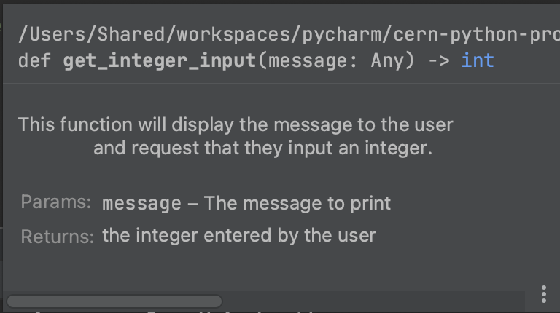
Documenting code: reStructuredText
Field lists
Field lists are sequences of fields marked up like this:
:fieldname: Field content
For example
def get_integer_input(message):
"""
This function will display the message to the user
and request that they input an integer.
:param message: The message to print
:returns: the integer entered by the user
"""
value_as_string = input(message)
while not value_as_string.isnumeric():
print('The input must be an integer')
value_as_string = input(message)
return int(value_as_string)

Slide 6
Documenting code: reStructuredText
Can use the following to format text
Emphasis e.g. *emphasis*
String (bold) e.g. **strong**
Literal value e.g. ``literal``
Lists
Note
cannot start or end with whitespace: * text* is wrong!
* This is a bulleted list.
* It has two items, the second
item uses two lines.
1. This is a numbered list.
2. It has two items too.
#. This is a numbered list.
#. It has two items too.

Slide 7
Local & Global Variables
Variables can be declared as being global (to the program) or local to a function
local variables can only be referenced within the scope they are defined in
global variables can be referenced anywhere
a_global_count = 10 def some_func(): a_local_variable = 100 print('a_local_variable:', a_local_variable) print('a_global_count:', a_global_count) some_func()
a_local_variable: 100
a_global_count: 10

Slide 8
Modifying Globals within a function
By default local variables will hide global variables with the same name
known as 'Shadowing'
def my_function(): a_variable = 100 print('inside function:', a_variable)
a_variable = 25
print(before function:', a_variable) my_function() print('outside function:', a_variable)
before function: 25
inside function: 100
outside function: 25

Slide 9

Modifying Globals within a function
To modify a global within a function
must first declare as global
inside function before use
max = 100
print('initial value of max:', max)
def print_max(): global max max = max + 1 print('inside function:', max) print_max() print('outside function:', max)
initial value of max: 100
inside function: 101
outside function: 101

Slide 10
Non local variables
Can also references variables from an enclosing scope that is not global
def outer(): title = "original title" print('initial title:', title)
def inner(): nonlocal title title = "another title" print("inner:", title) inner() print("outer:", title) outer()
initial title: original title
inner: another title
outer: another title

Slide 11
Anonymous / Lambda Functions
Can define anonymous functions
aka lambda functions
Can optionally take parameters
Always return a value
lambda arguments: expression
func0 = lambda: print('no args')
func1 = lambda x: x * x
func2 = lambda x, y: x * y
func3 = lambda x, y, z: x + y + z
no args
16
12
9
func0()
print(func1(4))
print(func2(3, 4))
print(func3(2, 3, 4))

Slide 12
Functions and Containers
Functional programming style operations available on containers aka Higher Order Functions
filter() filters out elements from a collection
returned iterable is the same size or smaller than original collection
map() applies a function to all elements in a collection
return iterable is always same size as original
Notes:
Note no built-in flat map

Slide 13
Functions and Containers
Using filter()
data = [1, 3, 5, 2, 7, 4, 10] print('data:', data) # Filter for even numbers using a lambda function d1 = list(filter(lambda i: i % 2 == 0, data)) print(f'filtered d1: {d1}')
def is_even(i): return i % 2 == 0
d2 = list(filter(is_even, data)) print(f'filtered d2: {d2}')
data: [1, 3, 5, 2, 7, 4, 10]
filtered d1: [2, 4, 10]
filtered d2: [2, 4, 10]

Slide 14
Functions and Containers
Using map()
data = [1, 3, 5, 2, 7, 4, 10] print('data:', data) # Apply the lambda function to each element in the list # using the map function d1 = list(map(lambda i: i + 1, data)) print('d1', d1) def add_one(i): return i + 1 # Apply the add_one function to each element in the # list using the map function d2 = list(map(add_one, data)) print('d2:', d2)
data: [1, 3, 5, 2, 7, 4, 10]
d1 [2, 4, 6, 3, 8, 5, 11]
d2: [2, 4, 6, 3, 8, 5, 11]

Slide 15
Functions and Containers
Can nest operations
apply filter to initial data to find even numbers
use map to add 10 to iterable returned from filter
data = [1, 3, 5, 2, 7, 4, 10] print('data:', data) def is_even(i): return i % 2 == 0 # Filter for even numbers and use map to add 10 new_data = list(map(lambda i: i + 10, filter(is_even, data))) print('new_data:', new_data)
data: [1, 3, 5, 2, 7, 4, 10]
new_data: [12, 14, 20]

Slide 16
Custom Sorting using HoFs
There are two ways that you can sort a list
Using the sort method
alist.sort() - Which sorts the current list
Using the sorted function
sorted(alist) - Which returns a new sorted list
Both can sort in ascending (default) or descending order
sorted(alist, reverse=True) / alist.sort(reverse=true)
Both can take a key which can be a function/lambda
Used to determine how to determine value to sort on
sorted(alist, key=lambda x: len(x))
alist.sort(key=lambda x: len(x))

Slide 17
Questions?
?

