Slide 1

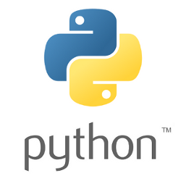

Introduction to Classes & Object Oriented Programming
Framework Training

Slide 2
Plan for Session
Everything is an Object
Class Terminology
Defining user defined classes
Instantiating Objects from Classes
Printing Objects
Be careful with assignment
Class Comments
Defining behaviour

Slide 3
Everything in Python is an Object
Objects are examples / instances of Classes
Classes act as templates for objects
define data / behaviour of object
example class Person
Objects (or instances) of a class
hold actual data values & used to execute behaviour
there can be many objects for a given class
for example, given a class Person may have instances John, Denise, Phoebe and Gryff
print(type(4)) print(type(5.6)) print(type(True)) print(type('Ewan')) print(type([1, 2, 3, 4]))
<class 'int'>
<class 'float'>
<class 'bool'>
<class 'str'>
<class 'list'>

Slide 4
Class Terminology
Class is a template defining data and behaviour that operates on that data
Instance or object
All instances of a class possess the same data fields / attributes but contain their own data values
Each instance of a class responds to the same set of requests
Attribute / field / instance variable
The data held by an object is represented by its attributes
Method a function executed within an object
Message requests some behaviour / data from object

Slide 5
Can create User Defined classes
A class definition has the format
Class Person
name follows Camel Case conventions with no spaces (or _)
defines two attributes name and age
also defines special method called _ _init_ _
object initialiser aka constructor
class NameOfClass: def _ _init_ _() methods
class Person: def _ _init_ _(self, name, age): self.name = name self.age = age
Note special variable self
All methods start with
this variable

Slide 6
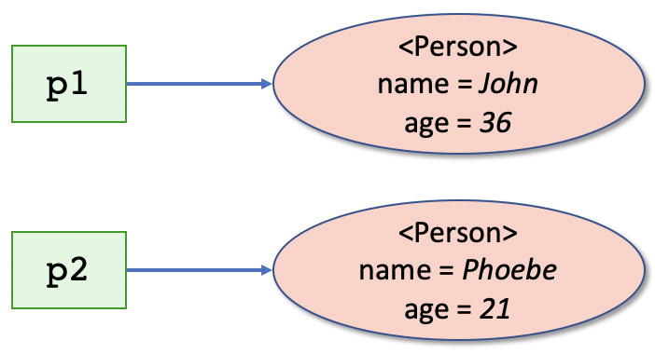
Creating objects from class Person
Objects created
using the name of the class and
passing in the values for parameters of initialisation method
Each object / instance is unique
Has own unique id number
p1 = Person('John', 36) p2 = Person('Phoebe', 21)
print('id(p1):', id(p1)) print('id(p2):', id(p2))
id(p1): 4547191808
id(p2): 4547191864

Slide 7
Printing Objects
Can print out an object
default prints name and indicative address in memory
hard to work out which object is which
Can print attributes directly
Can override default behaviour using _ _str_ _()
another special method
takes reference to object as first parameter
print(p1) print(p2)
<__main__.Person object at 0x10f08a400>
<__main__.Person object at 0x10f08a438>
class Person: def _ _init_ _(self, name, age): self.name = name self.age = age
def _ _str_ _(self): return self.name + ' is ' + str(self.age)
print(p1) print(p2)
John is 36
Phoebe is 21

Slide 8

Representing Objects
Defined using _ _repr_ _()
an alternative to _ _str_ _()
used to create a representation of an object that can be used to create a new instance of the object
where as __str__() is used to present a string version
common to provide both
Used by lists when a list prints its contents
class Person: def _ _init_ _(self, name, age): self.name = name self.age = age
def _ _repr_ _(self): return f'Person(name={self.name} + ‘, age=‘ + {str(self.age)}'

Slide 9
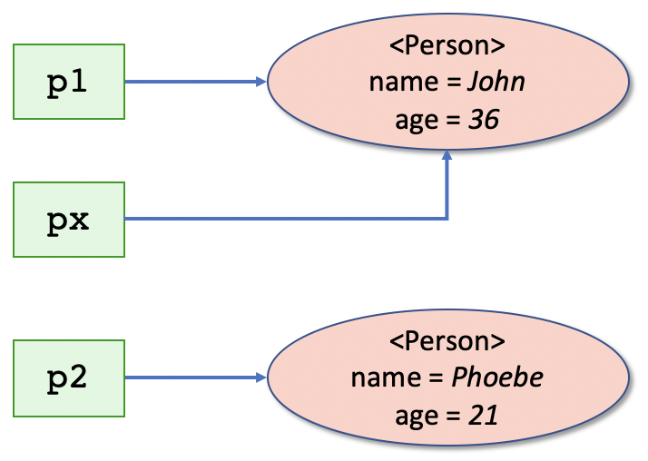
Be Careful with Assignment
Assignment copies address of object
May not be obvious when printed
ids make it clear
p1 = Person('John', 36) p2 = Person('Phoebe', 21)
px = p1
print(p1) print(px)
John is 36
John is 36
print('id(p1):', id(p1)) print('id(px):', id(px))
id(p1): 4326491864
id(px): 4326491864

Slide 10
Class Comment
A docstring for a class
accessible through _ _doc_ _ attribute
considered good practice
typically provides information on purpose of class
often gives guidance on usage
class Person: """ An example class to hold a persons name and age"""
def _ _init_ _(self, name, age): self.name = name self.age = age
def _ _str_ _(self): return self.name + ' is ' + str(self.age)

Slide 11
Adding Behaviour
Add some behaviour
first parameter to method is always reference to the object
called self by convention
Method names follow variable naming conventions
class Person: """ An example class to hold a persons name and age"""
def _ _init_ _(self, name, age): self.name = name self.age = age
def _ _str_ _(self): return self.name + ' is ' + str(self.age)
def birthday(self): print ('Happy birthday you were', self.age) self.age += 1 print('You are now', self.age)
p3 = Person('Adam', 21) print(p3) p3.birthday() print(p3)
Adam is 21
Happy birthday you were 21
You are now 22
Adam is 22

Slide 12
Adding Behaviour
Methods can have parameters and / or return values
class Person: """ An example class to hold a persons name and age"""
def _ _init_ _(self, name, age): self.name = name self.age = age
# ...
def calculate_pay(self, hours_worked): rate_of_pay = 7.50 if self.age >= 21: rate_of_pay += 2.50 return hours_worked * rate_of_pay
def is_teenager(self): return self.age < 20
pay = p2.calculate_pay(40) print(f'Pay {p2.name} {pay}') pay = p3.calculate_pay(40) print(f'Pay {p3.name} {pay}') print(f'p2.is_teenager {p2.is_teenager()}')
Pay Phoebe 400.0
Pay Adam 300.0
p2.is_teenager False

Slide 13
Questions?
?

