Slide 1



Working with Files
Framework Training

Slide 2
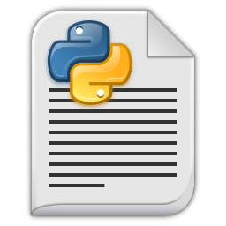

Plan for Session
Obtaining a reference to a file
File Access Modes
Reading Files & File Contents Iteration
Writing Data to Files
Using files and with statements
Renaming and Deleting files
Directories
CSV Files

Slide 3

Obtaining a reference to a file
open() function creates a file object
can use to read and / or write data
requires the name of the file you want to work with
optionally you can specify the access mode
Signature for open function
file_name indicates the file to be accessed
access_mode determines mode file opened in
i.e. read (default), write, append, etc.
in text (default) or binary modes
file_object = open(file_name, access_mode)

Slide 4
File Access Modes
Mode | Description
r | Opens a file for reading only (default).
rb | Opens a file for reading only in binary format.
r+ | Opens a file for both reading and writing. Cursor at start of file.
rb+ | Opens a file for both reading and writing in binary format.
w | Opens a file for writing only. Overwrites the file if the file exists.
wb | Opens a file for writing only in binary format. Overwrites the file if the file exists.
w+ | Opens a file for both writing and reading. Overwrites the existing file if the file exists.
wb+ | Opens a file for both writing and reading in binary format. Overwrites the existing file if the file exists. Cursor at end of file
a | Opens a file for appending. If the file does not exist, it creates a new file for writing.
ab | Opens a file for appending in binary format.
a+ | Opens a file for both appending and reading. Cursor at end of file
ab+ | Opens a file for both appending and reading in binary format.

Slide 5
Reading Files
Can read info from file object via
read(), readline() and readlines() methods
read() return the entire contents of the file as a single string
readline() next line from a file
readlines() method returns a list of all the lines in a file
Don’t forget to close the file object
Once a line is read it won’t be read again
# Read one line of data
file = open('myfile.txt', 'r') line_of_data = file.readline() print(line_of_data, end='')
file.close()
# Read multiple lines of data
file = open('myfile.txt', 'r') lines = file.readlines() for line in lines: print(line, end='')
file.close()

Slide 6
File Contents Iteration
Often want to process contents of file a line at a time
File objects support iteration:
file = open('myfile.txt', 'r') for line in file: print(line, end='')
file.close()

Slide 7

Using files and with statement
File type implements the Context Manager Protocol
can use in a with as statement
entry behaviour opens file
exit behaviour closes the file
best practice / pythonic way to open and close files
with open('myfile.txt', 'r') as f: lines = f.readlines() for line in lines: print(line, end='')

Slide 8
File Access can raise Errors
Try accessing a file that does not exist!
Can wrap in try block
with open('myfile2.txt', 'r') as f: lines = f.readlines() for line in lines: print(line, end='')
Traceback (most recent call last):
File "/read-file-using-with.py", line 4, in <module>
with open('myfile2.txt', 'r') as f:
FileNotFoundError: [Errno 2] No such file or directory: 'myfile2.txt'
try: with open('myfile2.txt', 'r') as f: lines = f.readlines() for line in lines: print(line, end='') except FileNotFoundError as err: print('oops') print(err)
oops
[Errno 2] No such file or directory: 'myfile2.txt'

Slide 9
Writing Data to Files
Use file object’s write() method
assuming file was opened in write mode
write method does not add a newline character ('\n') to the end of line
don’t forget to close the file
print('Writing file’)
try:
with open('myfile2.txt', ‘w') as f: f.write('Hello from Python!!\n’) f.write('Working with files is easy...\n’) f.write('It is cool ...\n’)
f.write(str(42)) # only writes strings
except FileNotFoundError as err: print(err)

Slide 10
Renaming and Deleting Files
File can be renamed using the os.rename() function
function takes 2 args, current filename and new filename
part of the Python os module which provides methods that can be used to perform a range of file-processing operations
Delete a File
use os.remove() function
import os
os.rename( 'myfileoriginalname.txt', 'myfilenewname.txt' )
import os
os.remove( 'somefilename.txt' )

Slide 11
Directories
Directories are hierarchical structures
containing files and sub directories
os module provides directory-oriented functions
mkdir() used to create a directory
chdir() used to change the current working directory
getcwd() returns name of the current working directory
rmdir() remove / delete a directory
listdir() returns a list containing the names of the entries in the directory

Slide 12
Directories
import os
print('os.getcwd(:', os.getcwd()) print('List contents of directory') print(os.listdir()) print('Create mydir') os.mkdir('mydir') print('List the updated contents of directory’)
print(os.listdir()) print('Change into mydir directory') os.chdir('mydir') print('os.getcwd(:', os.getcwd()) print('Change back to parent directory') os.chdir('..’)
print('os.getcwd(:', os.getcwd()) print('Remove mydir directory') os.rmdir('mydir') print('List the resulting contents of directory') print(os.listdir())
os.getcwd(: /Users/Shared/workspaces/pycharm/pythonintro/textfiles
List contents of directory
['my-new-file.txt', 'myfile.txt', 'textfile1.txt', 'textfile2.txt']
Create mydir
List the updated contents of directory
['my-new-file.txt', 'myfile.txt', 'textfile1.txt', 'textfile2.txt', 'mydir']
Change into mydir directory
os.getcwd(: /Users/Shared/workspaces/pycharm/pythonintro/textfiles/mydir
Change back to parent directory
os.getcwd(: /Users/Shared/workspaces/pycharm/pythonintro/textfiles
Remove mydir directory
List the resulting contents of directory
['my-new-file.txt', 'myfile.txt', 'textfile1.txt', 'textfile2.txt']

Slide 13
Working with CSV Files
Comma Separated Values (csv) format
widely used for data import and export
but no well-defined standard
Supported by the built-in csv module
can read and write CSV files
supports formats used by Excel
can also support other dialects or
special-purpose user defined formats
Key objects are csv.reader and csv.writer
for more information see
https://docs.python.org/3/library/csv.html

Slide 14
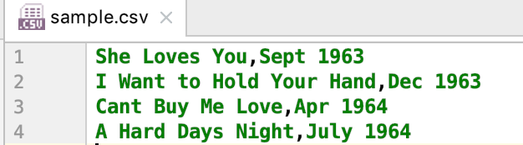
Working with CSV Files
Write out CSV file
import csv
print('Crearting CSV file') with open('sample.csv', 'w') as csvfile:
writer = csv.writer(csvfile)
writer.writerow(['She Loves You', 'Sept 1963']) writer.writerow(['I Want to Hold Your Hand', 'Dec 1963']) writer.writerow(['Cant Buy Me Love', 'Apr 1964']) writer.writerow(['A Hard Days Night', 'July 1964'])

Slide 15
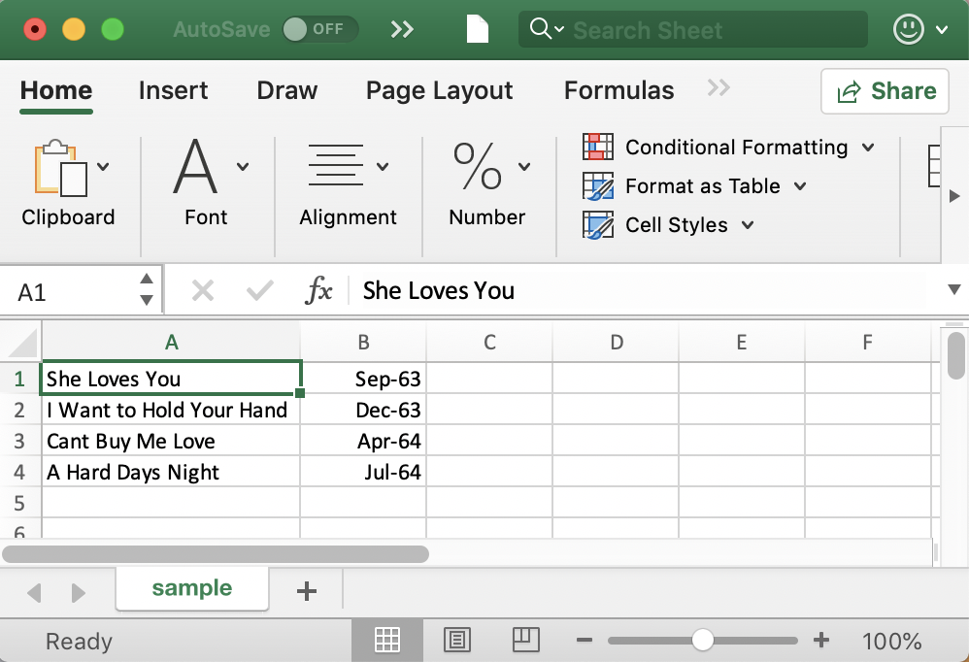
Working with CSV Files
Reading from a CSV file
import csv
print('Starting to read csv file') with open('sample.csv') as csvfile: reader = csv.reader(csvfile) for row in reader: print(f'{row[0]}, {row[1]}')
print('Done Reading')
Starting to read csv file
She Loves You, Sept 1963
I Want to Hold Your Hand, Dec 1963
Cant Buy Me Love, Apr 1964
Done Reading
row is a list

Slide 16
Questions?
?

