Slide 1



Introduction to Threads
Framework Training

Slide 2
Plan for Session
Python Threads
Thread States
The Thread Class
Creating a Thread
Passing Arguments to a Thread
Multiple Threads
Timers

Slide 3
Python Threads
Lightweight, pre-emptive, thread of execution
within a single os process
Internal to Python runtime
Shares the same memory space
Implemented by the class Thread
Have a priority and a state

Slide 4

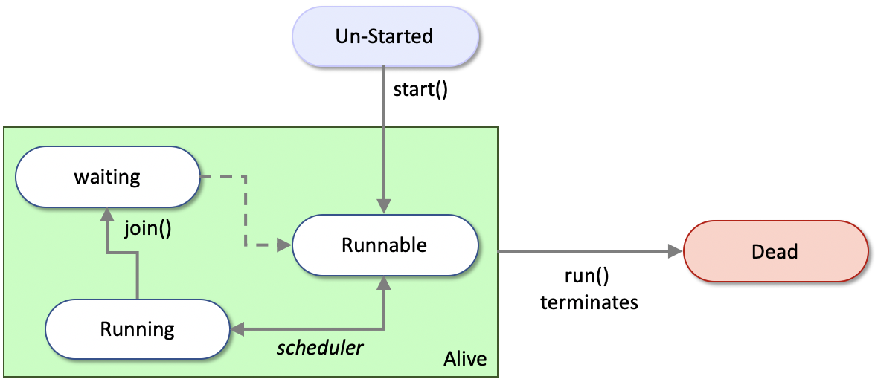
Thread States
When a thread object is first created it exists, but it is not yet schedulable; it must be started
It is then runnable
Scheduler may run it
Thread may need to wait for another thread
Thread remains runnable or running until its run() method terminates

Slide 5
The Thread Class
Defined in the threading module
Defines a thread in Python
start() Start the thread
run() Method representing the thread’s activity
Do not call this method.
join(timeout=None) Wait until the receiving thread terminates
name The threads’ name
ident The ‘thread identifier’ of this thread or None if the thread has not been started. This is a nonzero integer
is_alive() True if the run method has not terminated
daemon boolean indicating whether thread is a daemon

Slide 6
Creating a Thread
Pass a reference to a callable object
(such as a function or method)
into the Thread class constructor
this reference acts as the target for the Thread to execute
from threading import Thread
def simple_worker(): print('hello')
t1 = Thread(target=simple_worker) t1.start()
print(t1.name) print(t1.ident) print(t1.is_alive())
hello
Thread-1 (simple_worker)
123145370800128
False
Thread-1 (simple_worker)
123145370800128
True
hello

Slide 7
Passing Arguments to a Thread
Parameters can be passed to the function to be run by the thread via the args parameter
from threading import Thread from time import sleep
def worker(msg): for i in range(0, 10): print(msg, end='', flush=True) sleep(1)
print('Starting') t1 = Thread(target=worker, args='A') t2 = Thread(target=worker, args='B') t3 = Thread(target=worker, args='C') t1.start() t2.start() t3.start()
print('Done')
Starting
ABCDone
ABCACBABCABCCBAABCABCABCBAC
Notes:
Here's a breakdown of why this is useful, especially in the context of experimental physicists and engineers:
Concurrent Execution:
The primary advantage of using threads here is the ability to execute multiple tasks concurrently. Each thread (t1, t2, t3) runs the worker function simultaneously.
In real-world scenarios, this could represent different tasks like data acquisition, processing, and logging happening at the same time.
Resource Sharing:
Threads share the same memory space, so they can easily share data and resources, making inter-thread communication more efficient.
This is beneficial when multiple tasks need to access shared resources or data structures, like updating a shared data buffer from different data sources.
Improved Responsiveness:
In applications with a user interface, threading can prevent the UI from becoming unresponsive while executing time-consuming operations.
For instance, a monitoring application for experimental setups can continue updating the interface while processing data in the background.
Parallelism in Multi-Core Systems:
Although Python threads are subject to the Global Interpreter Lock (GIL) and don't achieve true parallelism, they can still provide benefits on multi-core systems for I/O-bound tasks.
In scenarios where tasks are waiting for external resources or data (like reading from sensors), threads can manage multiple operations simultaneously, making better use of system resources.
Simplicity in Asynchronous Operations:
Threads can simplify the design of a program where tasks need to be performed asynchronously, like sending a query to a database while performing computations.
However, it's important to note the limitations of threading in Python, particularly due to the GIL, which prevents multiple native threads from executing Python bytecodes at once. This means for CPU-bound tasks, threads won't provide a speed-up and might even cause overhead. For such tasks, multiprocessing is often a better choice.

Slide 8
Passing Arguments to a Thread
Parameters can be passed to the function to be run by the thread via the args parameter
from threading import Thread from time import sleep
def worker(msg): for i in range(0, 10): print(msg, end='', flush=True) sleep(1)
print('Starting') t1 = Thread(target=worker, args='A') t2 = Thread(target=worker, args='B') t3 = Thread(target=worker, args='C') t1.start() t2.start() t3.start()
print('Done')
Starting
ABCDone
ABCACBABCABCCBAABCABCABCBAC
Notes:
Here's a breakdown of why this is useful, especially in the context of experimental physicists and engineers:
Concurrent Execution:
The primary advantage of using threads here is the ability to execute multiple tasks concurrently. Each thread (t1, t2, t3) runs the worker function simultaneously.
In real-world scenarios, this could represent different tasks like data acquisition, processing, and logging happening at the same time.
Resource Sharing:
Threads share the same memory space, so they can easily share data and resources, making inter-thread communication more efficient.
This is beneficial when multiple tasks need to access shared resources or data structures, like updating a shared data buffer from different data sources.
Improved Responsiveness:
In applications with a user interface, threading can prevent the UI from becoming unresponsive while executing time-consuming operations.
For instance, a monitoring application for experimental setups can continue updating the interface while processing data in the background.
Parallelism in Multi-Core Systems:
Although Python threads are subject to the Global Interpreter Lock (GIL) and don't achieve true parallelism, they can still provide benefits on multi-core systems for I/O-bound tasks.
In scenarios where tasks are waiting for external resources or data (like reading from sensors), threads can manage multiple operations simultaneously, making better use of system resources.
Simplicity in Asynchronous Operations:
Threads can simplify the design of a program where tasks need to be performed asynchronously, like sending a query to a database while performing computations.
However, it's important to note the limitations of threading in Python, particularly due to the GIL, which prevents multiple native threads from executing Python bytecodes at once. This means for CPU-bound tasks, threads won't provide a speed-up and might even cause overhead. For such tasks, multiprocessing is often a better choice.

Slide 9
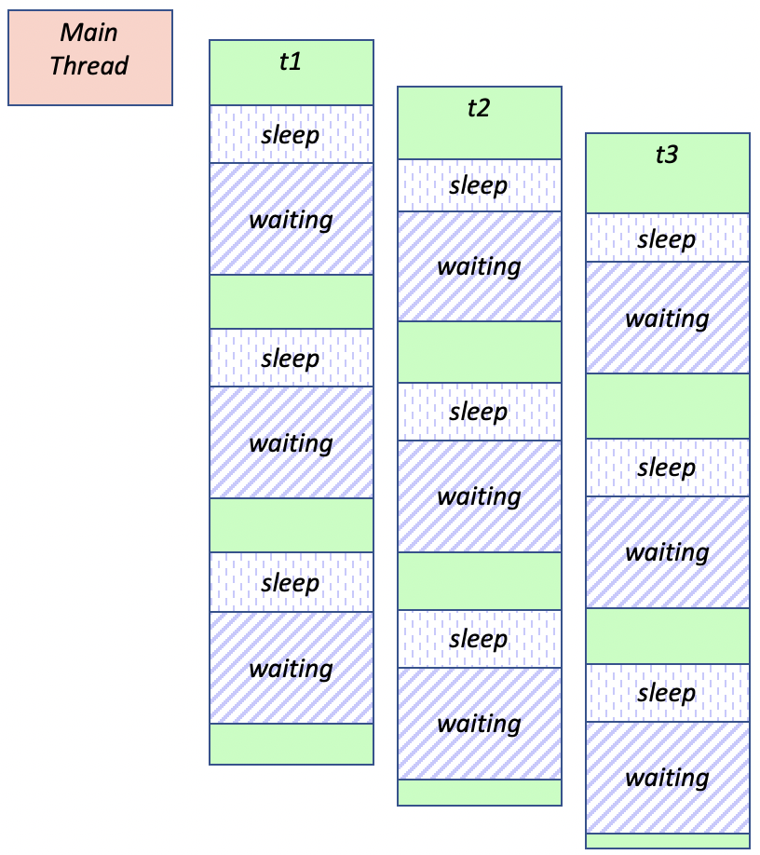
Multiple Threads
What just happened?
the main thread, and three worker threads are all Runnable
(although only one thread will run at a time).
This means that once started each worker thread will print out a string, sleep for 1 second and then wait until it is selected to run again
The scheduler will manage execution of runnable threads

Slide 10
Sharing Data Structures
Threads are using the same process, so communication is easier.
import threading
import time
import random
def read_sensor_data(queue):
while True:
# Simulate reading data from a sensor
data = random.random()
queue.append(data)
time.sleep(1)
def process_data(queue):
while True:
if queue:
data = queue.pop(0)
# Process data (e.g., update graph)
print(f"Processing data: {data}")
time.sleep(0.5)
data_queue = []
thread1 = threading.Thread(target=read_sensor_data, args=(data_queue,))
thread2 = threading.Thread(target=process_data, args=(data_queue,))
thread1.start()
thread2.start()
Notes:
Here's a breakdown of why this is useful, especially in the context of experimental physicists and engineers:
Concurrent Execution:
The primary advantage of using threads here is the ability to execute multiple tasks concurrently. Each thread (t1, t2, t3) runs the worker function simultaneously.
In real-world scenarios, this could represent different tasks like data acquisition, processing, and logging happening at the same time.
Resource Sharing:
Threads share the same memory space, so they can easily share data and resources, making inter-thread communication more efficient.
This is beneficial when multiple tasks need to access shared resources or data structures, like updating a shared data buffer from different data sources.
Improved Responsiveness:
In applications with a user interface, threading can prevent the UI from becoming unresponsive while executing time-consuming operations.
For instance, a monitoring application for experimental setups can continue updating the interface while processing data in the background.
Parallelism in Multi-Core Systems:
Although Python threads are subject to the Global Interpreter Lock (GIL) and don't achieve true parallelism, they can still provide benefits on multi-core systems for I/O-bound tasks.
In scenarios where tasks are waiting for external resources or data (like reading from sensors), threads can manage multiple operations simultaneously, making better use of system resources.
Simplicity in Asynchronous Operations:
Threads can simplify the design of a program where tasks need to be performed asynchronously, like sending a query to a database while performing computations.
However, it's important to note the limitations of threading in Python, particularly due to the GIL, which prevents multiple native threads from executing Python bytecodes at once. This means for CPU-bound tasks, threads won't provide a speed-up and might even cause overhead. For such tasks, multiprocessing is often a better choice.

Slide 11
Timers
Timer class represents an action (or task)
to run after a certain amount of time has elapsed
Signature of Timer class
Print ‘hello’ after 5 seconds
Timer(interval, function)
from threading import Timer
def hello(): print('hello')
print('Starting') t = Timer(5, hello) t.start() print('Done')
Starting
Done
hello

Slide 12
Questions?
?

