Slide 1

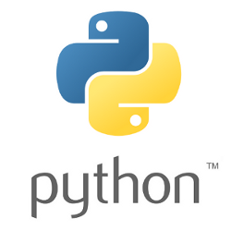

Introduction to Processes
Framework Training

Slide 2
Plan for Session
The multiprocessing Library
The Process Class
Working with the Process class
Alternative Ways to run a process
Using a Pool

Slide 3
The multiprocessing library
Supports the generation of separate (operating system level) processes
to execute behaviour (such as functions or methods)
using an API that is similar to the Threading API
Introduces additional features
such as execution Pools

Slide 4
The Process Class
Defined in multiprocessing library
as equivalent of the Thread class
Provides similar set of methods / attributes
start() Start the process
join([timeout]) wait for receiving process to complete (or timeout is met)
is_alive() return True if process is alive
name The process’s name
daemon True if process is a daemon process
pid Return The process ID

Slide 5
The Process Class
Adds further methods attributes
exitcode The process exit code
terminate() Terminate the process.
kill() Same as terminate() except that on Unix the SIGKILL signal is used instead of the SIGTERM signal
close() Close the Process object, releasing all resources associated with it

Slide 6
Alternative Ways to run a Process
When start() method is called there are 3 different approaches to starting the underlying process:
'spawn' The parent process starts a fresh Python interpreter process.
'fork' The parent process uses os.fork() to fork the Python interpreter.
'forkserver' In this case a server process is started. From then on, whenever a new process is needed, the parent process connects to the server and requests that it fork a new process
set_start_method() should be used to set approach
Notes:
Fork is a child of the parent process

Slide 7
Alternative Ways to run a Process
from multiprocessing import Process, set_start_method
from time import sleep
import os
def worker(msg):
print('module name:', __name__)
print('parent process:', os.getppid())
print('process id:', os.getpid())
for i in range(0, 10):
print(msg, end='', flush=True)
print('Starting') print('Root application process id:', os.getpid()) set_start_method('spawn') t = Process(target=worker, args='A') t.start() print('Done')
Starting
Root application process id: 6281
Done
module name: __main__
parent process: 6281
process id: 6283
AAAAAAAAAA
Notes:
Let's break down why this is useful, especially in the context of experimental physics and engineering:
Independent Execution:
Each Process instance runs in its own Python interpreter and has its own memory space. This independence allows the process to execute tasks without any interference from the main process or other subprocesses.
This is particularly useful for CPU-bound tasks in Python, as it circumvents the Global Interpreter Lock (GIL) that can limit the performance of threaded applications.
Utilizing Multiple Cores:
Unlike threads in Python, processes can fully leverage multiple CPU cores, making them ideal for computationally intensive tasks.
For example, in scientific computing or data analysis, you can split a large computation into smaller chunks and run them in parallel across multiple processes, significantly reducing execution time.
Reliability and Stability:
Processes are isolated from each other, so if one process encounters an issue and crashes, it won't affect the others or the main application. This isolation adds to the robustness of applications where stability is crucial.
In a lab setting, this means that a crash in one part of an experiment's data processing won't necessarily disrupt other ongoing processes.
Debugging Information:
The code prints out useful debugging information, such as the module name, the ID of the parent process, and the ID of the current process.
This information can be invaluable in a complex system where multiple processes are running simultaneously, as it helps in tracking the execution flow and identifying potential issues.
Cross-Platform Compatibility:
By setting the start method to 'spawn', the code ensures more predictable and safer behavior, especially on platforms like Windows where 'fork' is not available.
Ensuring compatibility across different operating systems is essential in scientific environments where software needs to run on diverse systems.
Simulation of Real-World Scenarios:
In experimental physics and engineering, processes can simulate real-world scenarios where different tasks (like controlling an instrument, processing data, and logging results) occur independently and might need to operate on separate machines or cores.

Slide 8

Working with Multiples Processes
from multiprocessing import Process
from time import sleep
def worker(msg):
for i in range(0, 10):
print(msg, end='', flush=True)
if __name__ == '__main__': set_start_method('spawn') print('Starting') p1 = Process(target=worker, args='A') p2 = Process(target=worker, args='B') p3 = Process(target=worker, args='C') p1.start() p2.start() p3.start() print('Done')
Similar to threads
Don’t forget to set the set start method
Starting
Done
ABCABCABCABCABCABCABCACBACBACB

Slide 9
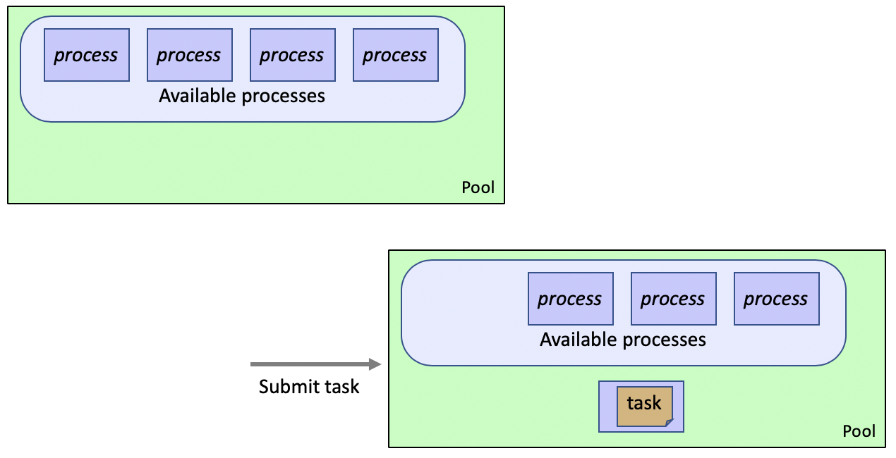
Using a Pool
Creating Processes is expensive
Better to reuse processes within an application
The Pool class provides such reusable processes
Pool class represents a pool of worker processes
that can be used to perform concurrent, parallel operations

Slide 10
Using a Pool
Pool class signature
Where
processes number of worker processes. If None then no. of CPUs is used
initializer function to run when Process is started.
maxtasksperchild number of tasks performed before process exists
this allows resources to be freed - a new process will then take its place
default is None – indicating worker will live as long as the pool
context can be used to specify context used for starting worker processes
default pool is created using the function multiprocessing.Pool().
contect can specify alternative object which must have Pool() method
class multiprocessing.pool.Pool(processes, initializer, initargs,
maxtasksperchild, context)
Notes:
processes is the number of worker processes to use. If processes is None then the number returned by os.cpu_count() is used.
initializer If initializer is not None then each worker process will call initializer(*initargs) when it starts.
maxtasksperchild is the number of tasks a worker process can complete before it will exit and be replaced with a fresh worker process, to enable unused resources to be freed. The default maxtasksperchild is None, which means worker processes will live as long as the pool.
context can be used to specify the context used for starting the worker processes. Usually a pool is created using the function multiprocessing.Pool(). Alternatively the pool can be created using the Pool() method of a context object.

Slide 11
Using a Pool
Can submit tasks to pool using map method:
func is function to execute,
iterable is params to function
pool.map(func, iterable)
from multiprocessing import Pool
def worker(x): print('In worker with: ', x) return x * x
if __name__ == '__main__': with Pool(processes=4) as pool: print(pool.map(worker, [0, 1, 2, 3, 4, 5]))
In worker with: 0
In worker with: 1
In worker with: 2
In worker with: 3
In worker with: 4
In worker with: 5
[0, 1, 4, 9, 16, 25]
Notes:
Only 4 processes can run at a time – so last two must wait – this is a way to throttle the amount of work done at one time

Slide 12
Questions?
?

