Slide 1

Vector Stores and PostgreSQL

Slide 2
Welcome and Introductions

Slide 3
Introductions
Kevin Cunningham
Lived, taught, and developed in Brighton for 20 years
Relocated back to Northern Ireland 3 years ago
Dad to two kids
Love learning new things (currently 3D printing and local first development)
You can find me on Bluesky (@dolearning.dev) or on my website (https://kevincunningham.co.uk)

Slide 4
PDF chunking
1. Overview of AI Workflows | 2. Why Postgres as a vector store | 3. Storing and managing vectors | 4. Querying the vector store
Look at high-level architecture - LLMs, vector stores and JSON Look at key vocabulary and concepts (embeddings, vectors, hybrid queries, etc.) | What is a vector store? Key concepts and use cases. Why Postgres and how does it compare with other market tools Setting up Postgres with vector capabilities (pgvector) Lab: Install and configure Postgres using Docker | Generating embeddings: Overview of tools and workflows Storing and organizing embeddings in Postgres Strategies for handling large datasets including chunking Dense and sparse vectors Lab: Generate embeddings for a dataset and store them | Techniques for similarity search: k-NN, cosine similarity Using indexes to optimize vector queries Reranking results Lab: Query stored vectors to retrieve similar items (document/image search)
5. Querying LLMs with retrieved data | 6. NoSQL with JSON in Postgres | 7. Integrating Vector, Relational and JSON Data | 8. Putting it all together
Recap on querying LLMs vis APIs Best practices for combining vector retrieval with LLM prompts Prompt configuration parameters (temperature, top-k, etc) Lab: Build a pipeline where vector store results enhance LLM responses (context-aware Q&A, etc) | Overview of JSON/JSONB support in Postgres Querying JSONB data with SQL Indexing JSONB data for performance Lab: Design a schema mixing vector, relational and JSONB data for a sample project | Building hybrid queries to power advanced workflows Case study: Combining embeddings, metadata (relational) and configurations (JSON) Lab: Implement a hybrid query to support a sample AI use case | Full stack pipeline demo: Retrieve data, query the LLM and return results Debugging and optimising the workflow Spotlight on LLM frameworks Lab: Build a working application combining all elements

Slide 5
Who are you?
Name & Role
LLM/PostgreSQL/Vector Experience
What will make these two days feel useful?

Slide 6
Timings (or when are we getting coffee?)
09.30 – 11.00 – Session 1
11.00 – 11.15 – Coffee
11.15 – 12.45 – Session 2
12.45 – 13.45 – Lunch
13.45 – 15.15 – Session 3
15.15 – 15.30 – Tea
15.30 – 16.30 – Session 4

Slide 7

Questions
?

Slide 8
Overview of AI Workflows

Slide 9
Plan for the session
Recap on key components of AI workflows
Understand key terminology
Explore real-world use cases
Visualise high-level AI architecture
Integration Challenges and Trade-offs

Slide 10
Modern AI workflows combine structured and unstructured data, embeddings and vector search to enable intelligent systems.

Slide 11
Key Components of AI Workflows
What is it?
Pre-trained models capable of understanding and generating natural language.
What does it do?
Generate responses, process queries and interact intelligently.
What examples of it are there?
ChatGPT, bp, BERT
What is it?
Numerical representations of text, images, or other data that capture semantic meaning.
What does it do?
Enable similarity-based search and machine understanding of context.
What examples of it are there?
Searching for “cute pets” retrieves related images of puppies and kittens based on vector similarity.
Large Language Models (LLMs)
What is it?
Specialized databases optimized for storing and querying embeddings.
What does it do?
Facilitate fast similarity search, ranking, and retrieval.
What examples of it are there?
pgvector, Pinecone, FAISS
Embeddings
Vector Stores
JSON (and Relational Data)
What is JSON?
A lightweight data format used for storing and exchanging structured information in a human-readable and machine-parsable way.
What does it do?
Facilitates flexible data storage, serialization, and transmission, often used in APIs, NoSQL databases, and config files.
What examples of it are there?
PostgreSQL (JSONB), MongoDB, MySQL (JSON), CouchDB, Elasticsearch
What is Relational Data?
A structured data model that organizes information into tables with predefined schemas and relationships.
What does it do?
Ensures data integrity, supports complex queries, and enables efficient storage and retrieval using SQL.
What examples of it are there?
PostgreSQL, MySQL, SQLite, SQL Server, Oracle Database
Notes:
Can you think of an example of an application you’ve used recently that likely relies on an LLM?
A fun way to think about embeddings is as GPS coordinates for concepts in a multi-dimensional space. Words, images, or sentences with similar meanings are 'closer together' in this space.
Why not just store embeddings in a traditional database? This is a common question, and the answer lies in the computational overhead. Vector stores are specifically optimized for operations like nearest-neighbor searches, which are critical in similarity-based applications.
Think of an e-commerce site. The vector store retrieves similar products based on embeddings, while the relational data fills in the details you see on the page.
These components—LLMs, embeddings, vector stores, and JSON/relational data—are the building blocks of modern AI workflows. In the next sections, we’ll dive deeper into their roles, starting with the terminology and vocabulary you need to fully grasp how these pieces fit together.

Slide 12
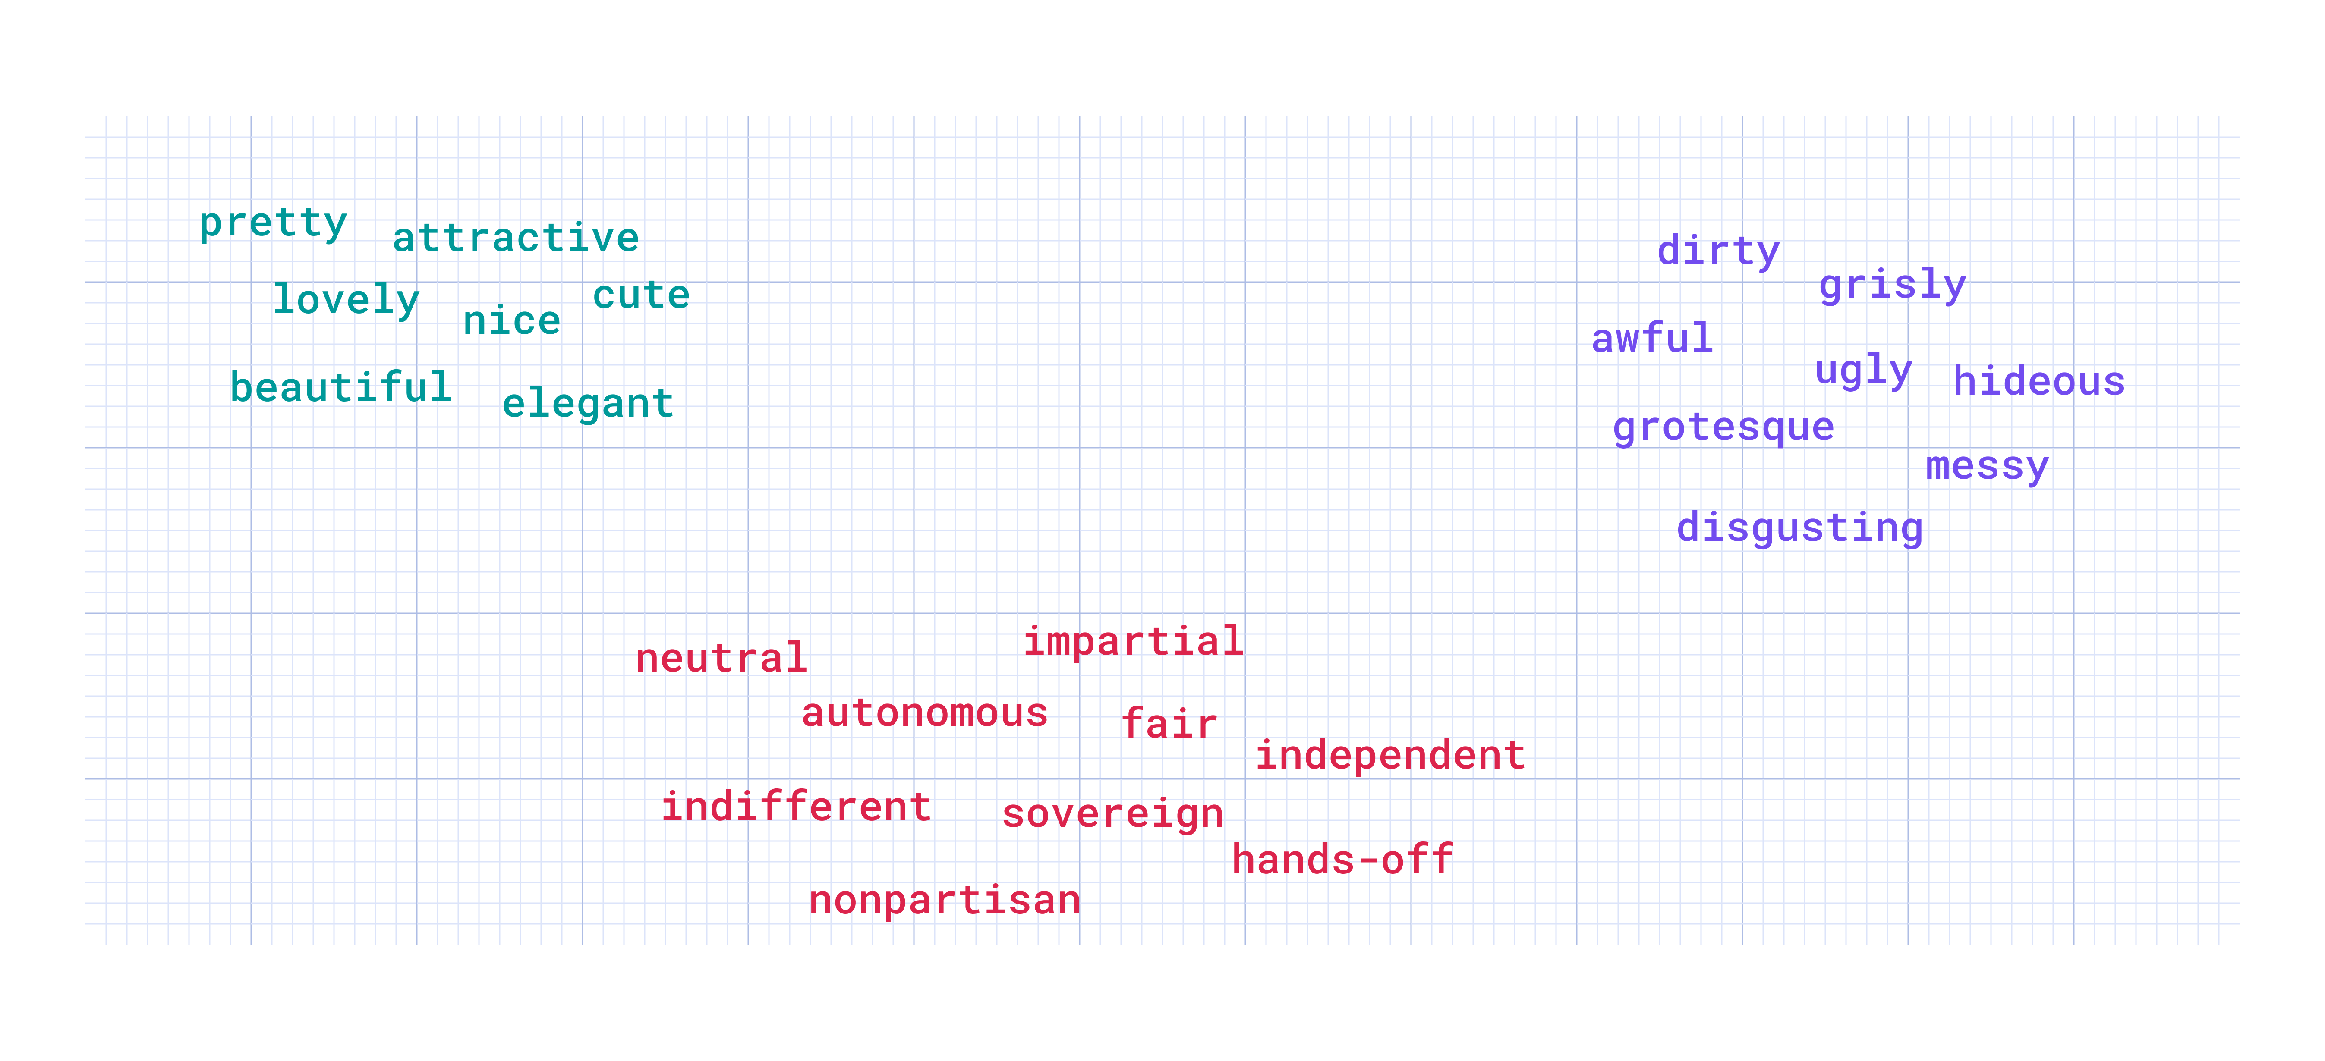
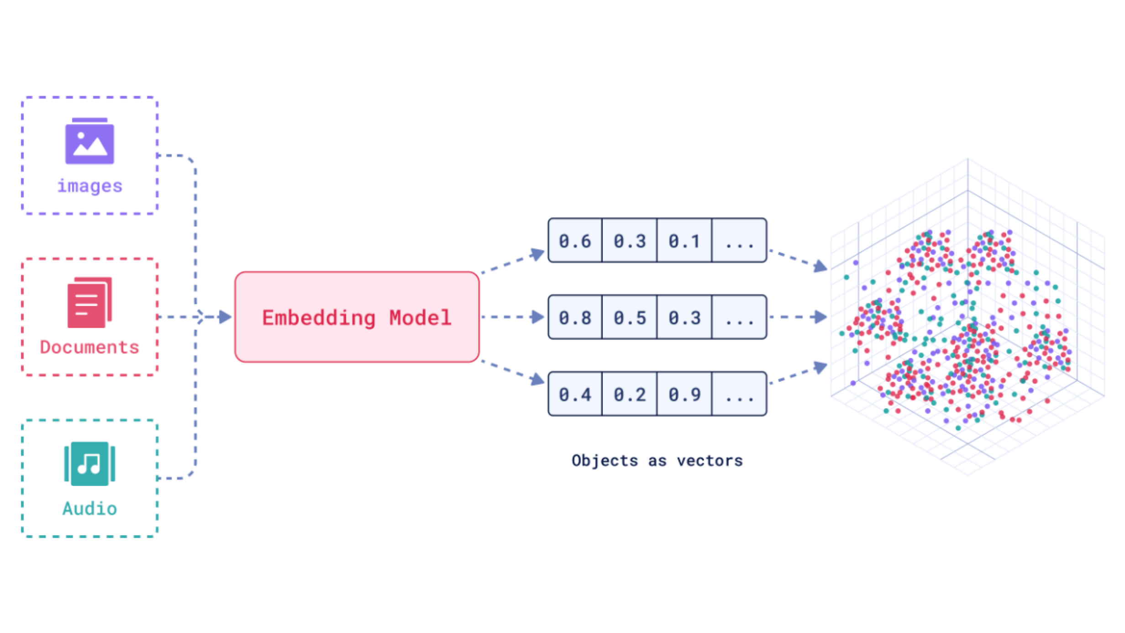
Key Vocabulary
How to make pizza?
Embeddings
Vectors
Similarity search
Hybrid queries
Homemade pizza recipes
Best pizza-making tips
Notes:
The nuances of natural language or the hidden meaning in large datasets of images, sounds, or user interactions are hard to fit into a table.
At their core, vector embeddings are about semantics. They take the idea that “a word is known by the company it keeps” and apply it on a grand scale.
Embeddings are the numerical representations of data—whether it’s text, images, or audio—that capture their semantic meaning. Think of embeddings as a way to translate messy, unstructured data into something machines can understand and compare. For instance, the phrase 'cute puppies' and the word 'adorable dogs' might have embeddings that are very close to each other in a multi-dimensional space.
Different models produce embeddings with vector spaces of varying dimensions, depending on how the model was designed and trained.
Embeddings are represented as vectors—essentially, multi-dimensional arrays of numbers. These vectors allow us to perform mathematical operations, such as calculating similarity between two data points. It’s through vectors that we can move beyond simple keyword matches to understanding meaning.
Most but not all normalise these to 1.
Similarity Search
This is where the magic happens. Similarity search allows us to compare embeddings to find the closest matches. For example, in a document database, we could search for text that’s most 'semantically similar' to a given query. This is much more powerful than keyword search, especially for natural language.
Hybrid Queries
Hybrid queries combine the power of vector-based similarity search with structured database queries. For instance, you could retrieve all products similar to 'wireless earbuds' but filter them by price or stock availability using a traditional SQL query.
Any other terms we want to get out on the table?
Now that we have a shared understanding of these key terms, we’re ready to explore how they’re applied in practical workflows, starting with embeddings and vector stores.

Slide 13
Real-World Applications
Activity
Split in groups (2/3)
Pick one of the application types
Discuss and brainstorm a new or unique use case for the selected application type.
Think about a specific domain (e.g., healthcare, education, e-commerce, etc.) where this application could solve a real-world problem.
Summarize your idea in 1-2 sentences. Be ready to share your group’s idea with everyone in the room.
Optional Prompts to Guide Thinking:
"What problem does this solve?"
"Who would benefit from this application?"
"What kind of data would you need to make it work?"
Semantic Search
Recommendation Systems
Q&A
Image/Multimedia Search
Hybrid Applications

Slide 14
Visualise the workflow
Data preprocessing
Query the system
Input data
Generate embeddings
Feedback loop
Output
Store embeddings
Notes:
Input Data:
"Everything starts with raw data. This could be a user query, an uploaded image, or audio input. For example, think of a user typing 'best books on Python' into a search bar or uploading an image for reverse image search. The type of input determines the preprocessing and embedding approach."
Data Preprocessing:
"Once we have the raw input, preprocessing ensures the data is clean and ready for embedding generation. For text, this might mean tokenizing words, removing stopwords, or normalizing casing. For images, it might mean resizing or cropping. Preprocessing ensures that we’re feeding consistent, high-quality data into the next step."
Prompt to Audience:
"What challenges do you think preprocessing might introduce when working with large, unstructured datasets?"
Generate Embeddings:
"After preprocessing, the data is transformed into embeddings using a model like BERT, GPT, or a custom-trained model. These embeddings are essentially numerical representations that capture the meaning or features of the data. For instance, the phrase 'learn Python' might generate an embedding close to 'Python tutorials' in the vector space."
Example:
"Imagine embeddings as coordinates in a multi-dimensional space where similar inputs are located closer together."
Challenging Question:
"How do you decide which model to use for generating embeddings? What trade-offs might you need to consider?"
Store Embeddings:
"These embeddings are then stored in a vector store, which is optimized for tasks like similarity search and fast retrieval. Examples of vector stores include pgvector for Postgres, FAISS for local memory, and Pinecone for cloud-based scalability."
Key Point:
"This stage is critical for systems like semantic search or recommendation engines, where speed and efficiency matter."
Query the System:
"When a user interacts with the system—like searching for 'best books' or 'similar images'—their input is converted into an embedding and matched against stored embeddings. The system uses similarity measures like cosine similarity to find the closest matches. In more advanced setups, hybrid queries combine this semantic search with traditional SQL filters, like filtering products by price or location."
Prompt to Audience:
"Can you think of scenarios where hybrid queries might outperform purely semantic ones?"
Output:
"The results are presented to the user in a meaningful way—like a ranked list of documents, product recommendations, or a set of related images. This stage bridges the technical output with the end-user experience."
Example:
"For a Q&A system, the output might be a direct answer generated by an LLM, while for a search engine, it might be a ranked list of articles."
Feedback Loop:
"This step is often overlooked but is critical for improving the system over time. Feedback loops involve learning from user interactions—such as clicks, likes, or corrections—and using that data to retrain embeddings, optimize search rankings, or refine the model. For instance, if a user consistently ignores certain recommendations, the system can adjust to avoid similar results in the future."
Challenging Question:
"How do you think feedback loops could be integrated into an AI workflow without overwhelming the system with noise or bad data?"
Closing Statement:
"This workflow outlines the journey data takes through an AI system. Over the course of this session, we’ll explore each of these stages in more detail, focusing on how they’re implemented and optimized in real-world scenarios."

Slide 15
Challenges and Trade-offs in AI Workflows
Area | Challenge | Trade-off
Data preprocessing | Dealing with unstructured and noisy data | Extensive cleaning improves model performance but adds processing time
Embedding generation | Choosing the right model for embeddings | Larger models capture more detail but increase computational cost and latency
Vector Stores | Balancing speed and scalability | Highly optimized vector stores may require significant storage or expensive infrastructure
Querying the System | Combining semantic and structured queries effectively | Hybrid queries add complexity but improve user experience
Feedback Loop | Handling noisy or biased feedback | Ignoring feedback avoids bias but slows improvement; incorporating noisy data may harm performance
Notes:
Data Preprocessing:
"The quality of your input data determines the effectiveness of the entire system. However, cleaning and preprocessing data takes time and resources, especially with unstructured formats like text or images."
Embedding Generation:
"Choosing the right embedding model is a critical decision. Larger models offer more accuracy but come with a trade-off in speed and computational requirements. For instance, GPT-based embeddings might capture richer meaning but may be too slow for real-time applications."
Vector Stores:
"Storing and retrieving embeddings at scale requires significant infrastructure. Vector stores optimized for performance can be expensive and may introduce challenges in distributed systems."
Querying the System:
"Hybrid queries, while powerful, require careful integration of semantic and structured search. Balancing complexity with performance is an ongoing challenge."
Feedback Loop:
"Incorporating user feedback can improve system accuracy, but not all feedback is useful. For example, biased or noisy feedback can lead to unintended consequences, such as reinforcing stereotypes or degrading search quality."

Slide 16
Modern AI workflows combine structured and unstructured data, embeddings and vector search to enable intelligent systems.

Slide 17
Questions
?

