Slide 1

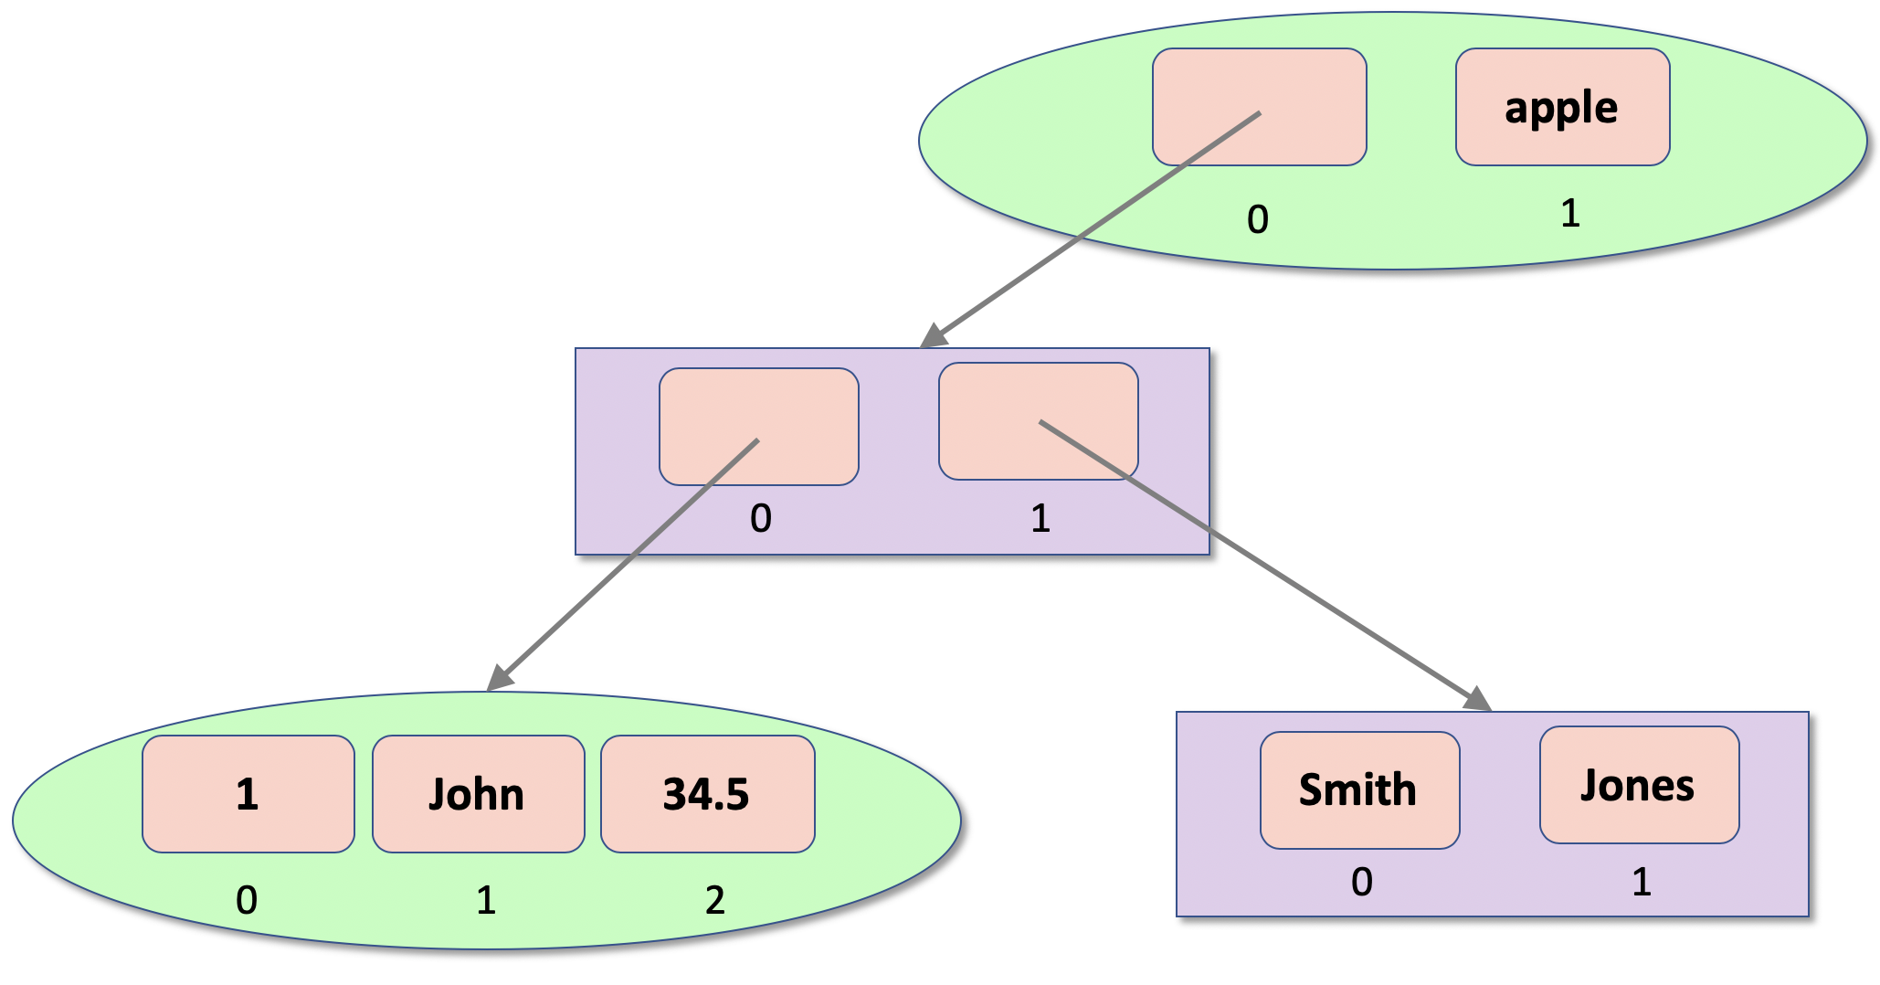
Python Data Container Types
Kevin Cunningham

Slide 2
Plan for Session
Characteristics of Data Containers
Python Collection Types
Tuples
Lists
Dictionaries
Collection constructor functions
Check for membership & iterations

Slide 3

Characteristics of Data Containers
Allow multiple values to be held together
Have a set of features
ordered or unordered
mutable or immutable
that is modifiable or not
allow duplicates or not
may associate a value with an index or key
may be growable or not
Choose appropriate container type based on your requirements
Often referred to as collections

Slide 4
Python Collection Types
Four core container types
Tuples represent a collection of values
ordered, fixed size
immutable (cannot be modified)
allow duplicate members
indexed
Lists are
ordered
mutable (changeable)
allow duplicate members
indexed
growable
Sets are
unordered, growable
mutable (changeable)
do not allow duplicate values
can only hold immutable objects
Dictionaries are
ordered 3.7 on (unordered prior to 3.7)
mutable (changeable)
indexed by a key which references a value
growable

Slide 5

Tuples
Immutable ordered collections
empty_tuple = ()
tup1 = (1, 3, 5, 7) print('tup1[0]:\t', tup1[0]) print('tup1[1]:\t', tup1[1])
print('tup1[1:3]:\t', tup1[1:3]) # return a slice print('tup1[:3]:\t', tup1[:3]) print('tup1[1:]:\t', tup1[1:])
print('len(tup1):\t', len(tup1))
tup2 = (1, 'John', True, -23.45) print(tup2) tup3 = ('apple', 'pear', 'orange', 'plum', 'apple') for fruit in tup3: print(fruit)
if 'orange' in tup3: print('orange is in the Tuple')
tup1[0]: 1
tup1[1]: 3
tup1[1:3]: (3, 5)
tup1[:3]: (1, 3, 5)
tup1[1:]: (3, 5, 7)
len(tup1): 4
(1, 'John', True, -23.45)
apple
pear
orange
plum
apple
orange is in the Tuple

Slide 6
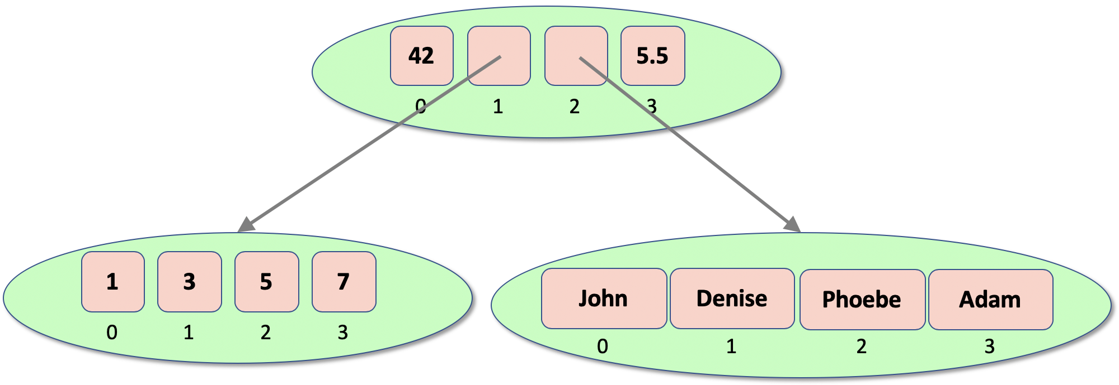
Nested Tuples
Can nest tuples
tuple1 = (1, 3, 5, 7) tuple2 = ('John', 'Denise', 'Phoebe', 'Adam') tuple3 = (42, tuple1, tuple2, 5.5) print(tuple3)
print(tuple3[1][1])
(42, (1, 3, 5, 7), ('John', 'Denise', 'Phoebe', 'Adam'), 5.5)
3

Slide 7
Lists
Mutable ordered container
empty_list = [] # empty_list = list()
list1 = ['John', 'Paul', 'George', 'Ringo’]
print(list1, ': ', len(list1))
print('list1[1]:', list1[1]) print('list1[1:3]:', list1[1:3]) # obtain a slice from 1 up to 3 print('list[:3]:', list1[:3]) # obtain a slice from start up to 3 print('list[1:]:', list1[1:]) # obtain a slice from start 1 to end
list1.append('Pete') print(list1) list1.extend(['Albert', 'Bob']) print(list1)
list1.insert(2, 7) print(list1)
list1.remove('Pete')
print(list1)
del list1[1:3]
print(list1)
['John', 'Paul', 'George', 'Ringo'] : 4
list1[1]: Paul
list1[1:3]: ['Paul', 'George’]
list[:3]: ['John', 'Paul', 'George’]
list[1:]: ['Paul', 'George', 'Ringo’]
['John', 'Paul', 'George', 'Ringo', 'Pete’]
['John', 'Paul', 'George', 'Ringo', 'Pete', 'Albert', 'Bob’]
['John', 'Paul', 7, 'George', 'Ringo', 'Pete', 'Albert', 'Bob]
['John', 'Paul', 7, 'George', 'Ringo', 'Albert', 'Bob]
['John', 'George', 'Ringo', 'Albert', 'Bob']

Slide 8
List methods
Method | Description
append() | Adds an element at the end of the list
clear() | Removes all the elements from the list
copy() | Returns a copy of the list
count() | Returns the number of elements with the specified value
extend() | Add the elements of a list (or any iterable), to the end of the current list
index() | Returns the index of the first element with the specified value
insert() | Adds an element at the specified position
pop() | Removes the element at the specified position
remove() | Removes the item with the specified value
reverse() | Reverses the order of the list
sort() | Sorts the current list

Slide 9
Nested Lists
Can nest lists
John
Denise
0
1
2
3
1
43.5
Phoebe
True
apple
orange
31
0
1
2
3
0
1
2
l1 = [1, 43.5, 'Phoebe', True] l2 = ['apple', 'orange', 31] root_list = ['John', l1, l2, 'Denise'] print(root_list)
print(root_list[1][1])
['John', [1, 43.5, Phoebe, True], ['apple', 'orange', 31], 'Denise’]
43.5

Slide 10
Nesting Tuples and Lists
Can nest tuples and lists
t1 = (1, 'John', 34.5) l1 = ['Smith', 'Jones'] l2 = [t1, l1] t2 = (l2, 'apple') print(t2)
([(1, 'John', 34.5), ['Smith', 'Jones']], 'apple')

Slide 11
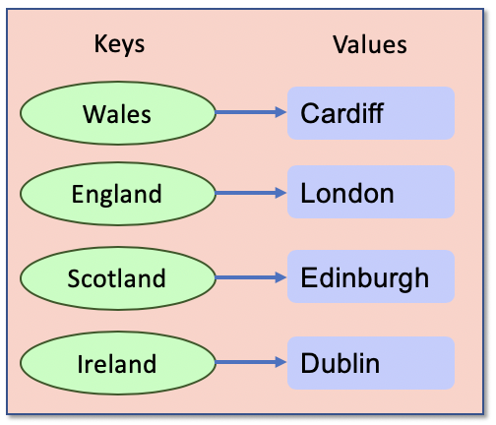
Dictionaries
Set of key:value pairs
empty_dictionary = {}
cities = {'Wales': 'Cardiff', 'England': 'London', 'Scotland': 'Edinburgh', 'Ireland': 'Dublin'}
print(cities)
{'Wales': 'Cardiff', 'England': 'London', 'Scotland': 'Edinburgh', 'Ireland': 'Dublin'}

Slide 12
Dictionaries
Working with Dictionaries
print('cities[Wales]:', cities['Wales']) print('cities.get(Ireland):', cities.get('Ireland’))
for country in cities: print(country, end=', ') print(cities[country])
print(cities.values()) print(cities.keys()) print(cities.items()) print('Wales' in cities) print('France' not in cities)
del cities['Scotland’] # Delete
cities['France'] = 'Paris’ # Add
cities['Wales'] = 'Swansea’ # Replace
cities[Wales]: Cardiff
cities.get(Ireland): Dublin
dict_values(['Cardiff', 'London', 'Edinburgh', 'Dublin'])
dict_keys(['Wales', 'England', 'Scotland', 'Ireland'])
dict_items([('Wales', 'Cardiff'), ('England', 'London'), ('Scotland', 'Edinburgh'), ('Ireland', 'Dublin')])
True
True
Notes:
print('cities[Italy]:', cities[Italy']) – throws an exception print('cities.get(Italy):', cities.get('Italy')) – returns None

Slide 13
Nesting Dictionaries
Keys must be immutable
but values can be any type of object inc. collections
seasons = {'Spring': ('Mar', 'Apr', 'May'),
'Summer': ('June', 'July', 'August'),
'Autumn': ('September', 'October', 'November'),
'Winter': ('December', 'January', 'February')}
print(seasons['Spring'])
print(seasons['Spring'][1])
('Mar', 'Apr', 'May')
Apr

Slide 14
Dictionary Methods
Method | Description
clear() | Removes all the elements from the dictionary
copy() | Returns a copy of the dictionary
fromkeys() | Returns a dictionary with the specified keys and values
get() | Returns the value of the specified key
items() | Returns a list containing the tuple for each key value pair
keys() | Returns a list containing the dictionary's keys
setdefault() | Returns the value of the specified key. If the key does not exist: insert the key, with the specified value
update() | Updates the dictionary with the specified key-value pairs
values() | Returns a list of all the values in the dictionary

Slide 15
Collection constructor functions
Take an iterable
anything implementing the iterable protocol
e.g. lists, tuples, sets etc.
Return a type of collection
Dictionaries have dict()
takes an iterable or a sequence of key:value pairs
Create empty containers
tuple(iterable)
list(iterable)
set(iterable)
tuple()
list()
set()
# could be lists or tuples
dict2 = dict([('uk', 'London'), ('ireland', 'Dublin'), ('france', 'Paris')])

Slide 16
Check for membership of Containers
# tuples
fruit = ('apple', 'pear', 'orange', 'plum', 'apple') if 'orange' in fruit: print('orange is in the Tuple') if 'orange' not in fruit: print('orange is NOT in the Tuple') # Lists list1 = ['John', 'Paul', 'George', 'Ringo'] if 'Pete' in list1: print('Pete in the list') else: print('Pete not in the list') # Dictionaries cities = {'Wales': 'Cardiff', 'England': 'London', 'Northern Ireland': 'Belfast', 'Ireland': 'Dublin'} if 'Wales' in cities: print('We know the capital of Wales')
Can check to see if a value is in a container
use the in and not in operators
can be used with tuples, lists, sets, dictionary keys etc.
orange is in the Tuple
Pete not in the list
We know the capital of Wales

Slide 17
Iterating through containers
Can iterate through all the values in a container
such as a list, a tuple or a set
Use a for loop
With a dictionary can iterate over the keys or values
# Set up the list
list = [1, 3, 5, 7, 9]
# Using for loop
for i in list:
print(i)
1
3
5
7
9
# note keys are not strings
dict1 = dict(uk='London', ireland='Dublin', france='Paris’)
# iterate over the keys
for key in dict1:
print(key)
# iterate over the values (items) in the dictionary
for value in dict1.values():
print(value)

Slide 18
Questions?
?

