Slide 1
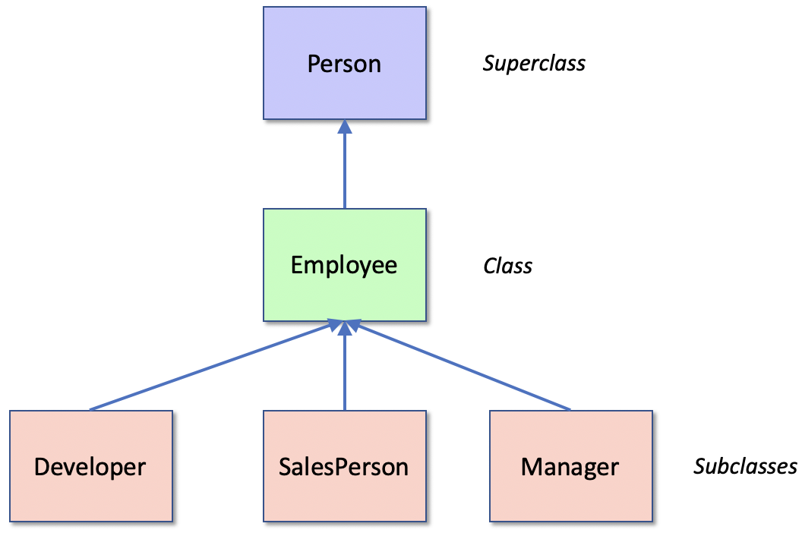

Class Inheritance
Kevin Cunningham

Slide 2
Plan for Session
What is Inheritance?
Inheritance Terminology
Purpose of a Subclass
Declaring Inheritance in Python
The Class object and Inheritance
Overriding and Extending Methods
Inheritance Naming Conventions
Multiple Inheritance

Slide 3

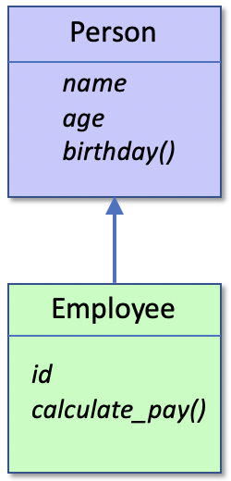
What is Inheritance?
Allows one class to inherit features defined in another class
Provides a from of reuse
Allows data and behaviour to be defined in one place
and therefore maintained in one place
Person defines
name, age attributes and birthday()
Employee
inherits the definitions of name, age and birthday()
and adds id attribute and calculate_pay() method

Slide 4
Inheritance Terminology
Commonly used inheritance terminology

Slide 5
Purpose of a Subclass
A subclass should do 1 or more of:
Extend the external protocol or interface of the superclass
Change the implementation of 1 or more methods
i.e. the way in which the behaviour provided by the superclass is implemented.
Add additional behaviour
that references inherited behaviour / data

Slide 6

Declaring Inheritance
A class extends a parent class
by listing the parent in brackets after the class name
can have one or multiple super (parent) classes
Subclass will inherit all attributes and methods
from superclass class
unless they override them
class SubClassName(SuperClassName):
class-body

Slide 7
Declaring Inheritance
Given the following classes
we can declare this subclass
class Person: def __init__(self, name, age): self.name = name self.age = age
def birthday(self): print('Happy birthday you were', self.age) self.age += 1 print('You are now', self.age)
class Employee(Person): def __init__(self, name, age, id): super().__init__(name, age) self.id = id
def calculate_pay(self, hours_worked): rate_of_pay = 7.50 if self.age >= 21: rate_of_pay += 2.50 return hours_worked * rate_of_pay

Slide 8
Declaring Inheritance
Employee extends Person
_ _init_ _() method
must reference _ _init_ _() method in class Person
used to initialise instances of that class
via the super()._ _init_ _() reference
All instances of the class Employee
have a name, and age and an id and
have the behaviours birthday() and calculate_pay(house_worked)
calculate_pay() in Employee class
can access attributes name and age just as it can access id

Slide 9
Inheritance
Can now use Person and Employee classes
print('Person') p = Person('John', 54) print(p) p.birthday() print(p.name) print(p.age)
print('-' * 25) print('Employee') e = Employee('Denise', 51, 7468)
print(e) e.birthday() print(e.name) print(e.age) print(e.id) print('e.calculate_pay(40):', e.calculate_pay(40) )
Person
John is 54
Happy birthday you were 54
You are now 55
John
55
-------------------------
Employee
Denise is 51 - id(7468)
Happy birthday you were 51
You are now 52
Denise
52
7468
e.calculate_pay(40): 400.0

Slide 10
The Class object and Inheritance
Every class extends one or more classes
even the class Person
by default, it extends class object
Had to be defined explicitly from Python 2.2 to Python 3
to ensure new style classes were used
pre Python 2.2 referred to as old style class inheritance
No longer used
class Person: def __init__(self, name, age): self.name = name self.age = age
class Person(object): def __init__(self, name, age): self.name = name self.age = age
=

Slide 11
The Class object behaviour
The object class provides some default special methods
Defines special methods
_ _str_ _(),
_ _init_ _(),
_ _eq_ _() (equals) and
_ _hash_ _() (hash method)

Slide 12
Overriding Methods
Occurs when subclass defines method with same signature as parent class
class Person: def __init__(self, name, age): self.name = name self.age = age
def __str__(self): return self.name + ' is ' + str(self.age)
class Employee(Person): def __init__(self, name, age, id): super().__init__(name, age) self.id = id
def __str__(self): return self.name + ' is ' + str(self.age) + ' - id(' + str(self.id) + ')'
Overrides method
in parent class

Slide 13
Extending Methods
May want to extend behaviour in parent class
achieved via call to super() version of method
class Person: def __init__(self, name, age): self.name = name self.age = age
def __str__(self): return self.name + ' is ' + str(self.age)
class Employee(Person): def __init__(self, name, age, id): super().__init__(name, age) self.id = id
def __str__(self): return super().__str__() + ' - id(' + str(self.id) + ')'
Extends method
in parent class

Slide 14
Inheritance Naming Conventions
Two naming conventions to be aware of
Single underbar convention
Methods or attributes to be considered protected
private to the class but can be accessed from any subclass
scope is thus the class and any subclasses (but only a convention)
Double underbar convention
Methods or attributes to be considered private to that class
should not be called from outside of the class
Python runtime can perform name mangling on these

Slide 15
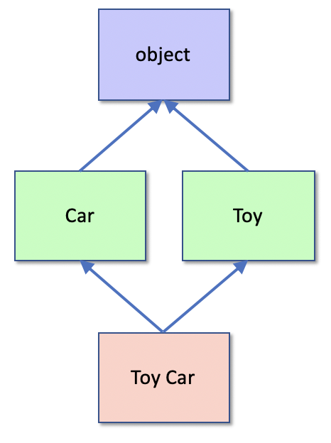
Python Multiple Inheritance
Python supports multiple inheritance
multiple super classes to be listed in the parent class list (defined by the brackets following the class name)
class Car: """ Car ""”
method1() class Toy: """ Toy ""”
method1() class ToyCar(Car, Toy): """ A Toy Car """
to find methods Python 3 performs a breadth first search up inheritance tree

Slide 16
Questions?
?

