Slide 1

Testing in Python
Kevin Cunningham

Slide 2
Plan for Session
What is pytest?
Writing tests
Test Fixtures
Parameterized Tests
Ignoring Tests
Testing for exceptions

Slide 3

What is pytest?
Testing library for Python
one of the most popular
see https://docs.pytest.org/en/latest/
builds on top of / extends unittest
provides an extended set of facilities
Can be used for different levels of test
unit, integration, system/e2e
most typically used for unit
used by Dropbox, Mozilla etc. as Python testing framework
Has support in IDEs such as PyCharm
allowing for red bar, green bar development

Slide 4

Simple pytest Example
Need something to test
May be a function
Can be a class
Calculator class in calculator.py file
has the concept of the current total
can have a current value entered
the action to apply to the current value
class Calculator:
def __init__(self):
self.current = 0
self.total = 0
def set(self, value):
self.current = value
def add(self):
self.total += self.current
def sub(self):
self.total -= self.current
def total(self):
return self.total
def add(x, y): return x + y

Slide 5

Writing a Test
Place tests in separate file / module
Test defined in a file test_calculator.py
therefore, a separate module
so will need to import from calculator module
pytest uses conventions to find tests:
search for test_*.py or *_test.py files.
From those files, collect test items:
test_ prefixed test functions
IDE typically provides support for creating suitable test files

Slide 6
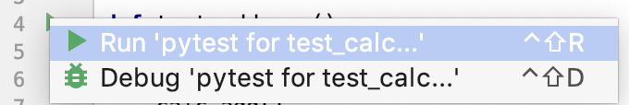
Writing a Test
A simple test
note use of descriptive test function name
makes it easier to understand test reports
Run using PyTest from command line or via IDE
from calculator import add def test_add_zeros(): result = add(0, 0) assert result == 0 def test_add_one_and_zero(): result = add(1, 0) assert result == 1 def test_add_zero_and_one(): result = add(0, 1) assert result == 1, "should be one"

Slide 7
Writing a Test
Can also test classes in exactly the same way
Again, can run from command line or via IDE
Using PyTest
from calculator import Calculator
def test_add_one(): calc = Calculator() calc.set(1) calc.add() assert calc.total == 1

Slide 8
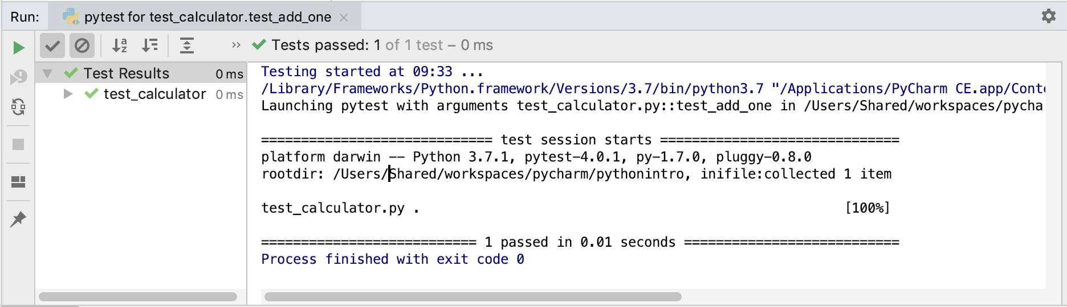
Running a Test
In IDE can see result of tests
and explore test reports

Slide 9

Test Fixtures
May need to run some behaviour
before or after each test or
before or after a group of tests in a module
to provide resource for a test
Such code is known as a fixture
may set up scenario for test
supply an object to be test
perform post test housekeeping etc.
Two styles
naming conventions
PyTest Python decorators

Slide 10
Test Fixtures as Functions
Based on naming conventions
from calculator import add def setup_module(): print('module set up') def teardown_module(): print('module teardown') def setup_function(): print('function set up') def teardown_function(): print('function teardown') def test_add_one_and_one(): result = add(1, 1) assert result == 2
module set up
function set up
PASSED [100%]
function teardown
module teardown

Slide 11
Test Fixtures Using Decorators
Can use pytest fixture decorator
have format @<name>
to indicate fixtures for tests
def test_initial_value(calculator): assert calculator.total == 0
def test_add_one(calculator): calculator.set(1) calculator.add() assert calculator.total == 1
def test_subtract_one(calculator): calculator.set(1) calculator.sub() assert calculator.total == -1
def test_add_one_and_one(calculator): calculator.set(1) calculator.add() calculator.set(1) calculator.add() assert calculator.total == 2
import pytest from calculator import Calculator
@pytest.fixture def calculator(): """Returns a Calculator instance""" print('calculator fixture’) return Calculator()
calculator fixture
calculator fixture
calculator fixture
calculator fixture
Notes:
autouse – means automatically run – don't need to be explicitly referenced

Slide 12
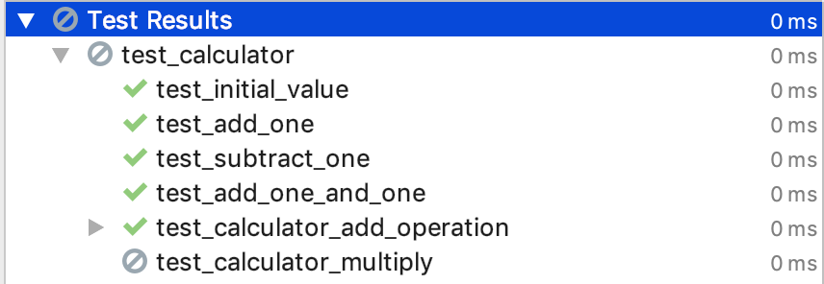
Ignoring Tests
May want to ignore tests
particularly during development
To ignore a test
decorate with @pytest.mark.skip
Reported on in IDE / pytest report
@pytest.mark.skip(reason='not implemented yet')
def test_calculator_multiply(calculator):
calculator.multiply(2, 3)
assert calculator.total == 6

Slide 13
Parameterized Tests
Common to run the same tests multiple times with several different input values
can greatly reduce the number of tests needed
Such tests are referred to as parametrised tests
specified via @pytest.mark.parametrize decorator
with values to apply provided to decorator
@pytest.mark.parametrize('input1,input2,expected', [ (3, 1, 4), (3, 2, 5), ]) def test_calculator_add_operation(calculator, input1, input2, expected): calculator.set(input1) calculator.add() calculator.set(input2) calculator.add() assert calculator.total == expected
Notes:
This illustrates setting up a parametrised test for the Calculator in which two input values are added together and compared with the expected value. Note that the parameters are named in the decorator and then a list of tuples is used to define the values to be used for the parameters. In this case the test_calculator_add_operation will be run two passing in 3, 1 and 4 and then passing in 3, 2 and 5 for the parameters input1, input2 and expected respectively.

Slide 14
Testing for Exceptions
Can write tests that verify that an exception was raised
In PyTest use the with statement and pytest.raises
import pytest
def test_current_account_overdraft():
current_account = CurrentAccount(0.0)
with pytest.raises(accounts.BalanceError):
current_account.withdraw(200.0)

Slide 15
Questions?
?

