Slide 1

Graphing with MatPlotLib (Optional)
Kevin Cunningham

Slide 2
Plan for Session
What is MatPlotLib?
Where does it fit in?
pyplot scripting API
Simple Line Plot
Configuring a Plot
Multiple Line Plot
Bar Charts
Pie Charts
Scatter graph
Saving Plot to a File

Slide 3
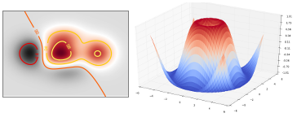
What is MatPlotLib?
A Python plotting library supporting
plots, histograms, bar charts
scatter graphs, heat maps, 3D Plots
animation, image display etc.
can have interactive plots
Very widely used
See Matplotlib home page for more details
http://matplotlib.org/
Also see W3 Schools for good overview
https://www.w3schools.com/python/matplotlib_intro.asp

Slide 4
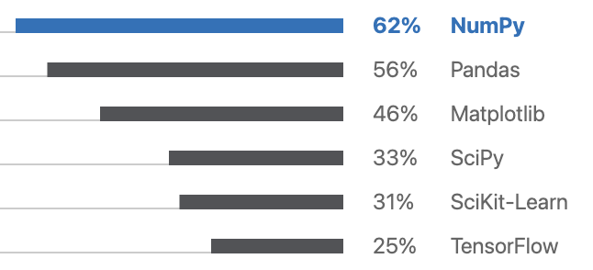
Where does MatPlotLib fit in?
Can be used in any Python program
Pandas
Matplotlib
SciPy
NumPy
Python

Slide 5
Where does MatPlotLib fit in?
Part of suite of tools commonly used
in data analytics
pandas
Data Analytics
Pandas
Matplotlib
Matplotlib
SciPy
SciPy
NumPy
NumPy
Python
Python

Slide 6
pyplot Scripting API
Several ways to work with MatPlotLib
Most common (and easiest) is via pyplot API
a module of MatPlotLib
usually imported as pyplot or plt
plyplot API used to
construct the plot
configure labels and axis
manage color and line styles
handles events / allows plots to be interactive
display (show) the plot
import matplotlib.pyplot as pyplot

Slide 7
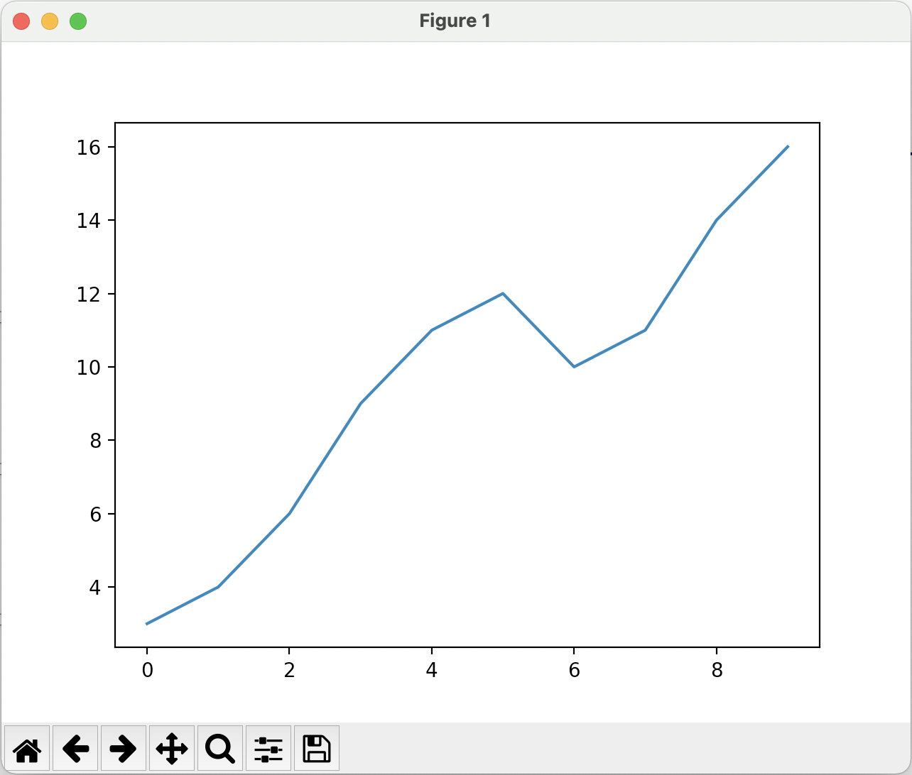
Simple Plot
Using matplotlib.pyplot
to generate a basic graph
# Import the pyplot api import matplotlib.pyplot as pyplot # Plot a sequence of values pyplot.plot([3, 4, 6, 9, 11, 12, 10, 11, 14, 16]) # Display the chart in a window pyplot.show()

Slide 8
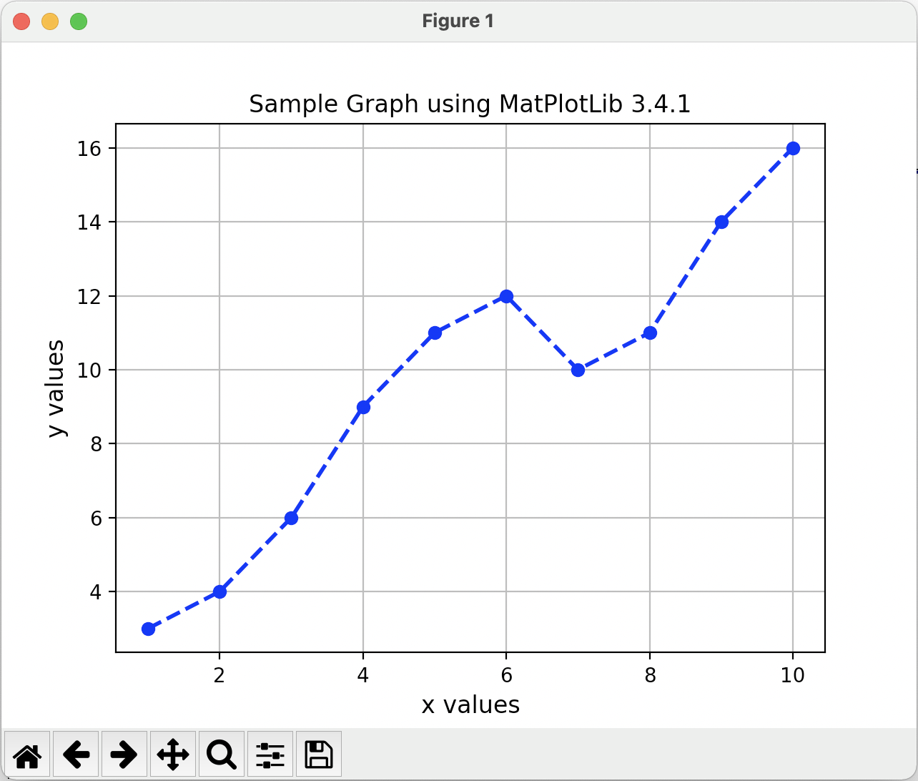
Configuring a Plot
Can set x and y labels, graph title, line styles etc.
import matplotlib import matplotlib.pyplot as pyplot x = range(1, 11) y = [3, 4, 6, 9, 11, 12, 10, 11, 14, 16] # Set the axes headings pyplot.ylabel('y values', fontsize=12) pyplot.xlabel('x values', fontsize=12) # Set the title pyplot.title("Sample Graph using MatPlotLib " + str(matplotlib.__version__)) # Configure line on plot pyplot.plot(x, y, linewidth=2.0, label="samples", marker='o', color='blue', linestyle='--') # Include a grid pyplot.grid() # Display the graph pyplot.show()

Slide 9
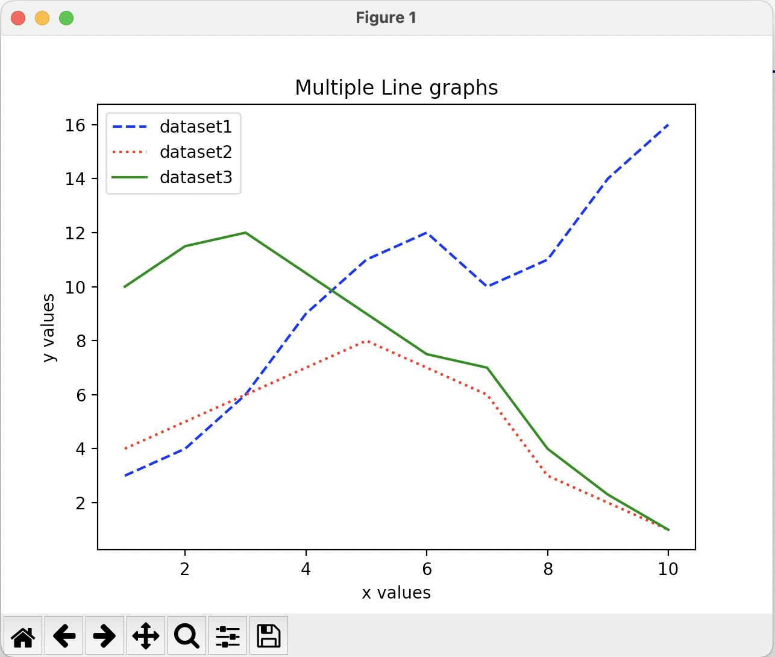
Multi Line Plot
Can have more than one graph on a plot
# … x = range(1, 11) y1 = [3, 4, 6, 9, 11, 12, 10, 11, 14, 16] y2 = [4, 5, 6, 7, 8, 7, 6, 3, 2, 1] y3 = [10, 11.5, 12, 10.5, 9, 7.5, 7, 4, 2.3, 1] # …
# Draw each line graph
pyplot.plot(x, y1, label="dataset1", color='blue', linestyle='--') pyplot.plot(x, y2, label="dataset2", color='red', linestyle=':') pyplot.plot(x, y3, label="dataset3", color='green') # Generate the legend pyplot.legend()
pyplot.show()

Slide 10
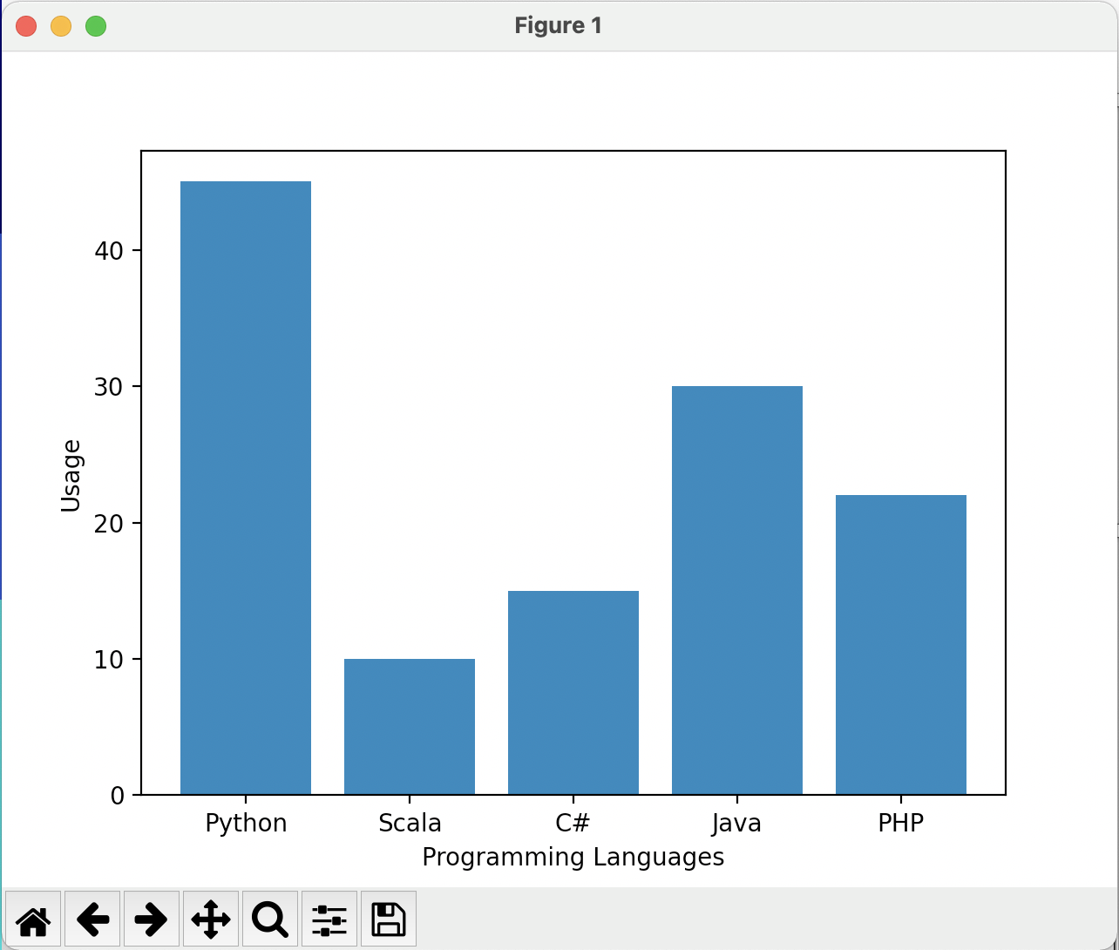
Bar Charts
import matplotlib.pyplot as pyplot # Set up the data labels = ('Python', 'Scala', 'C#', 'Java', 'PHP') index = (1, 2, 3, 4, 5) sizes = [45, 10, 15, 30, 22] # Set up the bar chart pyplot.bar(index, sizes, tick_label=labels) # Set up the horizontal bar chart # pyplot.barh(index, sizes, tick_label=labels) # Configure the layout pyplot.ylabel('Usage') pyplot.xlabel('Programming Languages') # Display the chart pyplot.show()
Can also create bar charts

Slide 11
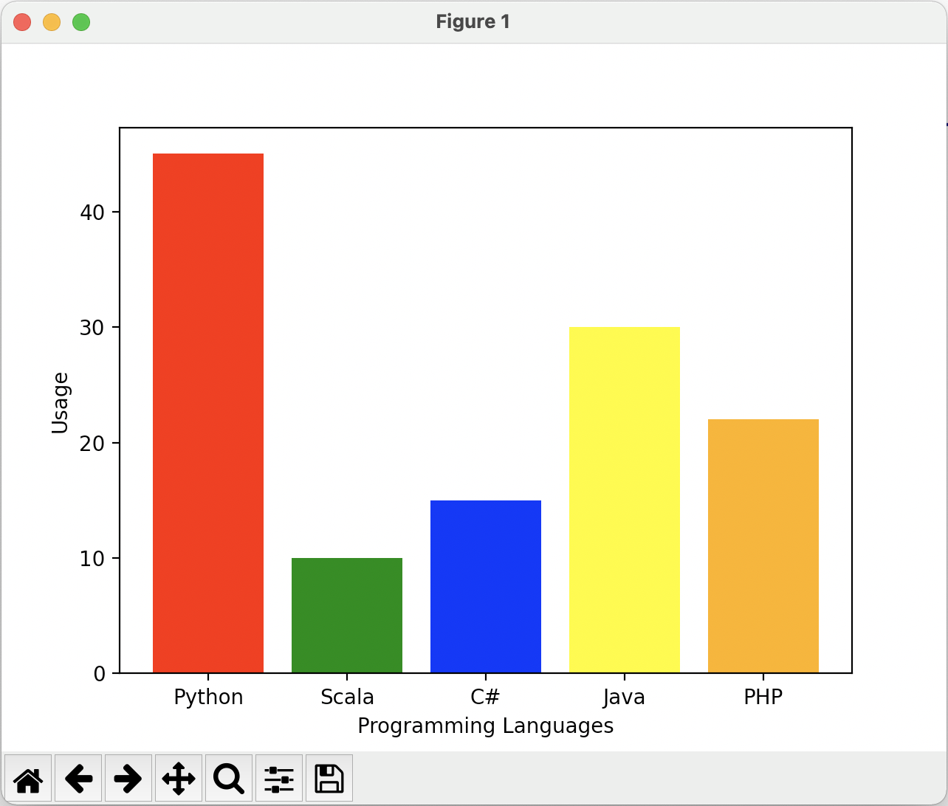
Bar Charts
import matplotlib.pyplot as pyplot # Set up the data labels = ('Python', 'Scala', 'C#', 'Java', 'PHP') index = (1, 2, 3, 4, 5) sizes = [45, 10, 15, 30, 22] # Set up the multi-coloured bar chart pyplot.bar(index, sizes, tick_label=labels,
color=('red', 'green', 'blue', 'yellow', 'orange')) # Configure the layout pyplot.ylabel('Usage') pyplot.xlabel('Programming Languages') # Display the chart pyplot.show()
Can also create bar charts
Can configure colours of bars etc.

Slide 12
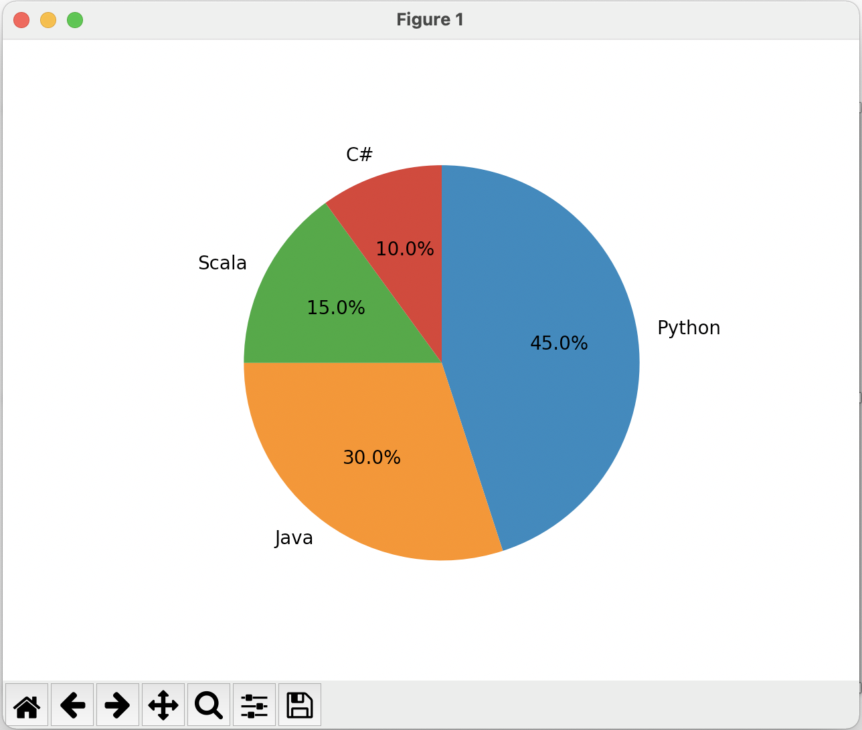
Pie Charts
Can create Pie charts
import matplotlib.pyplot as pyplot labels = ('Python', 'Java', 'Scala', 'C#') sizes = [45, 30, 15, 10] pyplot.pie(sizes, labels=labels, autopct='%.1f%%', counterclock=False, startangle=90) pyplot.show()
Notes:
# display the percentage value to 1 decimal place with a trailing %

Slide 13
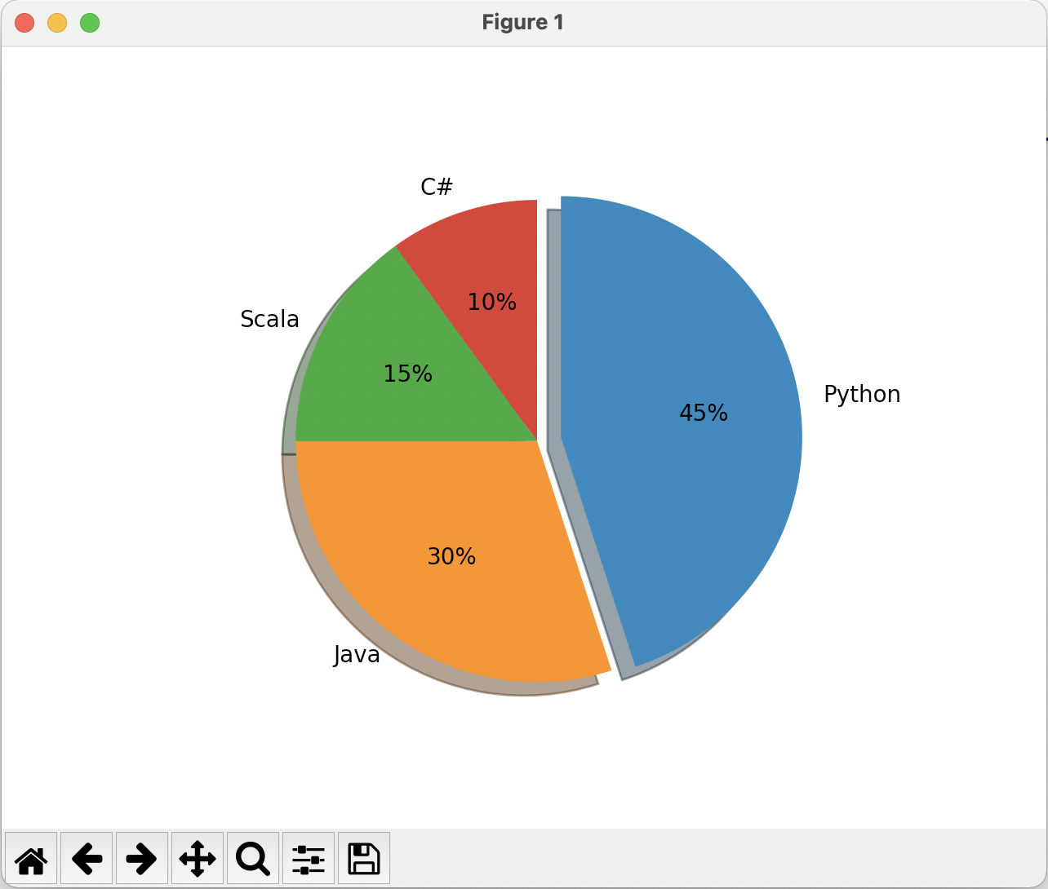
Pie Charts
Can configure Pie charts
import matplotlib.pyplot as pyplot labels = ('Python', 'Java', 'Scala', 'C#') sizes = [45, 30, 15, 10]
# only "explode" the 1st slice (i.e. 'Python') explode = (0.1, 0, 0, 0) pyplot.pie(sizes, explode=explode, labels=labels, autopct='%.0f%%', shadow=True, counterclock=False, startangle=90) pyplot.show()
Notes:
explode value also indicates by how much

Slide 14
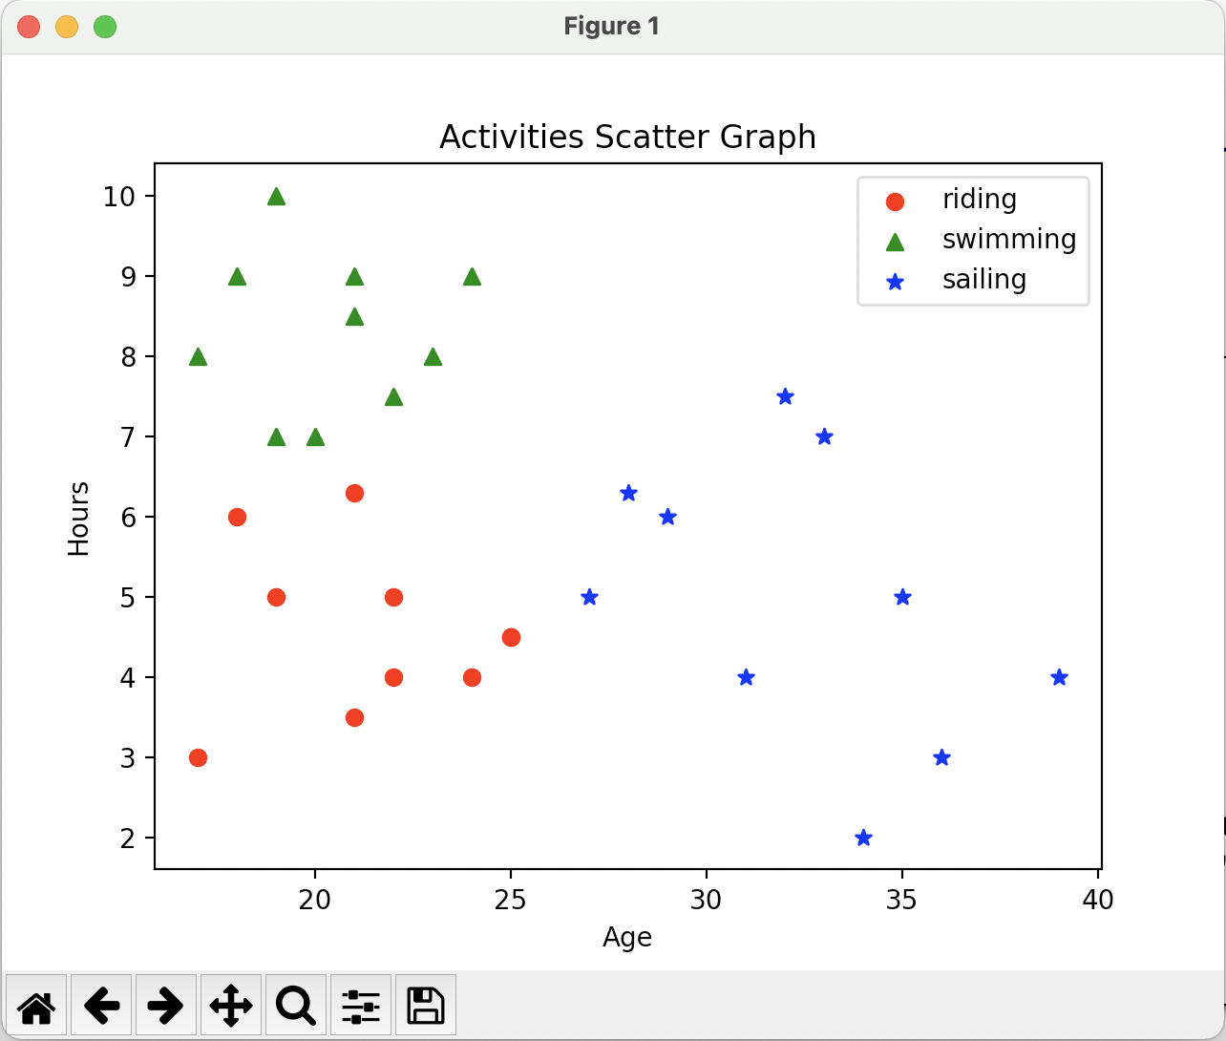
Scatter Plots
Can also generate scatter graphs
# Create data riding = ((17, 18, 21, 22, 19, 21, 25, 22, 25, 24), (3, 6, 3.5, 4, 5, 6.3, 4.5, 5, 4.5, 4)) swimming = ((17, 18, 20, 19, 22, 21, 23, 19, 21, 24), (8, 9, 7, 10, 7.5, 9, 8, 7, 8.5, 9)) sailing = ((31, 28, 29, 36, 27, 32, 34, 35, 33, 39), (4, 6.3, 6, 3, 5, 7.5, 2, 5, 7, 4)) # Plot the data pyplot.scatter(x=riding[0], y=riding[1], c='red', marker='o', label='riding') pyplot.scatter(x=swimming[0], y=swimming[1], c='green', marker='^', label='swimming') pyplot.scatter(x=sailing[0], y=sailing[1], c='blue', marker='*', label='sailing')

Slide 15

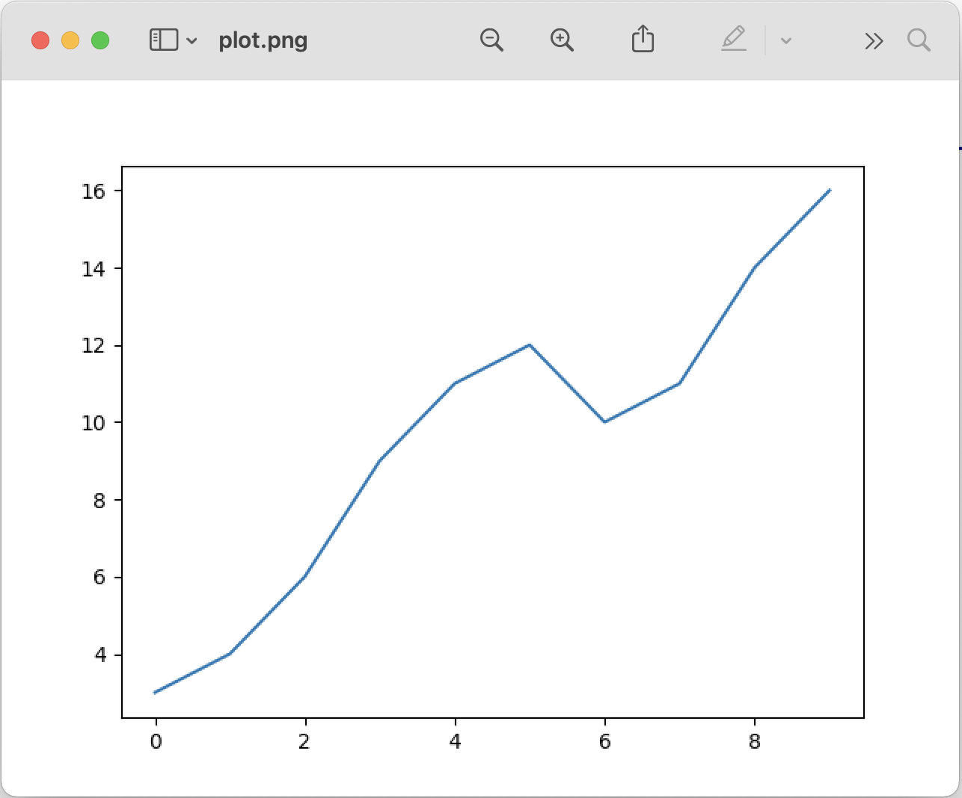
Save Plot to a File
Can do this interactively
Or programmatically
import matplotlib.pyplot as pyplot # Plot a sequence of values pyplot.plot([3, 4, 6, 9, 11, 12, 10, 11, 14, 16]) print('Saving plot as png file') # Save the plot to a file pyplot.savefig('plot.png')

Slide 16
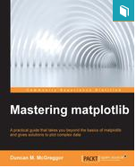
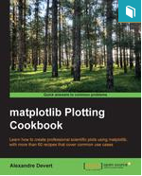
Additional Useful Resources
Matplotlib home
http://matplotlib.org
Python Matplotlib crash course
https://pythonprogramming.net/matplotlib-python-3-basics-tutorial
Books
Mastering Matplotlib by Duncan M. McGreggor
matplotlib Plotting Cookbook, A. Devert
Matplotlib for Python Developers, S. Tosi

Slide 17
Questions?
?

