Slide 1


Git and GitHub
Kevin Cunningham

Slide 2
Plan for Session
Git Introduction
Single Project Repository
Git Source Code Control
Git Change Flow
File States in Git
Git Tools
Command Line Git
Adding Files in Git
Working with a Remote Repository
GitHub
Branching & Pull Requests

Slide 3
Git Introduction
Git is a
Source Code Configuration Management system
aka SCCM or SCM system
Shared repository of code
to allow teams to work on codebase of a project
Track software changes
so that those changes can be undone if necessary
Tag releases
know exactly what code made it into a release
useful when different versions are needed for different clients

Slide 4

Git Introduction
Develop code local store centrally
Remote Server
commit
changes
Local Client

Slide 5
Git Source Code Control
clone remote repo
push updates
Local
Repository
push
Remote Repository
pull changes
commit
pull
Staging
(index)
Working Directory
add changes to
index / staging list

Slide 6
Git Change Flow
Working Directory
Staging
Area
Local
Repository
Remote
Repository
git add
git commit
git push
git pull
git checkout
git merge

Slide 7
File States in Git
Files can be in one of four states
State | Description
untracked | file is not tracked by Git
staged | file is included in list of changes to be committed
tracked | file has been staged and then committed, Git tracks changes to this file
modified | file has changed but not yet been staged
Notes:
A file can be in one of several states relative to the Git repository and branch currently be used with the working directory. These states are:
untracked: the file is not tracked by the Git repository, this means it is neither staged (added to the staging area) yet nor committed.
tracked: the file has been committed at least once, so Git keeps track of its changes.
staged: the file (or changes to the file) have been staged to be included in the next commit.
dirty / modified: the file has changed but the changes have not yet been staged.

Slide 8
Git Tools
Command Line Tools
basic command line interface for Git
GitHub
web based interface to Git repos
supports Pull Requests (PRs) and other workflow options
can support reviews
diff tools etc.
IDEs Git plugins / support
Git support in PyCharm
Git support also in Visual Studio Code etc.

Slide 9
Command Line Git
Available for Mac, Windows and Linux
Can be used to create a new project
can be useful for projects exploring how to solve problems
e.g. commit at regular intervals as you test new functionality
Need to initialize a new git project
$ mkdir my_project
$ cd my_project
$ git init
Initialized empty Git repository in my_project/.git/
$

Slide 10
Command Line Git
Can also clone an existing repository
can now make changes to this repository
add them
commit them
push them to the GitHub hosted repo
$ git clone https://github.com/johnehunt/javascript-intro.git
Cloning into 'javascript-intro'...
remote: Enumerating objects: 8, done.
remote: Counting objects: 100% (8/8), done.
remote: Compressing objects: 100% (8/8), done.
remote: Total 7152 (delta 0), reused 4 (delta 0), pack-reused 7144
Receiving objects: 100% (7152/7152), 27.51 MiB | 7.71 MiB/s, done.
Resolving deltas: 100% (2495/2495), done.
Checking connectivity... done
$

Slide 11
Adding Files in Git
Need to stage changes
adds them to the list of changed files
Commit inserts the staged changes into the local repository
$ cat > jjh-readme.txt
Johns readme
$ git add jjh-readme.txt
$ git commit -m 'My first commit'
[master (root-commit) 6b0dfe6] My first commit
1 file changed, 1 insertion(+)
create mode 100644 jjh-readme.txt
$

Slide 12
Working with Remote Repository
Use the git push command to update the remote repository
may need to specify the branch
e.g. git push main
$ git push
Username for 'https://github.com': johnehunt
Password for 'https://johnehunt@github.com': ******
Counting objects: 3, done.
Writing objects: 100% (3/3), 234 bytes | 0 bytes/s, done.
Total 3 (delta 0), reused 0 (delta 0)
To https://github.com/johnehunt/playarea.git
* [new branch] main -> main
$

Slide 13
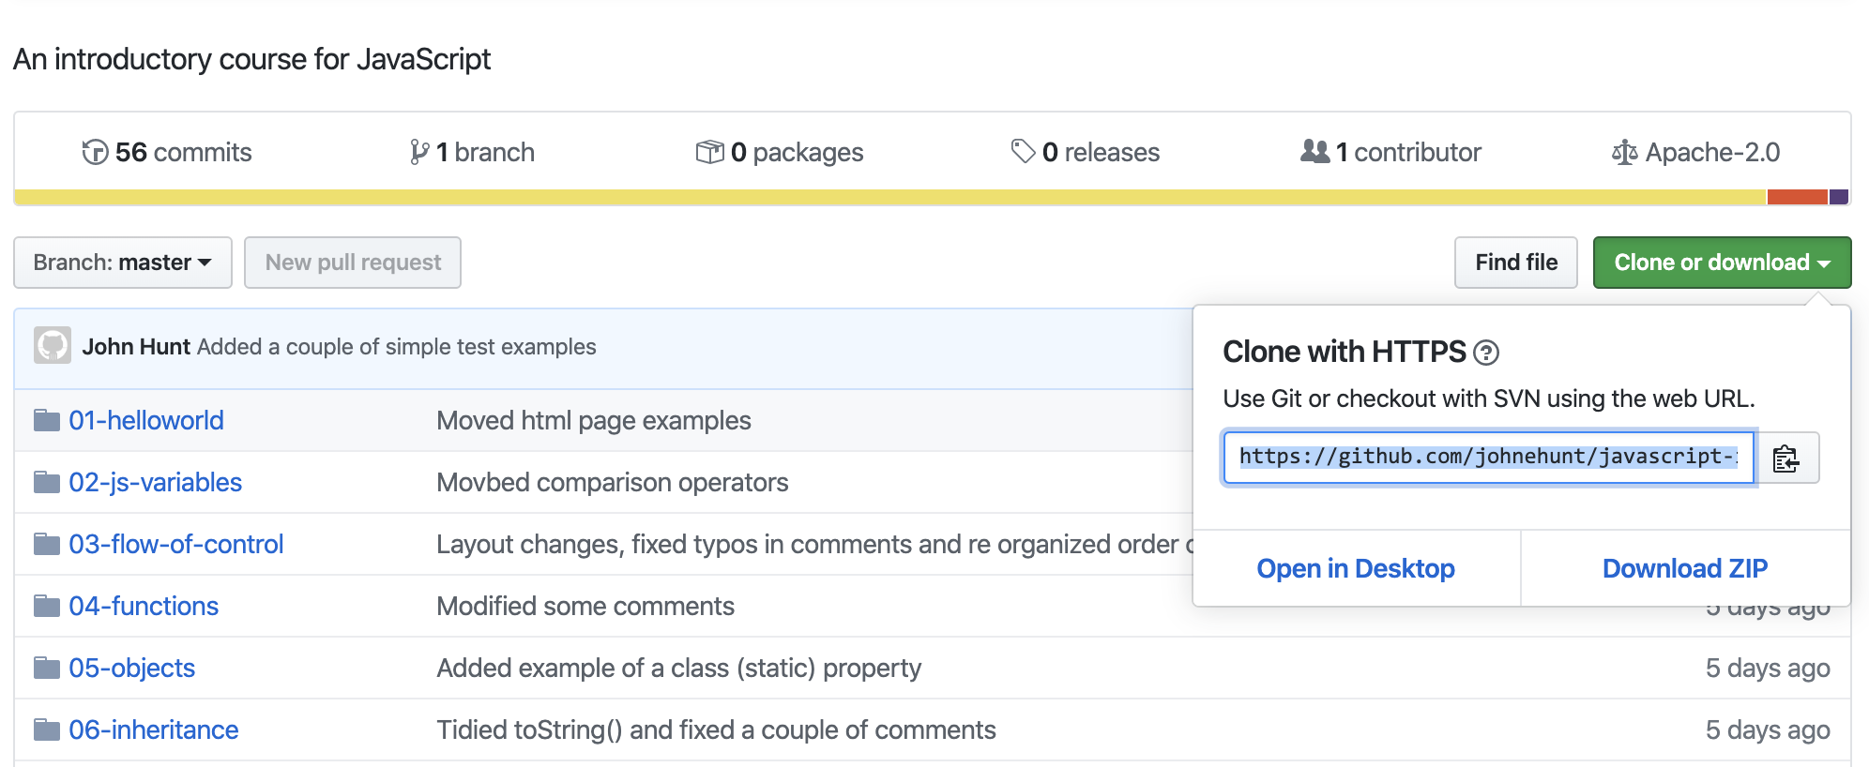
GitHub Interface
Can use web interface to see comments, commits, and get clone Url information

Slide 14
Branching
Typically do development in a branch
Then merge your changes back into master/main branch
Typically via a Pull Request (or PR)
which has a second developer review the changes
and then pull those changes into the main branch
Create branch using git checkout –b <branch-name>
$ git branch
* master
$ git checkout -b my_new_branch
Switched to a new branch 'my_new_branch'
$ git branch
master
* my_new_branch
$
Notes:
-b tells git to switch to that branch

Slide 15
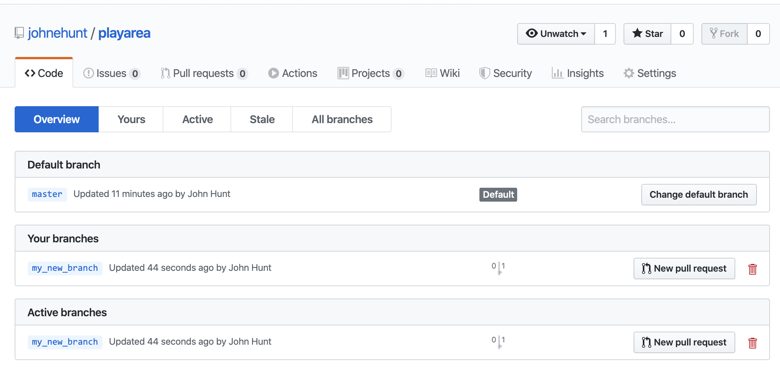
Branching
Master / main branch and my_new_branch

Slide 16
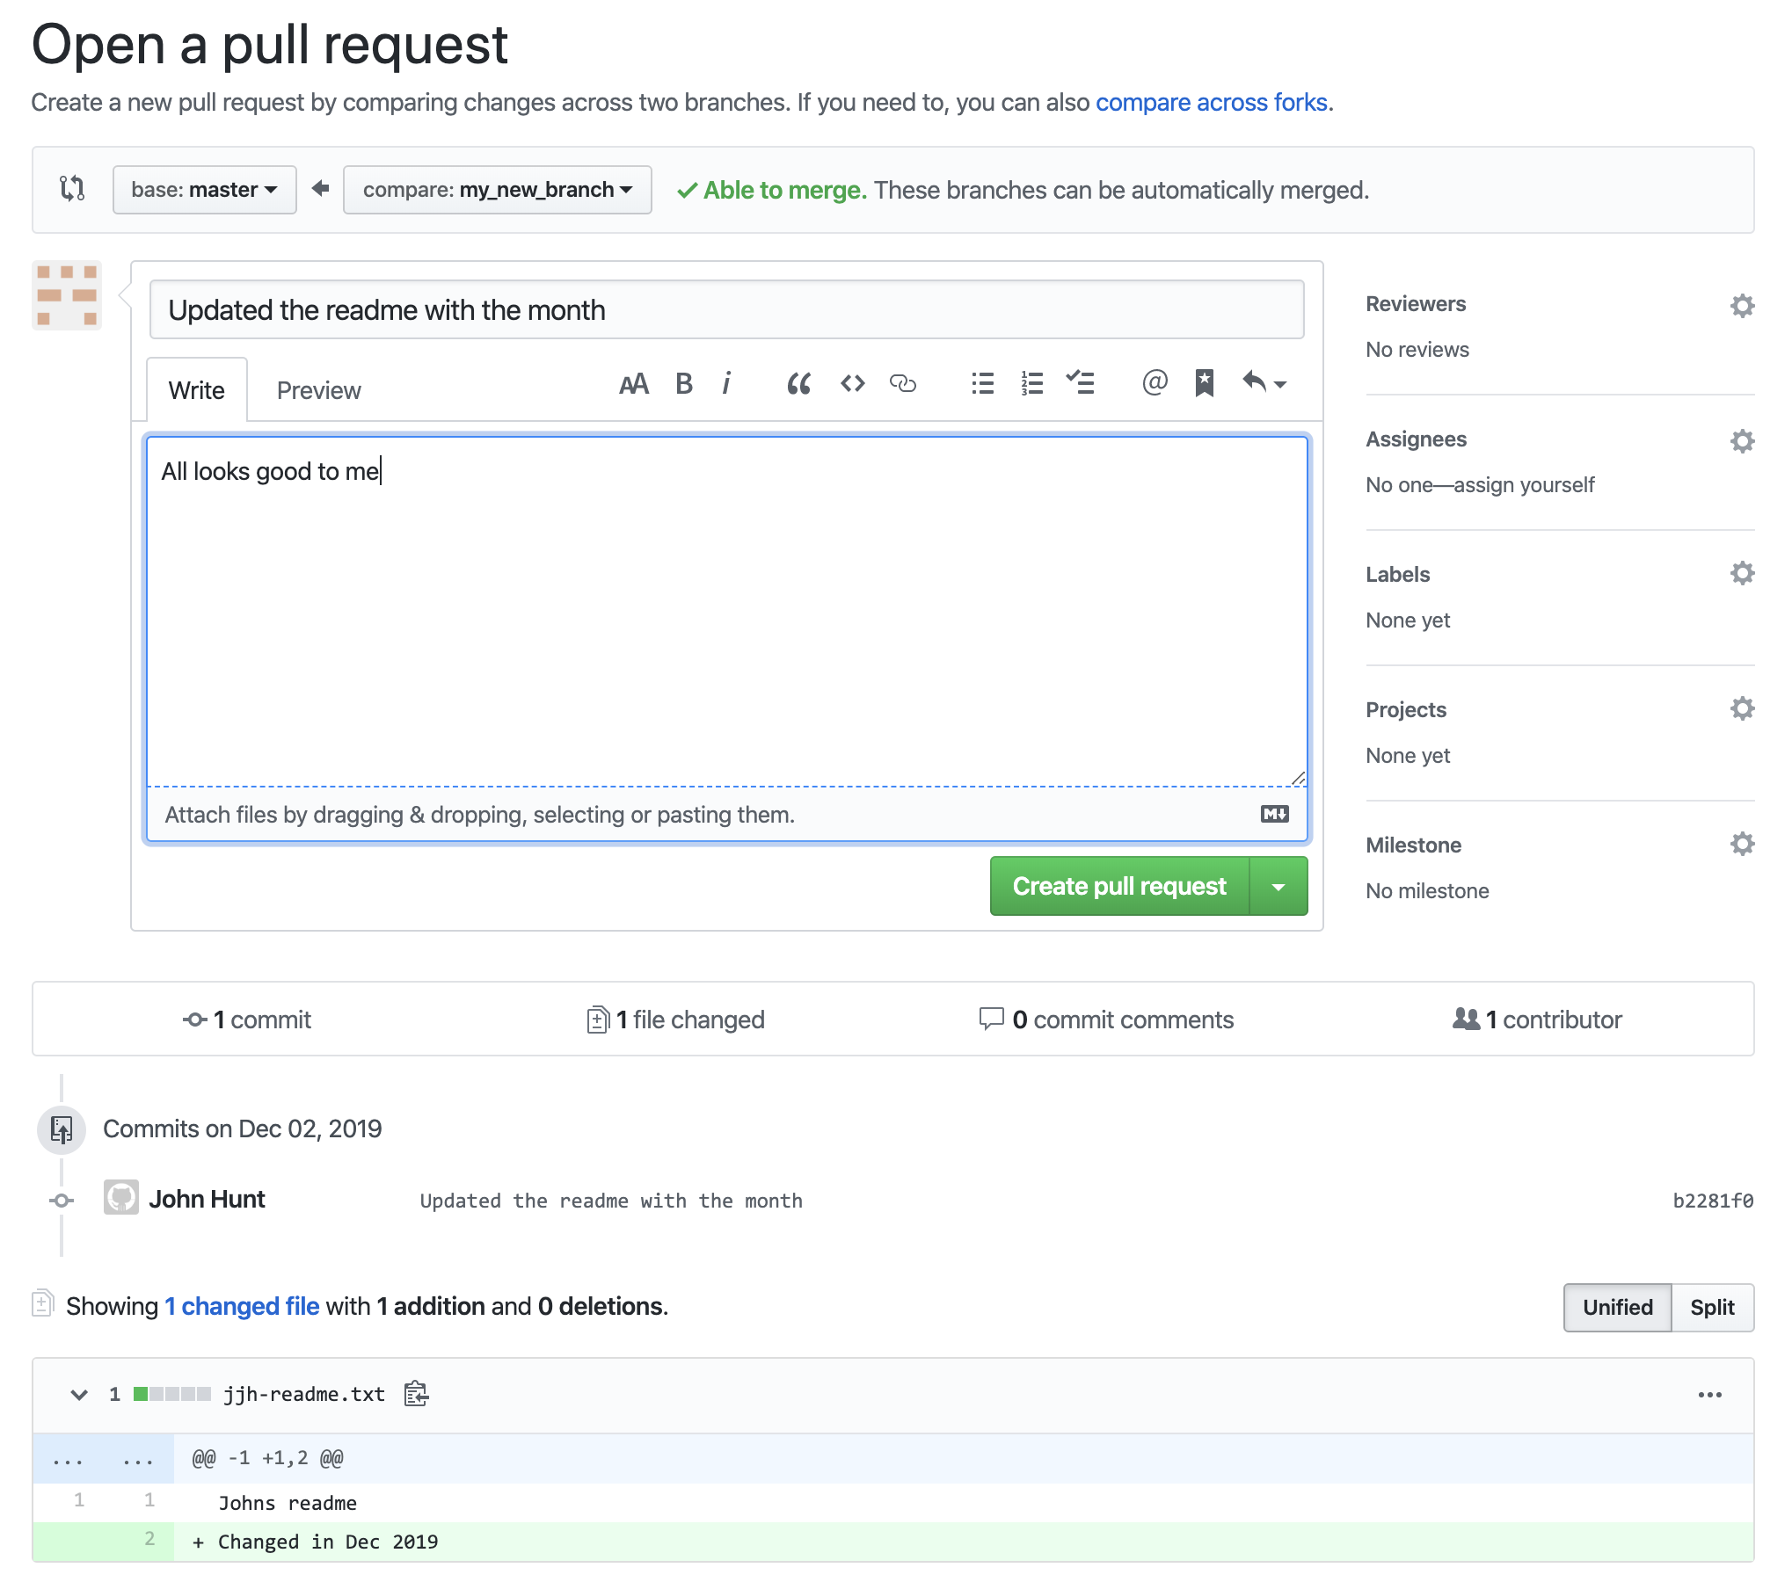
Branching & Pull Requests
Creating a PR
Used to request changes are merged from branch to main or dev
Another developer reviews and then pulls the changes into another branch

Slide 17
Git Terminology Quick Reference
Term | Description
HEAD | Symbolic reference to the latest version of the current branch
branch | reference to specific state of files in the working directory
staging area | Stores changes before they are committed (a change list) also called index
add | Add changes to the staging area
commit | Apply changes to the local repository
origin | The default upstream (remote) repository
push | Send changes from the local to the remote repository
pull | Retrieve changes from a remote repository and apply them to the local repository
pull request | Request to merge two branches following review and approval process

Slide 18
Useful References
Git Home Page
http://git-scm.com
http://git-scm/doc highly recommended
Git Glossary
https://www.kernel.org/pub/software/scm/git/docs/gitglossary.html
10 Git Commands Every Developer should Know
https://www.freecodecamp.org/news/10-important-git-commands-that-every-developer-should-know
Others
http://www.kernel.org/pub/software/scm/git/docs
http://progit.org/book Pro Git Book

Slide 19
Questions?
?

