Slide 1

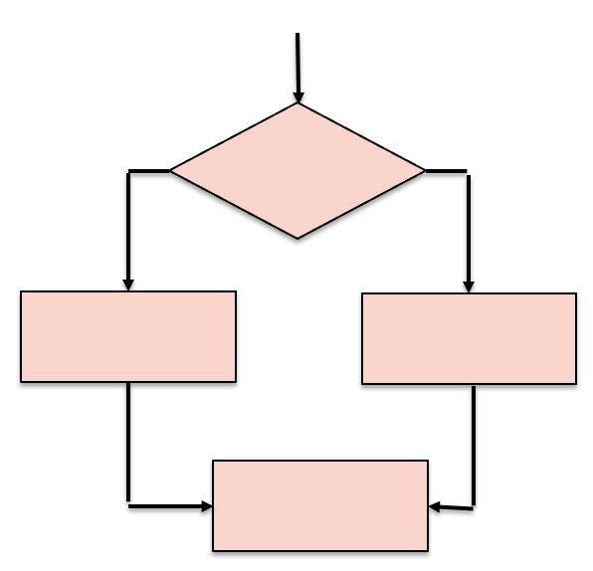

Flow Of Control: Conditional Statements
Framework Training

Slide 2
Plan for Session
Core Programming Concepts
Simple if Statement
If, If / Else, Compound Selection (elif)
Nesting if statements
Comparison operators
Logical operators
Pattern Matching

Slide 3
Core Programming Concepts
Sequence
Selection
Iteration

Slide 4

Simple If Statement
Is the test true?
Yes
Execute the conditional statement(s)
No
Carry on from here
Flowchart

Slide 5
Simple If Statement
Is the test true?
Yes
Execute the conditional statement(s)
Python
No
Carry on from here
if < some condition evaluates to true> :
execute the controlled statement(s)
print('Carry on from here')
Flowchart

Slide 6
Simple If Statement
Is the test true?
Yes
Execute the conditional statement(s)
Python
No
Carry on from here
if < some condition evaluates to true> :
execute the controlled statement(s)
print('Carry on from here')
and the colon
Flowchart
Note the indentation

Slide 7

The if Statement
Layout is key in Python;
It helps define structure of pgm
Basic structure - note indentation
Simple example
Extending the example
if <condition-evaluating-to-boolean>:
statement
num = int(input('Enter a number: '))
if num > 0:
print(num, 'is positive')
Enter a number: 1
1 is positive
num = int(input('Enter another number: '))
if num > 0:
print(num, 'is positive')
print(num, 'squared is ', num * num)
print('Bye')
Enter another number: 2
2 is positive
2 squared is 4
Bye

Slide 8
If / Else Statement
Flowchart
Is the test true?
Yes
No
Execute this statement(s)
Execute this statement(s)
Carry on from here

Slide 9
If / Else Statement
Flowchart
Is the test true?
Yes
No
Python
Execute this statement(s)
Execute this statement(s)
if < some condition evaluates to true> :
execute the controlled statement(s)
else:
execute some other statement(s)
print('Carry on from here')
Carry on from here

Slide 10
If / Else Statement
Flowchart
Is the test true?
Yes
No
Python
Execute this statement(s)
Execute this statement(s)
if < some condition evaluates to true> :
execute the controlled statement(s)
else:
execute some other statement(s)
print('Carry on from here')
Carry on from here
Note the indentation

Slide 11
Using if and else
Optional else branch in a conditional statement
num = int(input('Enter yet another number: ')) if num < 0: print('Its negative') else: print('Its not negative')
Enter yet another number: 1
Its not negative
Enter yet another number: -1
Its negative
Notes:
Can have multiple elif conditions

Slide 12
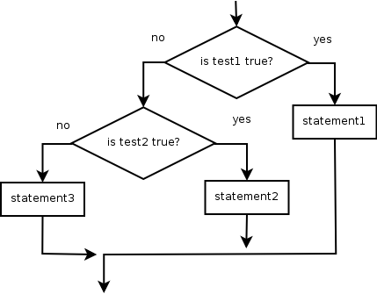
Compound Selection
Pseudocode
if <Is test 1 true? >
statement 1
else if <Is test 2 true? >
statement 2
else
statement 3
end if

Slide 13
Using else and elif
Also, additional conditional tests
The compound selection option
savings = float(input("Enter how much you have in savings: ")) if savings == 0: print("Sorry no savings") elif savings < 500: print('Well done') else: print('Thank you')
Enter how much you have in savings: 0
Sorry no savings
Enter how much you have in savings: 400
Well done
Enter how much you have in savings: 600
Thank you
Notes:
Can have multiple elif conditions

Slide 14
Nesting if statements
Can nest one if statement inside another
snowing = True
temp = -1
if temp < 0:
print('It is freezing')
if snowing:
print('Put on boots')
print('Time for Hot Chocolate')
print('Bye')
Note style of snowing –
Its already a Boolean!
It is freezing
Put on boots
Time for Hot Chocolate
Bye

Slide 15
Comparison Operators
Return True or False
Operator | Description | Example
== | Tests if two values are equal | 3 == 3
!= | Tests that two values are not equal to each other | 2 != 3
< | Tests to see if the left-hand value is less than the right-hand value | 2 < 3
> | Tests if the left-hand value is greater than the right-hand value | 3 > 2
<= | Tests if the left-hand value is less than or equal to the right-hand value | 3 <= 4
>= | Tests if the left-hand value is greater than or equal to the right-hand value | 5 >= 4

Slide 16
Logical Operators
Combine Boolean expression together
Can use logical operations
to combine Boolean conditions together
Operator | Description | Example
and | Returns True if both left and right are true | 3 < 4 and 5 > 4
or | Returns True if either the left or the right is true | 3 < 4 or 3 > 5
not | Returns True if the value being tested is False | not 3 < 2
age = 15 status = None if age > 12 and age < 20: status = 'teenager' else: status = 'not teenager' print(status)
teenager

Slide 17
Pattern Matching
Only Available in Python 3.10 and newer
Allows several conditions to be expressed in concise format
Note use of | to represent or and _ as a wildcard
command = input("What are you doing next? ")
match command:
case "quit":
print("Goodbye!")
case "look":
print("Looking out")
case "up" | "down":
print("up or down")
case _:
print("The default")
What are you doing next? look
Looking out

Slide 18
Questions?
?

