Slide 1
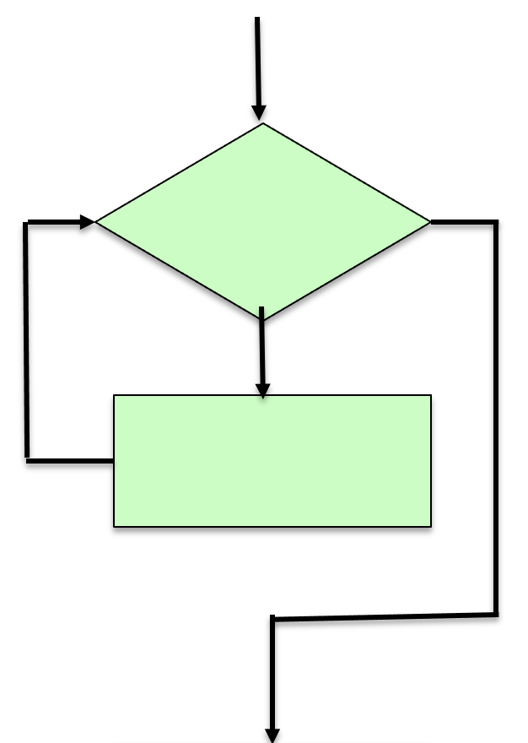


Flow of Control: Iteration / Looping
Framework Training

Slide 2
Plan for Session
Doing things a number of times
Iteration / Looping
Types of Loops
While Loop
For Loop
Choosing the Correct Loop

Slide 3
Doing Things a Number of Times
Common in real world as well as programming
Want to repeat a set of actions multiple times
For example
Let us say we have a routine to calculate the tax someone should pay
What if you wanted to calculate the tax for 10 people?
Should we copy the same calculation ten times
Or should we apply the same calculation ten times
In programming write something once and reuse it

Slide 4
Iteration / Looping
Sequence
Selection
Iteration

Slide 5

Types of Loops
Two types of loops
Conditional Loops
keep looping while sone condition is true
e.g. keep weeding the garden until there are no weeds left
typically represented by while loops
Counted Loops
loop for a predefined number of times
e.g. stir a cake mixture ten times
typically represented by for loops

Slide 6

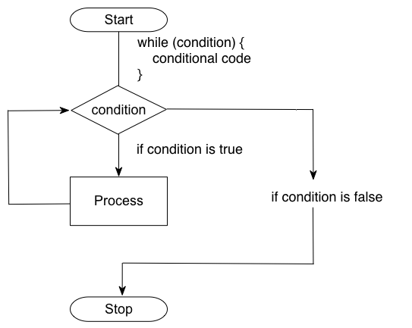
While Loop: Conditional Loop

Slide 7
Python While loops
No do-while in Python
Basic form
again note the indentation (very important)
An example
while <test-condition-is-true>: statement or statements
count = 0 print('Starting')
while count < 10: print(count, ' ', end='') # part of the while loop count += 1 # also part of the while loop
print() # not part of the while loop
print('Done')
Starting
0 1 2 3 4 5 6 7 8 9
Done

Slide 8
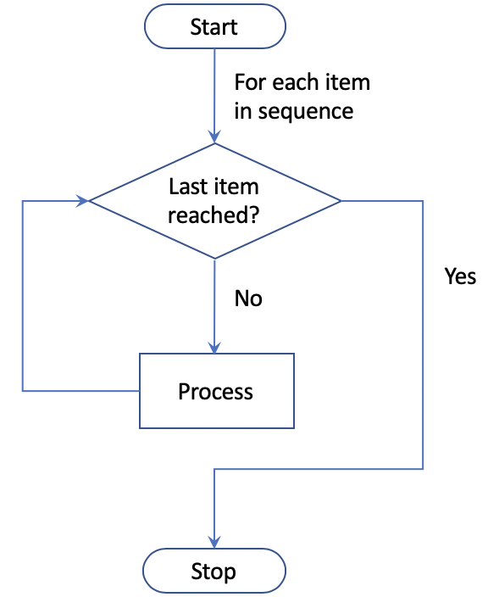
For Loop: Counted Loop

Slide 9
For Loop
Basic form iterates over an iterable
again note the indentation
Example
for <variable-name> in range(...):
statement
# Loop over a set of values in a range print('Print out values in a range')
for i in range(0, 10): print(i, ' ', end='')
print() print('Done')
Values 0 up to but
not including 10:
Referred to as open-closed
Print out values in a range
0 1 2 3 4 5 6 7 8 9
Done
Notes:
Can also have an increment value # Now use values in a range but increment by 2 print('Print out values in a range with an increment of 2') for i in range(0, 10, 2): print(i, ' ', end='') print() print('Done’)
Can also do 10, 0, -2 to count down

Slide 10
For Loop Alternatives
Can increment loop by value other than 1
Can count down by using a negative increment counter
for i in range(0, 10, 2): # increments by 2 print(i, ' ', end='')
print()
print('Done')
for i in range(10, 0, -1): # decrements by -1 print(i, ' ', end='')
print()
print('Done')
Note prints out
10 to 1

Slide 11
Choosing the Correct Loop
For (aka “counted”) loop
Use when you can work out how many iterations are needed before the loop starts
it uses a variable that changes value each time the loop executes
this can often be used if you need to know what iteration you are on
it can also be used as an “index” value

Slide 12
Choosing the Correct Loop
while (aka “conditional”) loop:
Use when you need to loop an unknown number of times
usually this means that loop exit depends on something that happens in the loop,
such as reaching the end of a file
normally needs to have a control variable that updates in the loop
it is a common mistake to forget to update the control variable in the loop

Slide 13
Questions?
?

