Slide 1

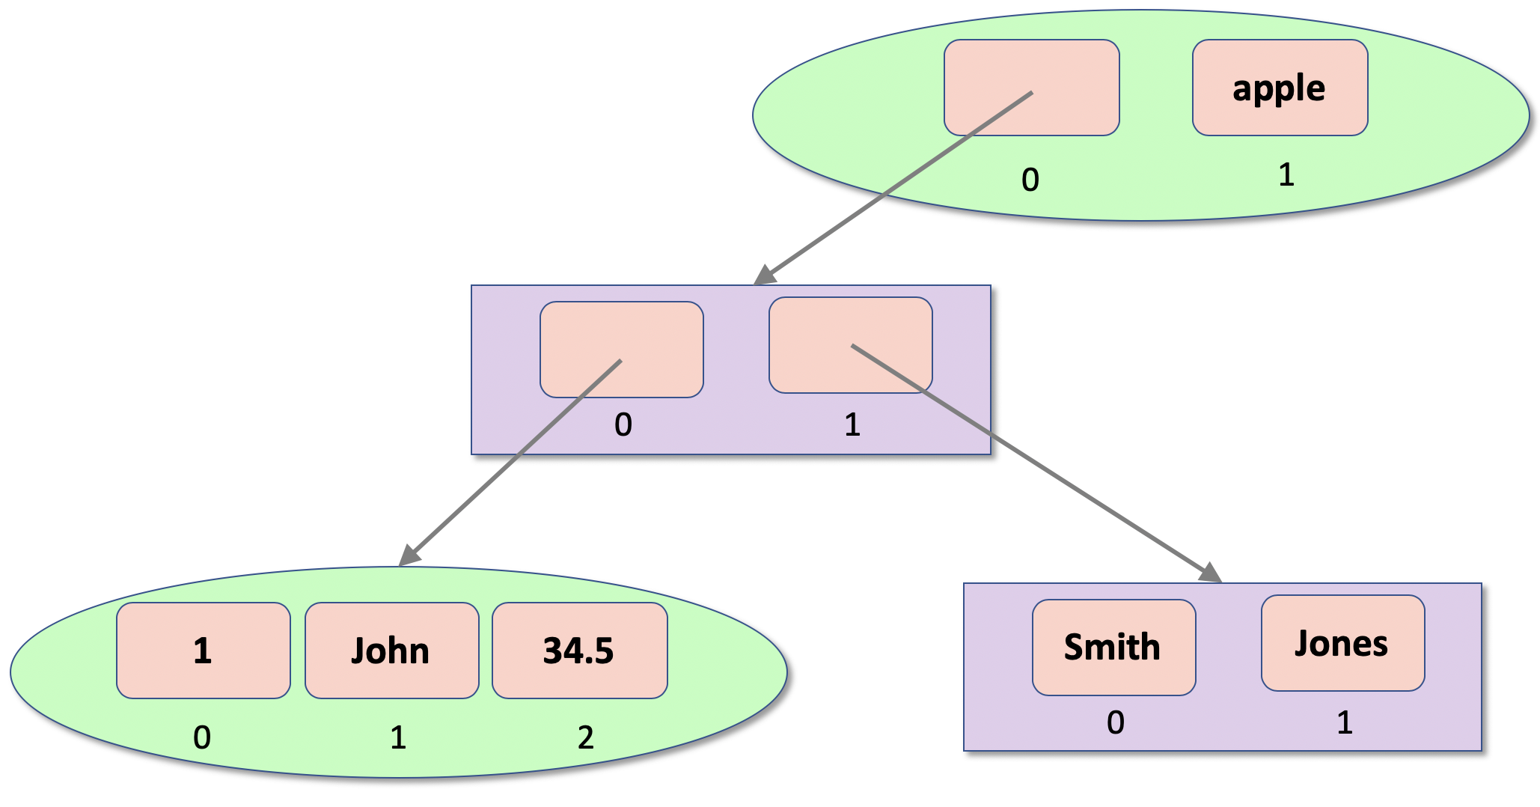

Sequential Data Containers
Framework Training

Slide 2
Plan for Session
Mutable and Immutable types
Characteristics of Data Containers
Python Collection Types
Tuples
Lists

Slide 3

Mutability & Immutability
Important concept in Computer Programming
Mutable things
Can be modified once created
Immutable things
Cannot be modified once created
Immutability makes
code easier to understand
easier to debug & maintain
easier to run in muti-threaded/process environments
but may have performance overheads

Slide 4
Characteristics of Data Containers
Allow multiple values to be held together
Have a set of features
ordered or unordered
mutable or immutable
that is modifiable or not
allow duplicates or not
may associate a value with an index or key
may be growable or not
Choose appropriate container type based on your requirements
Often referred to as collections

Slide 5
Python Collection Types
Tuples represent a collection of values
ordered, fixed size
immutable (cannot be modified)
allow duplicate members
indexed
Lists are
ordered
mutable (changeable)
allow duplicate members
indexed
growable

Slide 6

Tuples
Can be created using () or tuple function
round bracket syntax most common
An example tuple
Defined using
Note
four values so length of 4
indexed from zero so values are in indexes 0, 1, 2, and 3
empty_tuple = ()
another_emptry_tuple = tuple()
1
3
5
7
0
1
2
3
tup1 = (1, 3, 5, 7)

Slide 7
Tuples Further operations
empty_tuple = ()
tup1 = (1, 3, 5, 7) print('tup1[0]:\t', tup1[0]) print('tup1[1]:\t', tup1[1])
print('tup1[1:3]:\t', tup1[1:3]) # return a slice print('tup1[:3]:\t', tup1[:3]) print('tup1[1:]:\t', tup1[1:])
print('len(tup1):\t', len(tup1))
tup2 = (1, 'John', True, -23.45) print(tup2) tup3 = ('apple', 'pear', 'orange', 'plum', 'apple') for fruit in tup3: print(fruit)
if 'orange' in tup3: print('orange is in the Tuple')
tup1[0]: 1
tup1[1]: 3
tup1[1:3]: (3, 5)
tup1[:3]: (1, 3, 5)
tup1[1:]: (3, 5, 7)
len(tup1): 4
(1, 'John', True, -23.45)
apple
pear
orange
plum
apple
orange is in the Tuple

Slide 8
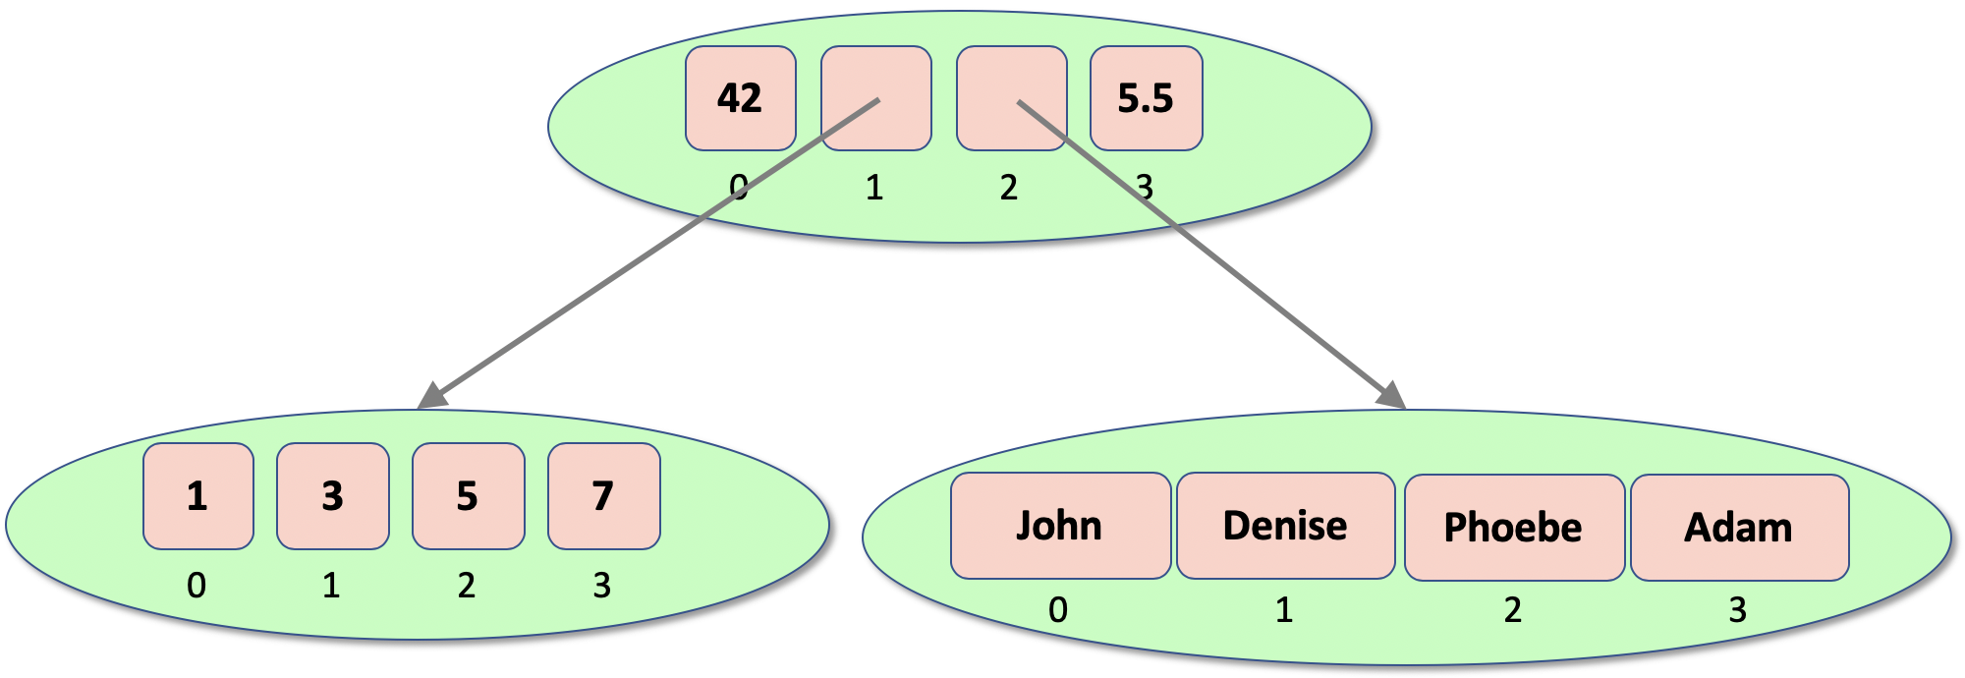
Nested Tuples
Can nest tuples
tuple1 = (1, 3, 5, 7) tuple2 = ('John', 'Denise', 'Phoebe', 'Adam') tuple3 = (42, tuple1, tuple2, 5.5) print(tuple3)
print(tuple3[1][1])
(42, (1, 3, 5, 7), ('John', 'Denise', 'Phoebe', 'Adam'), 5.5)
3

Slide 9
Lists
Mutable ordered container
empty_list = [] # empty_list = list()
list1 = ['John', 'Paul', 'George', 'Ringo’]
print(list1, ': ', len(list1))
print('list1[1]:', list1[1]) print('list1[1:3]:', list1[1:3]) # obtain a slice from 1 up to 3 print('list[:3]:', list1[:3]) # obtain a slice from start up to 3 print('list[1:]:', list1[1:]) # obtain a slice from start 1 to end
list1.append('Pete') print(list1) list1.extend(['Albert', 'Bob']) print(list1)
list1.insert(2, 7) print(list1)
list1.remove('Pete')
print(list1)
del list1[1:3]
print(list1)
['John', 'Paul', 'George', 'Ringo'] : 4
list1[1]: Paul
list1[1:3]: ['Paul', 'George’]
list[:3]: ['John', 'Paul', 'George’]
list[1:]: ['Paul', 'George', 'Ringo’]
['John', 'Paul', 'George', 'Ringo', 'Pete’]
['John', 'Paul', 'George', 'Ringo', 'Pete', 'Albert', 'Bob’]
['John', 'Paul', 7, 'George', 'Ringo', 'Pete', 'Albert', 'Bob]
['John', 'Paul', 7, 'George', 'Ringo', 'Albert', 'Bob]
['John', 'George', 'Ringo', 'Albert', 'Bob']

Slide 10
List Methods
Method | Description
append() | Adds an element at the end of the list
clear() | Removes all the elements from the list
copy() | Returns a copy of the list
count() | Returns the number of elements with the specified value
extend() | Add the elements of a list (or any iterable), to the end of the current list
index() | Returns the index of the first element with the specified value
insert() | Adds an element at the specified position
pop() | Removes the element at the specified position
remove() | Removes the item with the specified value
reverse() | Reverses the order of the list
sort() | Sorts the current list

Slide 11
Nested Lists
Can nest lists
John
Denise
0
1
2
3
1
43.5
Phoebe
True
apple
orange
31
0
1
2
3
0
1
2
l1 = [1, 43.5, 'Phoebe', True] l2 = ['apple', 'orange', 31] root_list = ['John', l1, l2, 'Denise'] print(root_list)
print(root_list[1][1])
['John', [1, 43.5, Phoebe, True], ['apple', 'orange', 31], 'Denise']

Slide 12
Nesting Tuples and Lists
Can nest tuples and lists
t1 = (1, 'John', 34.5) l1 = ['Smith', 'Jones'] l2 = [t1, l1] t2 = (l2, 'apple') print(t2)
([(1, 'John', 34.5), ['Smith', 'Jones']], 'apple')

Slide 13
Questions?
?

