Slide 1
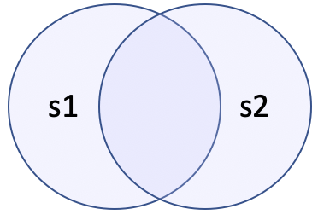


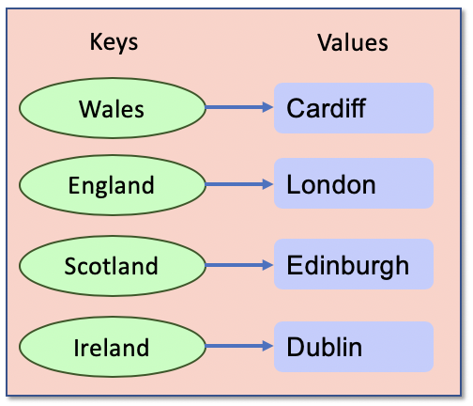
Advanced Data Containers (Sets & Dictionaries)
Framework Training

Slide 2
Plan for Session
Sets
Dictionaries

Slide 3

Python Collection Types
Advanced container types
Sets are
mutable, unordered and unindexed collection
do not allow duplicate values to be held
can only hold immutable values
Dictionary
a mutable, unordered collection
indexed by a key which references a value
keys must be unique
values can be duplicated

Slide 4
Sets
Unordered collection of immutable objects
Do not allow duplicates
empty_set = set() # Empty set
basket = {'apple', 'orange', 'apple', 'pear', 'orange', 'banana'} print(basket)
print(len(basket))
for item in basket:
print(basket)
print('apple' in basket)
basket.add('apricot') print(item)
# Add more than one item at a time
basket.update(['apricot', 'mango', 'grapefruit'])
basket.remove('apricot') # or discard
{'orange', 'banana', 'apple', 'pear’}
4
orange
banana
apple
pear
True
{'orange', 'banana', 'apple', 'apricot', 'pear'}
Notes:
Remove throws an error if the item is not in the set but discard does not

Slide 5

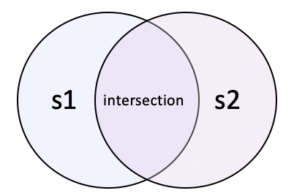
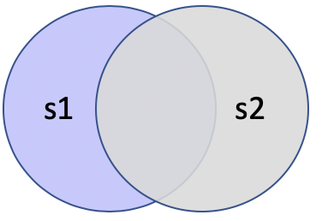
Set Like Operations
Provide set-like operations such as union (|), intersection (&), difference (-) etc.
For example, given
Union Intersection Difference
s1 = {'apple', 'orange', 'banana'} s2 = {'grapefruit', 'lime', 'banana'}
print('Union:', s1 | s2)
print('Intersect:', s1 & s2)
print('Difference:', s1 - s2)
Union: {'apple', 'lime', 'banana’,
'grapefruit', 'orange'}
Intersect: {'banana'}
Difference: {'apple', 'orange'}
print('Union:', s1.union(s2))
print('Intersect:’, s1.intersection(s2))
print('Difference:', s1.difference(s2))

Slide 6
Set Operations
Method | Description
add() | Adds an element to the set
clear() | Removes all the elements from the set
copy() | Returns a copy of the set
difference() | Returns a set containing the difference between two or more sets
discard() | Remove the specified item
intersection() | Returns a set, that is the intersection of two other sets
isdisjoint() | Returns whether two sets have a intersection or not
issubset() / issuperset() | Returns whether another set is a sub or super set
remove() | Removes the specified element
union() | Return a set containing the union of sets
update() | Update the set with the union of this set and others

Slide 7
Dictionaries
Mutable set of key:value pairs
empty_dictionary = {}
cities = {'Wales': 'Cardiff', 'England': 'London', 'Scotland': 'Edinburgh', 'Northern Ireland': 'Belfast', 'Ireland': 'Dublin'}
print(cities)
{'Wales': 'Cardiff', 'England': 'London', 'Scotland': 'Edinburgh', 'Northern Ireland': 'Belfast', 'Ireland': 'Dublin'}

Slide 8
Dictionaries
Working with Dictionaries
print('cities[Wales]:', cities['Wales']) print('cities.get(Ireland):', cities.get('Ireland'))
print(cities.values()) print(cities.keys()) print(cities.items()) print('Wales' in cities) print('France' not in cities) for country in cities: print(country, end=', ') print(cities[country])
del cities['Scotland'] # Delete
cities['France'] = 'Paris’ # Add
cities['Wales'] = 'Swansea’ # Replace
cities[Wales]: Cardiff
cities.get(Ireland): Dublin
dict_values(['Cardiff', 'London', 'Edinburgh', 'Belfast', 'Dublin'])
dict_keys(['Wales', 'England', 'Scotland', 'Northern Ireland', 'Ireland'])
dict_items([('Wales', 'Cardiff'), ('England', 'London'), ('Scotland', 'Edinburgh'), ('Northern Ireland', 'Belfast'), ('Ireland', 'Dublin')])
True
True
Wales, Cardiff
England, London ...
Notes:
print('cities[Italy]:', cities[Italy']) – throws an exception print('cities.get(Italy):', cities.get('Italy')) – returns None

Slide 9
Nesting Dictionaries
Keys must be immutable and unique
Values can be any type of object inc. collections
seasons = {'Spring': ('Mar', 'Apr', 'May'),
'Summer': ('June', 'July', 'August'),
'Autumn': ('September', 'October', 'November'),
'Winter': ('December', 'January', 'February')}
print(seasons['Spring'])
print(seasons['Spring'][1])
('Mar', 'Apr', 'May')
Apr

Slide 10
Dictionary Methods
Method | Description
clear() | Removes all the elements from the dictionary
copy() | Returns a copy of the dictionary
fromkeys() | Returns a dictionary with the specified keys and values
get() | Returns the value of the specified key
items() | Returns a list containing the tuple for each key value pair
keys() | Returns a list containing the dictionary's keys
setdefault() | Returns the value of the specified key. If the key does not exist: insert the key, with the specified value
update() | Updates the dictionary with the specified key-value pairs
values() | Returns a list of all the values in the dictionary

Slide 11
Questions?
?

