Slide 1



Python Modules and the CSV Module
Framework Training

Slide 2
Plan for Session
Python Modules
Importing from a Module
Using the os module to rename & delete files
Working with CSV Files
CSV Module

Slide 3
Python Modules
A Python module is a file with any or all of
Variables and Functions
Classes and objects
Executable code
Module comment (optional)
Name of a module is name of the file
(minus the suffix ‘.py’)
e.g. utils.py defines the module ‘utils’

Slide 4

Python Modules
Example utils module contains
a function printer and a function add
utils.py
"""This is a test module""" MIN = 0 MAX = 100 def printer(some_object): print('printer') print(some_object) print('done') def add(x, y): return x + y
File: utils.py
printer
MIN
add
MAX
Notes:
The module has a comment which is at the start of the file – this is useful documentation for anyone working with the module. In some cases, the comment at the start of the module can provide extensive documentation on the module such as what it provides, how to use the features in the module and examples that can be used as a reference.
A variable default_shape is also initialised when the module is loaded and can also be referenced outside the module in a similar manner to the module’s function and class. These variables can be useful in setting up defaults or predefined data that can be used by developers working with the module.

Slide 5
Importing a Module
Most modules are not automatically imported
must explicitly import them
using the import statement
note use the name of the module (not the file)
Can use utils module within code
import utils
import utils print(utils.MIN) print(utils.MAX) utils.printer("hello") result = utils.add(5, 6) print(result)
File: utils.py
printer
MIN
add
MAX

Slide 6
Importing from a Module
Previous examples still required name of module
Can avoid this using from <module name> import *
Can now reference module contents directly
Or can import only those elements of interest
from utils import * print(MIN) print(MAX) printer("hello") result = add(5, 6) print(result)
from utils import printer
printer("hello")
Notes:
Can hide some elements
wildcard import will import everything
unless an element starts with an underbar (_)
now it must be imported explicitly
"""This is a test module""" print('Hello I am the utils module')
# as before ...
def _special_function(): print('Special function’)
from utils import _special_function
_special_function()

Slide 7

Renaming and Deleting Files
Can use the os module
File can be renamed using the os.rename() function
function takes 2 args, current filename and new filename
part of the Python os module which provides methods that can be used to perform a range of file-processing operations
Delete a File
use os.remove() function
import os
os.rename( 'myfileoriginalname.txt', 'myfilenewname.txt' )
import os
os.remove( 'somefilename.txt' )

Slide 8
Working with CSV Files
Comma Separated Values (csv) format
widely used for data import and export
but no well-defined standard
Supported by the built-in csv module
can read and write CSV files
supports formats used by Excel
can also support other dialects or
special-purpose user defined formats
Key functions are csv.reader and csv.writer
for more information see
https://docs.python.org/3/library/csv.html

Slide 9
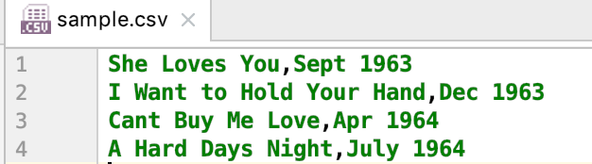
Working with CSV Files
Write out CSV file
import csv
print('Creating CSV file') with open('sample.csv', ‘w’, newline='') as csvfile: writer = csv.writer(csvfile) writer.writerow(['She Loves You', 'Sept 1963']) writer.writerow(['I Want to Hold Your Hand', 'Dec 1963']) writer.writerow(['Cant Buy Me Love', 'Apr 1964']) writer.writerow(['A Hard Days Night', 'July 1964'])

Slide 10
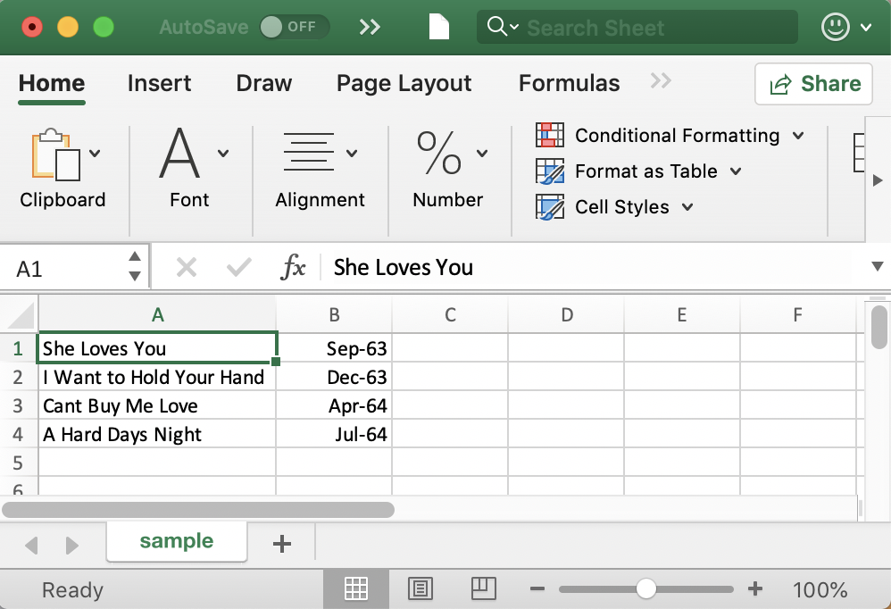

Working with CSV Files
Reading from a CSV file
import csv print('Starting to read csv file') with open('sample.csv') as csvfile: reader = csv.reader(csvfile) for row in reader: print(f'{row[0]}, {row[1]}')
print('Done Reading')
Starting to read csv file
She Loves You, Sept 1963
I Want to Hold Your Hand, Dec 1963
Cant Buy Me Love, Apr 1964
Done Reading
row is a list

Slide 11
Questions?
?

