Slide 1

TDD Primer Welcome & Introductions
Kevin Cunningham
Red
TDD
Refactor
Green
TDD

Slide 2
Introductions
Course Instructor
Kevin Cunningham
Course attendees
You…
Name
Professional Position
Programming Experience / Languages
TDD Experience
Motivation and Expectations

Slide 3
Course Content
Course is technology agnostic
You bring own experience from your technology
Course objectives
Provide understanding and some practical experience in TDD
On this course we are looking at:
What TDD is?
Why use a TDD approach?
What are TDD Katas?
and why use them to help learn TDD
TDD and Refactoring
Red
TDD
Refactor
Green

Slide 4
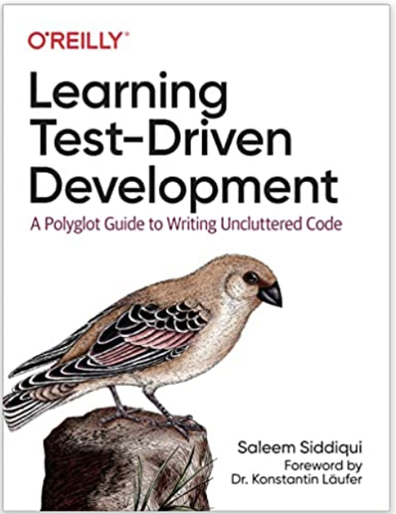

Books
TDD
Learning Test-Driven Development
Saleem Siddiqui
O’Reilly, 2021
ISBN 1098106474
Test-Driven Development: By Example
Kent Beck
Addison-Wesley, 2003
ISBN 0-321-14653-0

Slide 5

Books
TDD
Refactoring: Improving the Design of Existing Code
Martin Fowler
Addison-Wesley, 2019
ISBN 0134757599

Slide 6
Web Resources
TDD
Guru99
https://www.guru99.com/test-driven-development.html
TDD Free Code Camp
https://www.freecodecamp.org/news/test-driven-development-what-it-is-and-what-it-is-not-41fa6bca02a2/
JetBrains TDD Tutorial
https://www.jetbrains.com/help/idea/tdd-with-intellij-idea.html
Refactoring.com
http://www.refactoring.com/

Slide 7
Questions?
?

