Slide 1
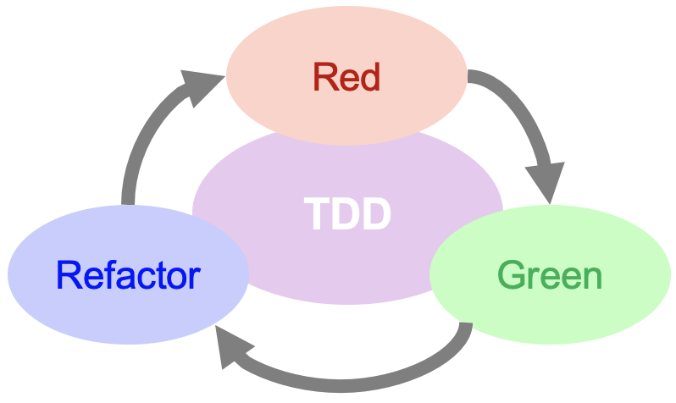

Test Driven Development TDD
Kevin Cunningham
TDD

Slide 2
Plan for Session
What is TDD?
Why teams might adopt TDD?
Why NOT TDD?

Slide 3
What is TDD?
TDD
What do YOU think?
?

Slide 4
What is TDD?
TDD
TDD is a technique whereby you write your test cases before you write any implementation code
Tests drive or dictate the code that is developed
Tests are an indication of “intent” or requirement
tests provide a specification of “what” a piece of code should do
some might argue that “tests are part of the documentation”
E.g. given-when-then
It’s a design process
Given a requirement
You design the interface to / expected outcome from, your code
Then you design / implement to that interface

Slide 5
Why TDD?
TDD
What do YOU think?
?

Slide 6
Why TDD?
TDD
To be a better developer
You should know what the code should do …
… before you start coding! But is that always the case?
If you can’t write the test then you shouldn’t write the code
Programmers dislike testing
testing isn’t the fun part so … it may not be done thoroughly
Testing may be done after the event
So time might be tight / may have incentive to pass all tests
Testing might be considered job of another department
so it’s their problem

Slide 7
Why TDD?
TDD
TDD encourages programmers to maintain an exhaustive set of repeatable tests
Tests live alongside the Class/Code Under Test (CUT)
Tests written first tend to be cleaner / better
As not influenced by implementation considerations
The tests can be run after every single change
Tests can be subject to same controls and quality as main code
Tests force programmer to consider interface to code
Allow code to be refactored / modified with confidence
Tests can be maintained inline with main body of code
Can pair program / use ping-pong style

Slide 8
Why NOT TDD?
TDD
What do YOU think?
?

Slide 9
Why NOT TDD?
TDD
Some counter arguments people make …
It takes too long
It costs too much in terms of developer and machine resources
The tests become hard to maintain
I spend all my time writing tests not the actual production code
I can’t write the test until I know what the code does
TDD focuses on passing tests not on correctness
What about other forms of testing
Performance testing, stability testing, scalability testing …
Code coverage – what gets measured get done
TDD may miss some cross behaviour issues
TDD is NOT a methodology

Slide 10
Questions?
TDD
?

