Slide 1
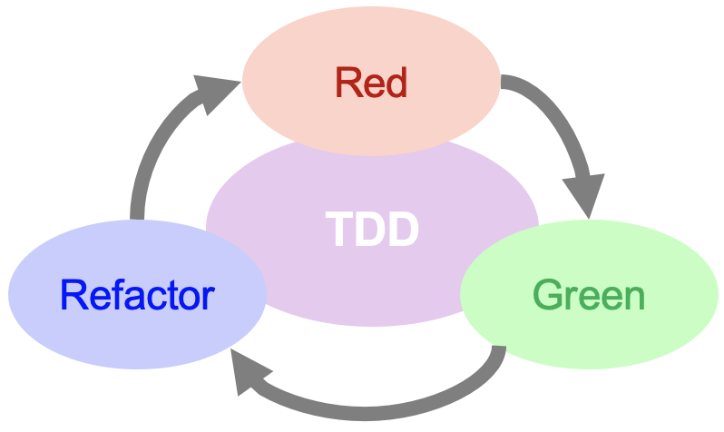

TDD Development Cycle
Kevin Cunningham
TDD

Slide 2
Plan for Session
Test Driven Development Cycle
TDD Mantra: red / green / refactor
Three Rules of TDD
Test Style / Complexity
Tests Drive the Development!
TDD is about Design!
Design Evolution
Summary of TDD Benefits

Slide 3
TDD Cycle
TDD
Write a test
Rerun all tests
Refactor code (production and test)
Compile
Run test, watch it pass
Fix compile errors
Write code
Run test, watch it fail

Slide 4
TDD Cycle
TDD
Write a single test
Compile it. It shouldn’t compile because you’ve not written the implementation code
Implement just enough code to get the test to compile
Run the test and see it Fail
Implement just enough code to get the test to pass
Run the test and see it Pass
Refactor for clarity and best practice
e.g. SOLID principles, “once and only once” etc.
Repeat
Notes:
S – Single Responsibility Principle
O – Open-Closed Principle
L – Liskov Substitution Principle
I – Interface Segregation Principle
D – Dependency Inversion Principle

Slide 5
TDD Mantra: Red/Green/Refactor
Leads to the Red / Green / Refactor cycle

Slide 6
TDD Mantra: Red/Green/Refactor
Each phase focusses on different aspect
Write Tests
Improve All Code
Write Code

Slide 7

3 Rules of TDD
You are not allowed to write any more of a unit test than is sufficient to fail
You are not allowed to modify / update any production code unless it is to make a failing unit test pass
You are not allowed to write any new production code than is sufficient to pass the one failing unit test
Robert C. Martin (aka Uncle Bob)
http://butunclebob.com/ArticleS.UncleBob.TheThreeRulesOfTdd

Slide 8
Test Style / Test Complexity
Do the simplest thing
“Strive for simplicity” in all you do
Tests should be as simple as possible
given the task in hand
Start with the simplest test and then build them up
Write a test that fails
Make the test pass
by updating the production code
but only do enough to pass the test
Then Refactor implementation and test code
change the internal design but not the external interface
If other tests fail resolve each individually
fix the failing test - then refactor the solution & test – one at a time

Slide 9
Test Style / Test Complexity
Address test complexity
by designing the test codebase appropriately
Design the production code for testability
should naturally flow from writing tests first
Use the compiler
let it tell you about errors and omissions
or for interpreted languages use the editor
Use code analysis tools
such as jsLint or
code analysis tools built into IntelliJ, GoLand, PyCharm etc.

Slide 10
Test Style / Test Complexity
Check / Test One Concept / Feature at a time
each test should represent a single concept, requirement, feature etc.
Each tests should test a single concept
leads to One assertion (Check/Assert) per test
Although one concept may require several assertions to validate it
subject of furious debate on various TDD groups
Tests must be maintainable
Tests must be of at least the same quality as prod code
Can use ping-pong style of development
Pair programming – swap between writing tests and code

Slide 11

Tests Drive the Development
Tests Force developers to Slow Down and Think
But testing can make Development Faster / Simpler
over time availability of tests provides confidence in changes
Tests make for simpler implementations
as code only meets test
clearer code is easier to understand, extend, debug, maintain …
Only write code to handle failed tests
if you have changed anything and existing tests fail
only write enough code to pass those tests
verify all tests pass

Slide 12

TDD is about Design
TDD appears to be verification oriented
hey testing is in the title
But in fact, it is more about Design Evolution
it is focussed on the Function of the Software
The act of writing a TDD test
is more an act of design than of verification
the resulting implementation should adopt the appropriate form
TDD isn’t about writing tests, it's about defining behavior
Write the tests w.r.t. the Interface you are designing
then design the implementation to meet the interface contract
Then review implementation design to improve it

Slide 13

Design Evolution
In writing the test you are specifying what the software should do – it represents some requirement
Do not write the tests based on the existing / planned implementation
You then implement that required behaviour and any changes this requires to existing code
Then stand back and review implementation and refactor – aim for best implementation of code & test
TDD is thus Testing + Design + Refactoring
makes it more than just Testing or Test First Development

Slide 14
Summary TDD Benefits for Developers
Design key to implementation
of tests, of implementation
Refactoring key part of TDD
improves quality of (all) code
Code proven to meet requirements
Tests become an asset
Tests are (part of the) documentation
No code left untested (in theory)
Future maintenance supported: Tests become Safety Net
Confidence in codebase

Slide 15
Questions?
?

Slide 16
TDD Short Lab: FizzBuzz
Requirements
Write a “fizzBuzz” function / method that accepts a number as input and returns a String.
For Zero return “Error”
For negative numbers return “must be a positive integer”
For non negative numbers return the number as a string
For multiples of three return “Fizz”
For the multiples of five return “Buzz”
For numbers that are multiples of both three and five return “FizzBuzz”.

