Slide 1
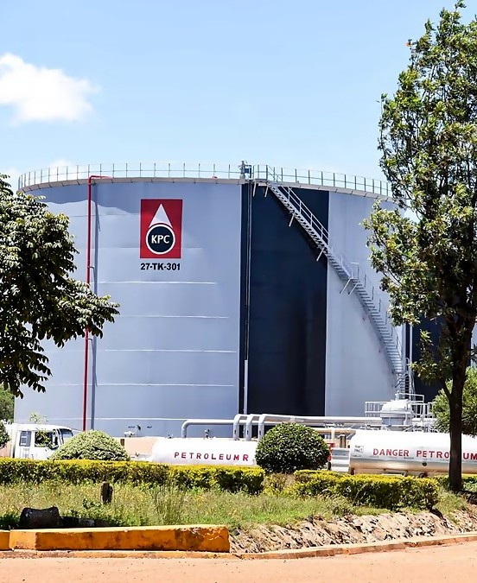
BOARD STRATEGY PITCH · PLP CAPSTONE 2026
Stop losing money on tanker waiting fees
Automated demurrage billing and revenue assurance for Kenya Pipeline Company
Brian Mugambi
Lead Architect, KPC Revenue Assurance team
Notes:
[0:30] Good morning. I'm Brian Mugambi, lead architect on the KPC Revenue Assurance team. In the next 15 minutes I'll show you where KPC's revenue is leaking, a working system that stops it, what it is worth, and the one decision I'm asking you to make today. Every figure I show is either from our demo data or a labelled assumption, and I will tell you which.

Slide 2

The ask: approve KES 12M to stop the leak
Base case: we recover half of an estimated KES 45M a year in unbilled waiting fees.
KES 19.0M
375%
7.6
net savings a year
return over 3 years
months to pay back
after KES 3.5M running cost*
on KES 12M invested*
base case*
Even if we recover only a quarter, it still pays back in 18.6 months and returns 94% over 3 years.
*Planning assumptions. The missed-fee estimate is modelled, not audited. Full workings on slide 6 and in the appendix.
KPC Revenue Assurance | Board Strategy Pitch
2
Notes:
[1:30] Let me start with the answer. We are asking for KES 12 million to roll this system out. In our base case it returns about KES 19 million a year after running costs, a 375 percent return over three years, and pays back in under eight months. I want to be clear these are planning numbers: they start from an estimated KES 45 million a year of unbilled fees, and I'll show you how we plan to test that. Even in a cautious case where we recover only a quarter of it, the investment still pays back in about 19 months.

Slide 3
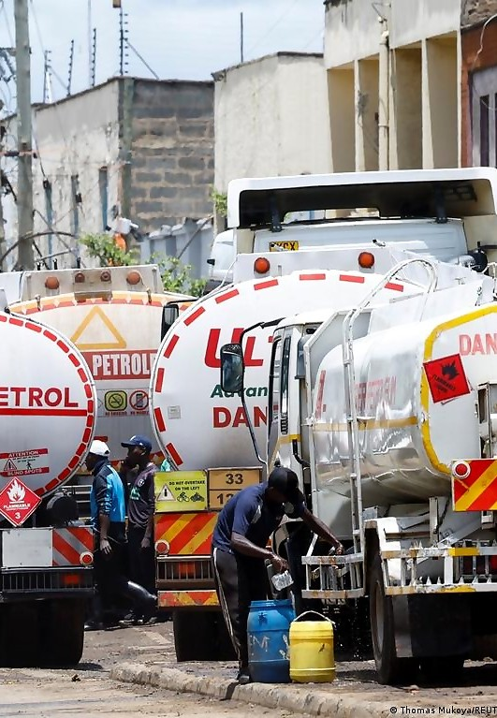



Where KPC's revenue quietly leaks
About KES 45M a year goes unbilled*
Paper gate passes and separate spreadsheets mean legitimate waiting fees are never charged.
45 to 60 days to settle
Customers dispute hand-made timesheets, so invoices drag on for weeks.
Scales not linked to billing
Weighbridge data and finance journals are separate, leaving weak evidence for auditors.
*Modelled estimate, to be validated against KPC audit data.
KPC Revenue Assurance | Board Strategy Pitch
3
Notes:
[1:30] Demurrage is the fee a tanker owes when it stays in a depot longer than its contract allows. Today that time is recorded on paper gate passes and separate spreadsheets across five terminals. That costs us twice. First, charges that are legitimately owed never get billed. We estimate about KES 45 million a year, and I want to stress that this is a modelled estimate that Finance has not yet audited. Second, when we do bill, customers dispute hand-made timesheets, so invoices take 45 to 60 days to settle. And because the weighbridge is not linked to billing, auditors get weak evidence.

Slide 4




Dwell time becomes an audited invoice
1. Capture
2. Apply
3. Check
4. Route
5. Post
Gate and weighbridge records for every truck
Each customer's free time, grace period and rates
Six compliance rules score every charge
Auto-approve, send to a person, or reject
SAP-ready invoice with a tamper-proof audit trail
Same inputs, same charge, every time
Unusual charges go to a person, never to a guess
Demo simulates the SAP push; live link is scoped in Phase 2
KPC Revenue Assurance | Board Strategy Pitch
4
Notes:
[1:30] Here is the solution in five steps. The system captures the gate and weighbridge records for each truck. It applies that customer's contracted free time and rates automatically. Every charge is then scored against six compliance rules, and each one is routed: cleanly verified charges are approved automatically, doubtful ones go to a person, and clearly invalid ones are rejected. Approved charges become invoice-ready with a tamper-proof audit trail. Two honest points: it is deterministic, so the same inputs always give the same charge, and in our demo the SAP posting is simulated. A live SAP connection is something we would scope with KPC IT in Phase 2.

Slide 5
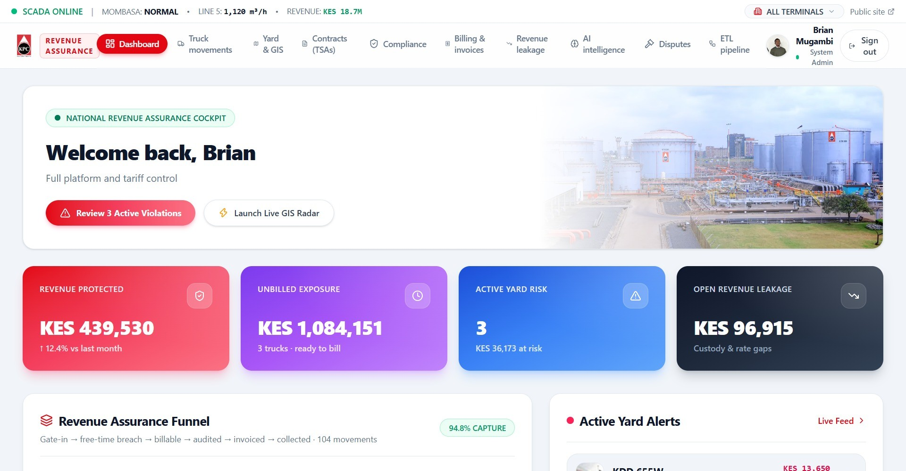
It already works: the platform is live
94.8%
of charges captured
4.2 days
to settle, vs 45 to 60 days
99.98%
arithmetic accuracy
6 rules
check every charge
KPC Revenue Assurance dashboard (seeded demo data)
demurrage-revenue-platform.vercel.app
Demo figures are illustrative, from the platform's seeded dataset. They are not audited financials.
KPC Revenue Assurance | Board Strategy Pitch
5
Notes:
[1:30] This is not a mock-up. The platform is live today, and this is its executive dashboard. On our demo dataset it captured 94.8 percent of charges, settled in 4.2 days against 45 to 60 days, and was 99.98 percent arithmetically accurate. I want to be careful here: that data is seeded demo data, so these numbers show the method works, not what KPC will achieve. That is exactly why our plan starts by testing it against real depot records. If there's time, I can open the live site.

Slide 6
The numbers: positive even in the cautious case
 | Base | Cautious
Share recovered | 50% | 25%
Annual savings | KES 19.00M | KES 7.75M
3-year net gain | KES 45.00M | KES 11.25M
ROI | 375% | 94%
Payback | 7.6 mo | 18.6 mo
Annual savings = KES 45M × share recovered − KES 3.5M running cost. ROI = (3 years of savings − KES 12M) ÷ KES 12M.
Costs are planning assumptions pending a Finance quote. Not counted: faster cash and lower audit effort.
KPC Revenue Assurance | Board Strategy Pitch
6
Notes:
[2:00] Here is the maths. We start from the estimated KES 45 million a year of missed fees. In the base case we recover half, KES 22.5 million, and after KES 3.5 million a year of running costs that is KES 19 million a year. Over three years that is KES 57 million of savings against a KES 12 million investment: a KES 45 million net gain, 375 percent return, payback in 7.6 months. The cautious case recovers only a quarter. Savings drop to KES 7.75 million a year, but the return is still 94 percent and payback is 18.6 months. Notice the lines: even the cautious line crosses zero during year two. What this does not count is faster cash, since invoices settle in days rather than months, and lower audit effort, so the real value should be higher. The KES 12 million and KES 3.5 million are planning assumptions I'd like Finance to replace with real quotes.

Slide 7
A quick win that builds toward prediction
Next: flag risky charges before billing (tested on simulated data)
Strategic bets
Quick wins
Prescriptive
What to do
This project
Predictive
What will happen
Impact →
Today: live dashboards and compliance checks
Avoid
Fill-ins
Diagnostic
Why it happened
Descriptive
What happened
Feasibility →
KPC Revenue Assurance | Board Strategy Pitch
7
Notes:
[1:30] Strategically, this project sits in the quick-win corner: high impact because it touches revenue directly, and high feasibility because the platform already exists and runs. On the analytics maturity ladder, we are at descriptive and diagnostic today: the dashboard shows what happened and the compliance checks show why a charge is doubtful. The natural next step is predictive. I have already built and tested a model, on simulated data, that ranks charges by how likely they are to be problematic, so reviewers look at the riskiest first. I would only use it in the pilot once we have real gate history to train on, and only ever as a guide for human reviewers.

Slide 8



A staged rollout with a decision gate
Days 0 to 60
Prove it
Months 3 to 6
Extend it
Months 6 to 12
Scale it
Finance and Internal Audit check the KES 45M estimate against real depot records
Go live at the Nakuru depot (PS25)
Release 1 of funding
Add Eldoret (PS27) and Kisumu (PS28)
Connect KRA cargo tracking and EPRA feeds
Scope the live SAP link with KPC IT
Bring all 40+ oil marketing companies onto the live tariff engine
Report recovered revenue to Finance monthly
Review results and plan the next phase
Decision gate at day 60: Release 2 happens only if Finance confirms savings of at least KES 7.75M a year.
Proposed timeline; dates depend on Board approval and access to depot data.
KPC Revenue Assurance | Board Strategy Pitch
8
Notes:
[1:30] The plan is deliberately staged. In the first 60 days Finance and Internal Audit test our KES 45 million estimate against real depot records, and we go live at one depot, Nakuru. Then comes a decision gate: the rest of the money is released only if Finance confirms savings at least as large as our cautious case, KES 7.75 million a year. If they do, months 3 to 6 add Eldoret and Kisumu, connect the KRA cargo-tracking and EPRA regulator feeds, and scope the live SAP link with KPC IT. In months 6 to 12 we bring all 40-plus oil marketing companies on. The timeline is my proposal and depends on getting access to depot data.

Slide 9


Two risks, and how we handle them
Risk 1: The savings estimate is not yet proven
Risk 2: Depot data and customer acceptance
The KES 45M figure is modelled, and the demo runs on sample data.
Gate and weighbridge records may arrive late or incomplete, and some customers may resist automatic billing.
Our response: Finance and Internal Audit test it against real depot records before the main funding is released. We plan around the cautious case.
Our response: Roll out one depot at a time, send every unusual charge to a person, and give customers the full record behind each charge.
What we are not claiming: the demo figures are illustrative, the SAP push is simulated in the demo, and the KES 12M and KES 3.5M costs are planning estimates awaiting quotes.
KPC Revenue Assurance | Board Strategy Pitch
9
Notes:
[1:30] Two risks matter most. First, the savings estimate is not yet proven: KES 45 million is modelled and the demo runs on sample data. The answer is the day-60 test against real records before most of the money is released. Second, depot data and customer acceptance: feeds can be late, and some customers may resist automatic billing. We roll out one depot at a time, every unusual charge goes to a person, and customers see the full record behind each charge, so disputes are settled with evidence. And so that nothing surprises you later, here is what we are not claiming: the demo figures are illustrative, SAP posting is simulated, and the costs are estimates awaiting quotes.

Slide 10
Recommendation: GO
Approve Phase 2 funding of KES 12M (planning estimate), released in two steps:
The cost of waiting
KES 3.75M
1
Release 1
Finance-led check of the missed-fee estimate and the Nakuru start-up.
estimated unbilled every month we delay (KES 45M ÷ 12, a modelled estimate)
2
Release 2
Eldoret, Kisumu, regulator connections and all 40+ customers, once Step 1 confirms at least KES 7.75M a year.
Expected result: KES 19.0M a year recovered, payback in about 8 months.
KPC Revenue Assurance | Board Strategy Pitch
10
Notes:
[1:30] So my recommendation is Go. Approve Phase 2 funding of KES 12 million, released in two steps. Release 1 pays for the Finance-led check of our estimate and the Nakuru start-up. Release 2 follows only if that check confirms at least the cautious-case savings. The alternative is not free: on our estimate, roughly KES 3.75 million of legitimate fees goes unbilled every month we wait. If the estimate is right, the base case returns about KES 19 million a year with payback in around eight months. I'm happy to take questions, and I've prepared backup slides on the questions I would expect on budget, risk and scalability.

Slide 11

Thank you. Questions?
The KPC Revenue Assurance team
Brian Mugambi
Carson Sila
Charlene Kamunyu
Emmanuel Brian
Brian Sigei
Lead Architect
SCADA Telemetry Lead
Billing and Revenue Assurance
Finance and AI Lead
Compliance Auditor
See it live: demurrage-revenue-platform.vercel.app
Backup slides follow: questions the Board may ask, and the financial model.
KPC Revenue Assurance | Board Strategy Pitch
11
Notes:
[0:30] Thank you. This was built by a five-person team, and we would welcome your questions. The platform is live at the address on screen. The next two slides are backup for questions on budget, risk and scalability, and the full financial model.

Slide 12
Backup: questions the Board may ask
Is the KES 45M real?
What if we recover only a quarter?
It is a modelled estimate. Finance and Internal Audit test it against real depot records in the first 60 days, before Release 2.
Annual savings are KES 7.75M, ROI is 94% and payback is 18.6 months. Still positive.
Is the SAP link live?
Can it scale past 5 depots?
Not yet. The demo produces SAP-ready postings with a reference number. A live connection is scoped with KPC IT and priced by quote.
The same engine runs all 5 terminals in the demo, and a new depot is configuration, not a rebuild. Phase 2 adds 3 depots and 40+ customers.
What if customers dispute charges?
What if the data feeds fail?
Every charge keeps an audit signature and its full record, so disputes are settled with evidence. Unusual charges get human review first.
Incomplete records route to a person instead of billing automatically, and we roll out one depot at a time to catch problems early.
KPC Revenue Assurance | Board Strategy Pitch
12
Notes:
Backup only. Use these if the Board asks about budget, risk or scalability.

Slide 13
Backup: financial model and assumptions
KES millions | Base | Cautious | Where it comes from
Missed fees per year | 45.00 | 45.00 | Project estimate, modelled, not audited
Share recovered | 50% | 25% | Assumption (demo showed 94.8% capture)
Annual savings before costs | 22.50 | 11.25 | 45 × share recovered
Running cost per year | 3.50 | 3.50 | Assumption, Finance quote needed
Annual savings | 19.00 | 7.75 | Savings before costs − running cost
One-time cost | 12.00 | 12.00 | Assumption, Finance quote needed
3-year savings | 57.00 | 23.25 | Annual savings × 3
3-year net gain | 45.00 | 11.25 | 3-year savings − one-time cost
ROI | 375% | 94% | Net gain ÷ one-time cost × 100
Payback | 7.6 months | 18.6 months | One-time cost ÷ annual savings × 12
Not counted, so real value may be higher: cash arriving in about 4 days instead of 45 to 60, and lower audit effort.
KPC Revenue Assurance | Board Strategy Pitch
13
Notes:
Backup only. Same model as the one-page business case.

