Slide 1

Tanz und Schauspiel im virtuellen Studio: Undercover
Konstantin Karas, Min Ting Luong, Jakob Raith
Technische Universität München
Garching, 07. Juni 2019

Slide 2
Motivation
Not another dance game
mainly „Schauspiel“ combined with „Tanz“
Combining fun games with an interesting setting
Inspiration: Hiding in the crowd mechanic from Assassins Creed franchise

Slide 3
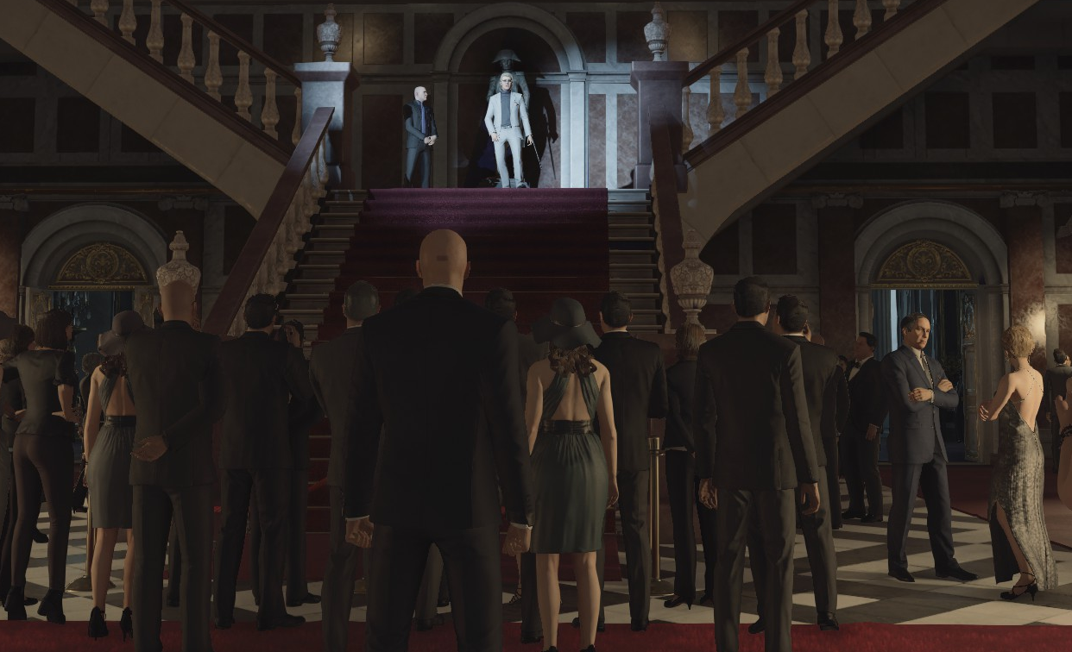
Scenario
Player is a spy who is infiltrating an elegant dinner party, seeking to eliminate a guest
Player have to integrate themselves into the crowd – they have to mimic the behavior of the other guests
Player raise the guards suspicion when performing poorly
Player wins when they reach their target or loose when they get caught

Slide 4
Game
Game End
(mostly) Third Person perspective
Beamer as screen
Support left and right hand when possible
Minigames
3 Games (might be more if enough time)
Start and Ending as cutscenes, might be future games
Gestures (2-3/game)
Points for good performance
thematically fitting (drinking, dancing…)
Game 3.1
Game 3.2
Game 2
Game 1.1
Game 1.2
GameStart

Slide 5
Game Start: Taking a photo
Game End
Cutscene: player enters the party
Game:
player is standing in front of the camera and has a picture taken (countdown)
picture will be presented at the end of the game
Game 3.1
Game 3.2
Game 2
Game 1.1
Game 1.2
GameStart

Slide 6
Game 1.1: Meet guests at the bar
Game End
Gesture 1: Tip your hat
Raise a hand to the head
Move hand forward and to the side
Gesture 2: drink an aperitif
Raise a hand to your throat
Tilt your head backwards and raise your elbow
Interaction: grab / put glass back
Game 3.1
Game 3.2
Game 2
Game 1.1
Game 1.2
GameStart

Slide 7
Game 1.2: Magic trick (optional)
Game End
Gesture 1: Pull a rabbit out of your hat
Hold an arm stretched out in front of you
Move the other arm towards the stretched out hand
Sharply pull your hands apart vertically
Applause (nice to have)
Gesture 2: Pet the rabbit
Move a hand to the rabbit’s head
Gently trace the rabbit’s back
Do not startle the rabbit (nice to have)
Game 3.1
Game 3.2
Game 2
Game 1.1
Game 1.2
GameStart

Slide 8
Game 2: Participate in a dance
Game End
3 dance moves in random order
Player is shown a small image of the dance move to perform
Player can see upcoming sequence
Include in-game movement (e.g step to the left) (nice to have)
Game 3.1
Game 3.2
Game 2
Game 1.1
Game 1.2
GameStart

Slide 9
Game 3.1: Balance a tablet
Game End
Player holds hands in front of body to carry a virtual tablet of e.g. drinks
Player has to stabilize the objects by raising and lowering their hands accordingly
Game 3.1
Game 3.2
Game 2
Game 1.1
Game 1.2
GameStart

Slide 10
Game 3.2: Give directions
Game End
A NPC asks the player for directions (e.g. where is the bar?)
Request is randomly chosen
While turning the head, the camera rotates and stops when the player looks straight ahead
When the player has located the object/area in question, they point at it with a hand
Game 3.1
Game 3.2
Game 2
Game 1.1
Game 1.2
GameStart

Slide 11
Game End: Eliminate Target
Game End
Cutscene:
eliminate target
Display player score
Show photo taken at the start
Game:
Pull a lever/cut a rope behind the stage
Something heavy drops on the target
Every time it is something different (nice to have)
Display player score on the object
Show photo taken at the start
Game 3.1
Game 3.2
Game 2
Game 1.1
Game 1.2
GameStart

Slide 12
Must have features
Game 1.1: Meet guests at the bar
Game 2: Participate in a dance
Game 3.1: Balance a tablet
Simple start and ending presentation

Slide 13
Nice to have features
Implementing all mini-games
Disguising yourself when getting caught (put on provided pair of glasses), one time use
Consistent art style

Slide 14
Milestones
Milestone 1 (deadline 14.6.2019)
Player model and tracking support
Mini-game manager and gesture manager
Game manager
Camera manager
Gesture evaluation
Milestone 2 (deadline 5.7.2019)
Finished must have features
Critical art assets included

Slide 15
Task distribution
Konstantin Karas
Gesture manager
Gesture evaluation (preliminary version)
Camera utils (paths, rotating)
Game 1.1: Meet guests at the bar
(Game 2: participating in a dance)
Optional:
Game Start: Taking a photo
Game 3.2: Give directions

Slide 16
Task distribution
Min Ting Loung
Gesture evaluation
Critical assets (dummy npc, glass, top-hat, tablet + content...)
Player model
Game 2 (choreography)
Game 3.1: Balance a tablet
Optional:
Game 1.2: Magic trick

Slide 17
Task distribution
Jakob Raith
Game manager
mini-game manager
Game 2: participating in a dance
Optional:
Disguise yourself
Game End: Eliminate target

Slide 18
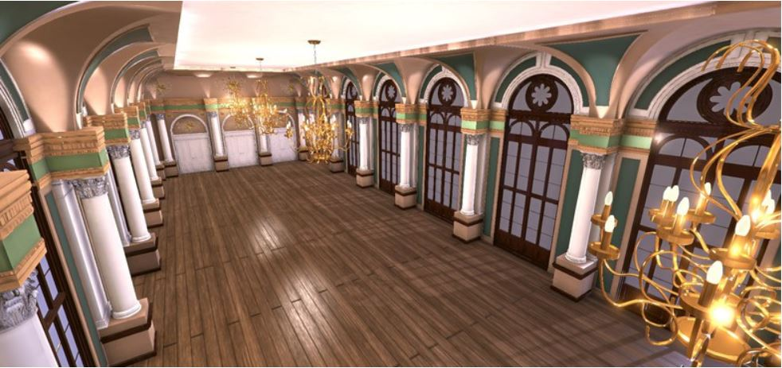
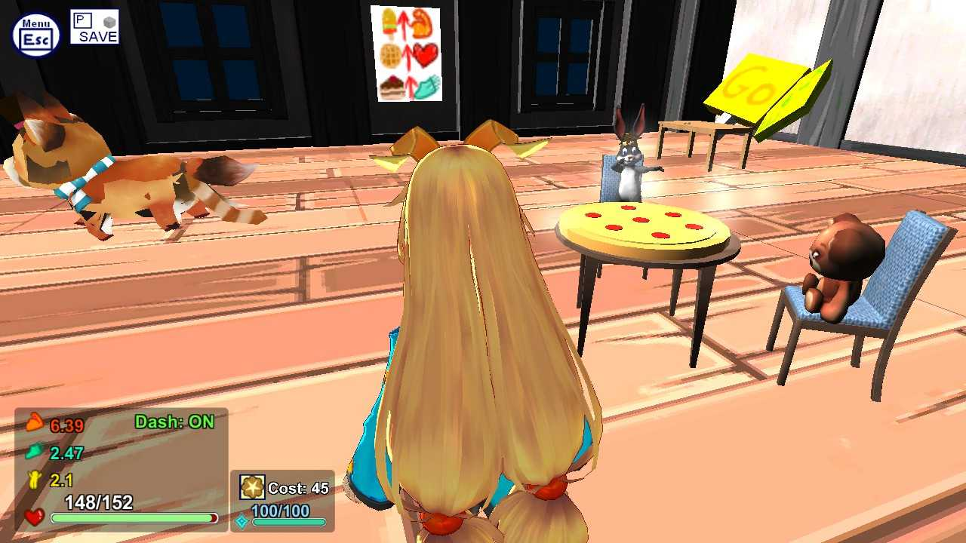
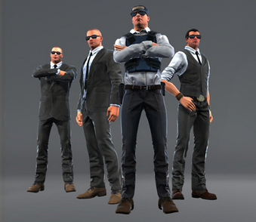
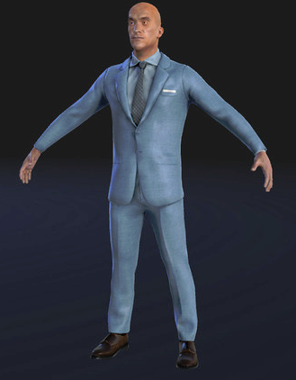
Ballroom and Character

Slide 19
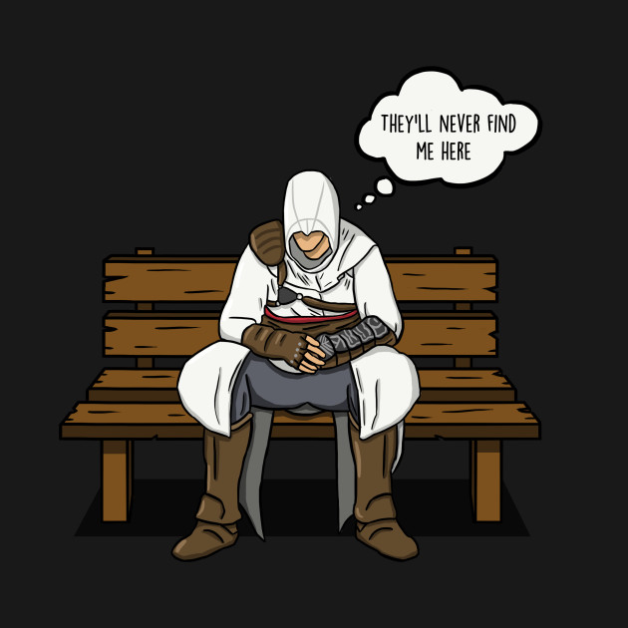
Questions?

