Slide 1

Tanz und Schauspiel im virtuellen Studio: Undercover
Konstantin Karas, Min Ting Luong, Jakob Raith
Technische Universität München
Garching, 19. Juli 2019

Slide 2
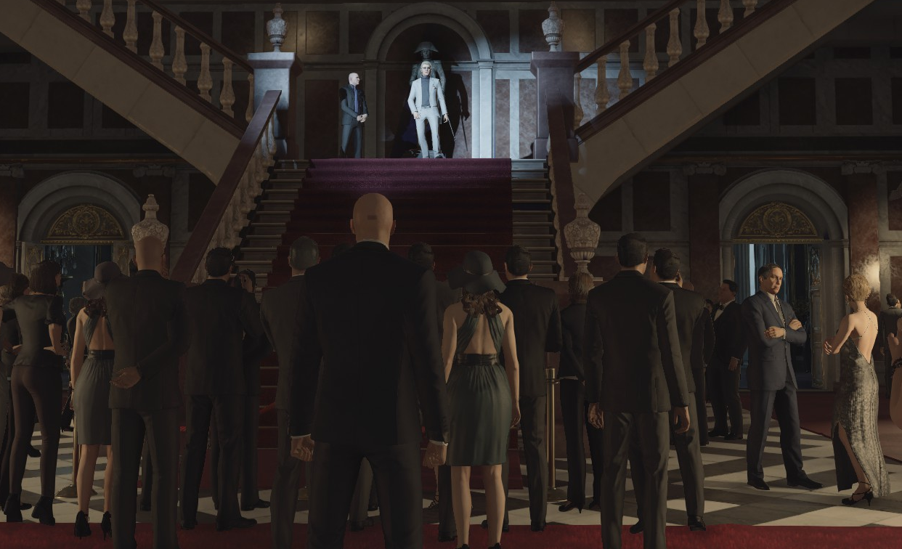
Scenario
Player is a spy who is infiltrating an elegant dinner party, seeking to eliminate a guest
Player have to integrate themselves into the crowd
Player raise the guards suspicion when performing poorly
Player wins when they reach their target or loose when they get caught

Slide 3
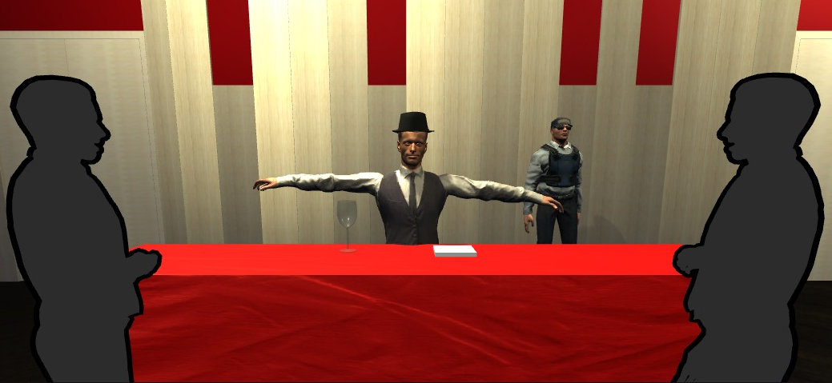
Refinement
Player is not mimicking the guests
Instead he has to act like an employee
He is asked to perform certain tasks by his client
316495

Slide 4
Game
Eliminate Target
Disguise
Third Person perspective
Beamer as screen
Support left and right hand when possible
Minigames
Gestures, steering, interact with objects
Points for good performance
thematically fitting (drinking, dancing…)
Give Directions
Balance
Dance
Meet Guests
Magic Trick
Take Picture

Slide 5
Game Overview
Eliminate Target
Disguise
3 core games:
Meet guests at bar (Tip Hat, Drink)
Perform for guests (Dance moves)
Balance a tablet (Do not let items fall off)
Nice to have:
Start: Take picture of player
Perform a magic trick (pull rabbit out of hat and pet it)
Give directions to an NPC (point at requested items/places in the scene)
Disguise (put on / take off glasses when caught to avoid failure)
End: Eliminate target
Give Directions
Balance
Dance
Meet Guests
Magic Trick
Take Picture

Slide 6
Completed Games
Eliminate Target
Disguise
3 core games:
Meet guests at bar (Tip Hat, Drink)
Perform for guests (Dance moves)
Balance a tablet (Do not let items fall off)
Nice to have:
Start: Take picture of player
Perform a magic trick (pull rabbit out of hat and pet it)
Give directions to an NPC (point at requested items/places in the scene)
Disguise (put on / take off glasses when caught to avoid failure)
End: Eliminate target
Give Directions
Balance
Dance
Meet Guests
Magic Trick
Take Picture

Slide 7
Left out Games
Eliminate Target
Disguise
Perform Magic trick:
Tracing the rabbit requires much more precise movement
Give directions to player:
Additional camera steering system required
Switch to first person already implemented
Completely new system to recognize pointing at objects or places in scene required
→ Possible, but not enough time
Give Directions
Balance
Dance
Meet Guests
Magic Trick
Take Picture

Slide 8
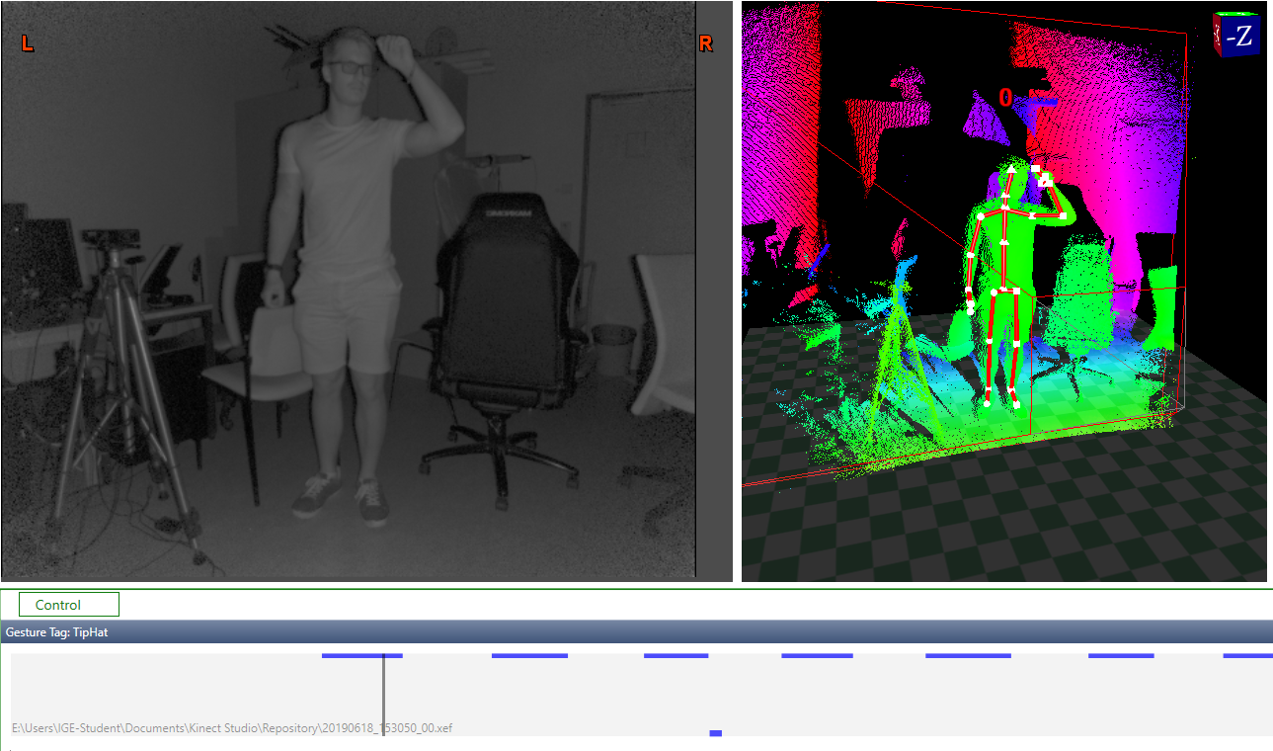
Our machine learning adventure
Additional gesture recognizer: Visual Gesture Builder
Idea: record training sets and receive confidence values from system to recognize what the player is doing
First try in Kinect SDK:
Tip hat → Solid results
3,5 weeks spend to understand system and integrate it into our game logic

Slide 9
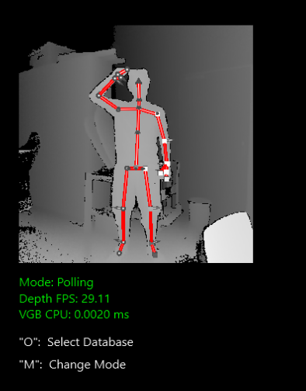
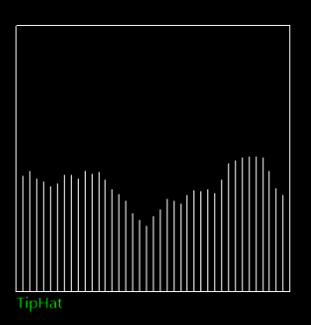
Our machine learning problems
We want to use gestures, but the discrete functionality proved insufficient for the task
As soon as there is confidence value the result would trigger
→ Very bad results would be thrown
The more gestures were added the less results were thrown at all
System got confused, gestures too similar
Training the system is difficult with limited time
Perhaps too little positive frames given in training

Slide 10
Lessons learned
You cannot scope too small
Get your git together
All stumbling and no progress make the team dull
Kinect is powerful, yet sometimes frustrating

Slide 11
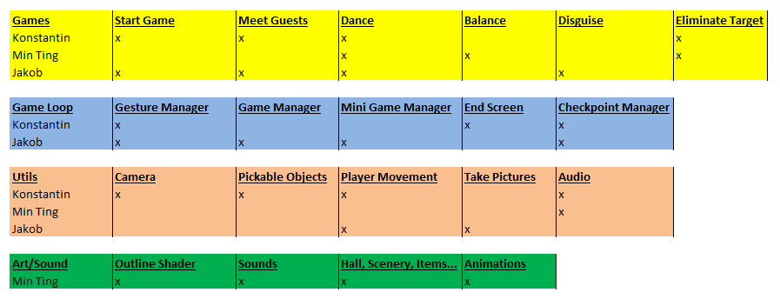
Task distribution

Slide 12
Gameplay!

Slide 13

Questions?

