Slide 1
Denoising using Multiscale Representations
IT530, Lecture Notes
Based on the paper: “Multiscale denoising of photographic images”, Rajashekhar and Simoncelli

Slide 2
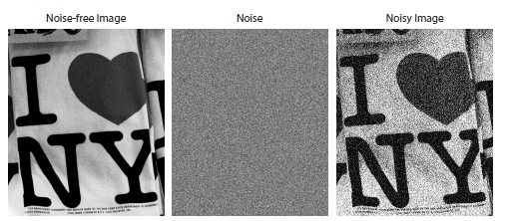
How to distinguish between signal and noise?

Slide 3
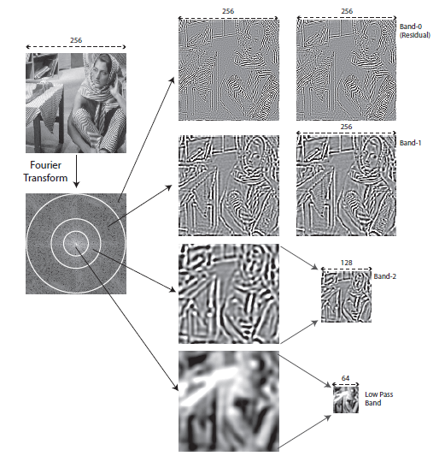
Multiscale representations
Separation into smooth (lower frequency) and non-smooth (higher frequency) bands.

Slide 4
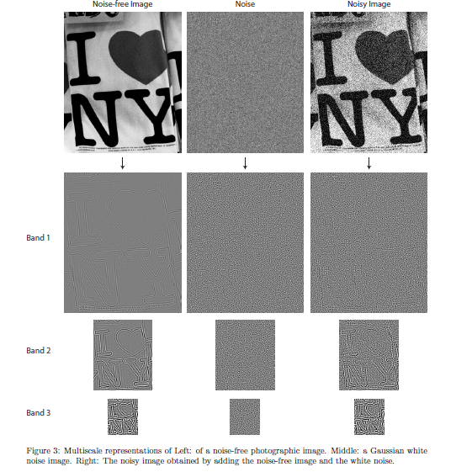
Multi-scale representations: facilitates better distinction between signal and noise

Slide 5
Multiscale representation: Laplacian Pyramid
Convolve the image I₀ with a Gaussian to get image I₁.
Downsample I₁.
Store L₀ = I₀ – Expanded (I₁).
Repeat for some K levels, e.g. L₁ = I₁ – Expanded (I₂), where I₂ is obtained by low-pass filtering I₁ followed by down-sampling.

Slide 6
Three step denoising procedure
Compute a multiscale representation (e.g. multi-level wavelet decomposition, OR Laplacian pyramid)
Denoise the noisy wavelet coefficients/Laplacian bands (denoted as y) to get an estimate of the true coefficients x.
Invert the multiscale representation to get the final denoised image.

Slide 7
Method (1): Band Processing
Actual signal coefficients tend to be more dominant in lower frequency bands (of the noisy image).
Noise dominates the higher frequency bands (of the noisy image).

Slide 8
Part 1(A): Band Thresholding
We can set all coefficients in a band to 0 if it is significantly corrupted by noise.
We can retain all coefficients in other bands as is.
Consider
Error incurred if we retain a noisy band is
and error incurred if we discard it is .

Slide 9
Part 1(A): Band Thresholding
Retain/discard depending upon
Problem – we don’t know .
Solution: Take “representative” clean training images, compute their multi-level decomposition. Decide during training whether to retain or discard a band at each level (using ).
We assume that the noise variance is known.

Slide 10
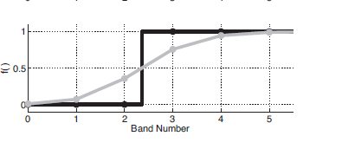
Part 1(A): Band Thresholding
Lower frequency
Higher frequency
Rule learned by the authors during offline training

Slide 11
Part 1(B): Band weighting
Band thresholding may be too restrictive.
Instead do some weighting – attenuate some bands more than others.
Solution: For each band, find a value a such that you minimize:
Offline training (on clean and noisy image pairs, for a given noise level) to find the best weight for each band.
You know this during training

Slide 12
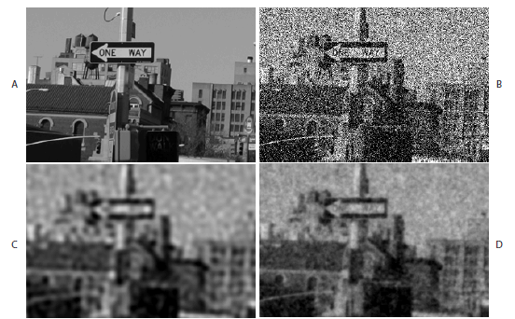
Part 1(B): Band Thresholding/Weighting
Higher frequency
Lower frequency
Thresholding rule
Weighting rule
13.40 dB
24.45 dB
25.04 dB

Slide 13
Part 2: Coefficient Processing
Why threshold/weight entire bands with the same threshold/weighting factor?
It may be a better idea to distinguish between signal and noise using the MAGNITUDE of the individual noisy coefficients.

Slide 14
Part 2(A): Coefficient Thresholding
For each band, find an optimal threshold T. Discard noisy coefficients whose absolute values fall below T, and retain the rest.
Learn the optimal T for every band offline using pairs of clean and noisy images from a training set. Do a brute-force search to find best T for each band.

Slide 15
Part 2(A): Coefficient Thresholding (Training Procedure in Detail)
Collect some K training images (all clean). Add noise of known sigma and create their noisy versions.
Decompose every clean and every noisy image into different bands.
For each band, find the best threshold T so as to minimize the afore-mentioned error (added up over all K images) – authors use a brute-force search.

Slide 16
Part 2(B): Coefficient Weighting
Find weight a for noisy coefficients of a given range of values (a “bin”) so as to minimize:
Note: we are binning the noisy coefficients, with bin-width delta and finding a different weight a for each bin.

Slide 17
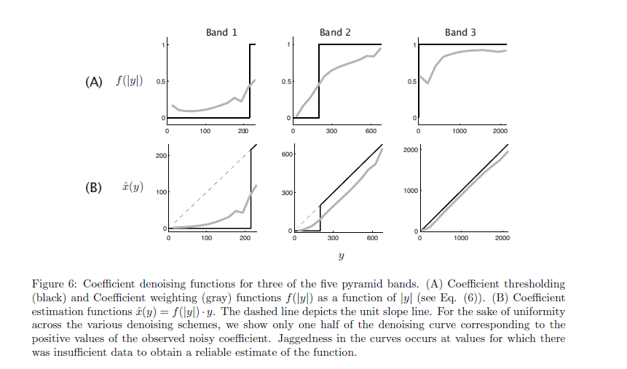

Slide 18
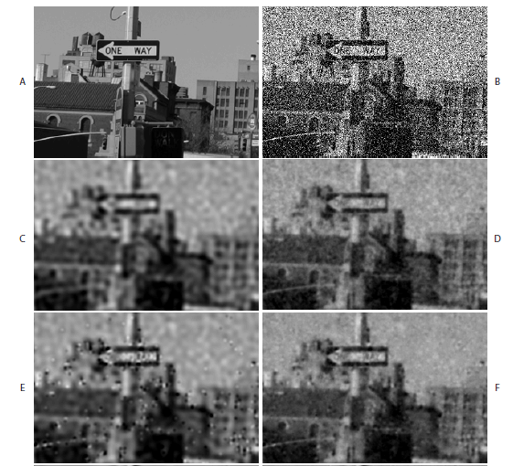
13.40 dB (noisy)
24.45 dB
(Band thresholding)
25.04 dB
(Band weighting)
24.97 dB
(Coeff.
thresholding)
25.72 dB
(Coeff.
weighting)

Slide 19
Part 3: Neighborhood processing
Band processing was too global.
Coefficient processing is local.
BUT it ignores the dependencies between wavelet coefficients at adjacent scales/locations.
So we will now not only consider the magnitudes of the individual wavelet coefficients, but also the local energy of a neighborhood around a given wavelet coefficient.

Slide 20
Part 3(A): Neighborhood thresholding
Consider i-th wavelet coefficient
and its neighborhood-energy
Discard wavelet coefficients whose neighborhood-energy falls below some threshold T. T is decided as follows:

Slide 21
Part 3(A): Neighborhood thresholding
Note: the training is performed on each band, given pairs of clean and noisy images.
For each band, find the threshold T that minimizes the aforementioned energy function.

Slide 22
Part 3(B): Neighborhood Weighting
Extend the thresholding idea to weighting.
Weigh a wavelet coefficient by a value a dependent on its neighborhood-energy. You learn a during training as follows:
Note, we are binning the neighborhood-energy values (not the wavelet coefficient values). A different weight a is learned for each bin.

Slide 23
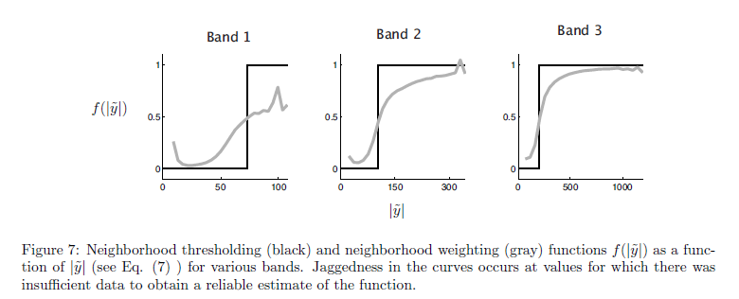

Slide 24
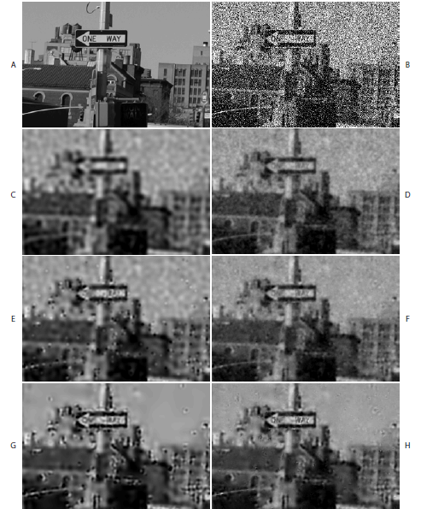
13.40 dB (noisy)
24.45 dB
(Band thresholding)
25.04 dB
(Band weighting)
24.97 dB
(Coeff.
thresholding)
25.72 dB
(Coeff.
weighting)
26.24 dB
(Neigh.
thresholding)
26.60 dB
(Neigh. weighting)

Slide 25
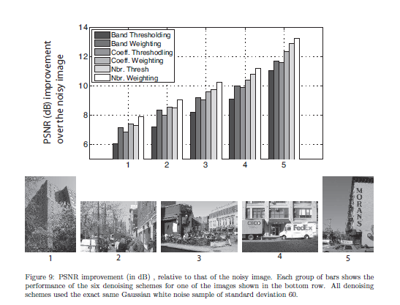

Slide 26
Summary
Three denoising methods studied: band processing, individual coefficient processing and neighborhood processing.
Thresholding and weighting studied in each case.
“Optimal” thresholds or weights learned on a set of representative images – clean images and their noisy versions.
Neighborhood weighting gives best results.

