Slide 1

Querying Databases with SQL
Spring 2020 workshop
Dominic Bordelon, djb190@pitt.edu
Digital Scholarship Services | University Library System
University of Pittsburgh
License: CC BY-SA 4.0

Slide 2
Objectives
By the end of this workshop, you will be able to...
Understand basic features and structures of relational databases
Query a database table to explore information as well as answer specific questions
Combine and query multiple tables at once using joins
Understand common data types and null values
Use functions to transform query inputs and results
Aggregate results (e.g., identify and count categories in the data)
Investigate a database to learn about what information it contains
Save queries and results

Slide 3
Setup
Visit: http://pi.tt/dss-sql2020
Download and run DB Browser for SQLite
Download the Chinook database (Chinook_Sqlite.sqlite)
Download the “portal all” database from Data Carpentry for Biologists (portal_mammals.sqlite)

Slide 4



What is SQL? What is an RDBMS*?
* Relational DataBase Management System
Structured
Query
Language
SQL
RDBMS
Result Sets
Database A
Database D
Database B
Database C
Table A
Table B
Table C

Slide 5
Data is stored in tables
id | lastName | department
1 | Smith | HR
2 | Jones | IT
3 | Harris | HR
Table: describes a category of thing
Person, publication, invoice, product, observation, event…
Column: an attribute/property of the thing
Eye color, publication date, invoice total, product name, geolocation…
There is usually an “ID” column, also called a primary key
Row: a thing (or more precisely, record of a thing)
id | movieTitle | year
1 | Jaws | 1975
2 | Toy Story | 1995
id | screen_name | location | description
17874544 | TwitterSupport | Twitter HQ | Your official source for Twitter Support. …

Slide 6




Some advantages of RDBMSes (or: why people use them)
Changes can be carefully controlled through reversible transactions
Built-in data integrity measures
RDBMS servers: single data store
+ job management
Scalability for complex and large amounts of data

Slide 7
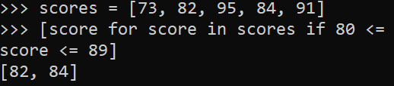
Example: Given a list of scores, which ones are in the range of 80-89?
SQL works on sets
In python
In SQL
➡ imperative language
how to get the results
SELECT score FROM scores
WHERE score BETWEEN 80 AND 89;
Give me the set of items such that their score is between 80 and 89.
For each score in the list, return the score if it is between 80 and 89.
➡ declarative language
what results you want (the engine figures out how)

Slide 8
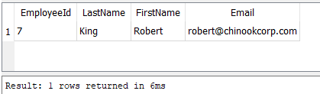
The result of a query is always a set
(even if it has only one member)
Give me the last name, first name, and email of the employee whose Employee ID is 7.

Slide 9
Tables are often combined to ask more complex questions— “joining”

Slide 10




What can you do with SQL? (types of statements)
Today’s focus
SELECT: read from the database
INSERT: create new row(s) in a table
UPDATE: update existing row(s) of a table
DELETE: delete row(s) from a table
CREATE TABLE, ALTER TABLE, RENAME TABLE, DROP TABLE…
GRANT, REVOKE for controlling user access
BEGIN TRANSACTION, COMMIT, ROLL BACK
SQL keywords are not case-sensitive ( SELECT == select )—but entities like tables and columns are case-sensitive

Slide 11
Anatomy of a SELECT query
(using the Chinook database)
“What are the names of the IT staff?”
SELECT EmployeeID, LastName, FirstName, Title FROM Employee
WHERE Title = "IT Staff"
clauses
⬅ columns
⬅ table
⬅ filtering based on some conditions
Laura

Slide 12
SELECT EmployeeID, LastName, FirstName, Title FROM Employee
WHERE Title = "IT Staff"
Employees
Title = “IT Staff”
EmployeeID
LastName
FirstName
Title

Slide 13
Anatomy of a SELECT query
(using the Chinook database)
“What are the names of the IT staff?”
SELECT EmployeeID, LastName, FirstName, Title FROM Employee
WHERE Title = "IT Staff"
clauses
⬅ columns
⬅ table
⬅ filtering based on some conditions
Try also:
SELECT * FROM Employee WHERE Title = "IT Staff" OR Title = "IT Manager"
…WHERE Title IN("IT Staff", "IT Manager")
…WHERE Title LIKE "IT%"
Laura

Slide 14
SELECT *
FROM Employee
WHERE Title = "IT Staff" OR Title = "IT Manager"
Employees
Title = “IT Manager”
All attributes!
(EmployeeID,
LastName,
FirstName,
Title,
ReportsTo,
BirthDate,
HireDate,
Address,
City,
State,
Country,
PostalCode,
Phone,
Fax,
Email)
Title = “IT Staff”

Slide 15
Sorting your results
SELECT Country, LastName, FirstName FROM Customer
ORDER BY Country, LastName
SELECT InvoiceId, InvoiceDate, Total FROM Invoice
ORDER BY InvoiceDate DESC
What is the “default” sort?
If there is no ORDER BY clause, relational DBs don’t guarantee any ordering in particular.
…but usually, it will be ascending by the ID column.

Slide 16
WHERE conditions: comparators
SELECT InvoiceId, InvoiceDate, Total FROM Invoice
WHERE Total > 10.00
>=, <, <= also work
Comparisons also work with dates:
…WHERE Total BETWEEN 5.00 AND 10.00
…WHERE InvoiceDate > '2009-01-01'
…WHERE InvoiceDate BETWEEN '2009-01-01' AND '2009-12-31'

Slide 17
What is NULL?
NULL means no value
It is not the same as 0 (zero)—NULL is not an integer, can’t be used for math, and does not exist on the number line
It is not the same as “” (an empty string)—NULL is not a string
What does it represent? It depends on the context
Could be: column not applicable for this row; value unknown; value to be filled later; a mistake…
In any case, ⚠ beware NULL when doing (in)equality or comparisons!
The proper way to test for it is
or
WHERE columnName IS NULL
WHERE columnName IS NOT NULL

Slide 18
WHERE conditions: functions
Functions can transform a column’s contents.
“What are the invoices whose total rounds to $9?”
SELECT * FROM Invoice
WHERE round(Total) = 9
⚠NOTE: Functions vary greatly from one database vendor to another!

Slide 19




Data types
123
Generic type | Common variants | In SQLite
Integer | INT, BIT, TINYINT, BIGINT | INTEGER
Real/decimal | FLOAT, REAL, DOUBLE | REAL
String | CHAR, VARCHAR | TEXT
Text (long) | TEXT | TEXT
Boolean (true or false) | BOOLEAN, BIT | INTEGER
Date / datetime | DATE, TIME, DATETIME | TEXT
BLOB (Binary Large Object) | BLOB | BLOB
10.1

Slide 20
A column’s data type determines…
What kind of values can be stored in it
A decimal or a string can’t be stored in an INT column
The maximum size that can be stored in it (size of number, or length of text), e.g. VARCHAR(50) or BIT
How much disk space is allocated for it
How efficiently the DB engine can use it (shorter text is faster than long)
What functions can be used on it
In stricter engines than SQLite, converting (also called “casting”) is a very common operation

Slide 21
Functions work in the SELECT clause, too
SELECT Total, round(Total) FROM Invoice
WHERE round(Total) = 9
“What are the minimum, maximum, and average invoice totals?”
SELECT min(Total), max(Total), avg(Total)
FROM Invoice
Combine two string columns using the concatenate operator ||
SELECT FirstName || ' ' || LastName AS FullName
FROM Employee

Slide 22
Querying more than one table: joins!
Oftentimes, the information we want is in more than one table…
“Who is Frank Harris’s customer support rep?”
Query Customer to get SupportRepId (4)
Query Employee using SupportRepId to see Employee #4’s name (Margaret Park)
Since we know that there is a relationship between the Employee and Customer tables—that SupportRepId corresponds to EmployeeId—we can join these tables into a single view.

Slide 23
How to join
“Connect the Customer and Employee tables, such that Customer.SupportRepId is the same as Employee.EmployeeId.”
SELECT C.LastName, C.FirstName, SupportRepId,
E.EmployeeId, E.LastName, E.FirstName
FROM Customer AS C
JOIN Employee AS E
ON C.SupportRepId = E.EmployeeId
WHERE C.LastName = "Harris"
⚠NOTE: This is the most common kind of join (“inner join”). There are others, with important differences.

Slide 24
Tables are often combined to ask more complex questions— “joining”

Slide 25
Why is it like this?
Why do we need to check multiple tables? Why not put everything in one?
When a DB designer sees the same value (or a small variety of values) in a column—for example, music genre—they try to normalize the data, by separating the values into their own table, and using the new ID (“foreign key”) to refer to the value.
This is good for disk space, data integrity, and database efficiency.

Slide 26
Before and after normalization
Title | GenreId
For Those About To Rock (We Salute You) | 1
Fast As a Shark | 1
Restless and Wild | 1
Princess of the Dawn | 1
Put The Finger On You | 1
… | …
Title | Genre
For Those About To Rock (We Salute You) | Rock
Fast As a Shark | Rock
Restless and Wild | Rock
Princess of the Dawn | Rock
Put The Finger On You | Rock
Let's Get It Up | Rock
Inject The Venom | Rock
Snowballed | Rock
Evil Walks | Rock
C.O.D. | Rock
Breaking The Rules | Rock
Night Of The Long Knives | Rock
Spellbound | Rock
Go Down | Rock
Foreign key relationship
GenreId | Name
1 | Rock
2 | Jazz
3 | Metal
… | …

Slide 27
Investigating a database
What tables are there, and what relationships do they have?
Tells us (maybe) what entities are described in the DB
GUI: usually an “explorer” feature
What are a table’s column definitions?
Tells us how an entity is described
Note data types, NULLable, DEFAULT
Foreign keys with other tables! Easiest is an Entity-Relationship (ER) diagram
Using SELECT DISTINCT to see the range of recorded values

Slide 28
Grouping results
“How many customers do we have in each country? How many tracks do we have in each genre? What are the min, max, and average lengths of track on each album?”
These can all be answered with the GROUP BY clause + aggregating functions
SELECT Country, COUNT(Country) FROM Customer
GROUP BY Country
ORDER BY COUNT(Country) DESC

Slide 29
SELECT Country, COUNT(Country) FROM Customer
GROUP BY Country
ORDER BY COUNT(Country) DESC
Customers
Country = Argentina
Country = Australia
Country = …
Country
count(*)

Slide 30
Using WHERE and GROUP BY together
WHERE filters rows before they are grouped.
The WHERE clause is always written before the GROUP BY clause.
SELECT City, COUNT(*) FROM Customer
WHERE Country = 'USA'
GROUP BY City
ORDER BY COUNT(*) DESC

Slide 31
SELECT City, COUNT(*) FROM Customer
WHERE Country = 'USA'
GROUP BY City
ORDER BY COUNT(*) DESC
Customers
Country = USA
City = Boston
City = Chicago
City = …
City
count(*)

Slide 32
Common aggregate functions
COUNT(), MIN(), MAX(), AVG(), SUM()
In the “portal all” database:
SELECT species_id, COUNT(*), MIN(weight), MAX(weight), AVG(weight)
FROM surveys
GROUP BY species_id
ORDER BY species_id ASC

Slide 33

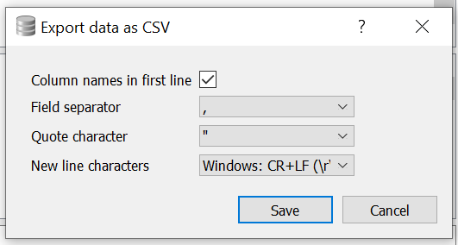
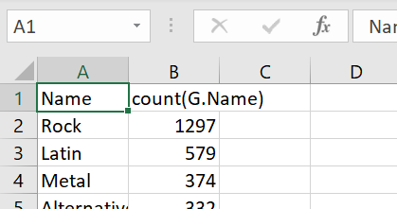

Saving queries and results
SQL queries can be saved as a plaintext .sql file
Comments (marked with -- ) can be very helpful reminders
SQL result sets can be exported as .csv files
Can be opened (and further manipulated) and visualized in Excel and many other applications
Can be used more programmatically with languages like python or R

Slide 34
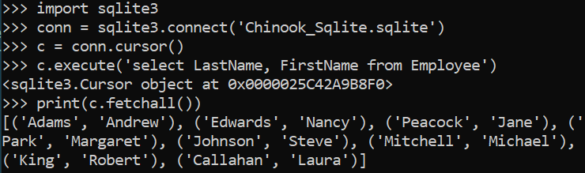
SQL + other programming languages
Many (most?) modern programming languages (python, R, javascript, Java, C#...) have libraries for connecting to a variety of RDBMSes.

Slide 35


If you want more…
RCE@Pitt workshops by SCI
8 weeks of data-centric workshops; 2 of them are about SQL
Videos and courses at LinkedIn Learning
Free for Pitt students, faculty, and staff (via CSSD)
(formerly Lynda.com)
Ebooks and videos at O’Reilly
Free for Pitt students, faculty, and staff (library subscription)
(formerly Safari Ebooks)

Slide 36
How did we do?
Please complete our survey!
Check out our other workshops: https://pi.tt/ds-workshops
Follow us on twitter: @DSSatPitt
Contact me: Dominic Bordelon, djb190@pitt.edu
https://bit.ly/dss_spring2020

Slide 37
Image credits
Cover slide: Photo by Ugur Akdemir on Unsplash

Slide 38
SQL box template
SELECT EmployeeID, LastName, FirstName, Title FROM Employee
WHERE Title = "IT Staff"

