Slide 1
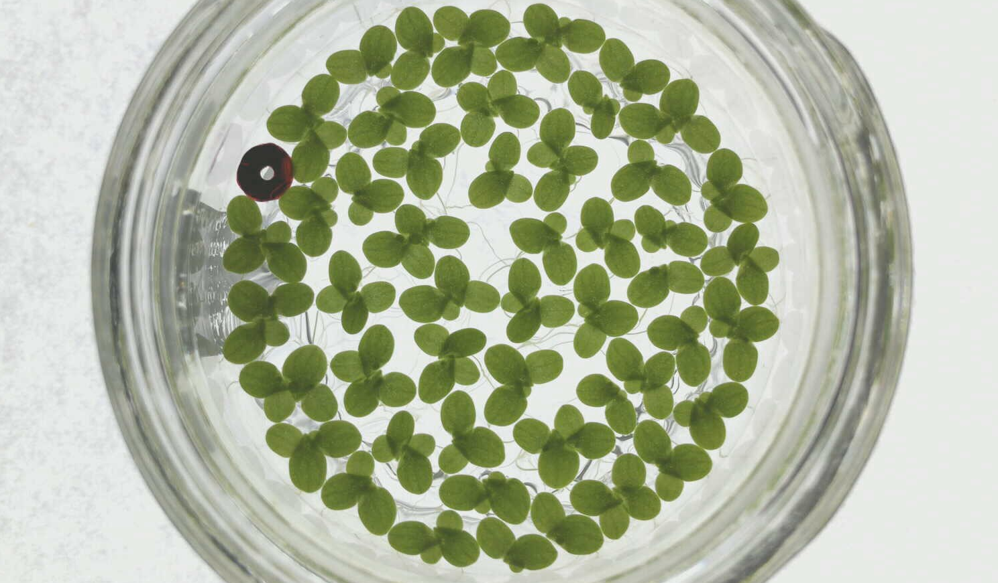
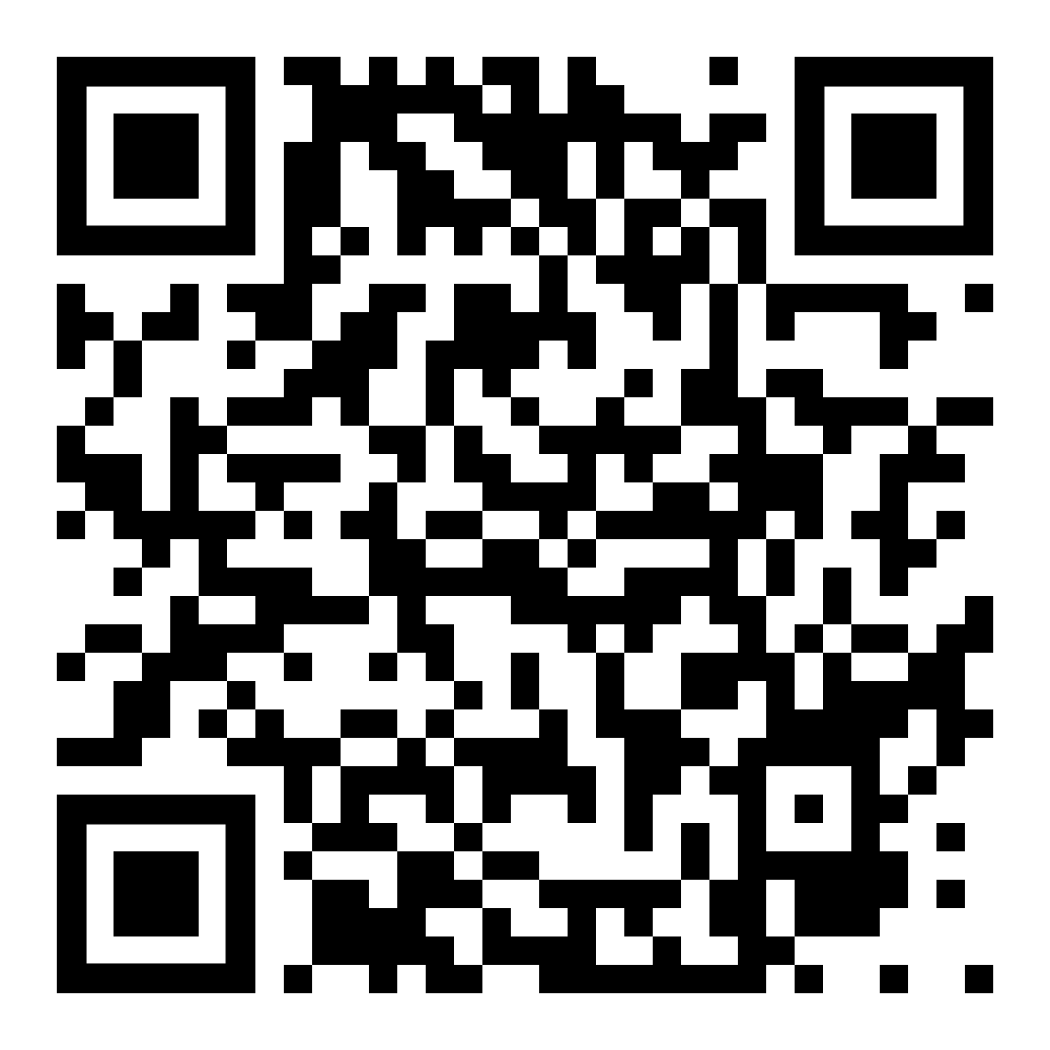

The New College Try: Enrolling in First-Year Science Courses as Embedded Librarianship
For university data librarians, informally “embedding” in undergraduate coursework can help us understand our communities and be more effective librarians.
(Early) Findings
Enrolling as a returning undergraduate has enabled me to learn about…
Current actual classroom practices: pedagogy; technology; usage of OER; secondary learning objectives; real exam questions
Pitt information: better familiarity with research resources; open questions and rumors
Affective dimensions: empathy with both students and instructors
Underutilization of the Library or its resources → ideas and opportunities for outreach and service provision
As an undergraduate classmate, I have a lot to offer, occasionally even acting as an ad hoc embedded librarian.
Dominic Bordelon,
Research Data Librarian,
University of Pittsburgh Library System
(dbordelon@pitt.edu)
Abstract
Librarians seek to better understand our communities, and this is no less true for university data librarians. The embedded librarianship model has furthermore aimed to meet users where they are and bring service provision outside the walls of the library. Serving STEM users, yet lacking my own formal STEM background, led me to enroll in undergraduate Biology courses. Unexpectedly, this experience has so far yielded not only more domain knowledge, but also better sociocultural and pedagogical understanding of a portion of my service community, ideas for potential services, and opportunities to provide value as a data librarian. I utilize autoethnography as the approach for exploring and sharing these experiences. Enrolling in undergraduate coursework is presented as a viable approach for practicing embedded librarianship.
Limitations
While empirical, (auto)ethnography is subjective and necessarily limited in scope.
Enrolling in and completing a university course requires effort, time, and out-of-pocket expense and may not predictably generate insights.
Background and Method
Ethnography is the practice of observing, recording, and representing sociocultural experiences, particularly relying upon interviews and participant observation over a length of time to make sense of both “insider” and “outsider” perspectives. Autoethnography shares the same interests but is limited in material to the author’s memories and introspection.
I transitioned into data librarianship from library systems/software development roles (2014-19) and a humanities undergraduate background (2003-8). Desiring to explore a longtime interest in biology, I enrolled as a part-time, non-matriculating student and began courses towards a B.S. in Ecology and Evolution. The current work is based on one year (with summer) of part-time coursework.
Conclusions
Embedded librarianship calls us to leave the library’s walls—enrolling in undergraduate coursework is one way to do that.
Explore a new subject or revisit a familiar one to see how it’s being taught now.
Go with an open and observant mind, as a student of the subject, but also as a student of the classroom culture.
Figure: Duckweed (Lemna minor) photographed by the author during a first-year authentic research lab course (unpublished, 2022)
Bibliography
Anderson, Leon. 2006. “Analytic Autoethnography.” Journal of Contemporary Ethnography 35 (4): 373–95. https://doi.org/10.1177/0891241605280449.
Ellis, Carolyn, Tony E. Adams, and Arthur P. Bochner. 2011. “Autoethnography: An Overview.” Historical Social Research (Koeln) 36 (4): 273–90. http://nbn-resolving.de/urn:nbn:de:0114-fqs1101108.
Shumaker, David. 2012. The Embedded Librarian: Innovative Strategies for Taking Knowledge Where It’s Needed. Medford, New Jersey: Information Today, Inc.
This work is licensed for reuse under a Creative Commons Attribution-NoDerivatives 4.0 International (CC BY-ND 4.0) license (https://creativecommons.org/licenses/by-nd/4.0/).

