Slide 1
CMSC 350 Data Structures and Analysis
Week 2 Stacks and Recursion

Slide 2
Stack – Abstract Data Type
Sets (Data types)
C: Components
S: Stacks
Mathematical functions (Interface)
push θ : S × C → S pop ρ : S → S × C empty 0 : ∅ → S
Axioms (Behavior)
∀ S ∈ S, c ∈ C, ρ(θ(S,c)) = (S,c) ρ(0) = (0, ∅)

Slide 3
Array Stack
public void push(T item) throws StackFull
{
if (top == stack.length)
throw new StackFull();
stack[top++] = item;
}
public T pop() throws StackEmpty
{
if (top == 0)
throw new StackEmpty();
return stack[--top];
}

Slide 4
Linked Stack
Linked lists contain one node for each data element
Unlike arrays, linked lists only use as much memory as needed
Linked lists require links for each node which add to memory usage
A linked stack is simplest because push and pop are both done at the head

Slide 5
Linked Stack

Slide 6
Stack Example

Slide 7
Java Stack
Operations in Stack class
push
pop
Implementation of Stack
Extension of Vector
Why was Vector chosen rather than LinkedList?
Should composition have been used?

Slide 8
Recursion Principles
Any problem that can be solved with iteration can be solved with recursion
Like infinite loops, recursion can produce infinite recursion causing a stack overflow
Correct recursive solutions must have a base case and a recursive case
Recursion is the first step toward declarative programming

Slide 9

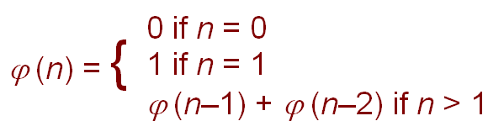
Fibonacci Numbers
Fibonacci numbers are difficult to define iteratively
Their definition involves the golden ratio
Recursive

Slide 10
Iterative Version
previous
current
next
next
0 1 1 2 3 5 8 13 21 35
next = previous + current;
previous = current;
current = next;

Slide 11
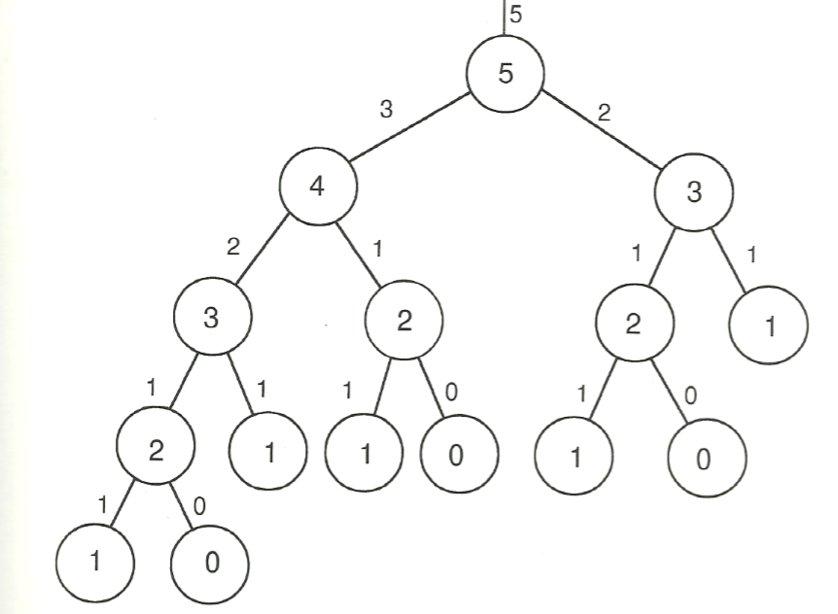
Recursive Version
Same values are computed repeatedly

Slide 12
Fibonacci Example
Version | Characteristic | Big-O
fibonacci0 | Iterative with Window of Three Variables | O(n)
fibonacci1 | Straightforward Recursive | O(1.6^{n})
fibonacci2 | Recursive with Two Additional Parameters | O(n)
fibonacci3 | Recursive with Dynamic Programming | O(n)

Slide 13
Fractals
Fractals are "self-similar" geometric objects
The self-similarity of fractals is inherently recursively defined
Actual fractals repeat infinitely to become ever smaller
Drawing fractals stops once the resolution of the monitor is reached

Slide 14
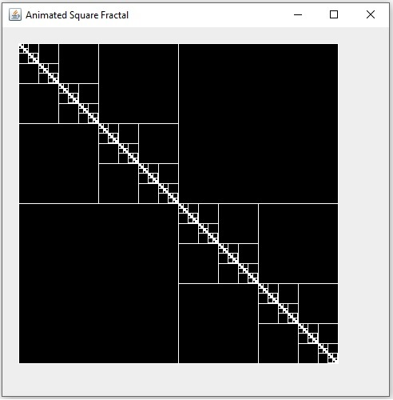
Fractal Example

Slide 15
Backtracking
Recursion simplifies backtracking
Triangular decomposition example
Every integer can be expressed as the sum of at most 3 triangular numbers
Decomposition attempts of 33
33 ≠ 28 + 3 + 1
33 ≠ 28 + 1 + 1
33 ≠ 21 + 10 + 1
33 = 21 + 6 + 6

Slide 16
Triangular Terms Example

Slide 17
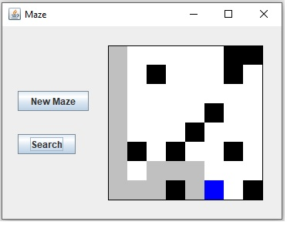
Maze Example
Recursion is ideal for depth-first searches

Slide 18
Stacks and Recursion
Recursion implicitly uses the compiler’s run-time stack
Recursion especially simplifies problems that cannot be solved in constant memory
Such harder problems generally require the explicit use of a stack when solved using iteration

Slide 19
Inefficient Recursive Solutions
Recursion is very undesirable when it involves duplication of work
Sometimes it is possible to rewrite such solutions recursively without duplication using tail recursion
Dynamic programming is a technique that saves intermediate results to avoid duplication of work

Slide 20
Efficient Recursive Solutions
Recursion works best on problems that cannot be solved with constant memory
Reversal of a list of unbounded length
Expression evaluation (nesting)
Recursion works best when the iterative version requires a stack
Effective recursive solutions are not tail recursive

Slide 21
Determining Efficiency of Recursive Methods
For recursive methods that have no loops (constant execution time)
Execution time is proportional to the number of nodes in the activation tree of the recursive calls to the method
Memory usage is proportional to the height of the activation tree
Recursive methods never have constant memory usage

Slide 22
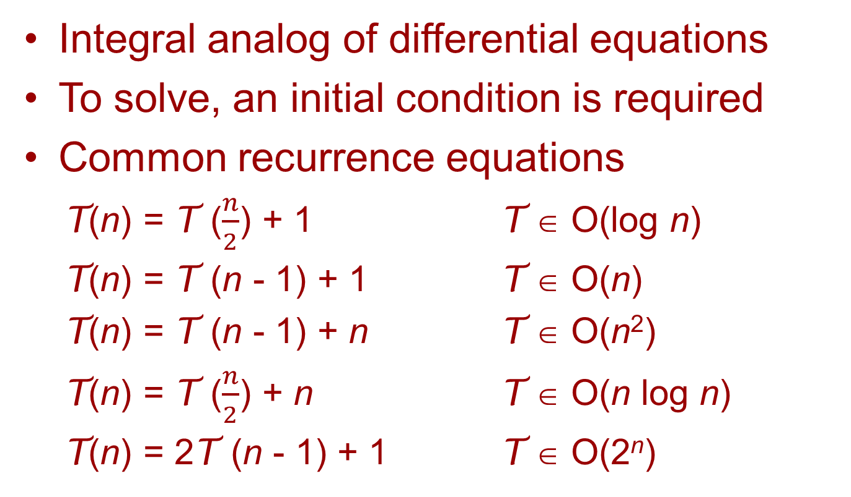
Recurrence Equations
Integral analog of differential equations
To solve, an initial condition is required
Common recurrence equations
T(n) = T ($\frac{n}{2}$) + 1 T ∈ O(log n)
T(n) = T (n - 1) + 1 T ∈ O(n)
T(n) = T (n - 1) + n T ∈ O(n²)
T(n) = T ($\frac{n}{2}$) + n T ∈ O(n log n)
T(n) = 2T (n - 1) + 1 T ∈ O(2^{n})

