Slide 1
CMSC 350 Data Structures and Analysis
Week 5 Binary Trees

Slide 2
Binary Trees
A binary tree is a data structure consisting of a collection of nodes, in which each node has 0, 1 or 2 children
Types of binary trees
Complete tree
Full tree
Proper binary tree
Arithmetic expression tree

Slide 3
Binary Tree Terminology
Parent, left child, right child and sibling
Types of nodes
Root, no parent
Leaf node, no children
Tree characteristics
Level of tree
Depth of node
Height of tree

Slide 4
Binary Tree Structure
A nested node class must be defined
Depiction of a binary tree
protected static class Node<E>
{
protected E element;
protected Node<E> left, right;
}

Slide 5
Binary Tree Traversals
Depth-first traversals
Traversal types
Preorder (DLR)
Inorder (LDR)
Postorder (LRD)
In all of the above, the left child is visited before the right
Breadth-first traversal
Level order

Slide 6
Recursive Traversals
The only difference between the three traversals is where node is “visited”

Slide 7
Iterative Traversals
As the traversal moves down the left branch, the right children are pushed onto the stack

Slide 8
Traversal Implementations
Depth-first traversals
Recursion simplifies the implementation
All three are doubly recursive
All three are very similar
Iterative implementation require one or more stacks
Breadth-first traversal
A level order is best done with a queue

Slide 9
Arithmetic Expression Trees
Arithmetic expression trees are proper binary trees
Interior nodes are operators
Exterior nodes are operands
Expression tree traversals
Traversal | Expression Format
Preorder | Prefix
Inorder | Infix
Postorder | Postfix

Slide 10
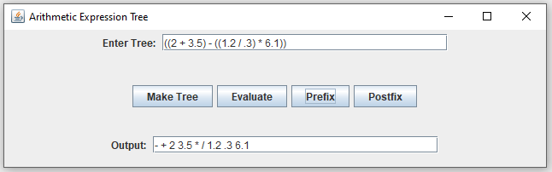
Arithmetic Expression Example

Slide 11
Binary Search Tree
Iterative definition
A binary tree in which the value in each node is greater than the values in the left subtree and less than all in the right subtree
Recursive definition
An empty tree
A nonempty tree
The root has the above property
Both subtrees are binary search trees

Slide 12
Binary Search Tree Iteration
A binary search tree is a sorted data structure
Performing an inorder traversal produces values in sorted order
Because it is a sorted structure, it must contain elements that implement the Comparable interface

Slide 13
Primary Operations
Add
A find is done first
If found, it is rejected as a duplicate
If not found, the location to insert is determined
Remove
Requires various cases
Leaf node is the simplest
2 children is the most complicated
Contains

Slide 14
Contains Operation
The two node parent-child window is needed for the add operation

Slide 15
Add Operation
Full trees are the fullest balanced trees and Fibonacci trees are the sparsest

Slide 16
Delete Operation
The deleteNode method locates the inorder successor for nodes with children

Slide 17
Iterative vs. Recursive Implementations
Iterative implementation
Find operation must maintain a two node window consisting of a parent and child
Inserting into an empty tree and deleting the last node are special cases
Recursive implementation
Helper methods are required
Special case is eliminated

Slide 18
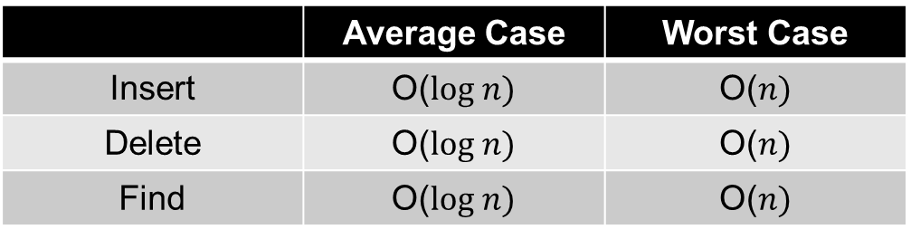
Operation Efficiency
Description of the cases
Best case is a full tree
Worst case is a degenerate tree (linked list)
Efficiency of the three cases
 | Average Case | Worst Case
Insert | O($log n)$ | O($n)$
Delete | O($log n)$ | O($n)$
Find | O($log n)$ | O($n)$

Slide 19
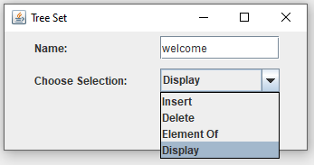
Tree Set Example

Slide 20
Balance Factors
The balance factor of a node is the difference between the height of the left subtree and the right subtree
Full trees are most balanced
All nodes have a balance factor of 0
The maximum balance factor is a measure of how out-of-balance a tree is
Degenerate trees are the most unbalanced

Slide 21
Height Balanced Trees
Iterative definition
A binary tree in which the value in each node has a balance factor whose absolute value is less than or equal to 1
Recursive definition
An empty tree
A nonempty tree
The root has the above property
Both subtrees are height balanced

Slide 22
Full and Fibonacci Trees
Full trees are the fullest balanced trees and Fibonacci trees are the sparsest

Slide 23
Rebalancing
To ensure that the height is logarithmically related the number of nodes a binary search tree must be kept balanced
Types of balanced binary trees
AVL trees
Red-black trees
Used by Java Collection Framework classes
Splay trees

