Slide 1
IMDb Top 1000 Movies
Dong Woo (Michael) Kang, Jade Smith, Tyler Walje

Slide 2
Examining and Analyzing Relationships Found Within the Top IMDb 1000 Movies of All-Time

Slide 3
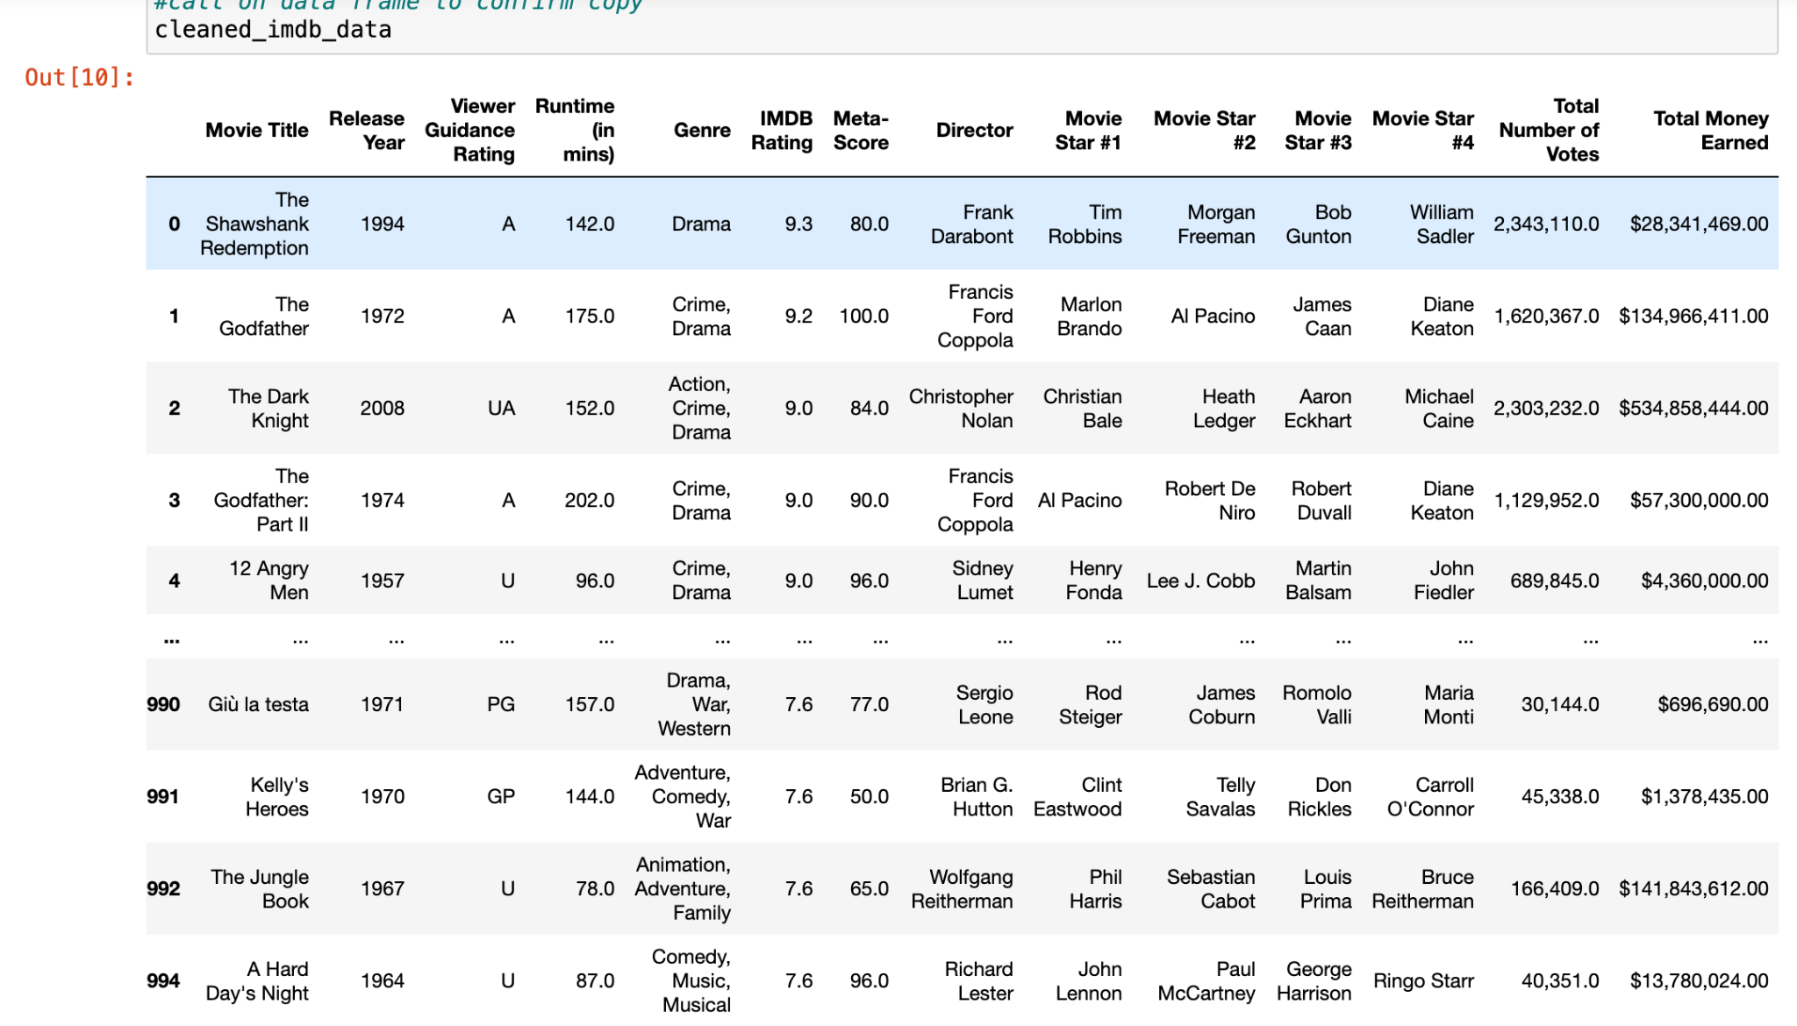
Data Cleaning
Import necessary libraries
Remove unwanted columns
Remove any null values
Legibly rename columns
Convert number columns to floats
Format number columns
Copy dataframe to CSV output file

Slide 4
User IMDb Rating vs Metacritic Meta-Score
Background:
User IMDB-Rating: (From the IMDb Website): IMDB registered voters can cast a vote (from 1-10) on every released title in the database, IMDb then aggregates and averages out these individual votes to determine a single IMDb rating visible on the title’s mainpage.
Metacritic Meta-Score: (From the Metacritic Website): Metacritic first curates a diverse group of highly respected critics and then assigns a score (0-100) to their reviews of a movie title. Then, the aggregated weighted average of these scores is calculated to display the finally Meta-Score of a movie title.

Slide 5
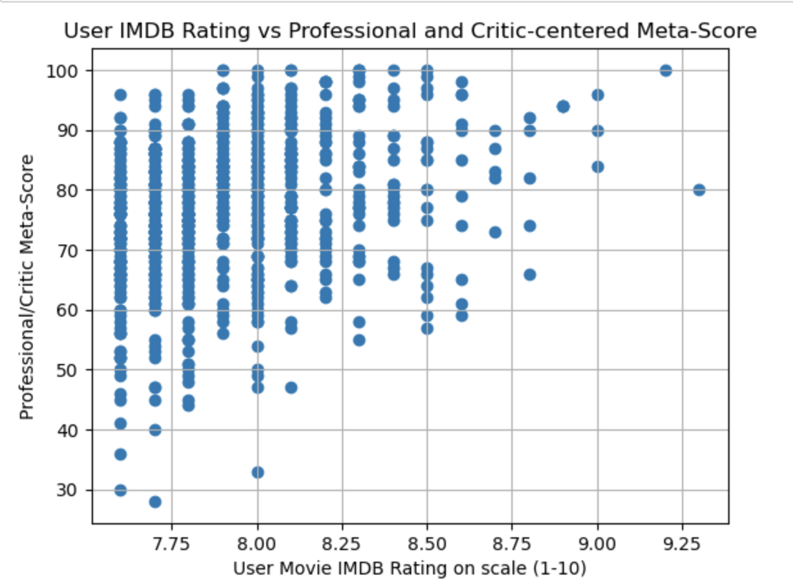
User IMDb Rating vs Metacritic Meta-Score
Total Average User IMDB Rating: (7.94)
Most Common User IMDB Rating: (7.7)
Total Average Metacritic Meta-Score: (77.16)
Most Common Metacritic Meta-Score: (76.0)

Slide 6
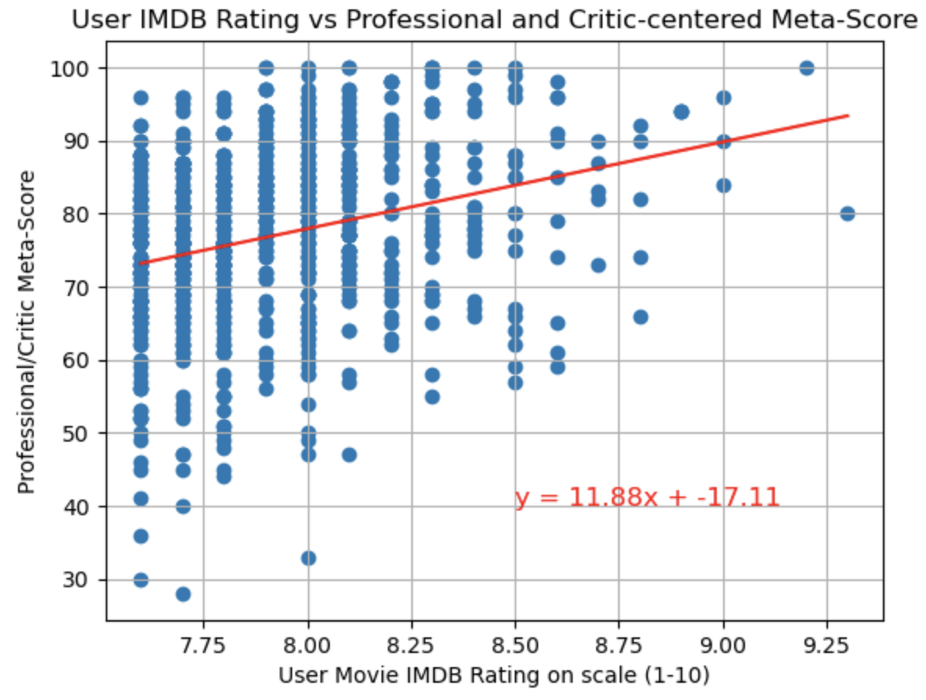
User IMDb Rating vs Metacritic Meta-Score
Regression Equation: [ y = 11.88x + (-17.11)]
R-Squared Value: (0.0789)

Slide 7
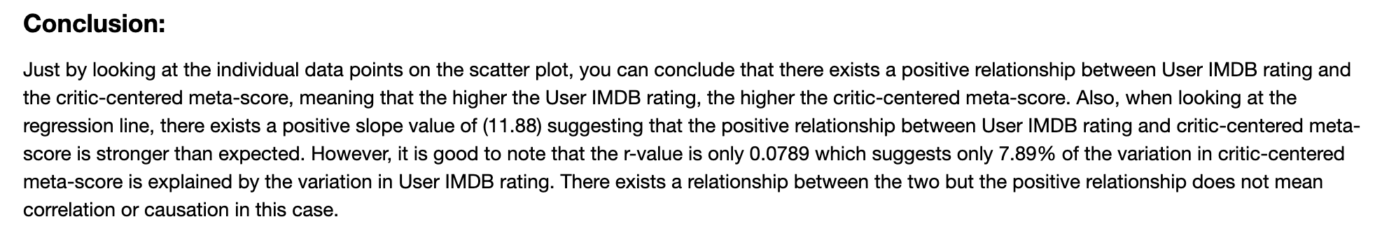
User IMDb Rating vs Metacritic Meta-Score

Slide 8
Is there a relationship between IMDB Rating and the total amount of money these movies have earned?

Slide 9
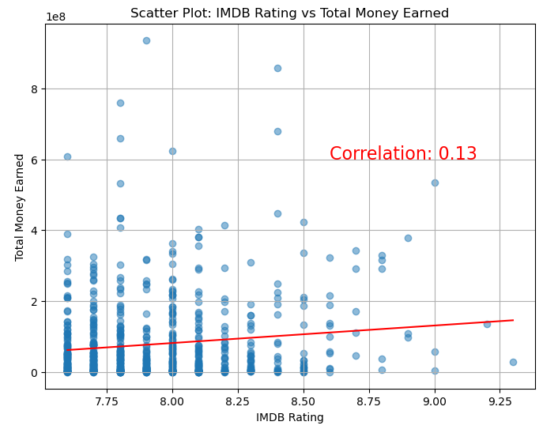
IMDB Rating vs Total Money Earned
Now that we've looked at the relationship between IMDB Ratings and the Meta-Score Ratings, let's see if there is any predictive value in comparing IMDB Rating and the total amount of money earned by each individual movie
In the plot to the right, we have compared these two categories and provided a correlation coefficient

Slide 10
IMDB Rating vs Total Money Earned
We can clearly see that there is a very weak, almost nonexistent, correlation between Total Money Earned and IMDB Rating
Based on this, we can conclude that we cannot predict how much money a movie will make (or has made) based on the IMDB Rating

Slide 11
Since we found no meaningful relationship between IMDB Rating and money earned, let's examine the relationship between actors/directors and those two categories

Slide 12
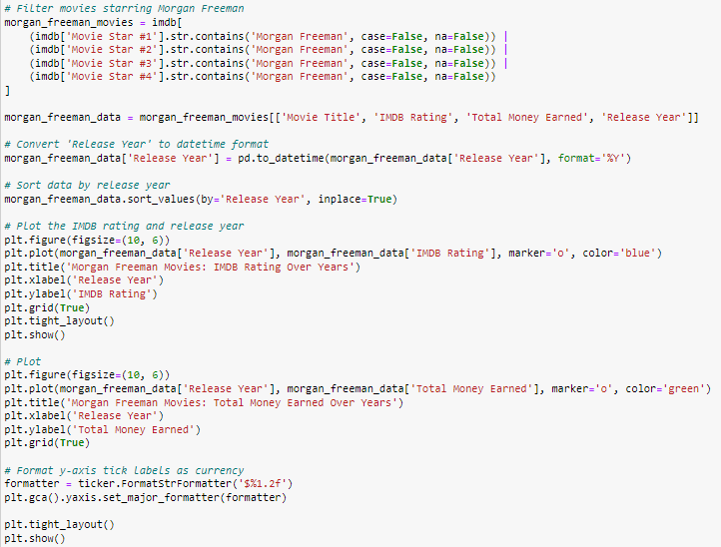
Examining Individual Actors
Perhaps it's possible that we can more accurately predict a movie’s financial success, as well as the IMDB Rating, if we look at individual actors over the years.
In the next few slides we will examine individual actors and see if there is a relationship between IMDB Rating and the total amount of money these movies have earned
Example of code used

Slide 13
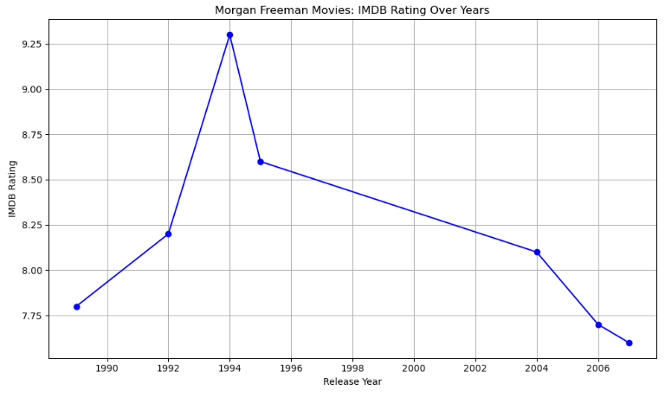
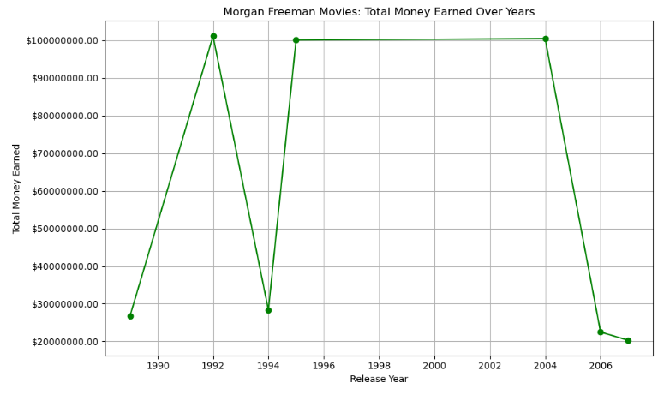
Morgan Freeman

Slide 14
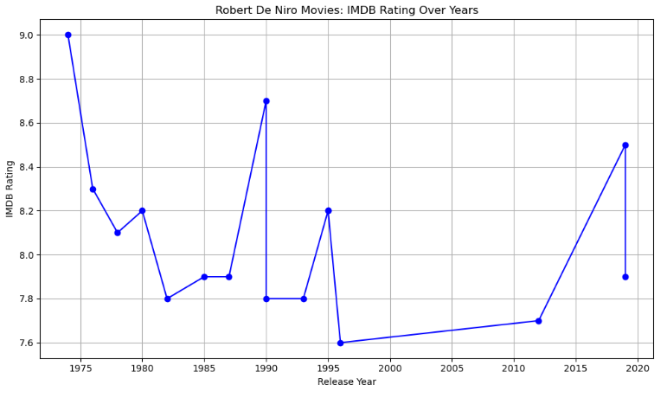
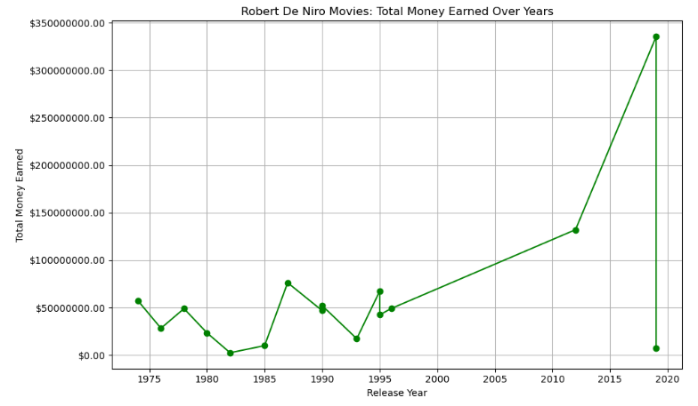
Robert De Niro

Slide 15
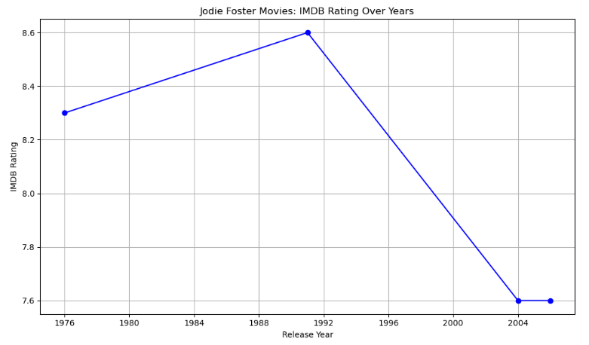
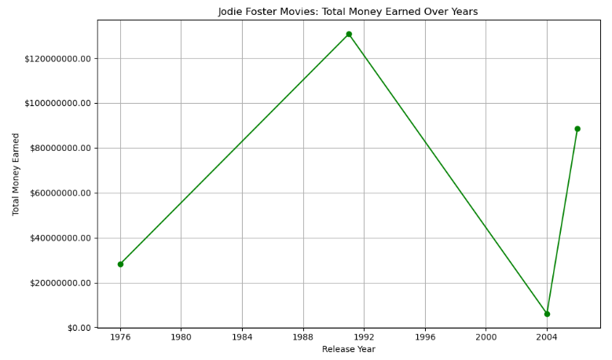
Jodie Foster

Slide 16
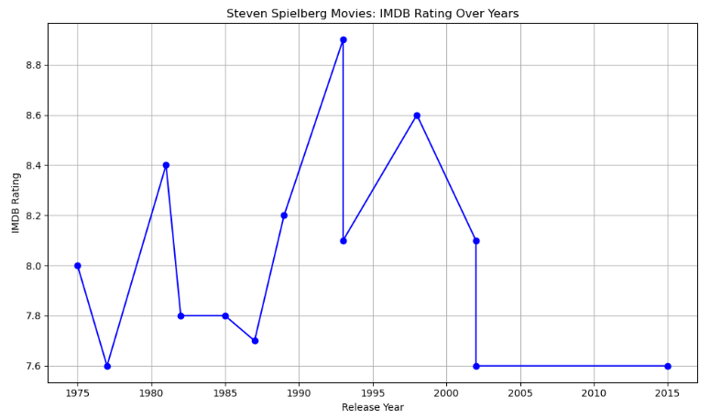
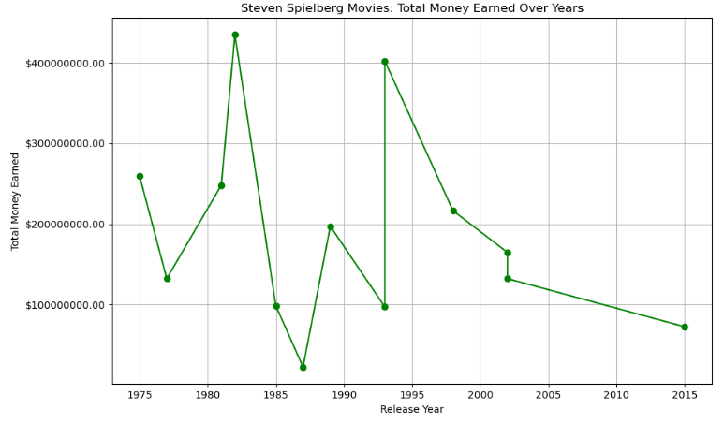
Steven Spielberg (Director)

Slide 17
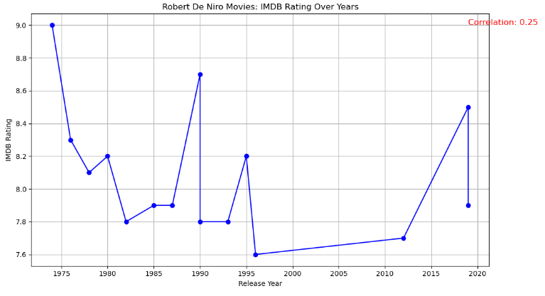
Actor/Director Analysis
Based on the previous slides, we can conclude that individually (Regarding IMDB Rating and Total Money Earned) there is little to no correlation.

Slide 18
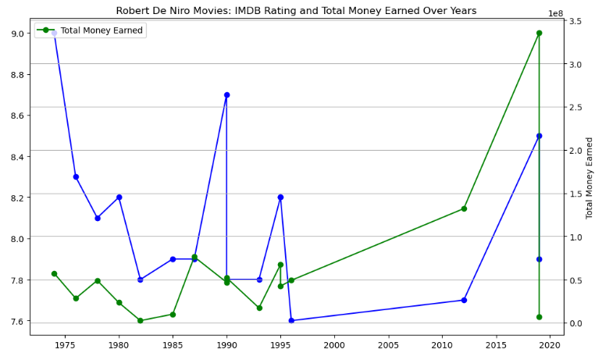
Actor/Director Analysis
But, if we superimpose one plot over the other we can actually start to see some similarities between Revenue and IMDB Rating
Since this contradicts our earlier findings that IMDB Rating and Total Money Earned are not correlated, we should assume that this is a unique circumstance. To visualize this, let’s look at another actor…

Slide 19
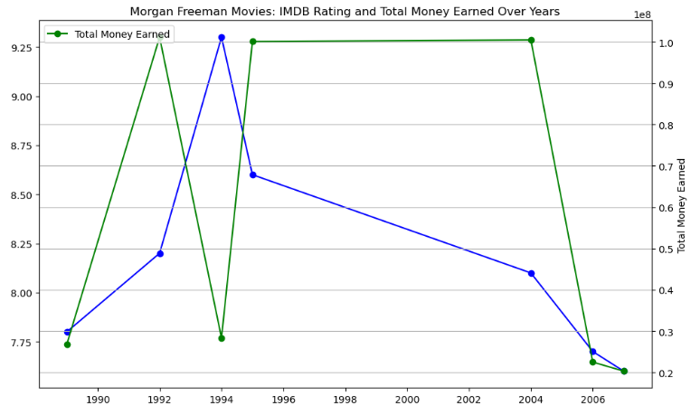
Actor/Director Analysis
Here, with Morgan Freeman, We can actually see an inverse relationship between IMDB Rating and Total Money Earned.

Slide 20
Actor/Director Analysis
TAKEAWAYS
We once again fail to find any kind of meaningful correlation or predictive value when evaluating actors/directors to the IMDB Ratings of their movies. The same conclusion can be made for the Total Money Earned.
Despite some actors and directors having closely related IMDB Ratings and Money Earned, the entirety of the data showed that these two things are not predictive of one another (not correlated).

Slide 21
Genre Analysis

Slide 22
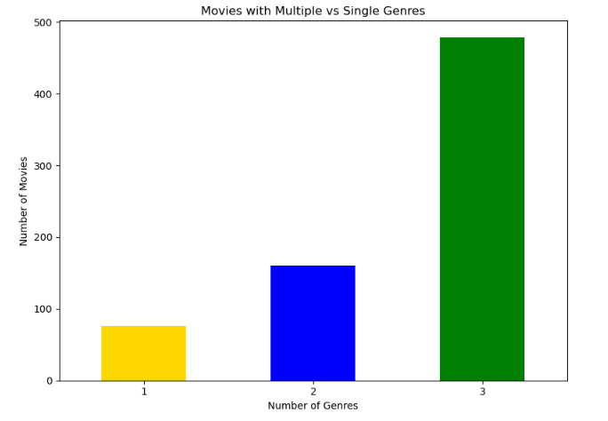
Genre Analysis
While exploring the data, we noticed that some movies just had one genre while other movies had up to three genres. Here we can visualize the amount of each:
There are clearly more movies with multiple genres listed compared to those with just one

Slide 23
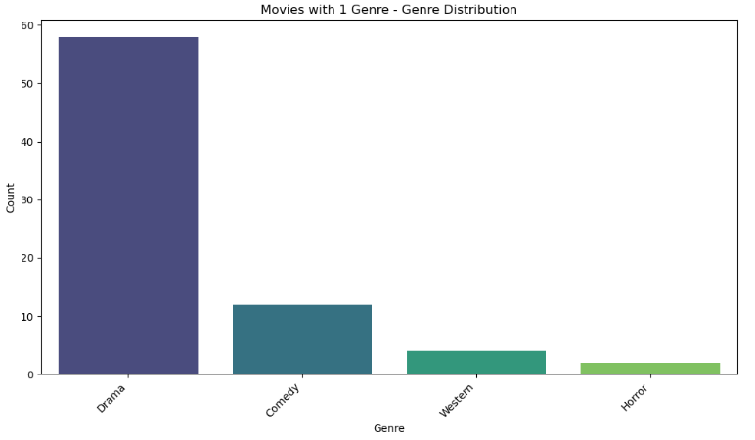
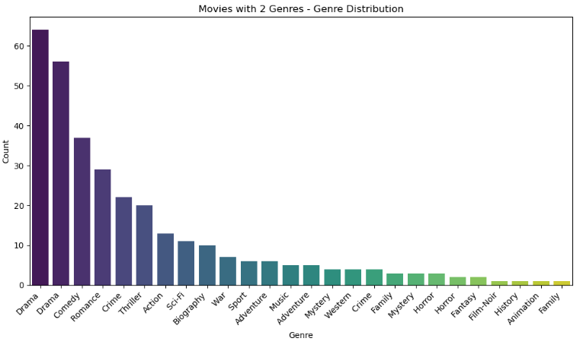
Genre Analysis
Let's examine the distribution of genres within these different movie classifications. When we group movies by how many genres are listed, this is what the distribution looks like:

Slide 24
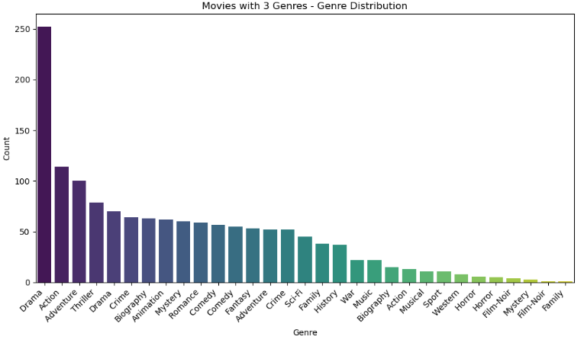
Genre Analysis
Let's examine the distribution of genres within these different movie classifications. When we group movies by how many genres are listed, this is what the distribution looks like:

Slide 25
Genre Analysis
Unfortunately it appears that the genre distribution is greatly weighted towards “Drama”, which would imply that this data is not normally distributed. If this data is not normally distributed, I don't think it's effective or predictive to use “genre” in comparison with other categories.
One interesting note is how often movies classify themselves as a drama. Among all three classifications, the “Drama” genre was widely the most common used, even in the group of movies with only one genre.

Slide 26
Is there a relationship between professional critic ratings and drama movie runtimes?

Slide 27
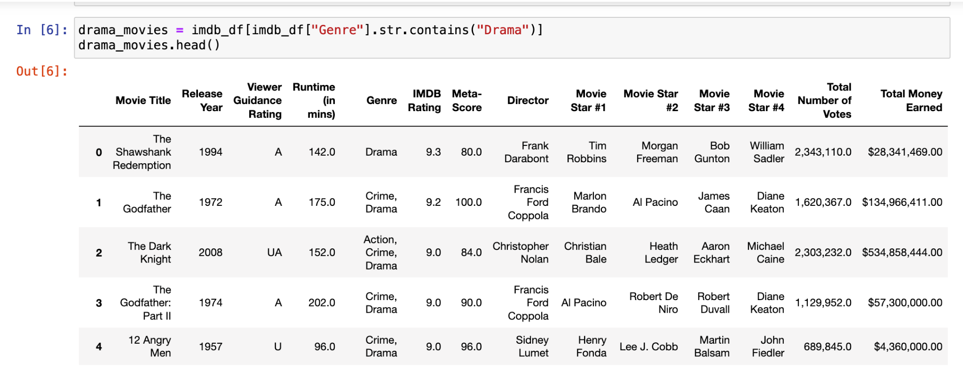
More Fine Tuning of Data

Slide 28
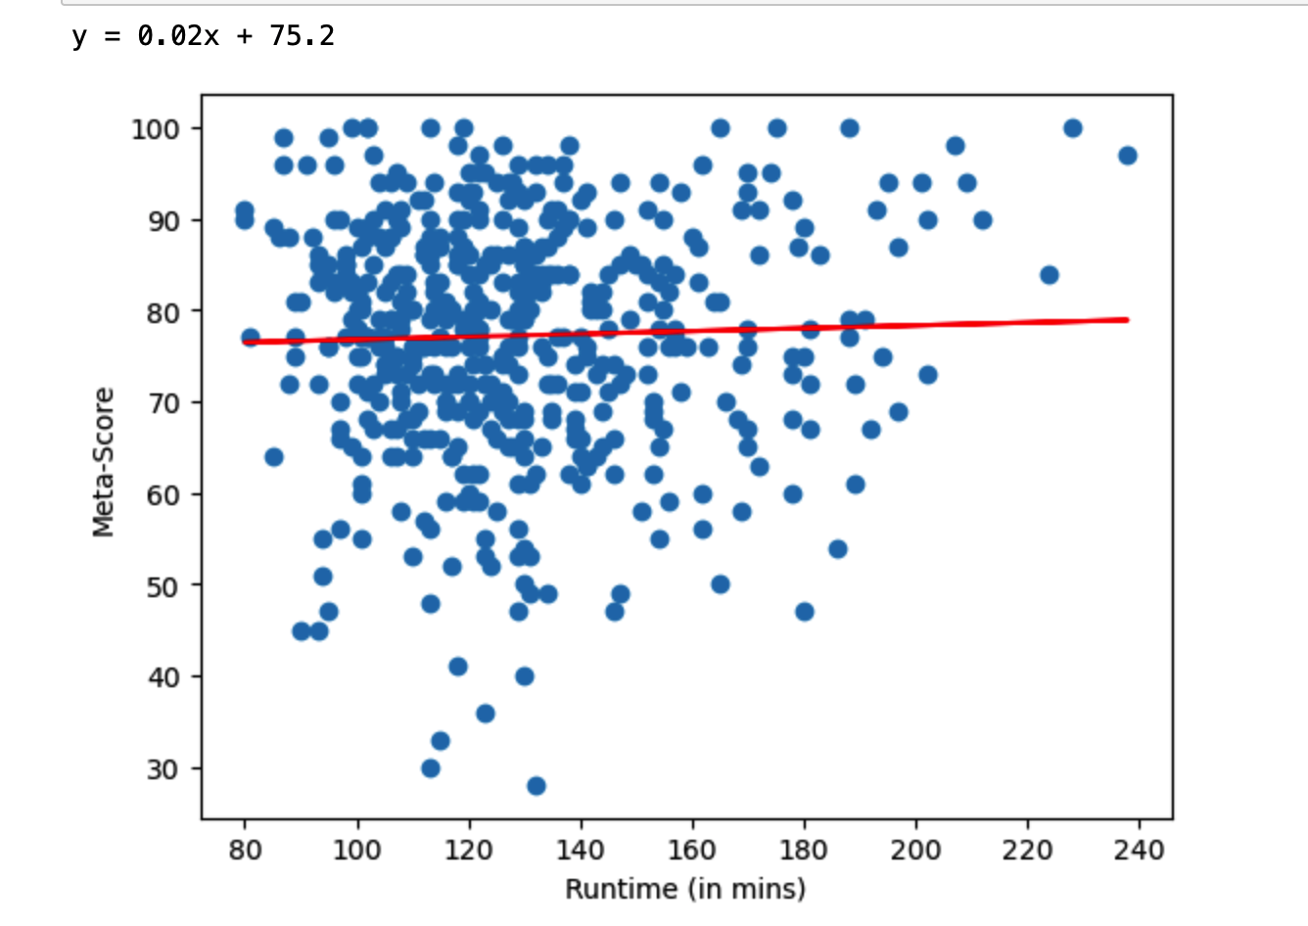
Runtime (in mins) vs Meta-Score

Slide 29
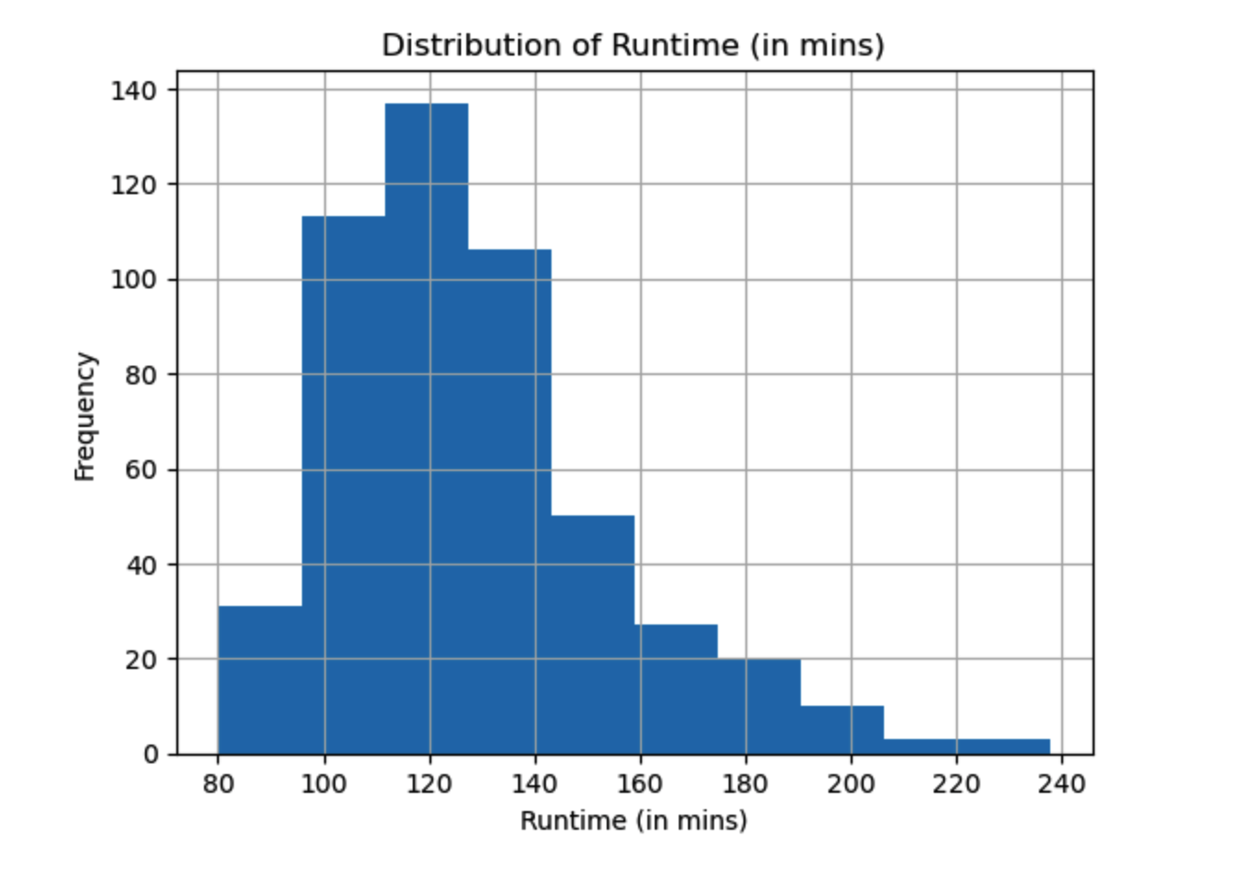
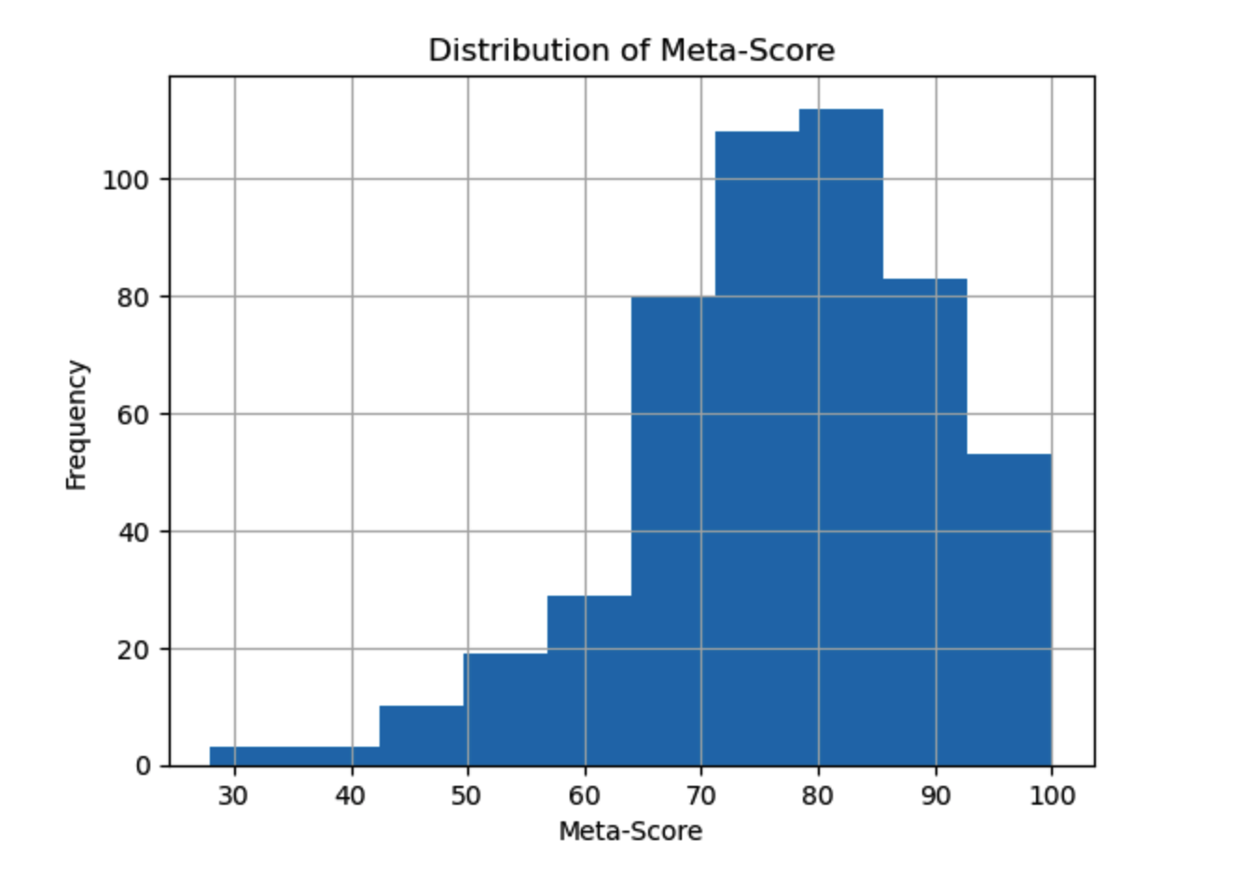
Current Distributions

Slide 30
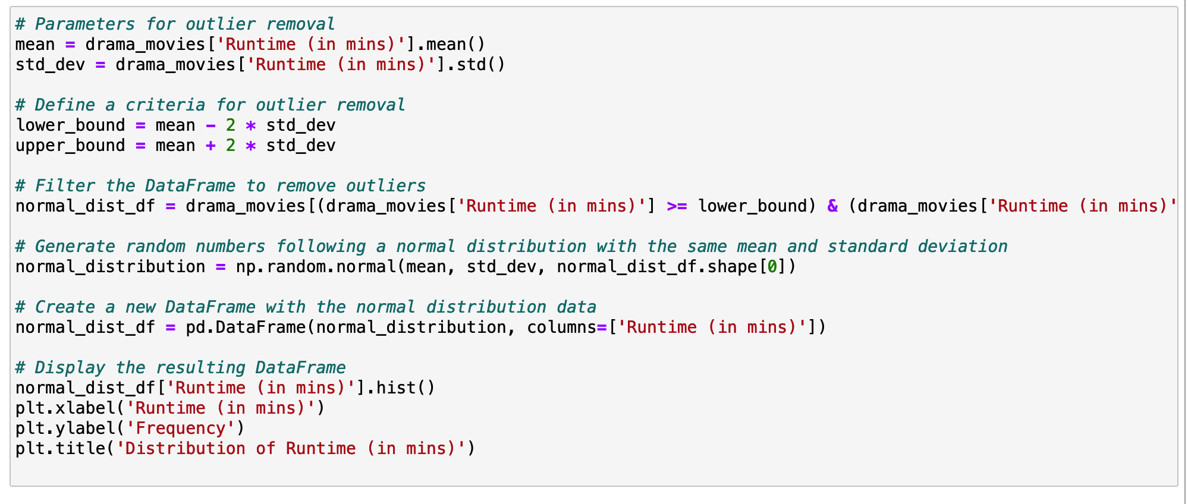
Creating Normal Distribution for Runtime

Slide 31
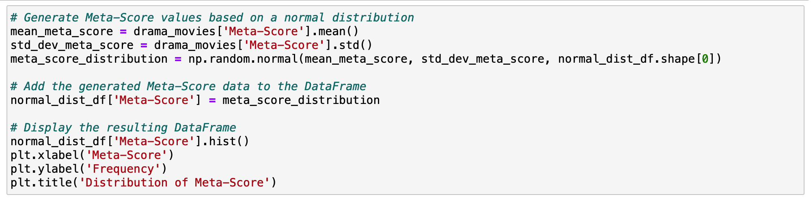
Creating Normal Distribution for Meta-Score

Slide 32
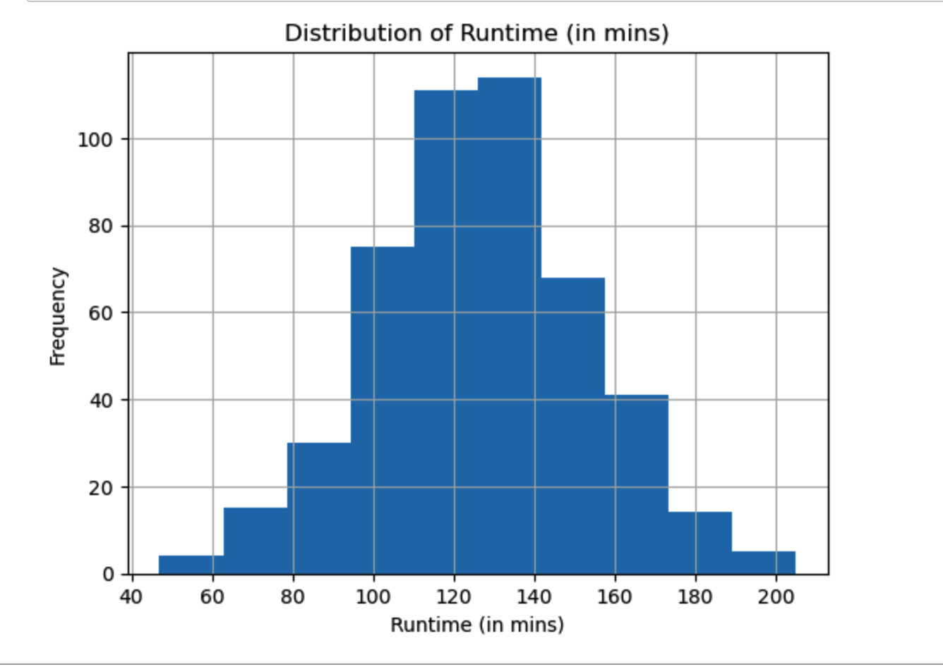
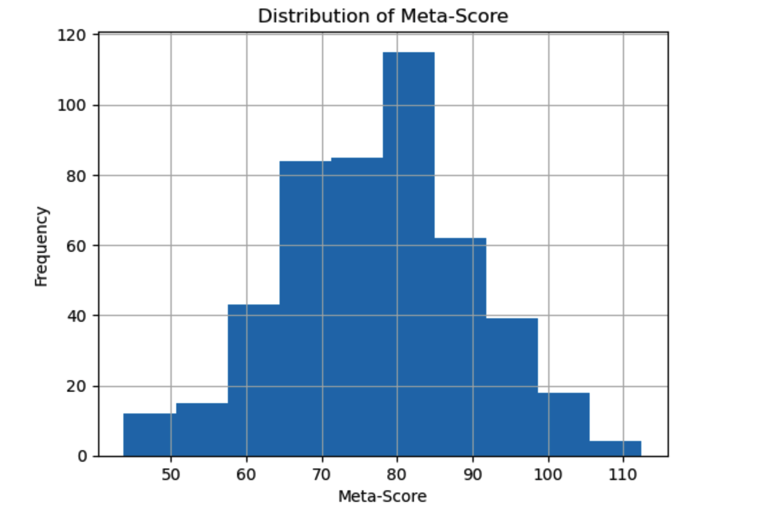
Normal Distributions

Slide 33
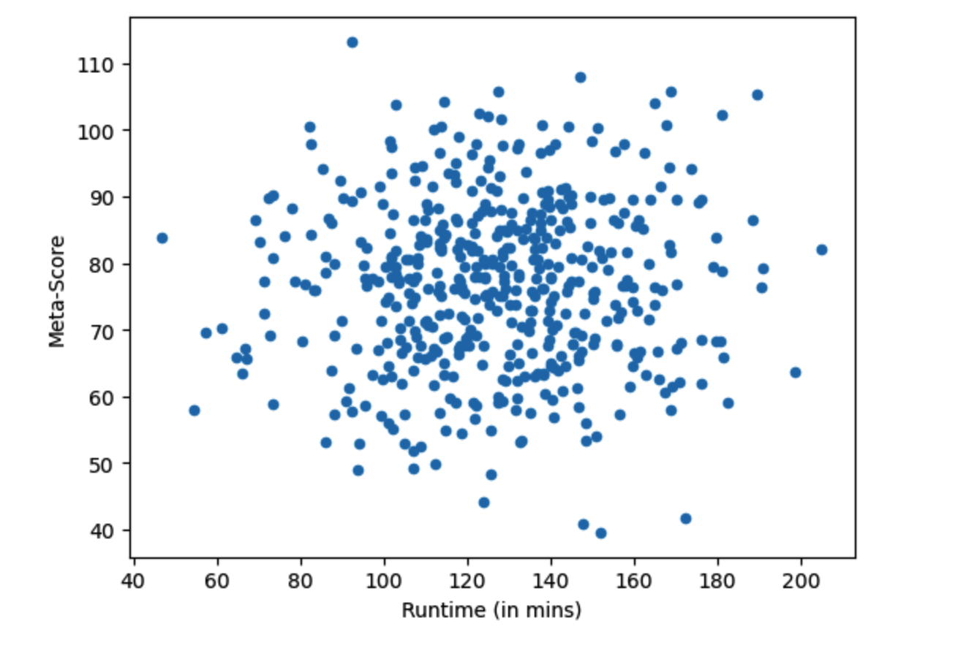
True Relationship Between Meta-Score and Runtime

