Slide 1
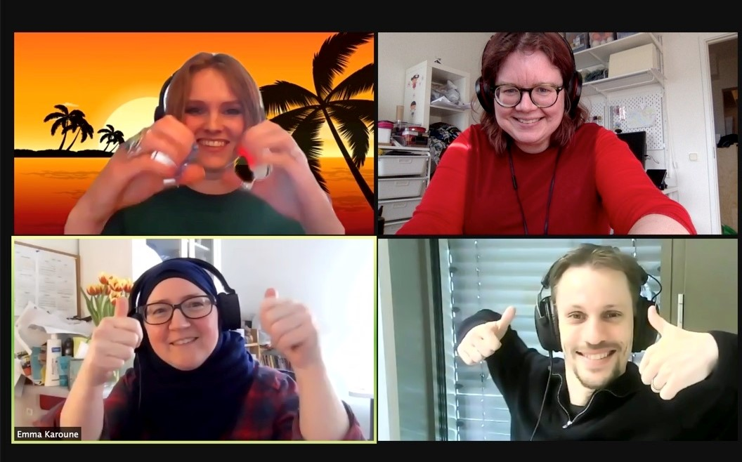
Credit-all
Emma Karoune, Malin Sandström, Dominic Kempf, Daisy Parry

Slide 2
Problem: Current systems that attribute contributions to input in outputs such as academic reports do not include all of the jobs/roles/tasks that are encompassed in projects. encompassed in research projects.
Solution: Develop a systems that attributes contributions to contributors for all tasks that are encompassed in research, including tool building, training, outreach. An ideal tool would….
Captures all roles on a project.
Captures all tasks within those roles.
With functions...
Convert this into the actual authorship and/or a contributions list that can be used for project outputs.
Presenting this list in different ways.

Slide 3
community management, including
BIDS contributors (201X)
Bug reports
Blogposts
Code
Content (separate from Blogposts)
Documentation and specification
Data (example datasets)
Design
Examples (for example datasets, use Data)
Event Organizers
Financial Support
Funding/Grant Finders
Ideas & Planning
Infrastructure (hosting, build-tools, etc)
Maintenance of the BIDS standard
Mentoring new contributors
Plugin/utility libraries
Project management
Reviewed Pull Requests
Tools
Translation
Tests
Tutorials
Talks
User testing (of new features, tools…)
Videos
CASRAI CRediT (2014)
Conceptualization
Data curation
Formal Analysis
Funding acquisition
Investigation
Methodology
Project administration
Resources
Software
Supervision
Validation
Visualization
Writing – original draft
Writing – review & editing
INRIA (2019)
(contrib on a 1-5 scale)
Design
Debugging
Maintenance
Coding
Architecture
Documentation
Testing
Support
Management
retaining existent & recruiting new contributors
“human infrastructure”
Forward engineering
adding new features
Reengineering
refactoring
Corrective
fixing bugs
Management
documentation
Milewicz,Pinto, Rodeghero (2019)
Characterizing the Roles of Contributors in Open-Source Scientific Software Projects
peers & reviewers

Slide 4
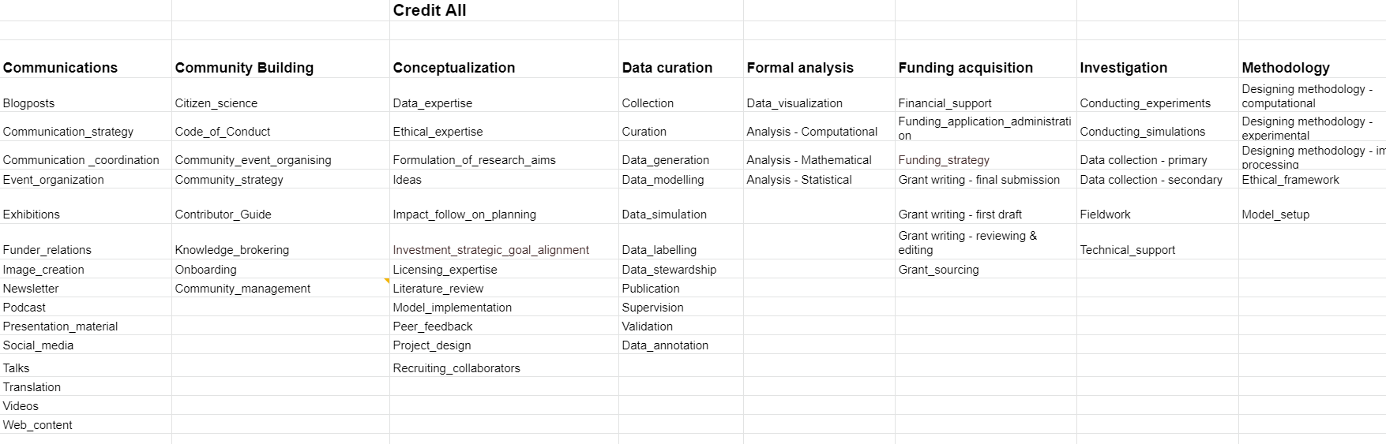
Approach > Combining existing models into an integrated list of categories and tasks

Slide 5
WWork completed
WFuture work
Gathering relevant resources
Setting up Github repository
  Adding Readme file
  CoC
  Github wiki with basic info & links to sources
  Contributor guidelines
Develop documentation tool
  Build on all-contributors file specification (>6k GH stars)
  Adds command line interface that enforces our taxonomy
  Different visualization backends using Jinja templating engine:
    CSV
    Latex
    Markdown
Get reviews/feedback on the list of tasks
Incorporate feedback from community
  Identify target communities
    BrainHack community
    Carpentries
    CodeRefinery
    CRediT (CASRAI)
    CSCCE
    CW21 attendees :)
    FAIRSharing community
    FORCE11
    INCF community
    ReSA
    Software Heritage
    Software Sustainability Institute
    TuringWay community
Finish adding list of tasks to YAML file
Decide on the presentation options

