Slide 1
Boosting
CMPUT 466/551
Principal Source: CMU

Slide 2
Boosting Idea
We have a weak classifier, i.e., it’s error rate is slightly better than 0.5.
Boosting combines a lot of such weak learners to make a strong classifier (the error rate of which is much less than 0.5)

Slide 3
Boosting: Combining Classifiers
What is ‘weighted sample?’

Slide 4
Discrete Ada(ptive)boost Algorithm
Create weight distribution W(x) over N training points
Initialize W₀(x) = 1/N for all x, step T=0
At each iteration T :
Train weak classifier C_{T}(x) on data using weights W_{T}(x)
Get error rate ε_{T} . Set α_{T} = log ((1 - ε_{T} )/ε_{T} )
Calculate W_{T+1}(x_{i} ) = W_{T}(x_{i} ) ∙ exp[α_{T} ∙ I(y_{i} ≠ C_{T}(x_{i} ))]
Final classifier C_{FINAL}(x) =sign [ ∑ α_{i} C_{i} (x) ]
Assumes weak method C_{T} can use weights W_{T}(x)
If this is hard, we can sample using W_{T}(x)

Slide 5
Real Adaboost Algorithm
Create weight distribution W(x) over N training points
Initialize W₀(x) = 1/N for all x, step T=0
At each iteration T :
Train weak classifier C_{T}(x) on data using weights W_{T}(x)
Obtain class probabilities p_{T}(x_{i}) for each data point x_{i}
Set f_{T}(x) = ½ log [ p_{T}(x_{i})/(1- p_{T}(x_{i})) ]
Calculate W_{T+1}(x_{i} ) = W_{T}(x_{i} ) ∙ exp[y_{i} ∙ f_{T}(x)] for all x_{i}
Final classifier C_{FINAL}(x) =sign [ ∑ f_{t}(x) ]

Slide 6
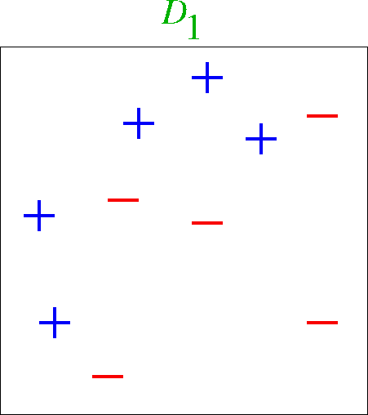
Boosting With Decision Stumps

Slide 7
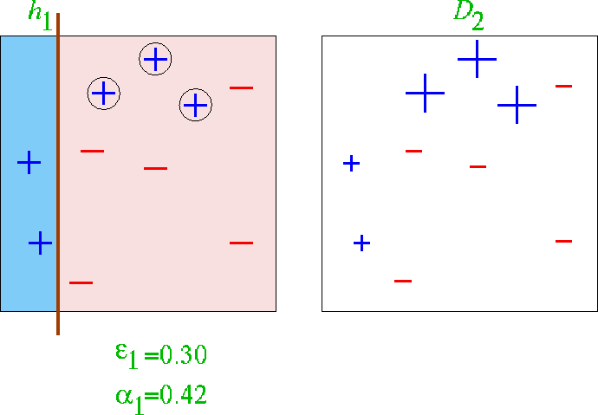
First classifier

Slide 8
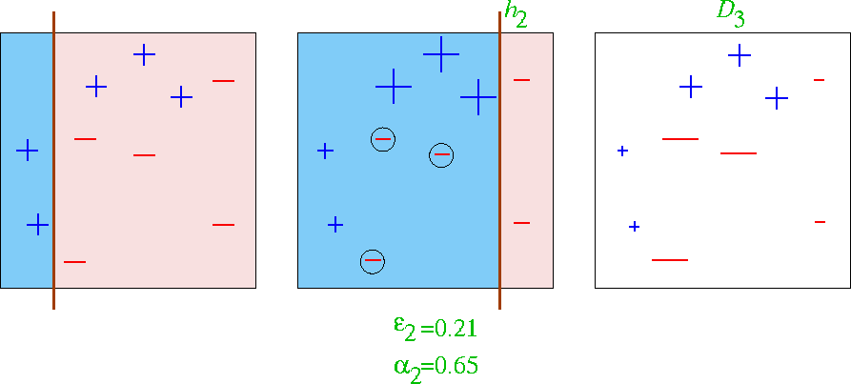
First 2 classifiers

Slide 9
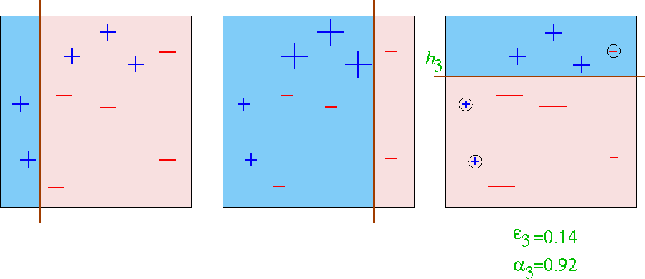
First 3 classifiers

Slide 10
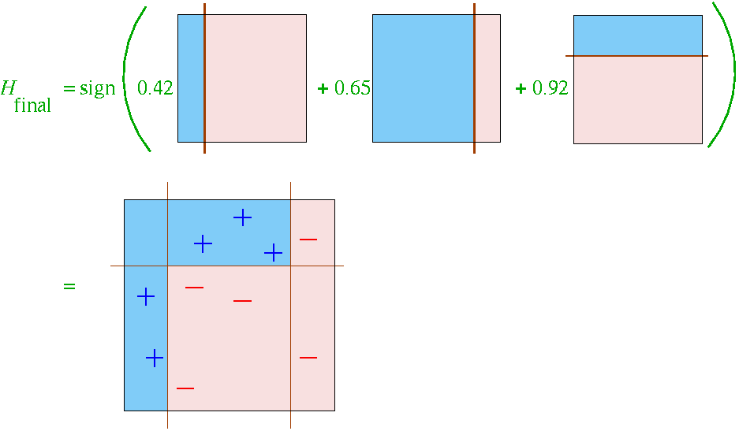
Final Classifier learned by Boosting

Slide 11
Performance of Boosting with Stumps
Problem:
X_{j} are standard Gaussian variables
About 1000 positive and
1000 negative training examples
10,000 test observations
Weak classifier is a “stump” i.e.,
a two-terminal node classification tree

Slide 12
AdaBoost is Special
The properties of the exponential loss function cause the AdaBoost algorithm to be simple.
AdaBoost’s closed form solution is in terms of minimized training set error on weighted data.
This simplicity is very special and not true for all loss functions!

Slide 13
Boosting: An Additive Model
Consider the additive model:
Can we minimize this cost function?
N: number of training data points
L: loss function
b: basis functions
This optimization is
Non-convex and hard!
Boosting takes a greedy
approach

Slide 14
Boosting: Forward stagewise greedy search
Adding basis one by one

Slide 15
Boosting As Additive Model
Simple case: Squared-error loss
Forward stagewise modeling amounts to just fitting the residuals from previous iteration
Squared-error loss not robust for classification

Slide 16
Boosting As Additive Model
AdaBoost for Classification:
L(y, f (x)) = exp(-y ∙ f (x)) - the exponential loss function
Margin ≡ y ∙ f (x)
Note that we use a property of the exponential loss function at this step.
Many other functions (e.g. absolute loss) would start getting in the way…

Slide 17
Boosting As Additive Model
First assume that β is constant, and minimize G:

Slide 18
Boosting As Additive Model
First assume that β is constant, and minimize G:
So if we choose G such that training error err_{m} on the weighted data is minimized, that’s our optimal G.

Slide 19
Boosting As Additive Model
Next, assume we have found this G, so given G, we next minimize β:
Another property of the exponential loss function is that we get an especially simple derivative

Slide 20
Boosting: Practical Issues
When to stop?
Most improvement for first 5 to 10 classifiers
Significant gains up to 25 classifiers
Generalization error can continue to improve even after training error is zero!
Methods:
Cross-validation
Discrete estimate of expected generalization error E_{G}
How are bias and variance affected?
Variance usually decreases
Boosting can give reduction in both bias and variance

Slide 21
Boosting: Practical Issues
When can boosting have problems?
Not enough data
Really weak learner
Really strong learner
Very noisy data
Although this can be mitigated
e.g. detecting outliers, or regularization methods
Boosting can be used to detect noise
Look for very high weights

Slide 22
Population Minimizers
Why do we care about them?
We try to approximate the optimal Bayes classifier: predict the label with the largest likelihood
All we really care about is finding a function that has the same sign response as optimal Bayes
By approximating the population minimizer, (which must satisfy certain weak conditions) we approximate the optimal Bayes classifier

Slide 23
Features of Exponential Loss
Advantages
Leads to simple decomposition into observation weights + weak classifier
Smooth with gradually changing derivatives
Convex
Disadvantages
Incorrectly classified outliers may get weighted too heavily (exponentially increased weights), leading to over-sensitivity to noise

Slide 24
Squared Error Loss
Explanation of Fig. 10.4:

Slide 25
Other Loss Functions For Classification
Logistic Loss
Very similar population minimizer to exponential
Similar behavior for positive margins, very different for negative margins
Logistic is more robust against outliers and misspecified data

Slide 26
Other Loss Functions For Classification
Hinge (SVM)
General Hinge (SVM)
These can give improved robustness or accuracy, but require more complex optimization methods
Boosting with exponential loss is linear optimization
SVM is quadratic optimization

Slide 27
Robustness of different Loss function

Slide 28
Loss Functions for Regression
Squared-error Loss weights outliers very highly
More sensitive to noise, long-tailed error distributions
Absolute Loss
Huber Loss is hybrid:

Slide 29
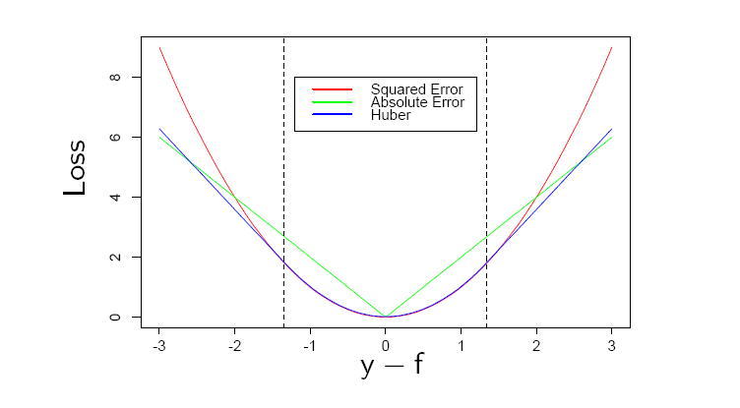
Robust Loss function for Regression

Slide 30
Boosting and SVM
Boosting increases the margin “yf(x)” by additive stagewise optimization
SVM also maximizes the margin “yf(x)”
The difference is in the loss function– Adaboost uses exponential loss, while SVM uses “hinge loss” function
SVM is more robust to outliers than Adaboost
Boosting can turn base weak classifiers into a strong one, SVM itself is a strong classifier

Slide 31
Summary
Boosting combines weak learners to obtain a strong one
From the optimization perspective, boosting is a forward stage-wise minimization to maximize a classification/regression margin
It’s robustness depends on the choice of the Loss function
Boosting with trees is claimed to be “best off-the-self classification” algorithm
Boosting can overfit!

