Slide 2

Group 16: 2D Heat Equation
Đỗ Khánh Nam | 20225988
Ngô Anh Tú | 20226005
Vũ Bình Minh | 20226058

Slide 3
Table of contents
Introduction
Discretization
Explicit method
Implicit method
Example

Slide 4
Table of contents
Introduction
Discretization
Explicit method
Implicit method
Example

Slide 5
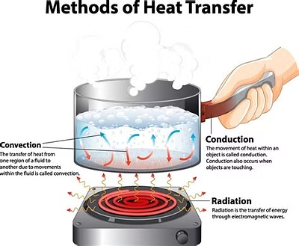
Introduction
Heat transfer is a fundamental process in physics, the heat equation is a powerful tool for modelling and understanding the behavior of heat flow in various systems. In this presentation, we will explore how to solve the heat equation in 2-dimensional domain.

Slide 6
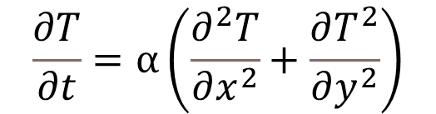
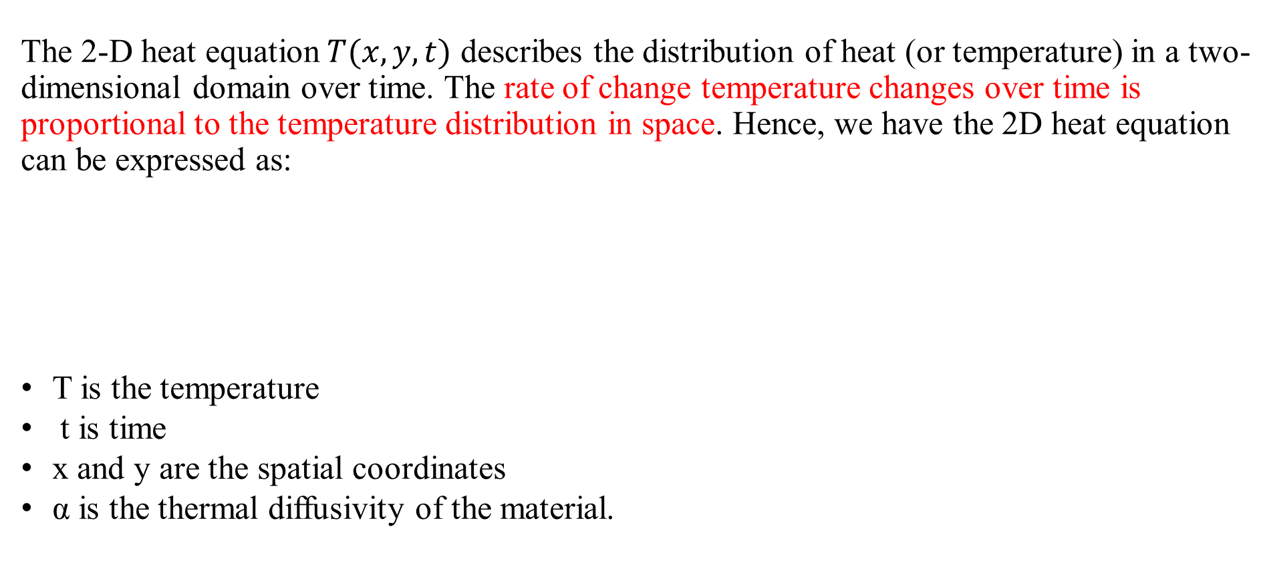
Introduction
1.1 The 2-D Heat Equation
The 2-D heat equation$T(x, y, t)$ describes the distribution of heat (or temperature) in a two-dimensional domain over time. The rate of change temperature changes over time is proportional to the temperature distribution in space. Hence, we have the 2D heat equation can be expressed as:
T is the temperature
t is time
x and y are the spatial coordinates
α is the thermal diffusivity of the material.
$$\frac{∂T}{∂t}=α\left(\frac{∂^{2}T}{∂x^{2}}+\frac{∂T^{2}}{∂y^{2}}\right)$$

Slide 7

Introduction
1.2 Boundary Conditions
Boundary conditions are essential for defining the 2-D heat equation and ensuring a unique solution. The most common boundary conditions are:
1
Dirichlet Boundary Condition
2
Neumann Boundary Condition
This condition specifies the temperature at the boundaries of the domain, i.e., T(n) = f(t) on the boundary, where n is the normal to the boundary.
This condition specifies the heat flux (rate of heat transfer) at the boundaries, i.e., ∂T/∂n = f(t) on the boundary, where n is the normal to the boundary.

Slide 8
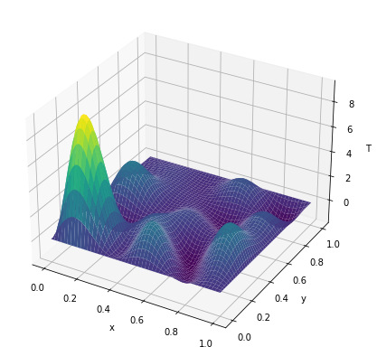
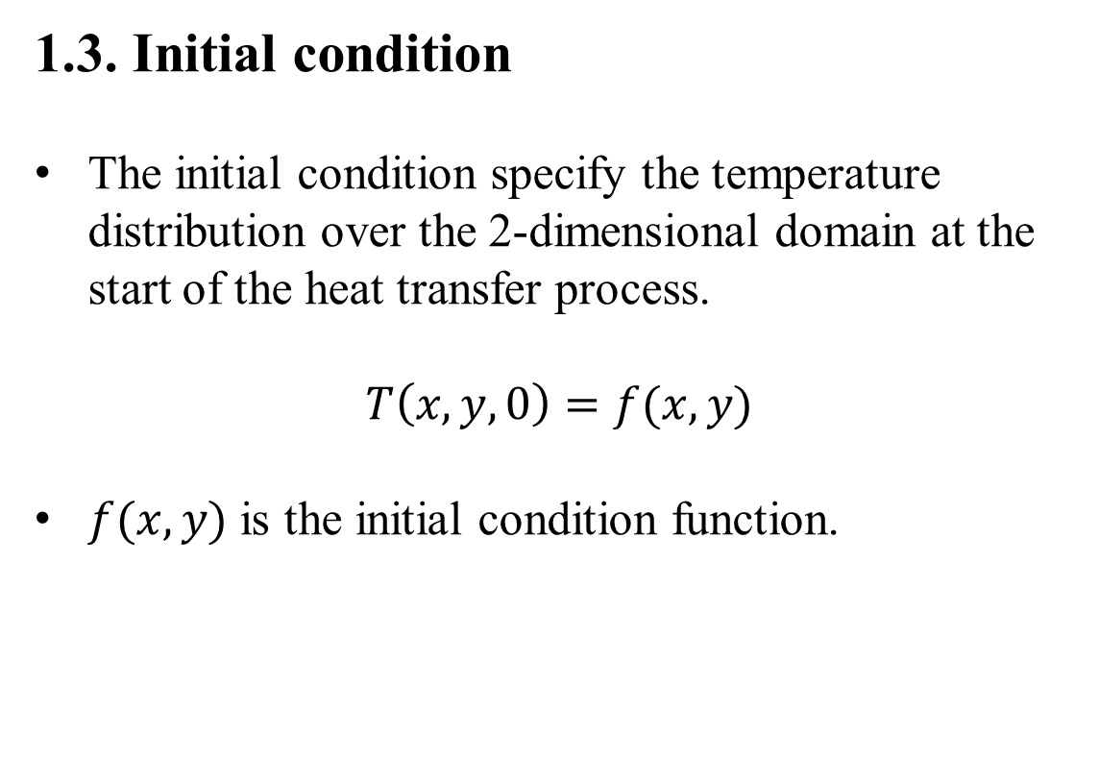
Introduction
1.3. Initial condition
The initial condition specify the temperature distribution over the 2-dimensional domain at the start of the heat transfer process.
$$T\left(x, y, 0\right)=f(x, y)$$
$f(x, y)$ is the initial condition function.

Slide 9
Table of contents
Introduction
Discretization
Explicit method
Implicit method
Example

Slide 10
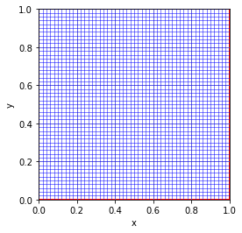
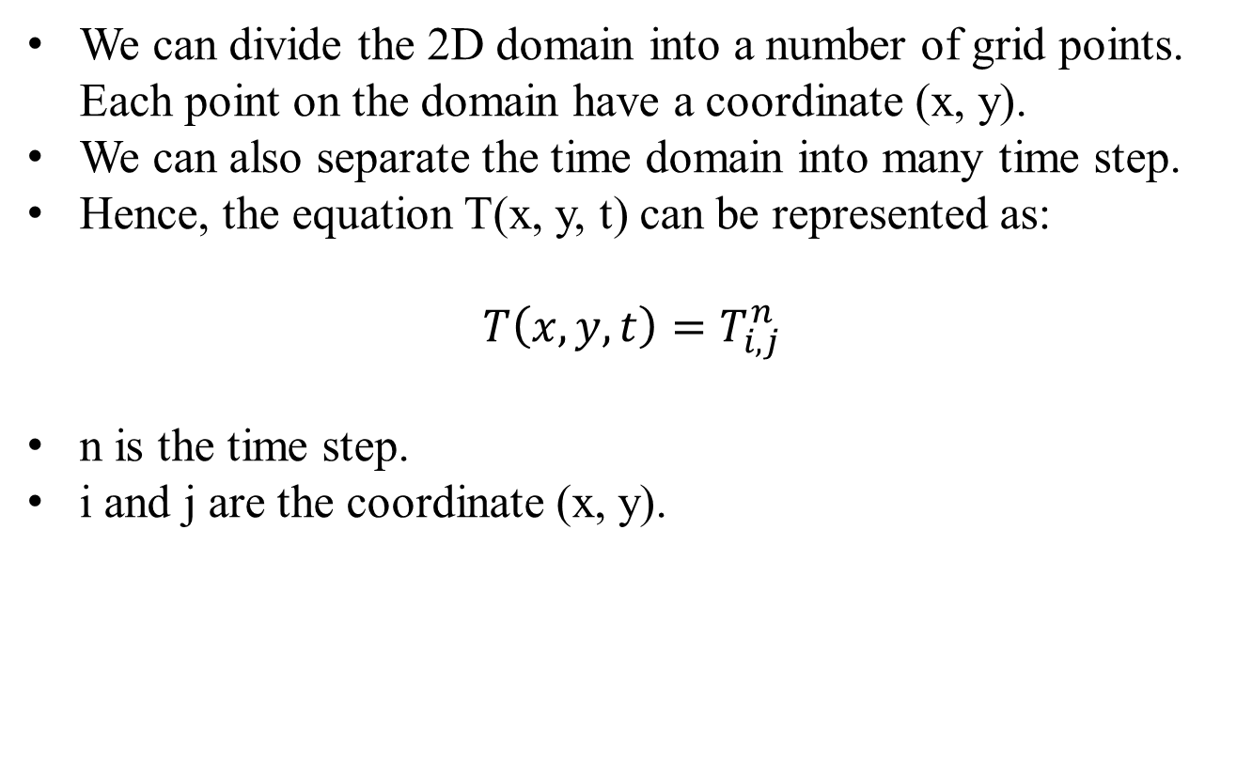
Discretization
We can divide the 2D domain into a number of grid points. Each point on the domain have a coordinate (x, y).
We can also separate the time domain into many time step.
Hence, the equation T(x, y, t) can be represented as:
$$T\left(x, y, t\right)=T_{i,j}^{n}$$
n is the time step.
i and j are the coordinate (x, y).

Slide 11
Table of contents
Introduction
Discretization
Explicit method
Implicit method
Example

Slide 12
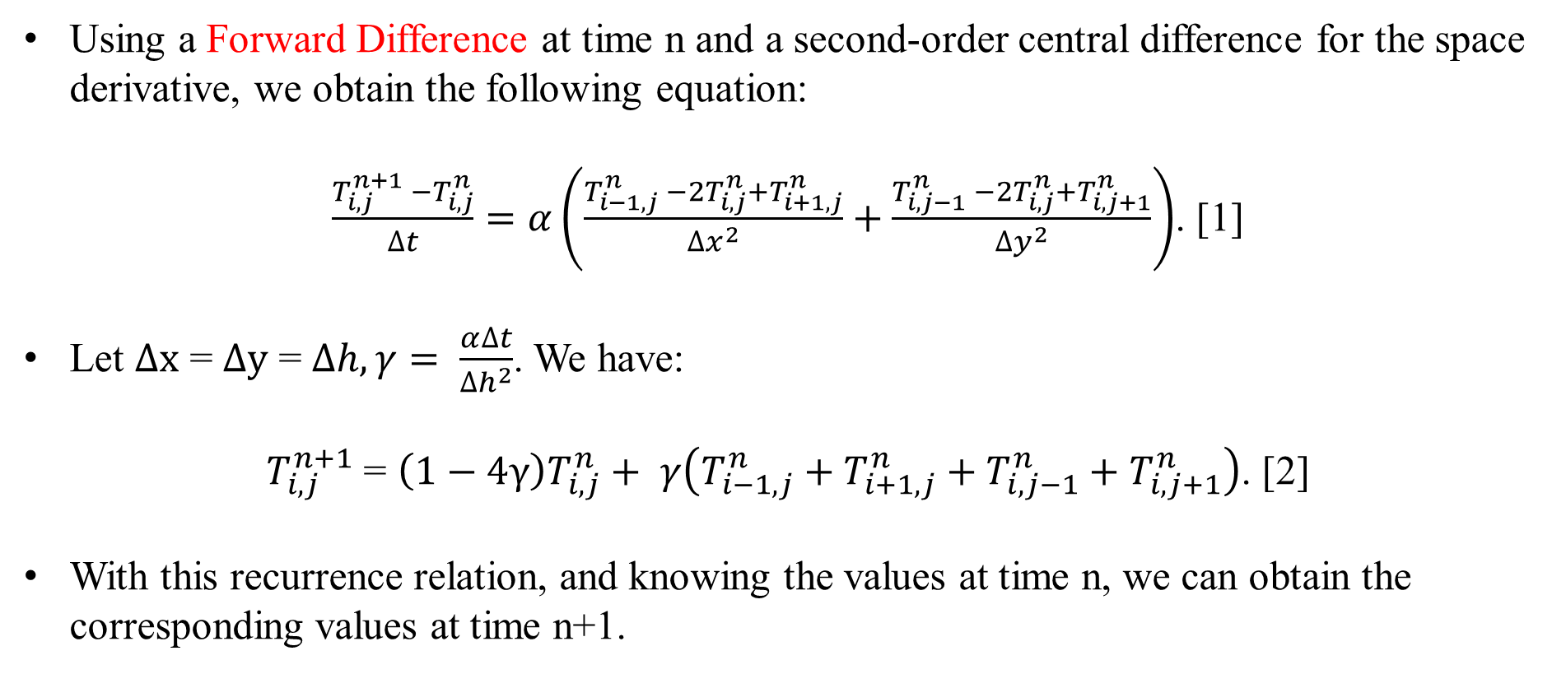
Explicit method
Using a Forward Difference at time n and a second-order central difference for the space derivative, we obtain the following equation:
$\frac{T_{i,j}^{n+1} −T_{i,j}^{n}}{∆t}=α\left(\frac{T_{i−1,j}^{n} −2T_{i,j}^{n}+T_{i+1,j}^{n}}{{∆x}^{2}}+\frac{T_{i,j−1}^{n} −2T_{i,j}^{n}+T_{i,j+1}^{n}}{{∆y}^{2}}\right)$. [1]
Let $∆x$ = $∆y$ = $∆h, γ= \frac{α∆t}{{∆h}^{2}}$. We have:
$T_{i,j}^{n+1}$ = $\left(1−4γ\right)T_{i,j}^{n}+ γ\left(T_{i−1,j}^{n}+T_{i+1,j}^{n}+T_{i,j−1}^{n}+T_{i,j+1}^{n}\right)$. [2]
With this recurrence relation, and knowing the values at time n, we can obtain the corresponding values at time n+1.

Slide 13
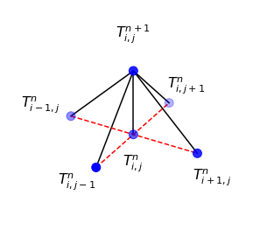
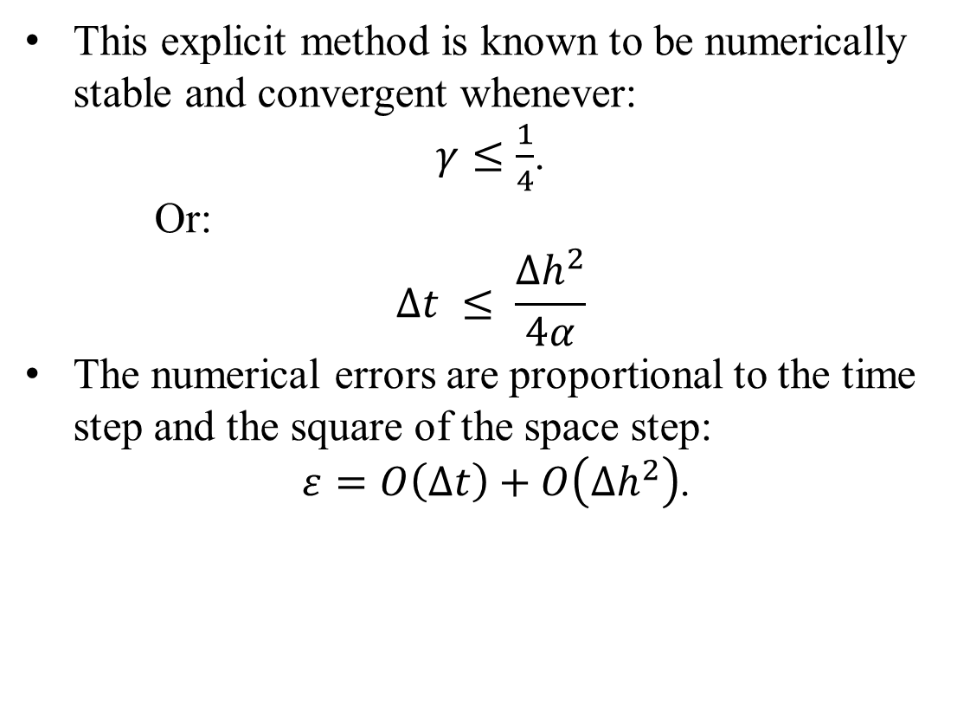
Explicit method
This explicit method is known to be numerically stable and convergent whenever:
$γ≤\frac{1}{4}$.
Or:
$$∆t ≤ \frac{{∆h}^{2}}{4α}$$
The numerical errors are proportional to the time step and the square of the space step:
$ε=O\left(∆t\right)+O\left({∆h}^{2}\right)$.
Stencil from explicit method

Slide 14
Table of contents
Introduction
Discretization
Explicit method
Implicit method
Example

Slide 15
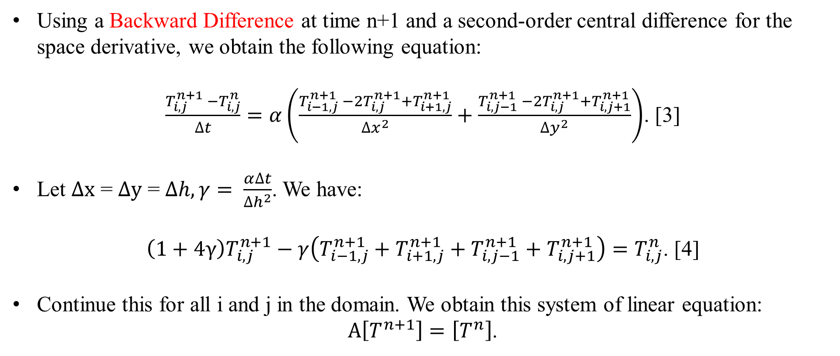
Implicit method
Using a Backward Difference at time n+1 and a second-order central difference for the space derivative, we obtain the following equation:
$\frac{T_{i,j}^{n+1} −T_{i,j}^{n}}{∆t}=α\left(\frac{T_{i−1,j}^{n+1} −2T_{i,j}^{n+1}+T_{i+1,j}^{n+1}}{{∆x}^{2}}+\frac{T_{i,j−1}^{n+1} −2T_{i,j}^{n+1}+T_{i,j+1}^{n+1}}{{∆y}^{2}}\right)$. [3]
Let $∆x$ = $∆y$ = $∆h, γ= \frac{α∆t}{{∆h}^{2}}$. We have:
$\left(1+4γ\right)T_{i,j}^{n+1}−γ\left(T_{i−1,j}^{n+1}+T_{i+1,j}^{n+1}+T_{i,j−1}^{n+1}+T_{i,j+1}^{n+1}\right)=T_{i,j}^{n}$. [4]
Continue this for all i and j in the domain. We obtain this system of linear equation:
$A\left[T^{n+1}\right]=\left[T^{n}\right]$.

Slide 16
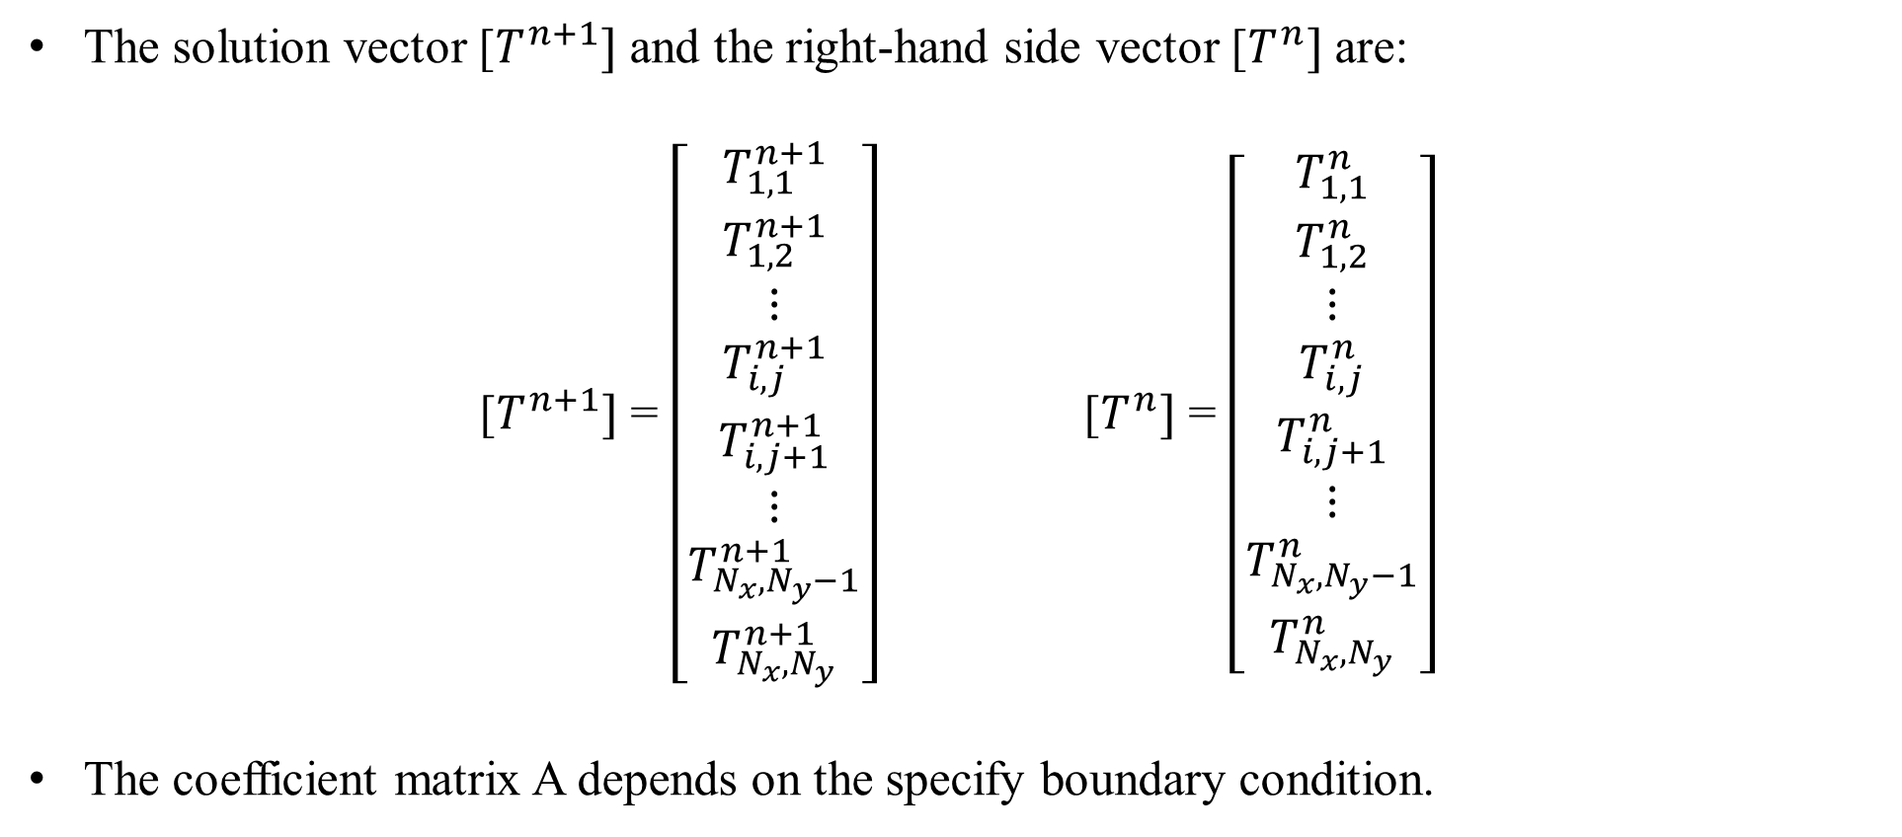
Implicit method
The solution vector [$T^{n+1}]$ and the right-hand side vector [$T^{n}]$ are:
[$T^{n+1}]$ = $\left[\begin{matrix}T_{1,1}^{n+1} \\ T_{1,2}^{n+1} \\ ⋮ \\ T_{i,j}^{n+1} \\ T_{i,j+1}^{n+1} \\ ⋮ \\ T_{N_{x},N_{y}−1}^{n+1} \\ T_{N_{x},N_{y}}^{n+1}\end{matrix}\right]$ [$T^{n}]$ = $\left[\begin{matrix}T_{1,1}^{n} \\ T_{1,2}^{n} \\ ⋮ \\ T_{i,j}^{n} \\ T_{i,j+1}^{n} \\ ⋮ \\ T_{N_{x},N_{y}−1}^{n} \\ T_{N_{x},N_{y}}^{n}\end{matrix}\right]$
The coefficient matrix A depends on the specify boundary condition.

Slide 17
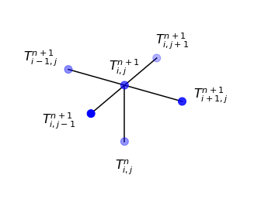

Implicit method
The right-hand side matrix b is known, so we can obtain the n+1 step temperature $as$:
$\left[T^{n+1}\right]=A^{−1}\left[T^{n}\right]$.
The implicit method is always numerically stable and convergent. The errors are linear over the time step and quadratic over the space step:
$ε=O\left(∆t\right)+O\left({∆h}^{2}\right)$.
Stencil for implicit method

Slide 18
Table of contents
Introduction
Discretization
Explicit method
Implicit method
Example

Slide 19
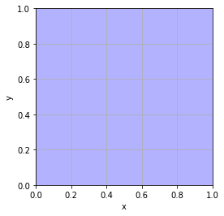
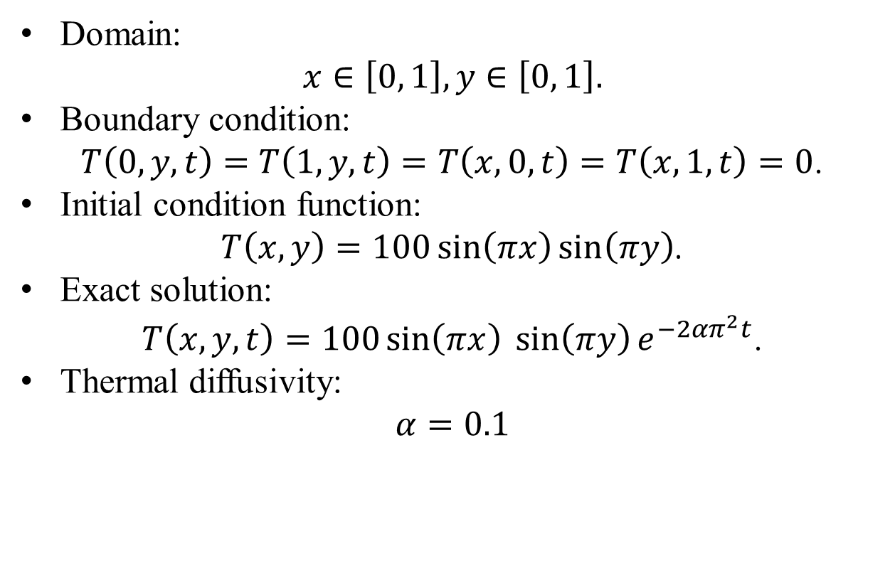
Example
Domain:
$$x∈\left[0, 1\right], y∈\left[0, 1\right].$$
Boundary condition:
$T\left(0,y,t\right)=$ $T\left(1,y,t\right)=T\left(x,0,t\right)=T\left(x,1,t\right)=0$.
Initial condition function:
$T\left(x,y\right)=100\sin\left(πx\right)\sin\left(πy\right)$.
Exact solution:
$T\left(x,y,t\right)=100\sin\left(πx\right)\sin\left(πy\right){e^{−2απ^{2}t}}$.
Thermal diffusivity:
$$α=0.1$$

Slide 20
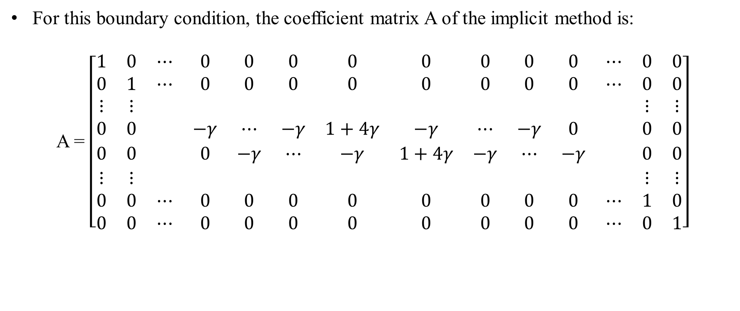
Example
For this boundary condition, the coefficient matrix A of the implicit method is:
A = $\left[\begin{matrix}1 & 0 & ⋯ & 0 & 0 & 0 & 0 & 0 & 0 & 0 & 0 & ⋯ & 0 & 0 \\ 0 & 1 & ⋯ & 0 & 0 & 0 & 0 & 0 & 0 & 0 & 0 & ⋯ & 0 & 0 \\ ⋮ & ⋮ & & & & & & & & & & & ⋮ & ⋮ \\ 0 & 0 & & −γ & ⋯ & −γ & 1+4γ & −γ & ⋯ & −γ & 0 & & 0 & 0 \\ 0 & 0 & & 0 & −γ & ⋯ & −γ & 1+4γ & −γ & ⋯ & −γ & & 0 & 0 \\ ⋮ & ⋮ & & & & & & & & & & & ⋮ & ⋮ \\ 0 & 0 & ⋯ & 0 & 0 & 0 & 0 & 0 & 0 & 0 & 0 & ⋯ & 1 & 0 \\ 0 & 0 & ⋯ & 0 & 0 & 0 & 0 & 0 & 0 & 0 & 0 & ⋯ & 0 & 1\end{matrix}\right]$

Slide 21
Example
The implicit method is more computationally demanding than the explicit method as it requires solving a system of numerical equations on each time step. The explicit method is easier to implement and less computationally demanding.
Both methods have comparable errors with respect to time step and space step.

Slide 22
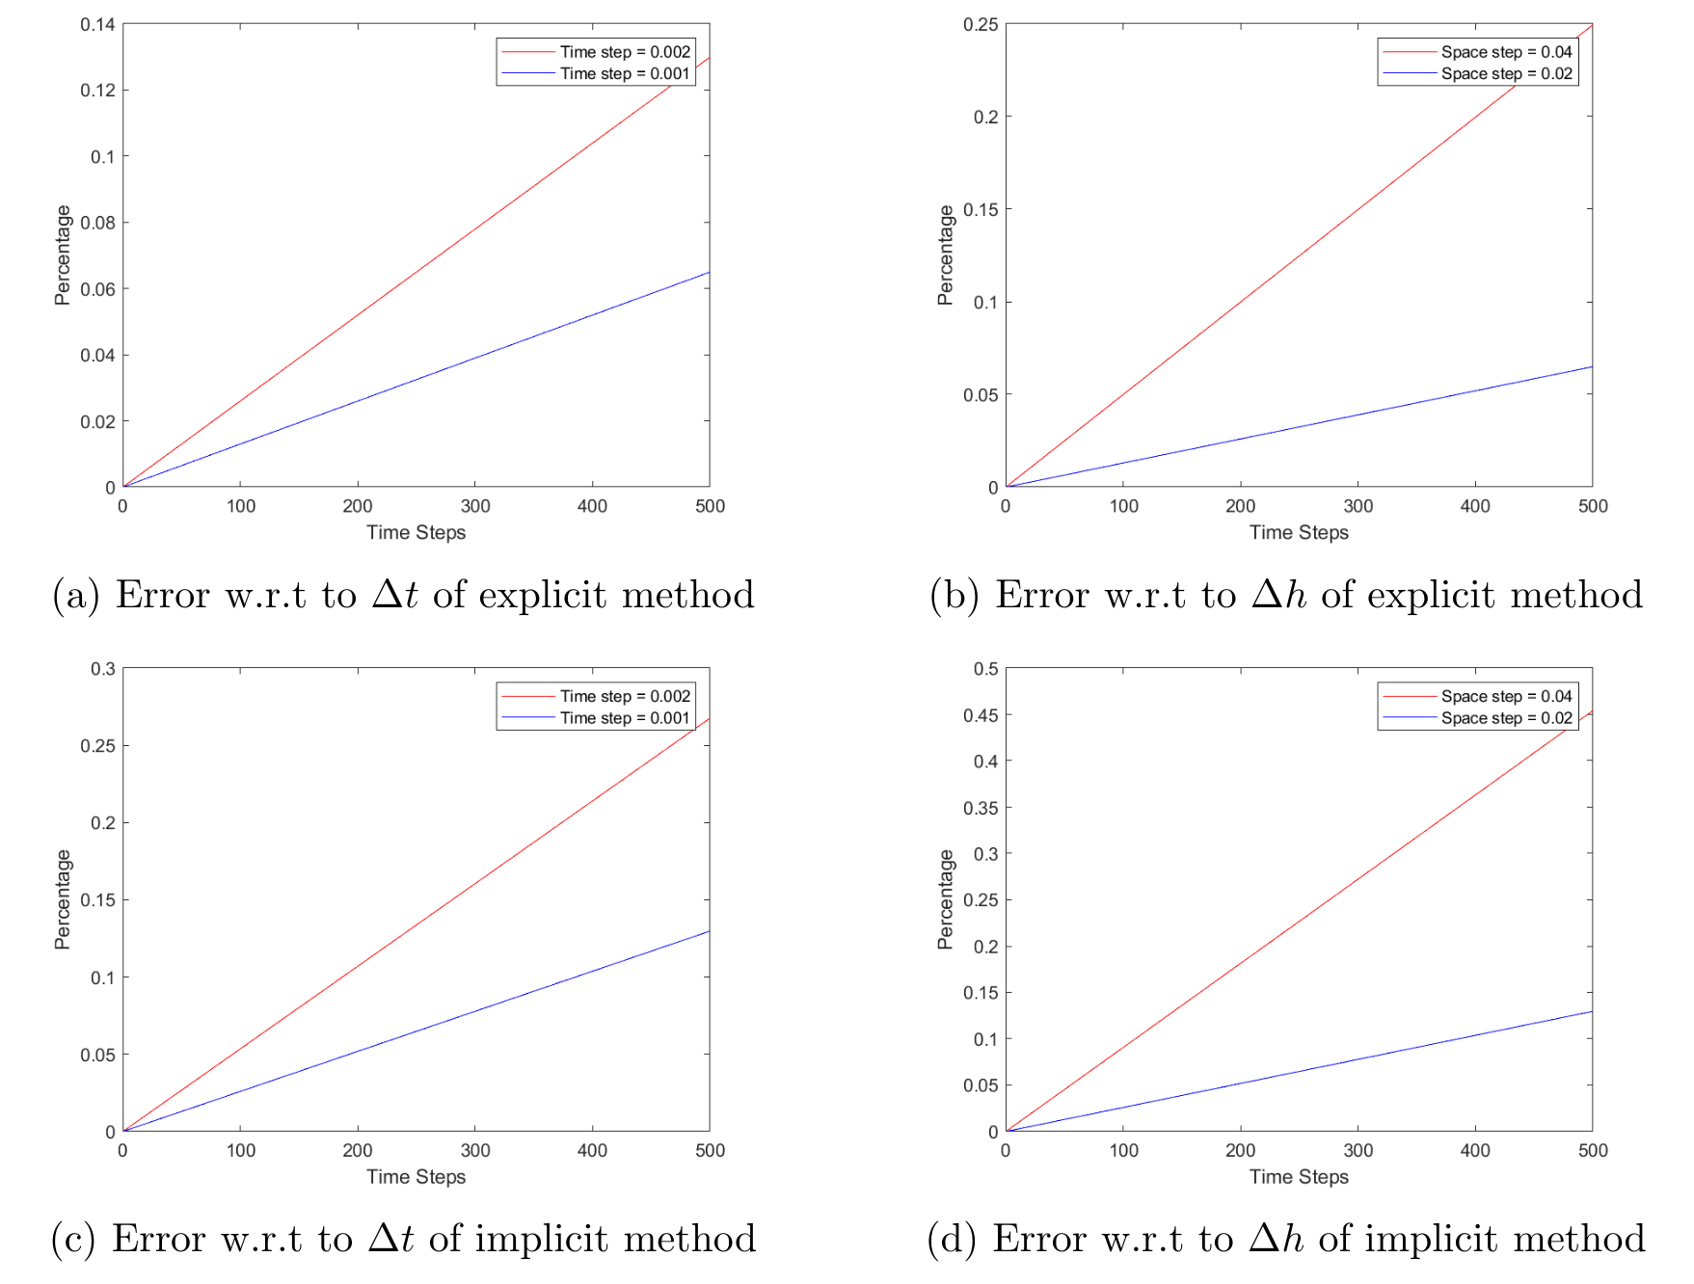
Example

Slide 23
THANK YOU !

