Slide 1
Loan Approval Prediction using Machine Learning
Accurate & Explainable Loan Decision System
Group 4
Sandesh Manjunath Raykar
Fumiya Nagatomo
Vinay A Patil
Daniel Lee

Slide 2
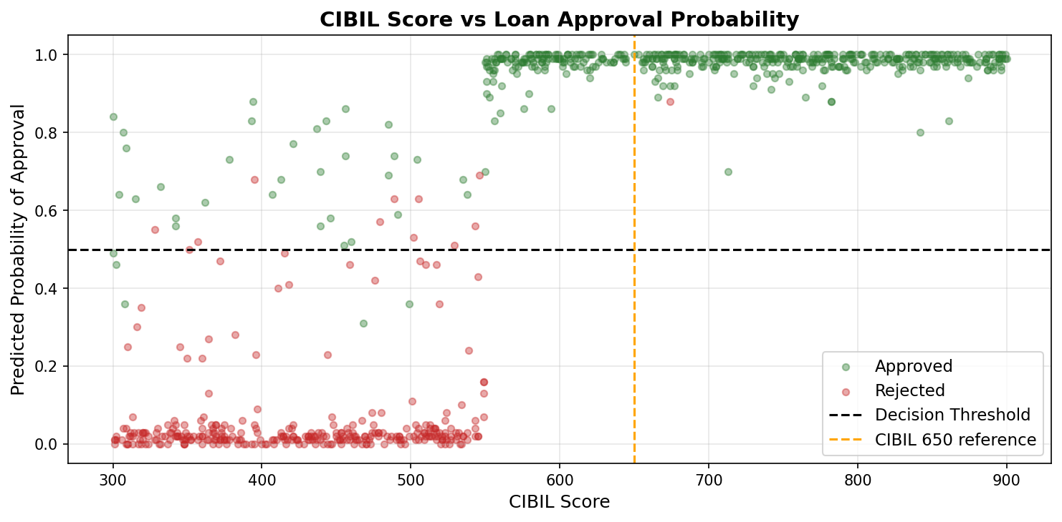
Application Context
Why Loan Approval Matters
High-stakes financial decision
Incorrect decisions → financial loss
Approve risky applicants → default risk
Reject good applicants → lost opportunities
Goal
Predict loan approval using applicant data
Enable automated, data-driven decisions
Approval probability increases with credit score

Slide 3
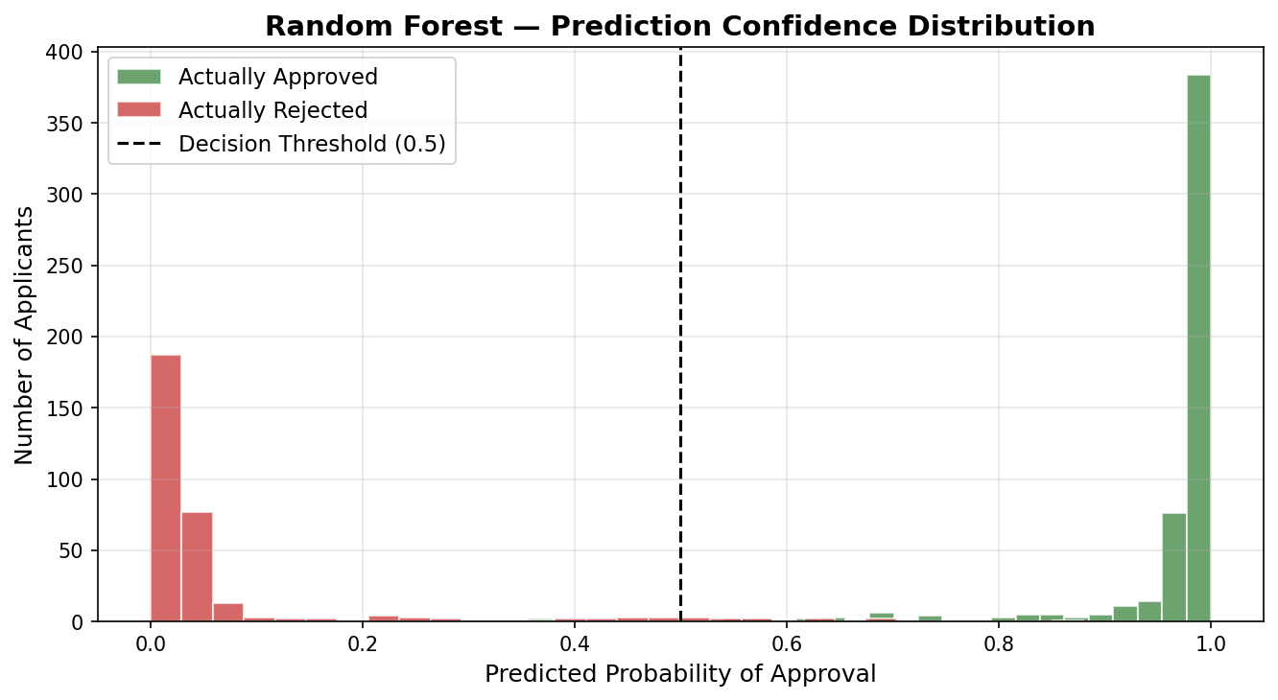
Key Technology
Modeling
Logistic Regression (baseline)
Random Forest (primary model)
XGBoost (performance comparison)
Explainability
SHAP (feature contribution analysis)
System Implementation
Flask backend (prediction API)
Trained model (.pkl) for deployment
Solution Approach
Workflow
Preprocess loan dataset
Train and evaluate models
Predict approval probability
Explain predictions using SHAP
Deployment
Input: applicant features
Output: approval decision + probability + explanation
The system predicts approval probability and explains decisions in real time

Slide 4
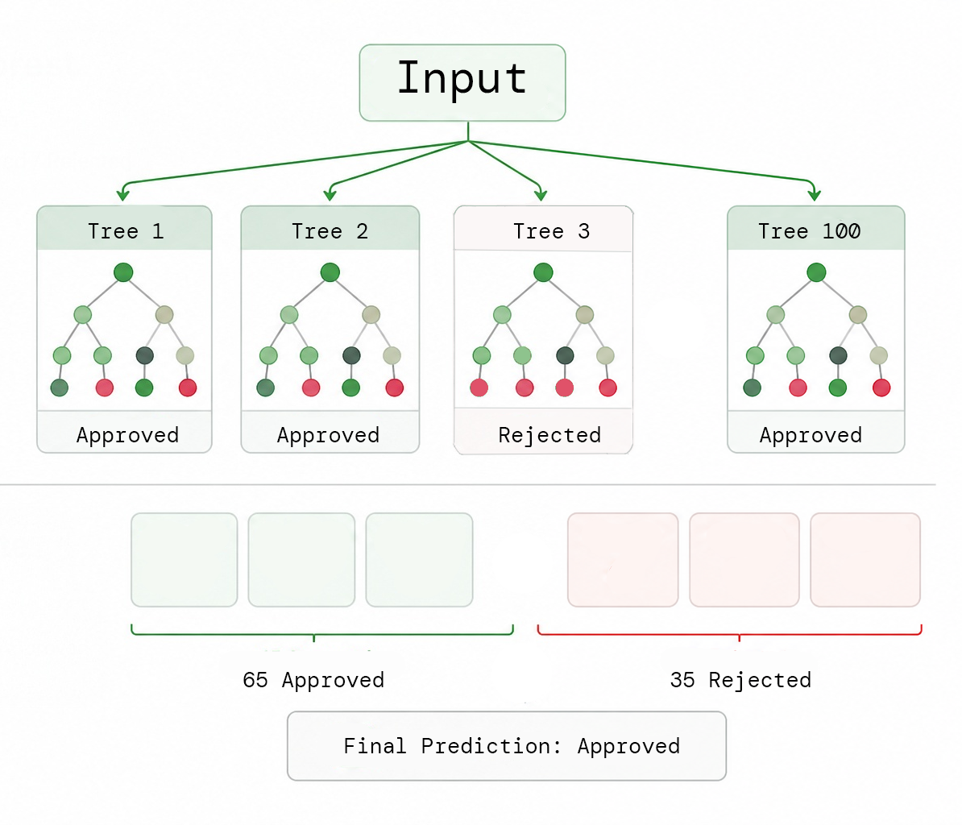
Train / Test split
Why 80/20?
Balance learning & evaluation
Prevent data leakage
Reliable performance check
Reproducible (random_state=42)
Random Forest
Multiple decision trees
Each predicts Approved / Rejected
Majority Vote
Combine predictions
Example: 65 vs 35 → Approved
Total Dataset: 4,269 applications
Set | Ratio | Size | Purpose
Training | 80% | 3,415 | Learn patterns
Testing | 20% | 854 | Evaluate on unseen data

Slide 5
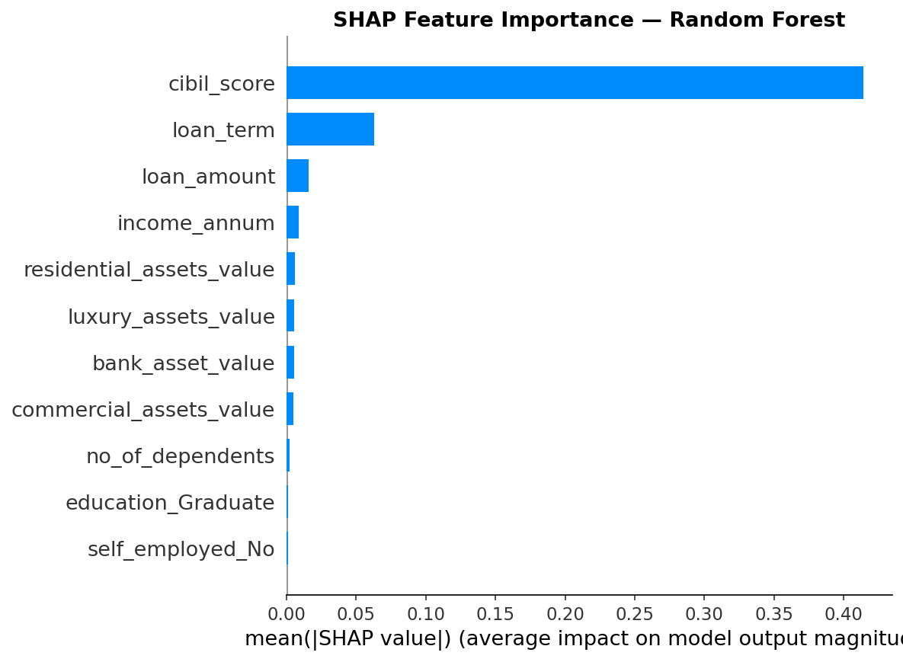
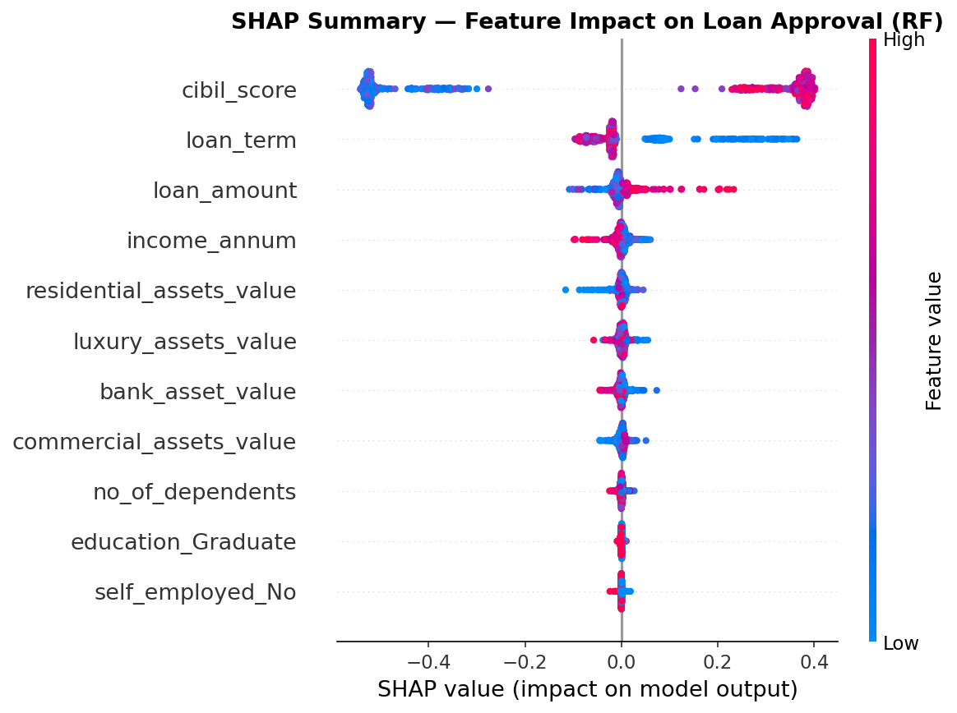
Critical Component
Key findings
Credit score is the most influential feature
Higher score → higher approval probability
Other factors include loan term and income
Why interpretation matters
Model decisions must be explainable
Important in financial applications
SHAP analysis
Measures contribution of each feature
Shows how features affect prediction

Slide 6

Demonstration

Slide 7
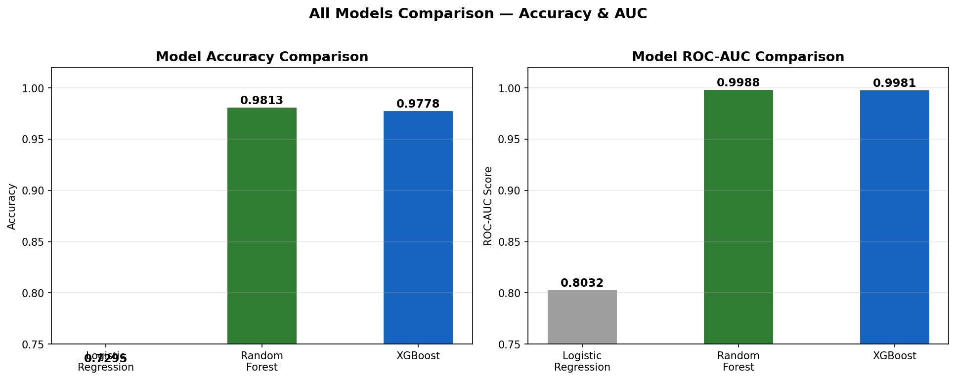
Results
Model | Accuracy | ROC - AUC
Logistic Regression | 81.97% | -0.89
XGBoost | 97.78% | 0.9981
Random Forest | 98.13% | 0.9987
Notes:
Vertical Analysis
Performance improves with model complexity
Largest gain from Logistic → Random Forest
XGBoost provides marginal additional improvement
Horizontal Analysis
Ensemble models outperform linear baseline
Non-linear models capture feature interactions better

Slide 8
Thank you!
Q&A

