Slide 1
Introduction
Data Mining and Analysis (MSDS5163)
Don Koch
John Brocklebank

Slide 2
Syllabus
Programming in SAS Studio
Descriptive Statistics
Univariate Analysis
One-Sample Tests
Two-Sample Tests
Analysis of Variance
Correlation

Slide 3
Syllabus (Cont.)
Variable Selection and Data Partitioning
Linear and Logistic Regression
Decision Trees and Forests
Neural Networks
Model Assessment and Implementation

Slide 4
Class Days
Monday, March 22
Thursday, March 25
Monday, March 29
Monday, April 1
Thursday, April 12
Monday, April 19
Thursday April 22

Slide 5
Grading
Activity | Percentage of Grade
Class Attendance | 10%
In-class Activities | 10%
Five Homework Exercises | 50%
Final Exam | 30%
NOTE: Assignments that ask for an analytical result, you may use other tools (e.g., Python or R) to arrive at the correct result. However, some exercises are specific to SAS technology and must be completed in SAS.

Slide 6
Course Materials
Git Hub
https://github.com/dokoch/Data_Mining_and_Analysis
Walkthrough...

Slide 7
It’s About the Data Mining Process
Business Problems to Solve
Data Sourcing and Preparation
Exploratory Data Analysis
Data Modeling
Model Deployment
Monitoring and Evaluation
Notes:
We will focus on the process of Data Mining. We are using SAS Studio as delivered on the SAS OnDemand for Academics Cloud because is free, feature rich, can do a lot without coding and helps us focus on the DM process.

Slide 8
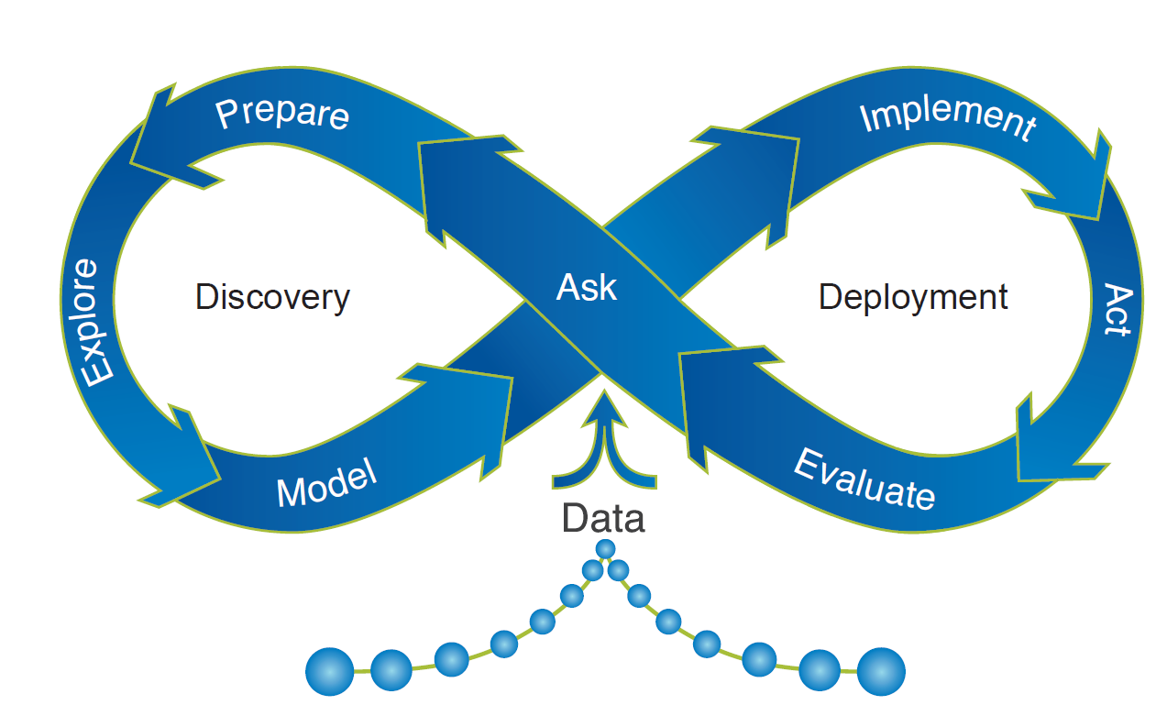
Iterative Analytical Life Cycle
Business Problems to Solve
Data Sourcing and Preparation
Exploratory Data Analysis
Data Modeling
Model Deployment
Monitoring and Evaluation

Slide 9
How Does it Fit Together?
Data Mining
Natural Language Processing
Statistics
Artificial Intelligence
Machine Learning
Deep Learning
Computer Vision
Neurocomputing
Notes:
Machine learning today is a mathematically rigorous discipline that encompasses sophisticated modeling, optimization, and learning research; it has concrete applications in medicine, software, robotics, and traditional business problems. Particularly in the business problem domain, there is significant overlap among the fields of data science, data mining, and machine learning.
In contrast to many statistical modeling approaches, which can value inference over prediction, the focus of machine learning is predictive accuracy (Breiman 2001a). High predictive accuracy is usually achieved by training complex models, which often involve advanced numerical optimization routines, on a large number of training examples. Because of their almost uninterpretable internal mechanisms, some machine learning algorithms have been labeled “black box” techniques. Yet algorithms such as neural networks, random forests, and support vector machines, gradient boosting can learn faint and nonlinear patterns from training data that generalize well in test data.

Slide 10
Questions?

