Slide 1
Cody Ch 12: Simple and Multiple Regression
12.1 Simple Regression
12.1 Multiple Regression

Slide 2
Cody Ch 12: Simple and Multiple Regression
12.1 Simple Regression
12.1 Multiple Regression

Slide 3
Regression
Simple Regression
Enables prediction of one variable based on the values of another variable
Multiple Regression
Enables prediction of one variable based on the values of two or more variables
Assumptions
Residuals are Normally Distributed
Homogenous variance across the independent variables

Slide 4
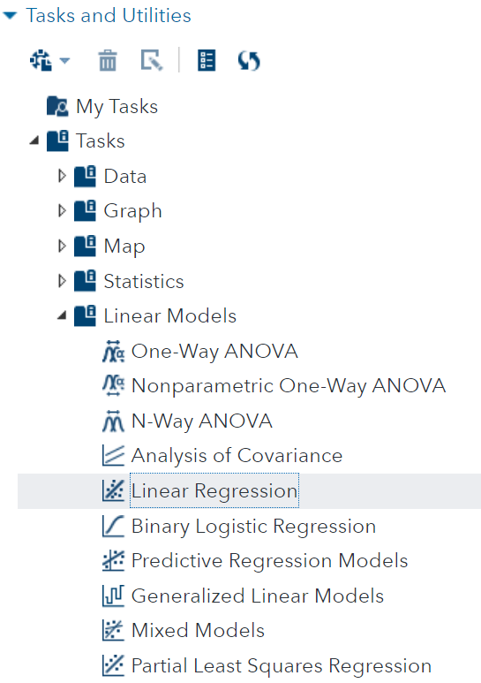
Linear Regression Task
Correlation Analysis is under Statistics

Slide 5
12.01 Activity
Select Tasks and Utilities in the Navigation pane. Expand Tasks, expand Linear Models and double-click Linear Regression
Select the STATS.EXERCISE2 data set
Select Pushups as the Dependent variable
Select Strength as the Continuous variable
On the MODEL tab, Click Edit
In the Model Effects Builder select Strength and click Add
Click OK
Select the Running Icon
Notes:
Type answer here

Slide 6
12.02 Multiple Choice Question
Use the information in the Parameter Estimates table to compute the predicted number of pushups a person with strength of 50 could do.
41 pushups
It’s not possible to compute
30 pushups
Notes:
Correct Answers: a, b, c

Slide 7

12.02 Multiple Choice Question
Use the information in the Parameter Estimates table to compute the predicted number of pushups a person with strength of 50 could do.
41 pushups
It’s not possible to compute
30 pushups
Notes:
Correct Answers: a, b, c

Slide 8
Cody Ch 12: Simple and Multiple Regression
12.1 Simple Regression
12.1 Multiple Regression

Slide 9
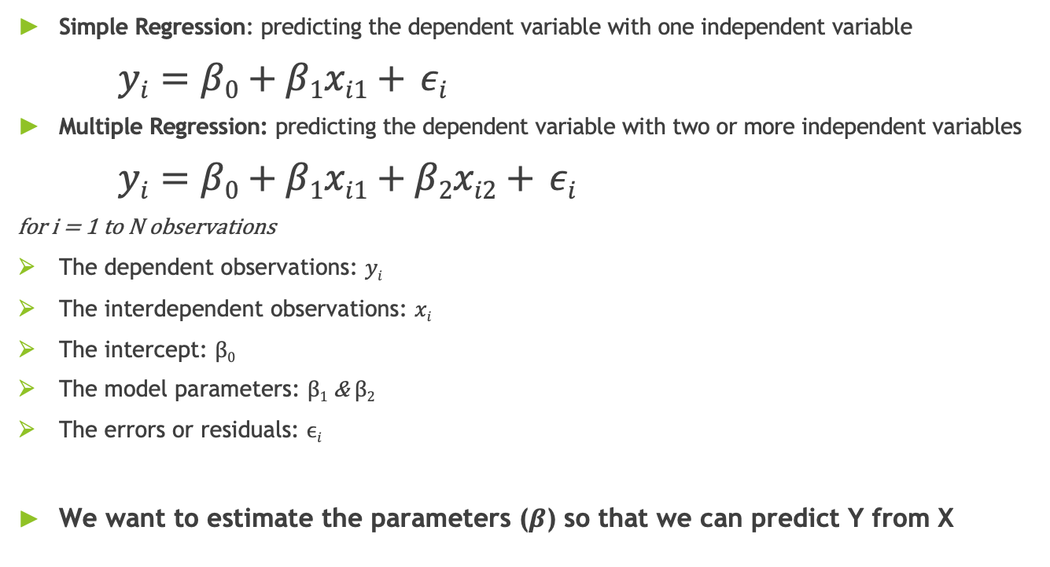
Multiple Regression
Simple Regression: predicting the dependent variable with one independent variable
$yi=β0+β1xi1+ εi$
Multiple Regression: predicting the dependent variable with two or more independent variables
$yi=β0+β1xi1+β2xi2+ εi$
for i = 1 to N observations
The dependent observations: $yi$
The interdependent observations: $xi$
The intercept: $β0$
The model parameters: $β1$ & $β2$
The errors or residuals: $ϵi$
We want to estimate the parameters ($β$) so that we can predict Y from X

Slide 10
12.03 Activity
We would like to add an additional predictor (independent) variables to our Pushups model.
Select Tasks and Utilities in the Navigation pane. Expand Tasks, expand Statistics and double-click Correlation Analysis.
Select the STATS.EXERCISE2 data set
Select Flexibility, Strength, Pushups, and Endurance as the Analysis variables
On the OPTIONS tab, under STATISTICS select Selected statistics for Display statistics: and check Correlations and Display p-values. .
On the OPTIONS tab, under PLOTS select Matrix of scatter plots for Type of plot: and check Include histograms.
Select the Running Icon
Notes:
Type answer here

Slide 11
12.04 Multiple Answer Question
Which variable(s) might to be good predictors of Pushups?
Strength
Flexibility
Endurance
Choose all that apply
Notes:
Correct Answers: a, b, c

Slide 12
12.04 Multiple Answer Question
Which variable(s) might to be good predictors of Pushups?
Strength
Flexibility
Endurance
Choose all that apply
Notes:
Correct Answers: a, b, c

Slide 13
12.05 Activity
Check if Endurance is a good predictor of Pushups since they are highly correlated.
Select Tasks and Utilities in the Navigation pane. Expand Tasks, expand Linear Models and double-click Linear Regression.
Select the STATS.EXERCISE2 data set
Select Pushups for the Dependent variable and Endurance as the Continuous variables
On the MODEL tab, select Edit and add Endurance
(the model is Pushups=Endurance)
Select the Running Icon
Notes:
Type answer here

Slide 14
12.05 Activity
Add Endurance and Strength as predictors of Pushups.
Use the same task as in 12.05.
Add Strength as the Continuous variables
On the MODEL tab, select Edit and add Endurance and Strength
(the model is Pushups=Endurance+Strength)
Select the Running Icon
Notes:
Type answer here

Slide 15
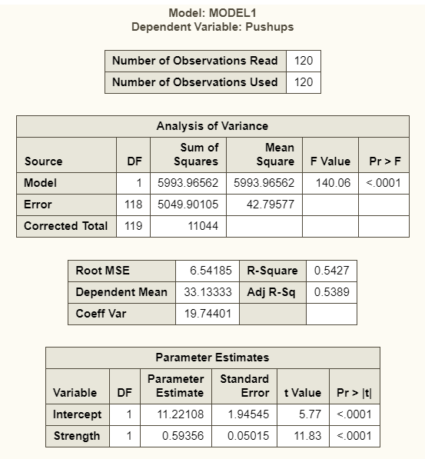
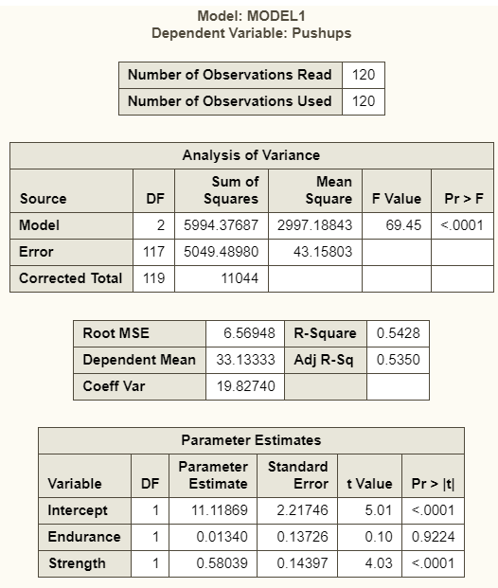
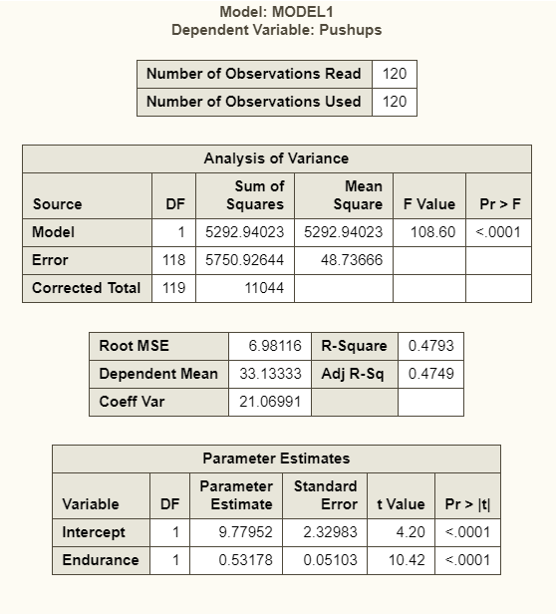
Comparing the Three Models
Strength
Strength + Endurance
Endurance

Slide 16
Discussion
The variable Strength had strong predictive value.
Strength explains almost all of the variance of Pushups.
Endurance does not have much more to contribute to the model.
We look for the unique contribution of each independent variable.
The correlation matrix showed Strength and Endurance are highly correlated
Therefore we don't want both in the model

Slide 17
Multicollinearity
One of the predictors (independent variables) can be predicted from the others
That is two or more of the predictors are highly correlated with each other
Use Variance Inflation Factors (VIF) to detect multicollinearity

Slide 18

Variance Inflation Factors
For each predictor variable
Perform a regression with the other predictors
Strength = Flexibility + Endurance
Flexibility = Strength + Endurance
Endurance = Strength + Flexibility
Large VIR values indicate multicollinearity
$$VIFi=\frac{1}{(1−Ri2)}$$

Slide 19
12.06 Activity
Use VIR to check for multicollinearity.
Use the same task as in 12.05.
Include Strength, Flexibility and Endurance as the Continuous variables
On the MODEL tab, select Strength, Flexibility and Endurance
(the model is Pushups=Endurance+Strength+Flexibility)
On the OPTIONS tab, expand STATISTICS select Default and selected statistics and expand Collinearity then check Variance inflation factors
Select the Running Icon
Notes:
Type answer here

Slide 20
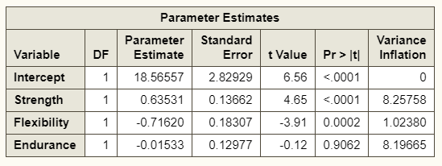
High VIF Indicates Multicollinearity

Slide 21
12.07 Demo
Using “Selection Methods” to automatically select a model.
Use the same task as in 12.06.
On the SELECTION tab under Settings, select Stepwise selection for the Selection method.
On the OPTIONS tab, expand STATISTICS select Default and selected statistics and expand Collinearity then check Variance inflation factors
Keep all other settings under Selection method as the defaults.
Select the Running Icon
Notes:
Type answer here

Slide 22
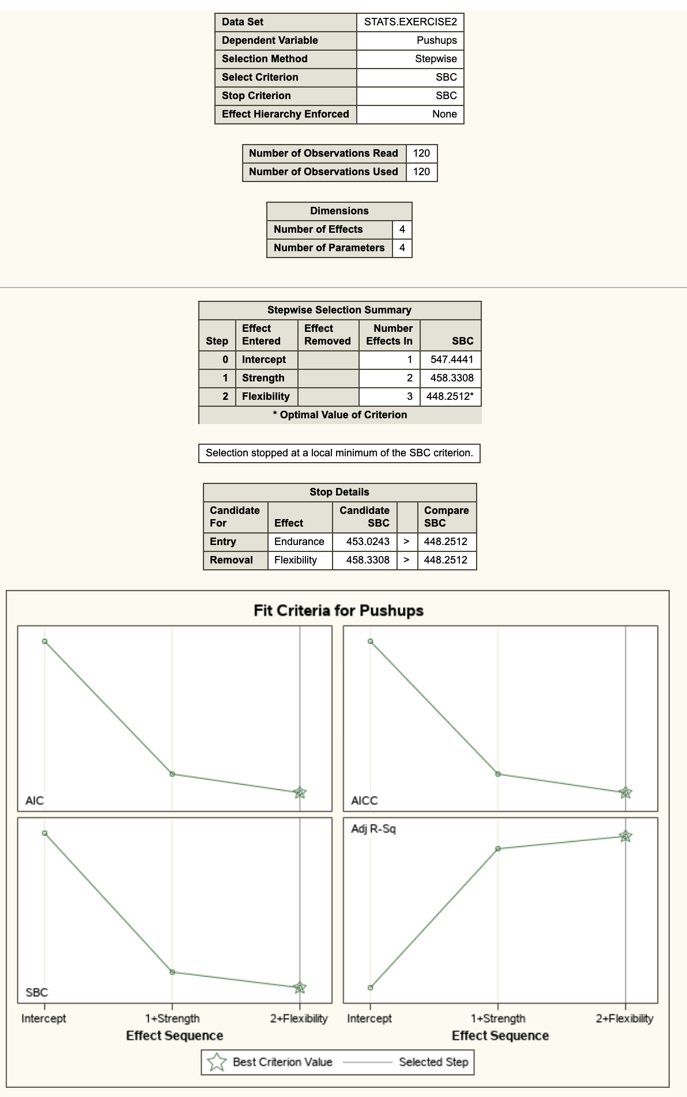
Stepwise Select Method Results
Optimal model according to SBC achieved after adding Flexibility

Slide 23
Questions?

